Slide 1
Energy and Security in Sweden and the Baltics
Selected messages from European and Global Assessments
Aleh Cherp
Central European University (Budapest)
Lund University

Slide 2
Brief introduction
Central European University, Director for Research, + prof. in Environmental Sciences & Policy
Lund University: coordinator of the MESPOM Consortium
Global Energy Assessment (Convening Lead Analyst for Energy, Security, Interdependence)
‘Zero carbon energy systems’ reports for Tallberg Forum, the Planet in 2050 etc.
Work on water, environment and energy in E.Europe and Central Asia, e.g. in Chernobyl, Semipalatinsk, Environment and Security Assessment for Eastern Europe; OSCE Environmental Security strategy, etc.

Slide 3
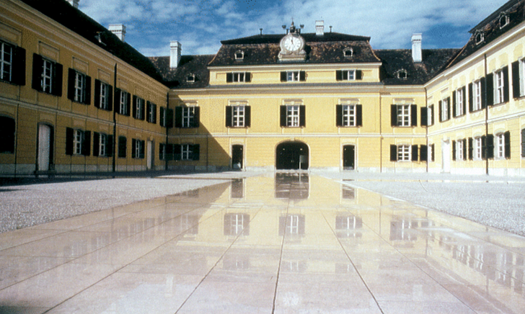
Global Energy Assessment
Cluster I: Major Global Issues and Energy
assessment of the Challenges
Cluster II: Energy Resources and Technological Options
assessment of the Components available to build future energy systems
Cluster III: Scenarios, Systems and Futures
assessment of how to combine the Components to create Systems that address the Challenges
Cluster IV: Policies
assessment of the Policies needed to address the Challenges and realize the Systems
ZERO ORDER DRAFT AT www.globalenergyassessment.org
IIASA
International Institute for Applied Systems Analysis
and its international partners

Slide 4
GEA Cluster I - Challenges
Access to modern forms of energy
Health risks (4-5% of global burden of disease)
Climate Change and the Environment
Security
Should be addressed simultaneously, adequately and timely

Slide 5
GEA KM5: Energy, security and interdependence
Energy security
Adequate supply
Affordability/price volatility
Minimal risk of disruptions
System resilience
Long-term adaptability
Impact of energy on broader security
Tensions, conflicts , (‘resource wars’?), military build up
Resource curse in energy exporting countries:
Poor Governance
Political instability
‘Dutch disease’ and other problems with economic performance

Slide 6
Oil (and gas) at the center of energy security risks
‘Cheap’ (large windfalls for producers and consumers)
In other words: Lack of substitutes (especially in the transport (and defense!)) sector
Large share in energy supply (70-80% globally)
Geographically concentrated deposits (away from major consumers)

Slide 7
Risks and energy systems
 |  | Oil | Gas | Coal | Nuclear | Renewable | Electricity
Risk of disruption | Natural/ Technical | M | M | L | L | H/M | H
 | Political | H | H | M | M | L | L
Vulnerability | Substitute suppliers | Mostly | Rarely* | Yes | Yes | Mostly
 | Substitute other sources | No | Mostly | Yes | Yes | Yes | No
Associated security risks | Conflict | H | H | L | M | M | L
 | Resource curse | H | M | L | L | L | L
 | Costs of failure | H | M | H | H | H (large hydro) L (other) | H

Slide 8
Future energy systems
Less oil
More diverse
More complex
In part, more distributed
More ‘electrified’
Are they more secure?

Slide 9
Swedish perspective
Phasing out nuclear
Oil-free by 2010 (check)
Climate adaptation report/program
Importance of electricity
CHP, biofuels

Slide 10
Questions for debate
Future energy: what are more secure configurations?
Other natural resource/environmental challenges: are energy lessons applicable?

