Slide 1
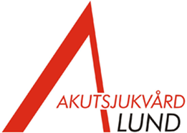

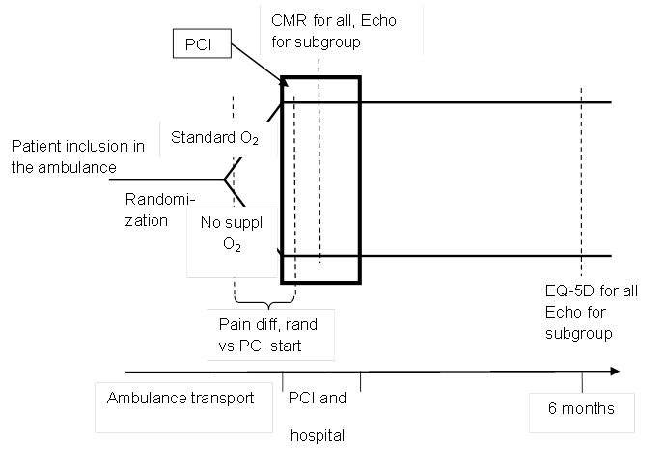
The effects of oxygen therapy on myocardial salvage in ST elevation myocardial infarction treated with acute percutaneous coronary intervention – The Supplemental Oxygen in Catheterized Coronary Emergency Reperfusion (SOCCER) study
Ardavan Khoshnood, Marcus Carlsson, Mahin Akbarzadeh, Pallonji Bhiladvala, Anders Roijer, Stefan Bodetoft, Peter Höglund, David Zughaft, Lizbet Todorova, David Erlinge & Ulf Ekelund
Background
Methods
Despite a lack of scientific evidence, oxygen has long been a part of the standard treatment in patients with acute myocardial infarction (AMI). However, several studies have suggested that oxygen therapy may have negative cardiovascular effects, perhaps especially in subjects with cardiac disease. In this paper, we describe a randomized controlled trial, the SOCCER-study, aiming to evaluate the effect of oxygen therapy on myocardial salvage and infarct size in patients with ST elevation myocardial infarction (STEMI) treated with primary percutaneous coronary intervention (PCI).
One hundred normoxic STEMI patients accepted for primary PCI are randomized in the ambulance to either standard oxygen therapy or no supplemental oxygen. All patients undergo cardiovascular magnetic resonance imaging (CMR) at day 2-6 after the primary PCI, and a subgroup of 50 patients undergo an extended echocardiography during the admission and at 6 months. All patients are followed for 6 months for hospital admission for heart failure and subjective perception of health. The primary endpoint is the myocardial salvage index on CMR.
Discussion
The SOCCER trial addresses a significant knowledge gap in the routine care of patients with AMI. Even though oxygen therapy is part of standard care, oxygen may not be beneficial to these patients, and possibly even harmful. The results of the present and concurrent oxygen trials may thus change international treatment guidelines for patients with AMI or ischemia. In addition, the results may be of interest in the management of all emergency patients where oxygen treatment is considered.
The SOCCER study- design

