Slide 1
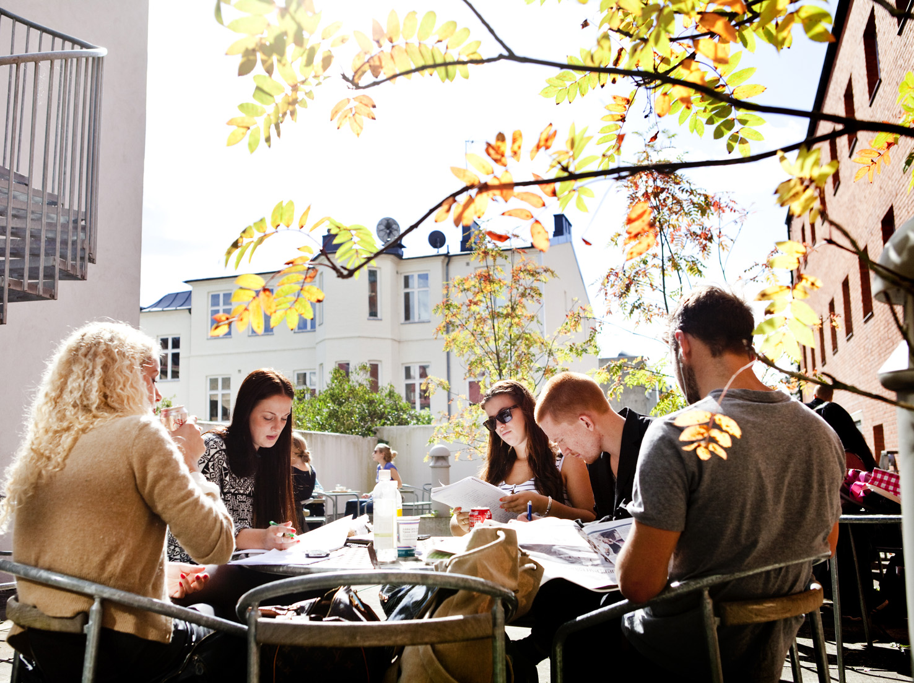
Hur kommer folkhögskolorna att påverkas av den digitala utvecklingen med global undervisning
Ebba Ossiannilsson, PhD
25 september 2013

Slide 2
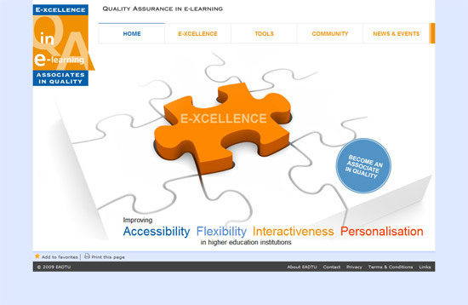
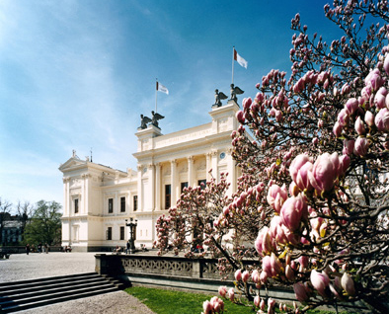
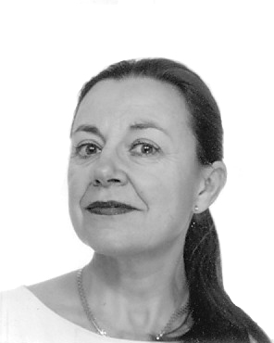
Ebba Ossiannilsson, PhD Lunds Universitet
Notes:
I am Ebba Ossiannilsson, Lund University, Sweden
I recently, dec 2012 earned my PhD from Oulu University in Finland and I did it through distance
I work for several international and national organisations on open learning and quality and some of them are represented here by their logos
I will here especially emphazise the work on the Paris declaration by UNESCO, the work with OER Service and the MOOC quality project. I also use to serve as a reviewer for several organisations, such as EFQUEL and Epprobate.
I have been asked to talk about the topic I am happy to share this with you today

Slide 3
Ossiannilsson (2012) Benchmarking (e)-learning in higher education, Doctoral dissertation, Oulu University, Finland

Slide 4
Möjligheter och utmaningar med global utbildning
TRENDER
MÖJLIGHETER
HINDER
ANSATSER
WHATS I N IT FOR ME?
WHAT´S NEXT
Some rights reserved by matsber
Notes:
Headings for the workshop

Slide 5
Folkhögskolor
”Folkhögskolan är en annorlunda skolform för vuxenutbildning inom folkbildningen. Vi utgår från dina egna behov, förkunskaper och erfarenheter och du kan själv vara med och påverka din utbildning”
”Något som utmärker folkhögskolan är samtalet och den studerandes aktiva deltagande i gruppen”
http://www.folkhogskola.nu/

Slide 6
Folkhögskolor
”Stödja verksamhet som bidrar till att stärka och utveckla demokratin
Bidra till att göra det möjligt för människor att påverka sin livs-situation och skapa engagemang att delta i samhällsutvecklingen (genom t.ex. politiskt, fackligt, kulturellt eller annat ideellt arbete)
Bidra till att utjämna utbildningsklyftor och höja utbildnings- och bildningsnivån i samhället
Bidra till att bredda intresset för och delaktigheten i kulturlivet
http://www.folkhogskola.nu/

Slide 7
Jag är den som väljer…

Slide 8
Demography
Globalisation
Technology
Labour Market
Drivers
Labour market trends & demands
New skills
Education & Training
New ways of learning
Initiative, resilience
Responsibility
Risk-taking, creativity
Personal skills
Learner-
centred
Tailormade & targeted
Active & constructive
Motivating & engaging
Personalisation
Social skills
Social
learning
Peer-learning
Sharing & collaborating
In communities
Team-, networking
Empathy, compassion
Co-constructing
Collaboration
Learning skills
Lifewide
learning
Anywhere, anytime
Blending virtual & real
Combining
sources/providers
Managing, organising
Meta-cognitive skills
Failing forward
Informalisation
ICT Trends
?
?
?
Augmented Reality
Data mining
Learning analytics
?
Electronic tutors
3D virtual worlds
Social networks
Games
Mobiles
e-books
OER
ePortfolios
LMS
Source: IPTS (2011): „The Future of Learning: Preparing for Change“,
http://ipts.jrc.ec.europa.eu/publications/pub.cfm?id=4719
© European Commission, 2011

Slide 9
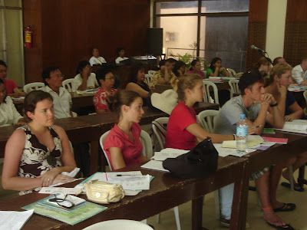
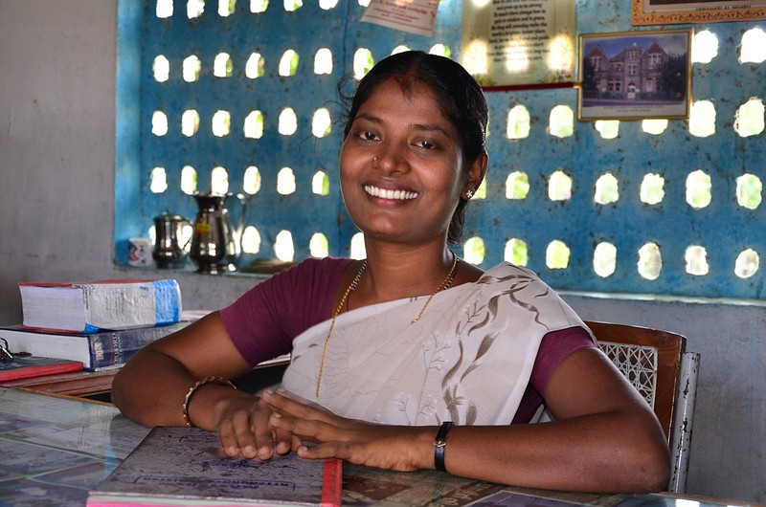
Our Students
Our Support
Education
Our Content
Friesen & Murray, 2011
Notes:
The third theme is about quality
A move from the paradigm my students, my course, my content..
towards
http://4.bp.blogspot.com/_-rcFBgUNtQ0/SFO-eE5igTI/AAAAAAAAEIk/4cyVccxKt_U/s400/GMU+service-learning+orientation+037.jpg
http://umami.typepad.com/umami/images/2007/07/18/p7050954.jpg
http://s3.frank.itlab.us/photo-essays/small/aug_05_4646_teacher.jpg

Slide 10
Notes:
Quality can enhance when use the very best of what is out there and available and often for free and peer reviewed
In research we are used to talk about peer review, but not that often in education
Towards any university, any content, any student
Probably the role of the University will shift to an assessing and credentialling institution or just for elite students and for research
http://img.scoop.it/_kg6c2d18VvkH-C1_rudTzl72eJkfbmt4t8yenImKBVaiQDB_Rd1H6kmuBWtceBJ

Slide 11
MOOC (Downes 2013)
Massive
Open
Online
Course
Notes:
Vad betyder så varje bokstav
Massive =att det är för många, väldigt många
Open = öppen i vidaste mening, i stort sett enbart ngn devise o Internet
Online = online inga fysiska möten alls
Course = att det är en kurs, vanligtvis veckomoduler
Vidare att MOOCen är autonom, mångfaldig, öppen och interaktiv
Autonomy, Diversity, Openess, Interactivity
Jfr Downes blogpost
cMOOC community basearat, man bygger gemenasmt kursen allteftersom
xMOOC innehållsbaserad
Open Badges
Såvida det inte är arbetsgivaren som ger sk Open Badges, som jag nämnde nyss, vilket redan är vanligt förekommande. I landet väster över…
===================================
Taxonomi 8 varianter Clark (2013)
transferMOOCs
madeMOOCs
synchMOOCs
asynchMOOCs
adaptiveMOOCs
groupMOOCs
connectivistMOOCS
miniMOOCSs
Note that these are not mutually exclusive categories, as one can have a transfer MOOC that is synchronous or asynchronous. What’s important here is that we see MOOCs as informing the debate around learning to get over the obvious problems of relevance, access and cost. This is by no means a definitive taxonomy but it’s a start. I’d really appreciate any comments, critiques or new categories.

Slide 12
Vad är en MOOC egentligen
Livslångt lärande
Komplement till annan utbildning
Förklara svåra koncept och fenomen, jfr Khan Academy
Arena för lärande
Kurs, kursmaterial
Marknadsföring
Globalisering
Demokratisering

Slide 13
Three main types of MOOC c, s and x
from Lisa (http://lisahistory.net/)
Notes:
cMOOCs are grounded in the Connectivist learning theory first proposed by George Siemens.
Learning is a networked process and course content is generated by teachers, students and other “nodes” in the network.
cMOOCs employ multiple technologies – 12 in the first MOOC offered by Siemens (Fini, 2009) – and the LMS is one in a range of technologies.
Standard MOOCs or sMOOCs are grounded in traditional pedagogies – predominantly Behaviorist with a smattering of Cognitivism and Constructivism.
The MOOC platform operates as a massive LMS and learning is process of working through transmitted material, engaging in multiple choice quizzes and being assessed by peers.
Use of additional technologies is limited.
Excellent, exploratory, expansive” (Rodrick & Sun, 2012) MOOCs or xMOOCs aspire to innovating in pedagogical practices / use of technologies for teaching and learning.
MOOC platform still seems to operate as a large scale LMS but the trajectory for these MOOC is one of innovation.
Use of technologies still seems to be somewhat limited but there are signs that this will change.
Dr. Iain Doherty (24th May 2013)

Slide 14
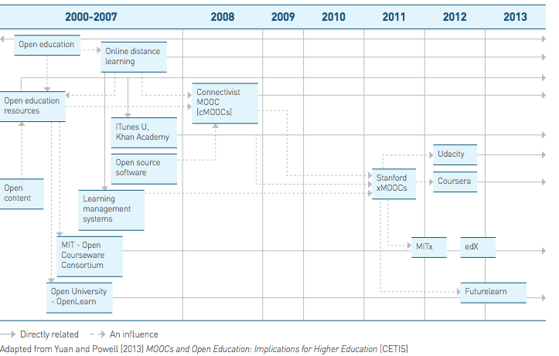

Slide 15
Vad är kännetecknande för MOOC
Video
Chat
Forum
Online material, pdf, etc
Böcker
Quizzar
Uppgifter
MeetUps (IRL eller virtuellt)
Examinationer
Certifikat

Slide 16
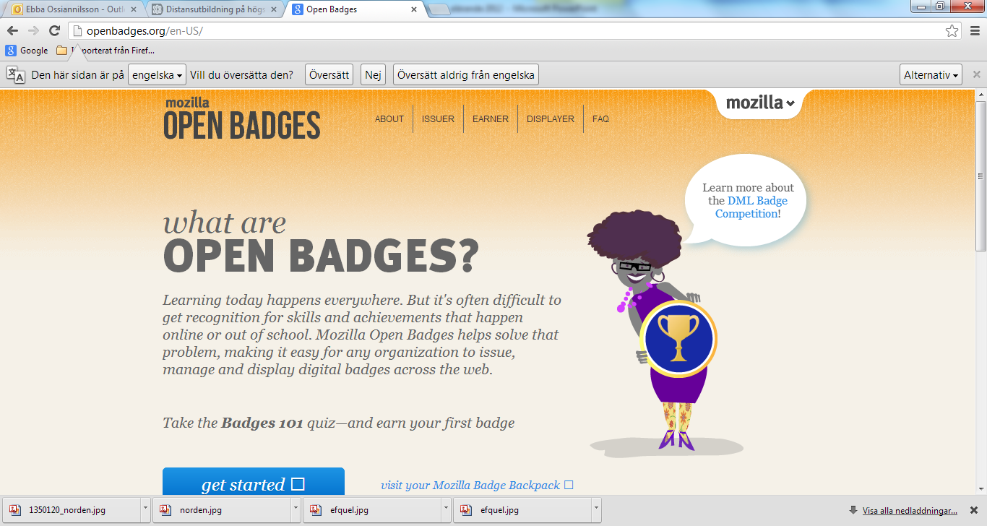

Slide 17
MOOC- varför? 1
Fönster mot världen
Vad som betalas med skattemedel ska tillbaka till skattebetalarna
Goodwill/Common good
Nätverkande
Olika affärs modeller beroende på syfte

Slide 18
MOOC- varför? 2
Branding
Entreprenörskap
Samarbeta för att konkurrera
Demokrati
Demografi
Globalisering
Individualisering
Ranking
Rekryteringar
Sustainability
Nätverkande/COP

Slide 19
Milestone 1
2004 MIT Open Courseware

Slide 20
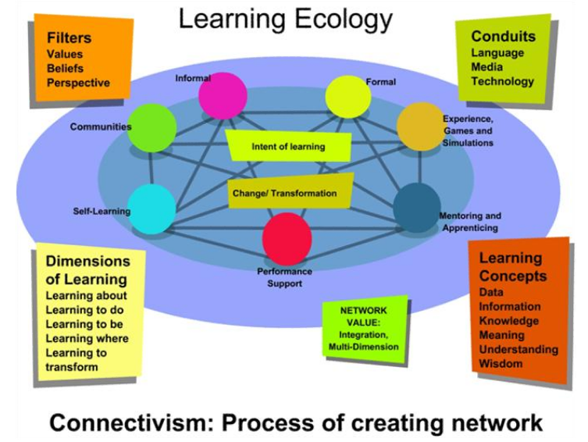
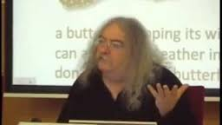
Milestone 2
2008 Siemens och Downes, CA. Connectivism and Connected Knowledge på Campus och 2 2000 online

Slide 21
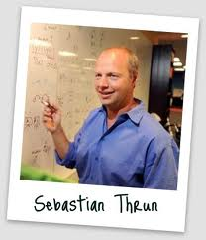
Milestone 3
2011 S Thrun (Stanford) and P Norvig (Google), Artificiell Intelligence.
160 000 participants from appr.190 countries. Udacity and Coursera started from here.

Slide 22
Milestone 4
2012 MIT and Harvard started edX later even Berkely
2012 Edinburgh connected to Coursera as the first European university
2012 FutureLearn (OUUK+ appr. 10 HEI in UK)
2012 several stakeholders offer accreditation of certificates from MOOCs e.g. www.excelsior.edu

Slide 23
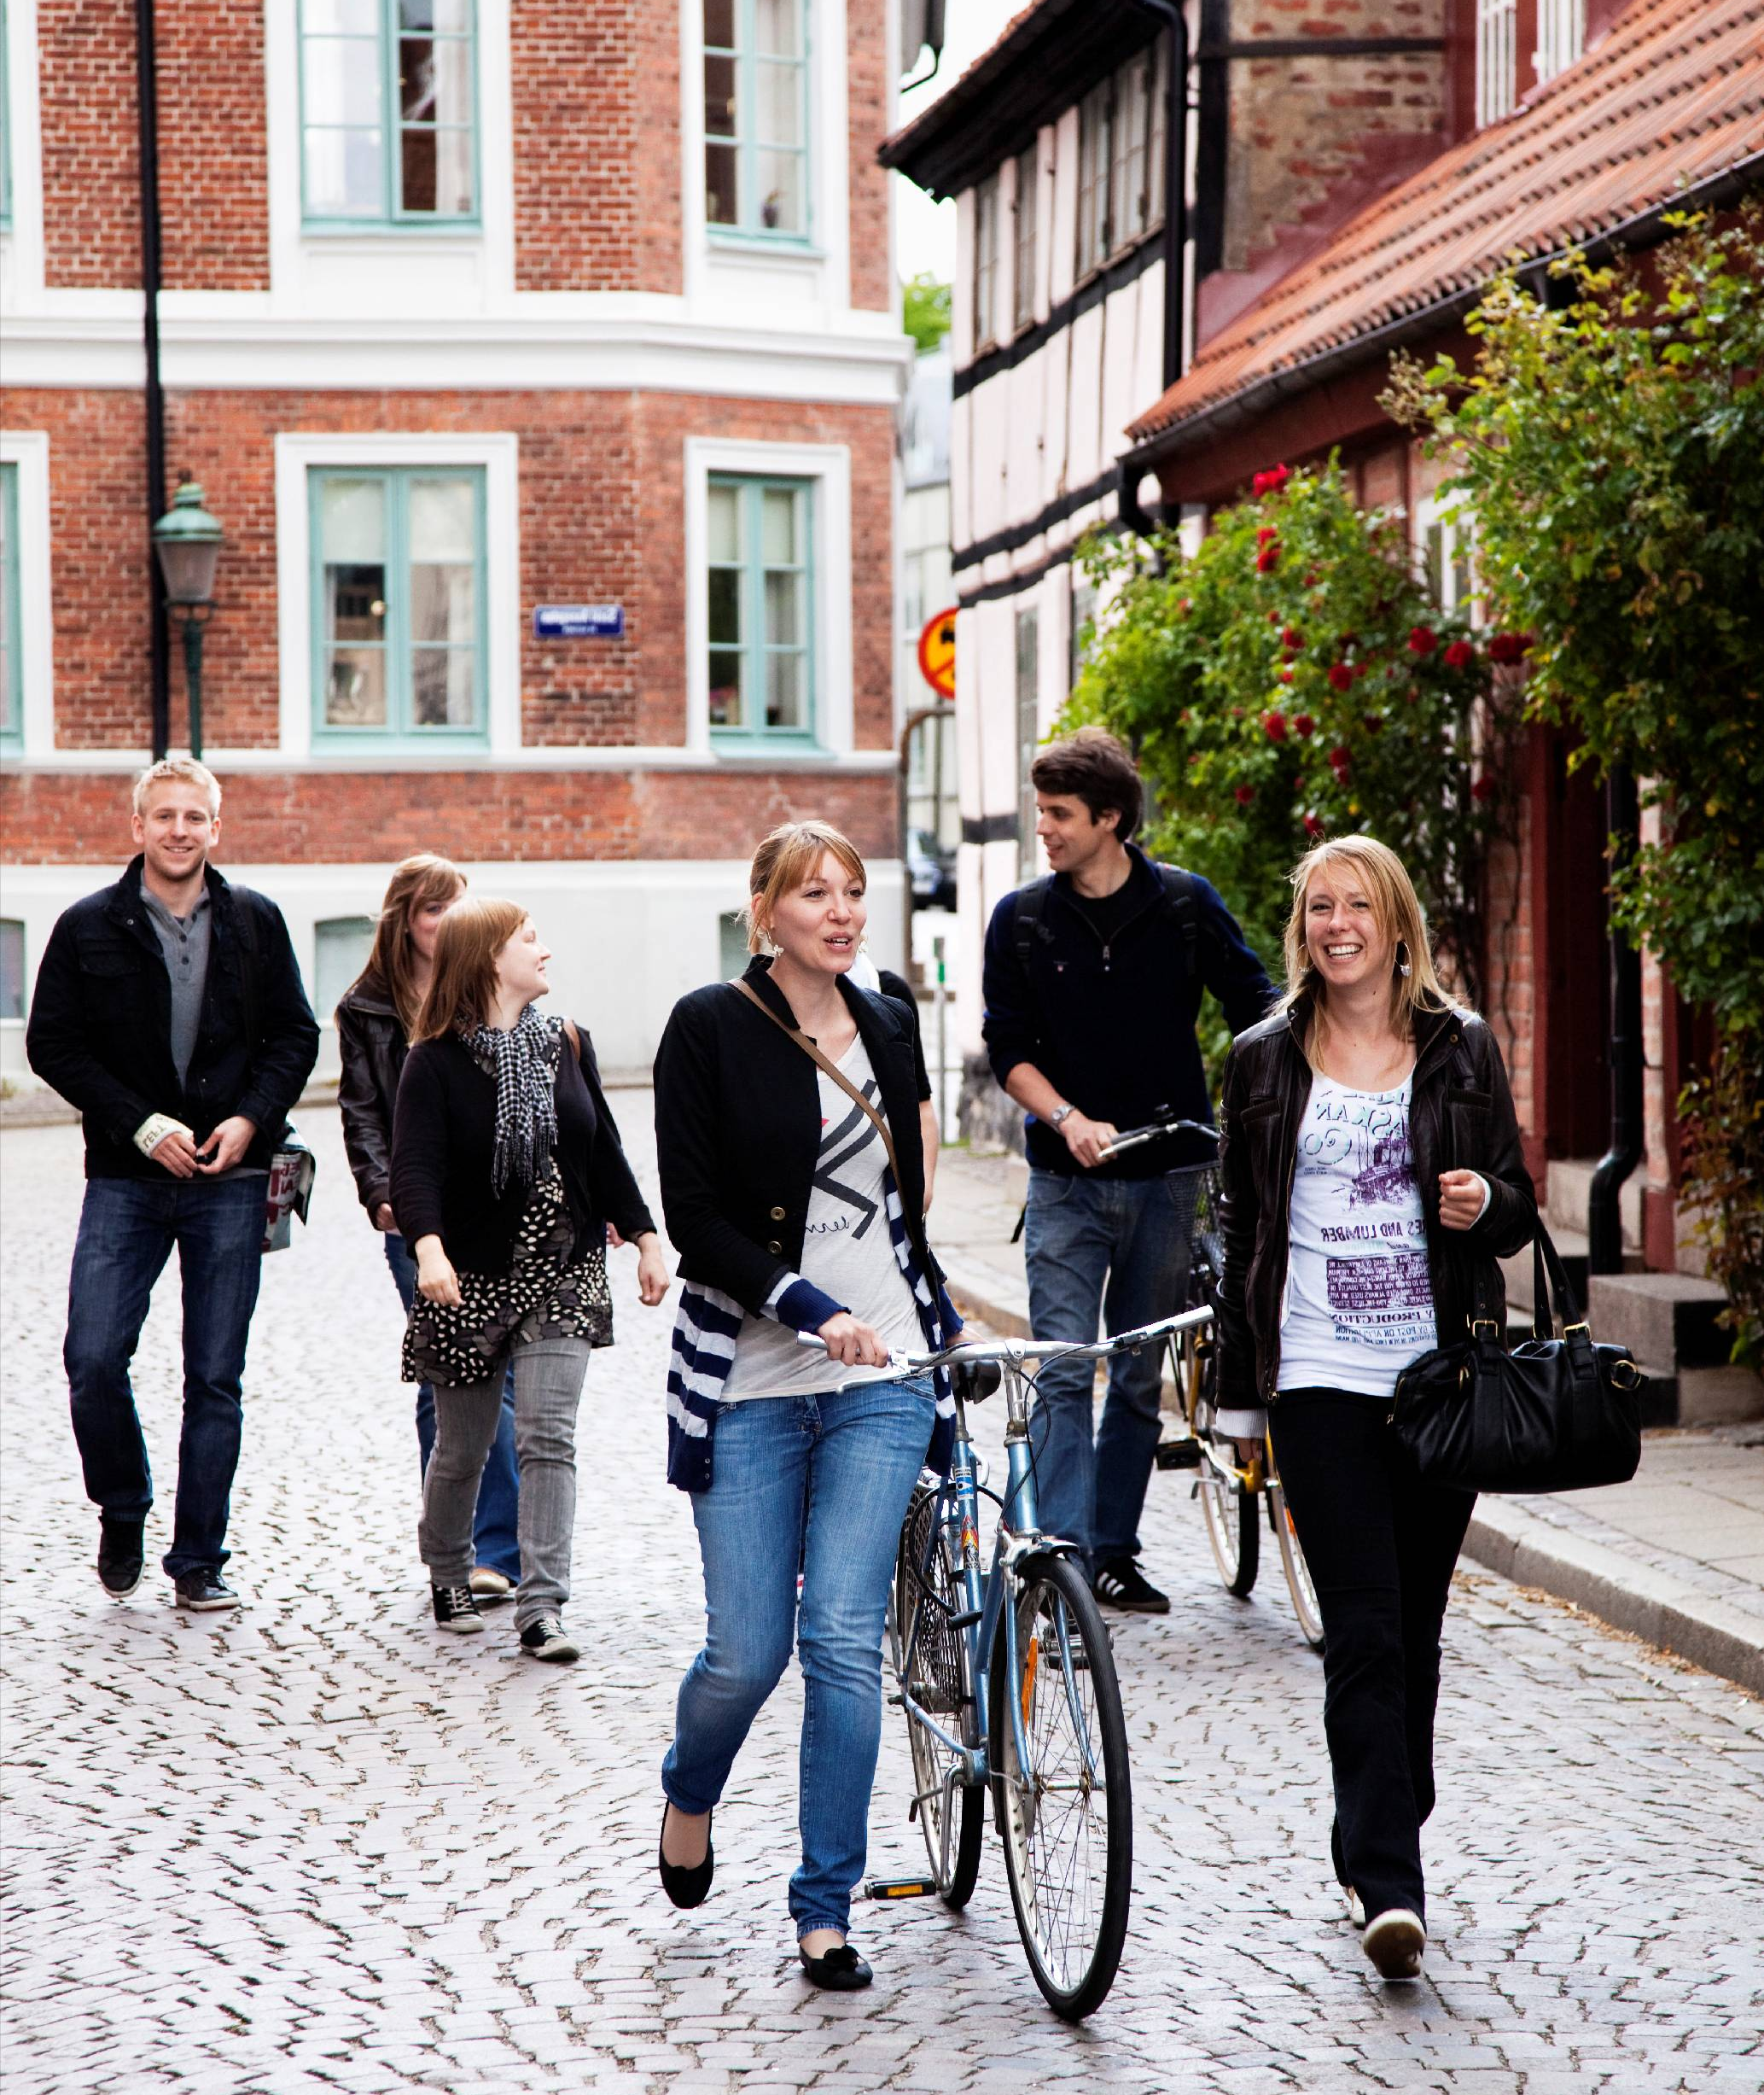
Milestone 5
2013 Copenhagen connected to till Coursera as the first Nordic University
KI
Karlstad/Lillehammer
Lunds universitet startat utredning

Slide 24
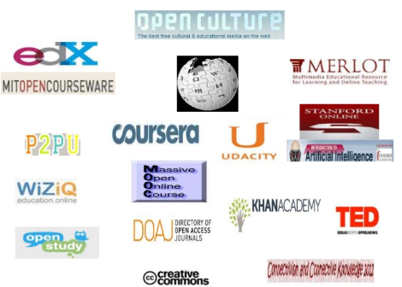

Slide 25
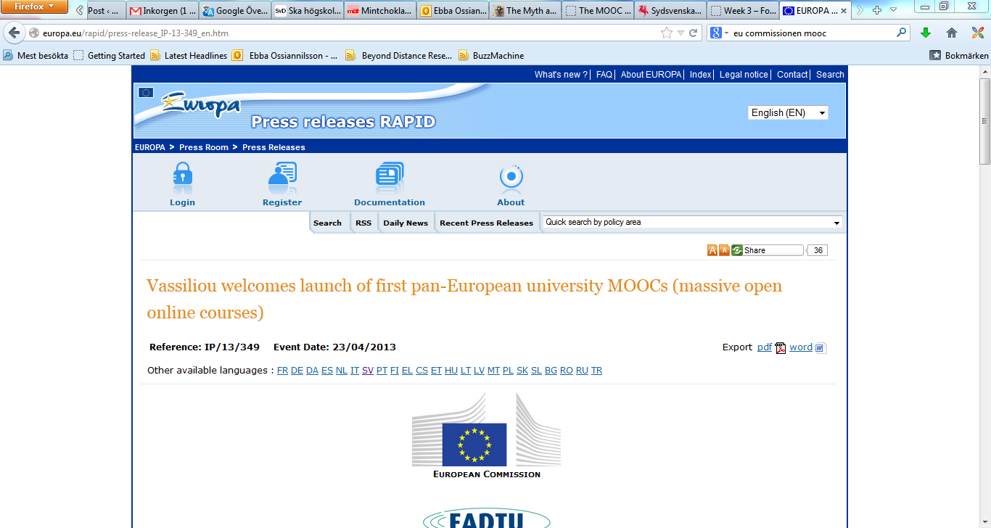

Slide 26
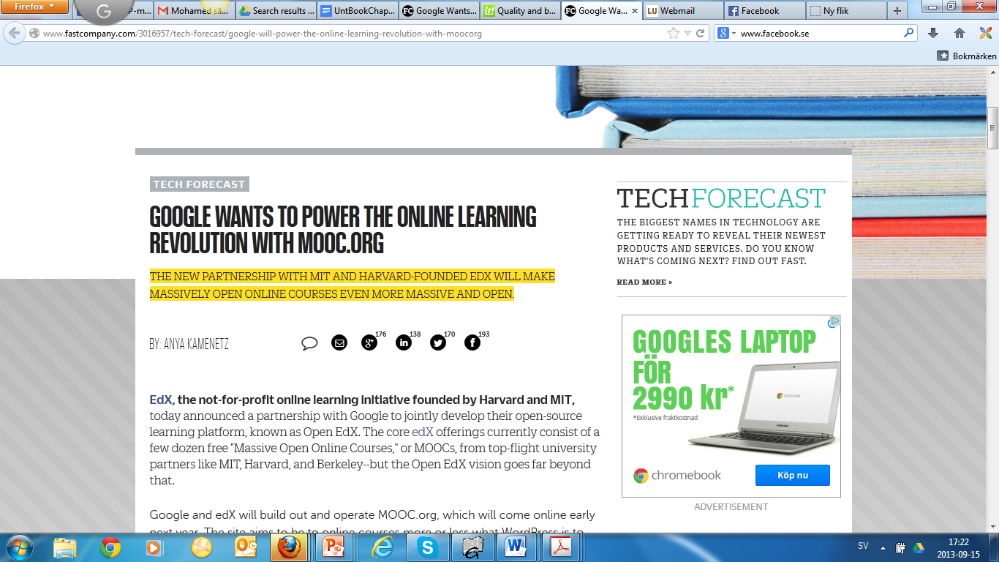

Slide 27
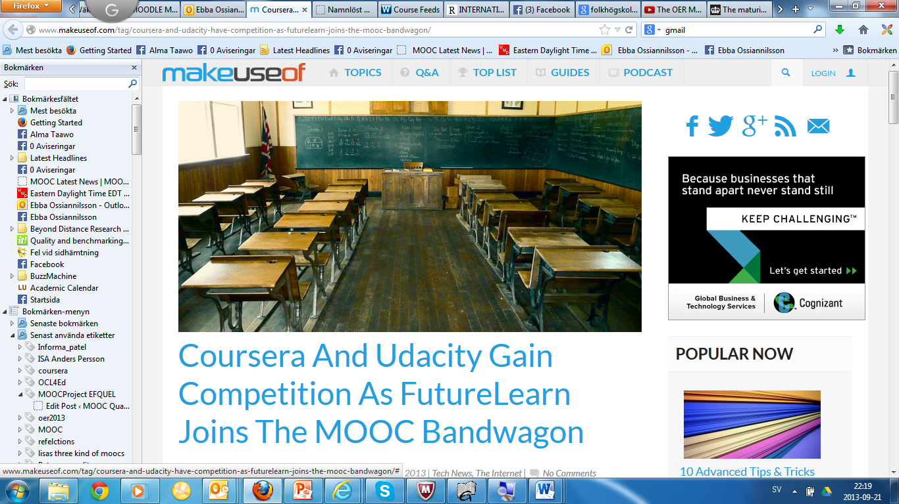

Slide 28
Hur gör man då…
A great idea for a course
A great plan
Lots of time for creating content
A platform to host the MOOC
A good social media campaign
A group of teachers you can rely on (Downes 2013)
http://blog.wiziq.com/how-to-launch-a-mooc-on-wiziq/?utm_source=rss&

Slide 29
Vad görs oftast på en MOOC…

Slide 30
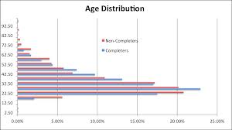
Where are these students located and ages?
Coursera registered about 2.8 million learners 27.7% from the United States
8.8% from India
5.1% from Brazil
4.4% from the United Kingdom
4.0% from Spain
3.6% from Canada
2.3% from Australia
2.2% from Russia
41.9% from the rest of the world
Waldrop, M. Mitchell; Nature magazine (March 13, 013). "Massive Open Online Courses, aka MOOCs, Transform Higher Education and Science". Scientific American. Retrieved April 28, 2013.

Slide 31
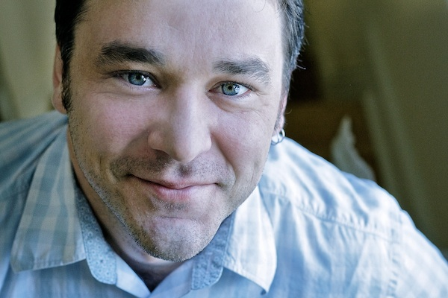
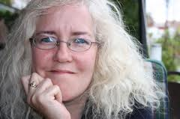
MOBP – a Massive Open Blog Project.
12 world leading contributers during 12 weeks
MOOCAthon during the EIF2013

Slide 32
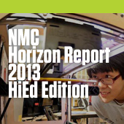
Innovating pedagogy 2013
MOOCs
Badges to accredit learning Learning analytics
Seamless learning
Crowd learning
Digital scholarship
Geo learning
Learning from games
Maker culture
Citizen inquiry

Slide 33
OER och MOOC

Slide 34
Nordic Open Educational Resource(OER) Alliance
Paris OER Declaration 2012
EC Opening up education
EUA (Gaebler 2013)
Policy
Institutions
Individuals
http://www.tinyurl.com/nordic-position
How to make it work?
How to create long-term, trusted, mutual partnerships?
Ossiannilsson_OER2013
Notes:
Goals and objectives for the Alliance
Paris declaration2012
EC EUA
Barriers
Actiions
Recommnendation; policy, instituional, and indicidual level
How to make it work?
How to create long-term, trusted, mutual partnerships?

Slide 35
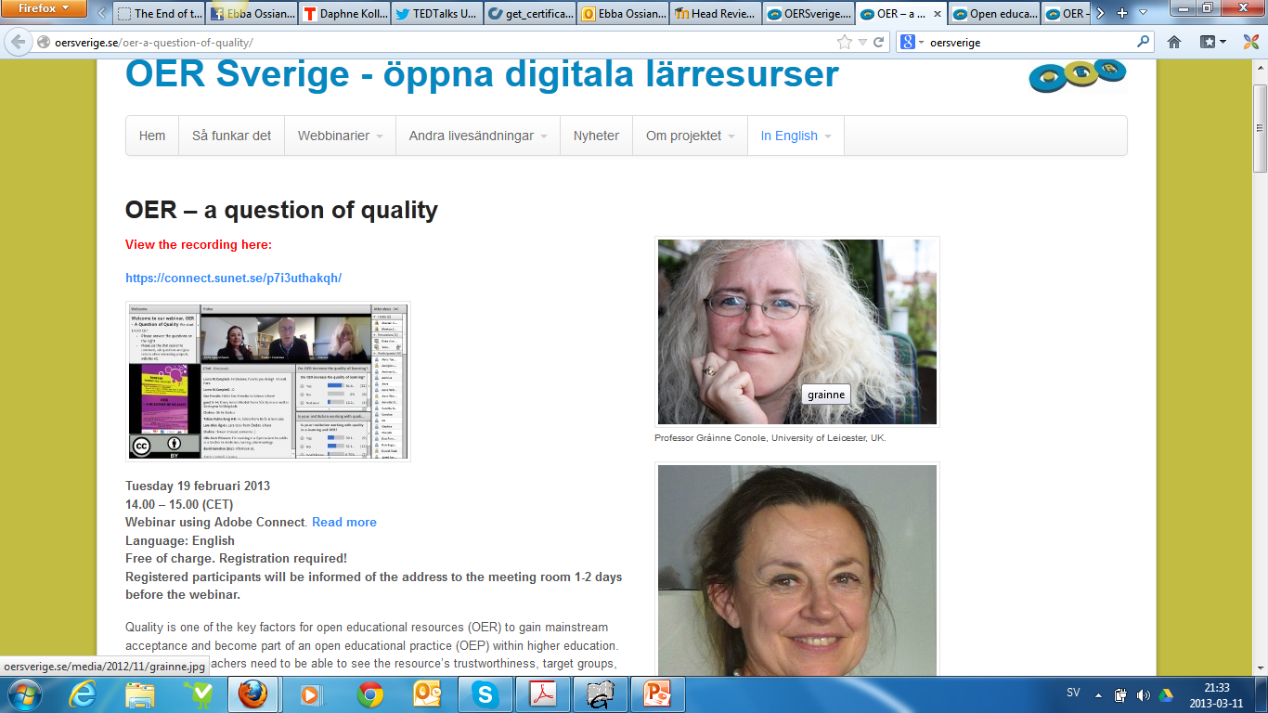

Slide 37
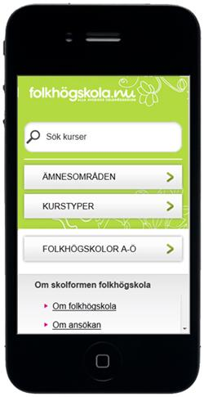
Mobilt och Ubiquitous lärande
Teknik
Pedagogik Didaktik
Informellt/formellt lärande
Learning on the go
Infrastruktur
Demografi
Från innehåll till sammanhang

Slide 38
Rethinking och transformation
From Sage on the stage…To Guide on the side…To Meddler in the middle
Frågan är INTE hur vi ska arbeta
med digitala medier/teknik i utbildning
utan snarare hur vi kan arbeta med
lärande i en digital värld/community
Från innehåll till sammanhang
content to context

Slide 39
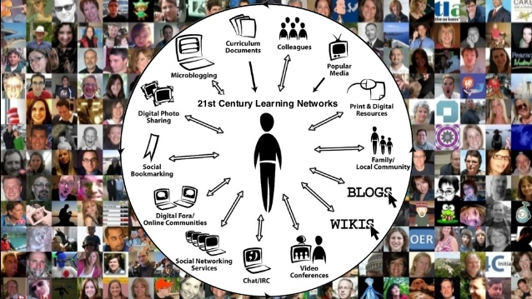
Learning design

Slide 40
PLE och COP
Filter; Netvibes, Freedly
Curate; ScoopIT, Pinterest, Educlipper
Collaborate; Padlet, Conceptboard
Free cloud tools:
Google drive, FB, Twitter, Blog etc
”Networking mentors and Prosumers”

Slide 41
Whats next?
MOOCC MOOPS MOORC
mOOC
SOOC BOOC
ROOC
DOOC
....

Slide 42
Kvalitet – Då det är jag som bestämmer…
Lärande handlar om människor INTE teknik
Ossiannilsson_OER2013
by Stephanie Lowman

Slide 43
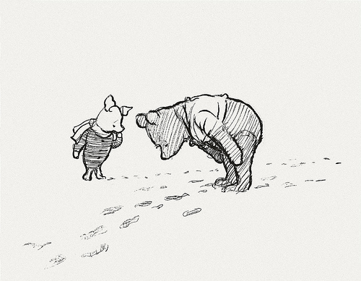
Caring is sharing, sharing is caring
Footprints
W:www.oulu.fi; www.lu.se/ced
E:Ebba.Ossiannilsson@oulu.fi
E:Ebba.Ossiannilsson@ced.lu.se
FB:Ebba Ossiannilsson
T:@EbbaOssian
Phone: +4670995448
S:http://www.slideshare.net/EbbaOssiann
Notes:
As my strong believe caring is sharing
So my footprints and contact details
My slides are available at slidshare where you can find my other presentations as well

