Slide 1
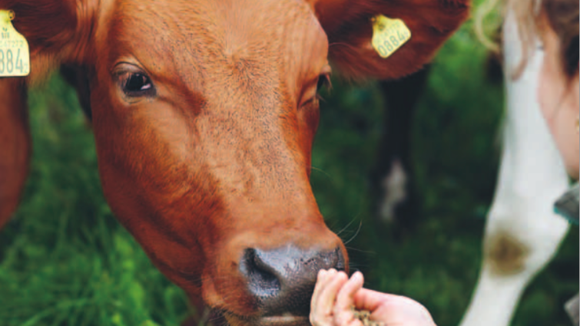
ARLA FOODS
”Caught In the Middle”
By: Moa, Thea and Matilda
December 14th 2015
Lund University – BUSN35
Professor: Mats Urde
Notes:
Hello everyone, nice to be here! Today we are going to present a very interesting case to you that we call “Caught in the middle” and it is about Arla Foods.
This picture might give a very peaceful impression. This however will soon be changed… what you will be facing in this case is...
Note to speaker: the green title “caught in the middle” is hyperlinked to the following video: https://www.youtube.com/watch?v=T_shfTFw0ow
One can choose to show the whole video, otherwise the first minute of the video will suffice. Make sure to show it before continuing the presentation.

Slide 2


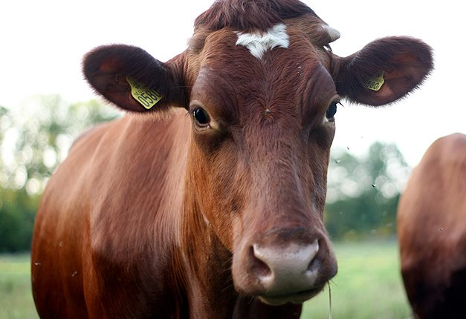
AGENDA
Background
The conflict
Case question
Actions
Notes:
We will come back to that later… First we will start with a background presenting some facts about Arla Food as a company, then we will guide you through the case which then will lead to a case question. Then we will have a discussion upon the questions. After the discussion we will present to you what Arla did and then we will have a discussing again….

Slide 3
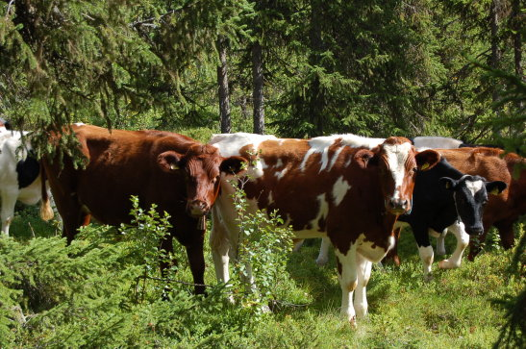
BACKGROUND THE CONFLICT CASE QUESTION ACTIONS
Danish-Swedish dairy company
Established in 2000 → Arla + MD Foods
12 700 farmers → owners and suppliers
Core values
Inspiration, security and well-being
Notes:
Arla Foods is a Danish-Swedish dairy company that was established in 2000 as a result of the merger between the Swedish dairy company Arla and the Danish dairy company MD Foods but both companies has a history in Scandinavia that goes back to the late 1800’s.
So now you now how the name Arla occurred and we will in the rest of the presentation only say Arla.
Arla is a cooperative owned by 12 700 farmers so they could be considered both the owners and suppliers.

Slide 4
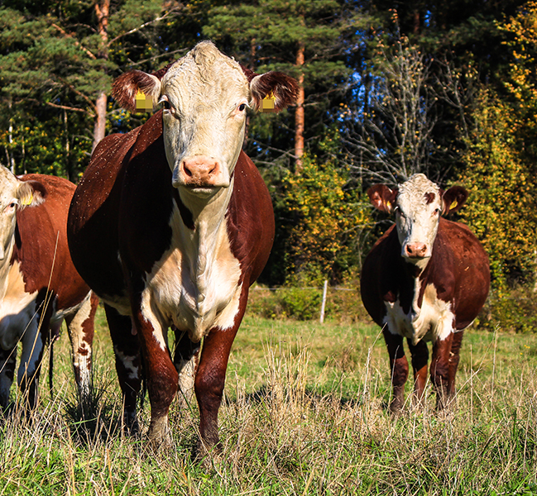
BACKGROUND THE CONFLICT CASE QUESTION ACTIONS
2005
Second largest dairy company in Europe
Sweden and Denmark ≈ 40 % of net turnover
Negative image by Danish consumers
Growth strategy in the Middle East
40 years on the Middle Eastern market
Supplies more than 50 000 stores in the Middle East
Notes:
We will turn back the time to 2005.
Arla is the second largest dairy company in Europe and the goal is of course to become number one.
Sweden and Denmark together accounts for about 40% of their market and Arlas origin is well known in the public.
What is important however is the fact that two thirds of the Danish consumers has a negative perceived image of Arla and that really needs to be improved.

Slide 5
BACKGROUND THE CONFLICT CASE QUESTION ACTIONS
2005 - 2006
30/9
8/10
September 30th - Cartoons of the Prophet Mohammed published by Danish newspaper Jyllandsposten
October 8th – Islamic Faith society demands Jyllandsposten to withdraw the pictures and apologize
“Freedom of speech” - Jyllandsposten
Notes:
It all starts on the 30th of September when the Danish newspaper “Jyllandsposten” publish a series of cartoons depicting the prophet Mohammed.
Some of the pictures were more provocative then others, but in one picture Mohammed is for example having a bomb inside his turban.
Important to say is that according to the Islamic belief any depiction of the prophet is considered a grave offence and very disrespectful.
It does not take long before the anger and irritation among the Muslims starts to grow.
They demand that the published pictures should be withdrawn and that Jyllandsposten should apologize for their act.
Jyllandsposten on the other hand claims that they have not committed any crime and simply used their right of freedom of speech.

Slide 6
BACKGROUND THE CONFLICT CASE QUESTION ACTIONS
2005 - 2006
30/9
8/10
19/10
21/10
October 19th – Protest letters to the Danish Government
October 21st – Danish Government replies
“Freedom of expression is the cornerstone of Danish democracy and wide-reaching. The Danish government has no possibility of influencing the press”
Notes:
The conflict grows and the Danish government receive protest letters from 11 Muslim countries with embassies in Denmark on the 19th of October and people are demonstrating against the caricatures.
The government reply on the 21st of October to the protest letters by saying
“Freedom of expression is the cornerstone of Danish democracy and wide-reaching. The Danish government has no possibility of influencing the press”.
So basically what the Danish government is saying is that they do not want to apologize and even if they wanted to they could not apologize on behalf of the press as the Danish Government does not have any influential power over the press.

Slide 7
BACKGROUND THE CONFLICT CASE QUESTION ACTIONS
2005 - 2006
30/9
8/10
19/10
21/10
November
1/12
30/1
November – Information travel
December 1st – Reward offered for murdering the illustrator
January 30th – Jyllandsposten “apologize”
Notes:
This leads to that a delegation of Danish Muslims travel to the Middle East in November spreading the word about the caricatures.
The conflict escalates and the information has now reach bigger parts of the Middle East.
For example is a reward offered for the murder of the illustrators, people in the Middle East are demonstrating and burning the Danish.
Moreover the Danish embassy’s in Damascus and Lebanon are burnt down and other has to be closed down due to attacks.
The Danish Government has advised Danish people that are currently in the Middle East to leave.
In the same time western Europe is adding more fuel to the fire by re-publishing the pictures defending the freedom of speech.
Due to the serious situation Jyllandsposten on the 30th of January publishes a statement saying that they regret offending Muslims and offered an apology,
but in the same time they said that their act was not against the Danish law.
However ,this apology is not accepted since it was not considered genuine and because it is not genuine the conflict escalates even more.

Slide 8
BACKGROUND THE CONFLICT CASE QUESTION ACTIONS
2005 - 2006
BOYCOTT
31/1
£ 1m per day
Notes:
So this is were Arla comes into the picture. Due to the conflict, Muslim opinion leaders calls for a boycott of all Danish products. By end of January 2006, the boycott is a fact. Due to their newly implemented growth strategy and large market share in the Middle East, Arla is the company that gets hit the hardest in this boycott. The financial losses of Arla is estimated to be 1 million pounds per day.

Slide 9
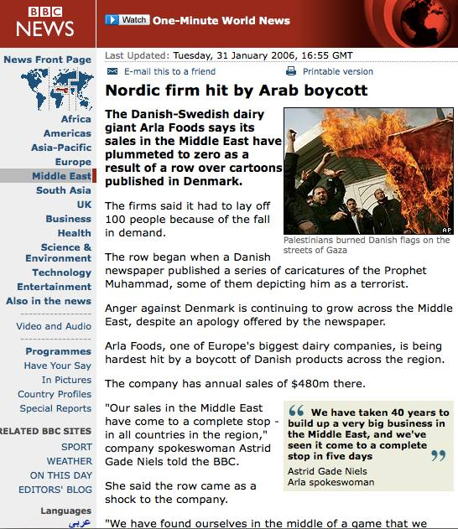
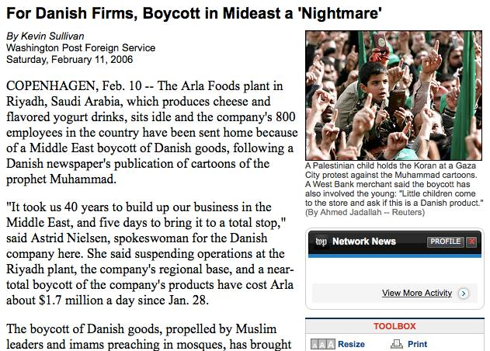
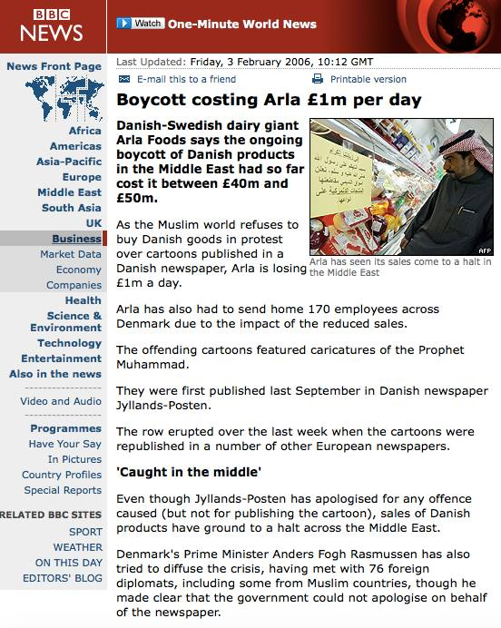
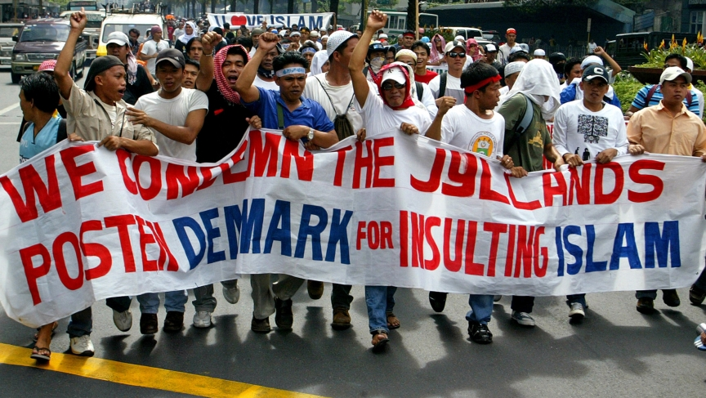
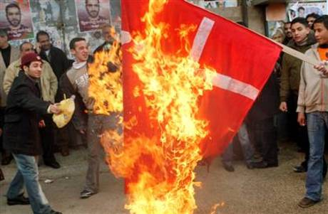
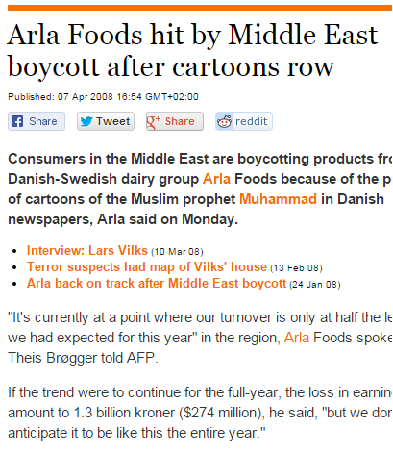
BACKGROUND THE CONFLICT CASE QUESTION ACTIONS
It is the end of January 2006
Notes:
Furthermore the media coverage is extensive, and much of the medias focus is directed towards Arla.

Slide 10
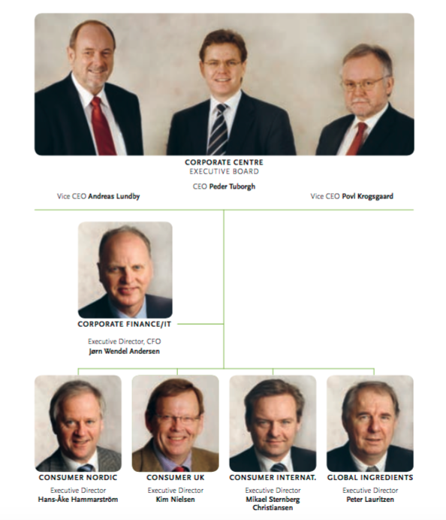
BACKGROUND THE CONFLICT CASE QUESTION ACTIONS
You are the executive management of ARLA FOODS
Notes:
So, you are now the executive managers of Arla Foods, and you are faced with having to make a strategic decision concerning the reputation of Arla.
(picture: ARLA FOODS ANNUAL REPORT 2006)

Slide 11
BACKGROUND THE CONFLICT CASE QUESTION ACTIONS
What should Arla do to regain their position and reputation in the Middle East?
- Who are the key stakeholders?
- What are the key issues?
- What are our alternatives?
- What actions should we take?
Notes:
So, what should Arla do to regain their position and reputation in the Middle East?

Slide 12
BACKGROUND THE CONFLICT CASE QUESTION ACTIONS
Step 2: Be Reactive and Take Control of the Situation
Not responsible for issue – Role “victim”
International Support of the Prophet Conference
Press and Trade Conference
  Broad range of local campaigns in the Middle East
  “Together for generations” “40 years with you”
Supporting humanitarian projects
”The only thing that can stop the current boycott of Danish products is a direct dialogue between the parties involved.”
Step 1: Reasoning with stakeholders
Requesting Governmental Action
Press Releases where Focus is shifted away from Arla
Notes:
This is what ARLA said – citat.
The first strategy applied by Arla was to try to reason with the key stakeholders. The key stakeholder here being: the danish government, the media and the consumers (both domestically and in the Middle East) They did this by requesting the Danish Government to take action, as well as publishing a number of press releases where they shifted the focus away from Arla and rather pointed to the “parties involved” as seen in the quote.
*Click*
However, as the tension continued to grow, and it became clear that the Danish Government had no intentions of giving the apology as demanded by the Muslim communities, Arla realized that they needed to take a more reactive approach.
Step 2: When they realise that they would not get any help from the government they realised that they had to take a more reactive approach. The strategy then chosen was the advocacy strategy. Which means that they tried to change the perception of the stakeholders. First they communicated that Arla was a victim and put themselves in the shoes of a victim and they were not to blame. Secondly they started to communicate to the Muslim conusmers in the Middle East by participating at the Prophet conference and press and trade conferences and they also did a range of local campaigns where they emphasize on their 40 year long relationship with Middle East
The managers of Arla were aware of the short term impact the boycott could have on the sales, but also about concerned about the long term impact that such a boycott would have on the company’s reputation
“condemned every expression, action or indication that attempts to demonize groups of people on the basis of their religion or their ethnical background”
To have these statements covered by the Saudi Arabian press Arla Foods paid for an advertisement citing
However, as the tension continued to grow, and it became clear that the Danish Government had no intentions of giving the apology as demanded by the Muslim communities, Arla realized that they needed to be reactive and take control of the situation.
At this point, they started clearly communicating that they were not responsible for the issue, and took on the role as a “victim” of the crisis.
Furthermore, they decided to advocate towards the Muslim opinion leaders and try to make them change their perceptions of Arla. For example, Arla promoted the International Support of the Prophet Conference, where Arla’s previous statements about how they were not to blame for the cartoons, were up for debate.
Arla also organized a Press and Trade Conference in Riyad where they invited all the retailers …. (Moa you know this, so just add on here).
In addition to the conferences, Arla implemented a broad range of marketing and communications campaigns in the Middle East where they emphasized their 40 year long relationship with Middle Eastern consumers.
As a final point, Arla also decided to try to strengthen their reputation by supporting humanitarian organisations and projects.
(The managers of Arla were aware of the short term impact the boycott could have on the sales, but also about concerned about the long term impact that such a boycott would have on the company’s reputation
“condemned every expression, action or indication that attempts to demonize groups of people on the basis of their religion or their ethnical background”
To have these statements covered by the Saudi Arabian press Arla Foods paid for an advertisement citing)

Slide 13
BACKGROUND THE CONFLICT CASE QUESTION ACTIONS
“For many years, Arla has traded, and enjoyed good relations with consumers in the Middle East. (…)We respect all religions and wish to express our sympathy and understanding for those who feel wronged by this incident. Obviously, Arla Foods does not support anything that offends people’s religion or ethnic background,”.
Notes:
This was said by ARLA
The managers of Arla were aware of the short term impact the boycott could have on the sales, but also about concerned about the long term impact that such a boycott would have on the company’s reputation
“condemned every expression, action or indication that attempts to demonize groups of people on the basis of their religion or their ethnical background”
To have these statements covered by the Saudi Arabian press Arla Foods paid for an advertisement citing

Slide 14
BACKGROUND THE CONFLICT CASE QUESTION ACTIONS
What are the potential risks of Arla’s chosen strategy?
Notes:
DISCUSSION ABOUT THE DECISIONS MADE
Do you see any risks with the chosen strategy?
Danish consumers? Credibility? Were they really neutral or not?
Today Arla foods has regained their position in the Middle East, however given the circumstances in the world today there is always a potential risk of a new boycott. Furthermore, Arla is having issues with their reputation among the Danish and Swedish stakeholders, however that is an entirely different case.

Slide 15
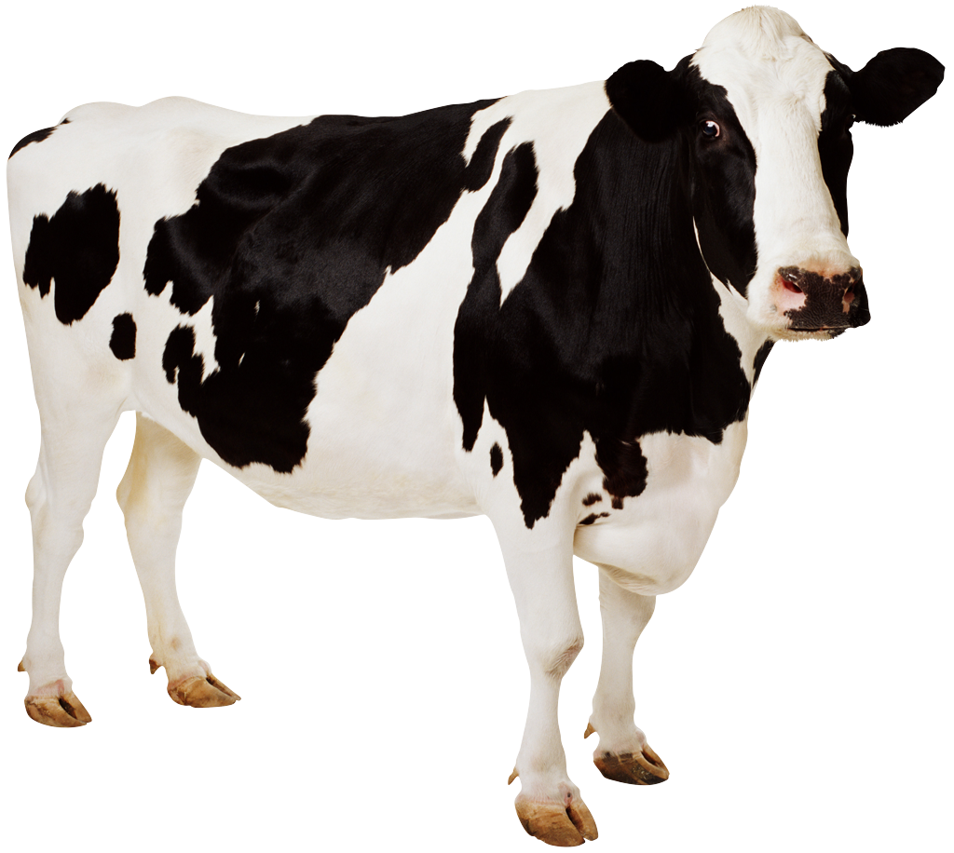
Case closed. Thank you!

