Slide 1

Notes:
Purpose of slide:
Introduction Slide
Speaker notes:
Setting the scene: explain to class their role as brand managers within McDonald’s.
Describe situation: One morning, an unexpected adverts by main competitor Burger King hits national and local newspapers inviting us (McDonald’s) to participate in a charity event.
Create ambience: If possible, hand out copies of the original full-pager (available at: http://adsoftheworld.com/sites/default/files/open_letter_usa.jpg) before describing the situation.

Slide 2
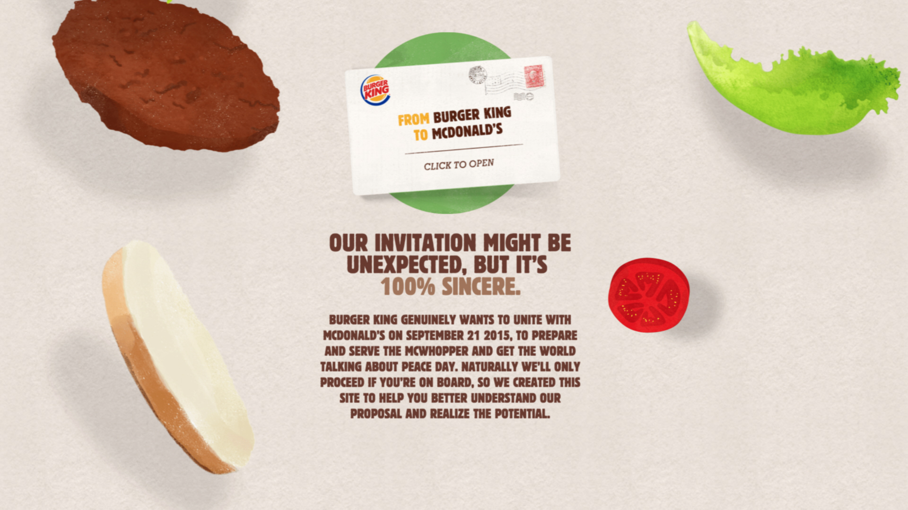
Notes:
Purpose of slide:
Summary of Burger King’s public invitation
Speaker notes:
Highlight main challenge: Burger King have widely publicised the initiative, including setting up a dedicated website (www.mcwhoper.com), and have been posting messages on their web media throughout the day encouraging customers to put pressure on us. The event will supposedly take place on September 21 2015, in less than a month’s time (today is August 26)
The proposal:
1. Setting up a one-day pop-up restaurant, halfway between the companies’ respective headquarters (Atlanta);
2. Serving the McWhopper, a hybrid between McDonald’s Big Mac and Burger King’s Whopper;
3. Involving employees from both companies;
4. Create common visual communications, uniforms and packaging with elements from the design languages of both corporate brands;
5. Promote discussion in the blogosphere through #settlethebeef.
Peace One Day: Proceeds from the event go to Peace One Day, an independent organization committed to introducing and raise awareness about the International Day of Peace around the world. The Organisation has fully endorsed the initiative.
International Observance: The United Nations has established September 21st as the International Day of Peace.

Slide 3


Notes:
Purpose of slide:
Brief info on the McDonald’s brand
Speaker notes:
McDonald’s is the biggest brand in the world both in terms of sales volume and presence (Forbes news, 2015).
The slogan “I’m lovin’ it” sums up the corporation’s core values: “better food, more sustainable sourcing, happier people, a stronger community and a healthier planet” (McDonald’s, 2015)
Assessing the brand reputation through the CBIRM instrument (Urde & Greyser, 2014), McDonald’s enjoys a strong performance. Its weaknesses, however, are the elements of Trustworthiness, Credibility, Responsibility, and Willingness-to-Support.
Following a change in the global Brand Management team, McDonald’s intends to focus more on the “lovin’” strategy – relationship-marketing and trust-building (McDonald’s, 2015).

Slide 4
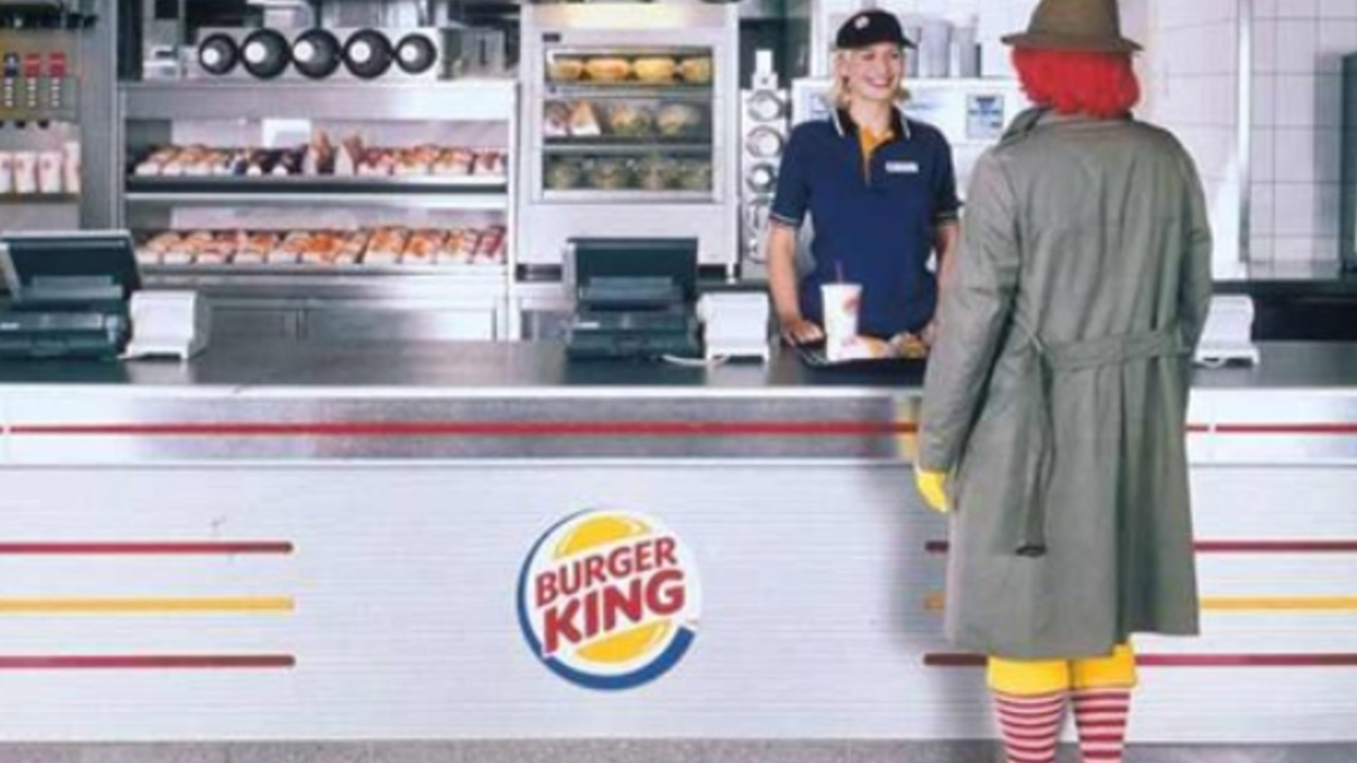
Notes:
Purpose of slide:
Quick background on the Burger Wars
Speaker notes:
McDonald’s and Burger King were fierce rivals from their early days, competing especially on differentiating product attributes.
In the 1980s, competition shifted to other aspects such as comparative advertising, endorsements and even lawsuits. The rivalry became known as “Burger Wars”.
The brands were defined by their respective signature burgers: McDonald's by the Big Mac, Burger King by the Whopper.
The Burger Wars are still raging, thirty years on.

Slide 5
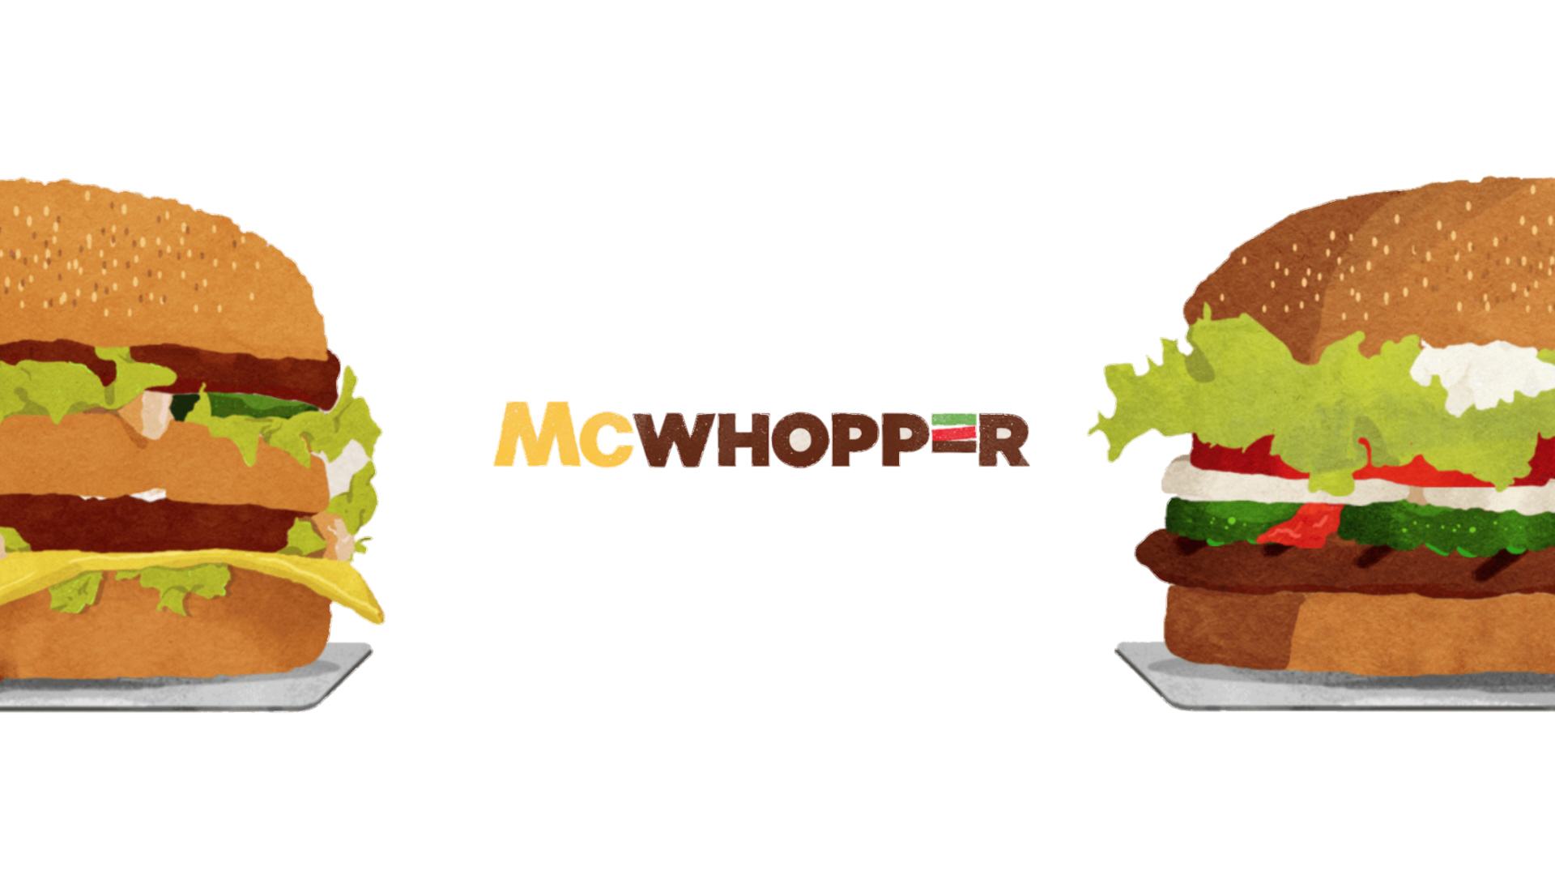

Notes:
Purpose of slide:
Bring attention back to the Case
Speaker notes:
The Proposal Video: play the clip to help class understand better the situation while they process the information given in the previous slides.
The video is Burger King’s official invitation on www.mcwhopper.com

Slide 6

Notes:
Purpose of slide:
Posing the main question
Speaker notes:
Main question: “How should McDonald's respond to Burger King’s proposal?”
Leading Questions:
1. Do we accept the proposal? Why?
2. How will saying yes or no influence McDonald’s reputation?
how could the decision impact the brand?
consider different stakeholders
3. How do we reply?
what is our communication plan?
where do we reply?
do we reply publically?
4. Who will reply?
who is responsible for communicating our answer?
If necessary, give additional information as the discussion goes on to direct the balance of opinion:
Countering arguments against accepting the invitation:
It is not unusual of McDonald’s to sell limited edition products. (Taylor, 2015)
McDonald’s sales were down 2% in the US, falling for the seventh quarter in a row. Global sales also fell 0.7% in the second quarter of 2015. Burger King's revenues, on the other hand, grew by 2.6% in one year, while sales were up by 6.7% overall. (Duprey, 2015) Burger King has only just reclaimed the runner-up position, but McDonald’s is still in decline. (Fedde, 2015)
The very day before the advert came out, McDonald’s was supporting a RMCH Conference, (McDonald’s, 2015) an international social responsibility meeting. This was never communicated through the day.
Countering arguments in favour of accepting the invitation:
The combination burger highlights the Whopper's strengths, as the circumference of Burger King's burger is larger than the Big Mac. (Taylor, 2015)
McDonald’s current strategy seems to be develop into more of a fast-casual diner, offering a healthier menu over hamburgers. (Duprey, 2015)
It is not in McDonald’s tradition to join forces with Burger King. Corporation founder, Ray Kroc, once said of Burger King, “If they were drowning to death, I’d put the hose in their mouth.” (Fedde, 2015)
In 2012 KFC drew sharp criticism for “pink-washing” by rolling out a campaign that donated to a breast cancer charity with every purchase of a special menu item. (McVeigh, 2012)
In March this year, McDonald’s launched an international 24-hour campaign, with fun activities in different cities intended to spread joy around the world. The company received a backlash from the public that bemoaned the working conditions of its own employees. (Summers, 2015)
Nothing was said in the proposal about expenses, funds but The Telegraph reports that all proceeds would go to Peace One Day. (Davidson, 2015)
While more than nine in every ten of Americans identify with a particular, less than four of them make a purchase solely because it is associated with a cause. (Renando)
Closing the discussion: The leader ends the discussion and recaps the main points, observations and outcomes. A vote is then initiated on the principal facet of disagreement.

Slide 7
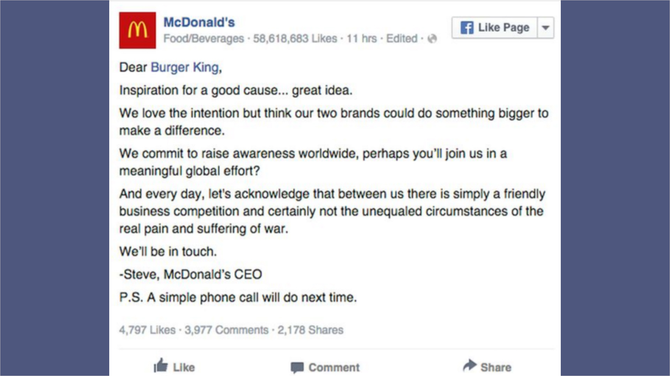
Notes:
Purpose of slide:
Illustrate the official response
Speaker notes:
McDonald’s answer: McDonald’s decided against taking up the invitation and replied in a terse Facebook message, signed by the corporation’s CEO Steve Easterbrook.
The message was edited twice in quick succession to correct a simple grammar mistake, revealing a panic situation within McDonald’s media room.
McDonald’s reply tries to deflate the hype stirred by Burger King by appearing to rise above the inter-company rivalry and point attention to more ‘substantial’ issues.
Mr Easterbrook was formerly Branding Executive for McDonald’s US.
The post attracted post 6,179 Comments (as at November 20, 2015): All but one of the top 50 comments criticize McDonald’s decision, the manner of reply, or both. It received over 9,000 Likes and was Shared more than 4,000 times. Normal engagement is considerably less.
Assessment of solution: The second round of exchange is opened, allowing the participants to make reactions and reflections.

Slide 8
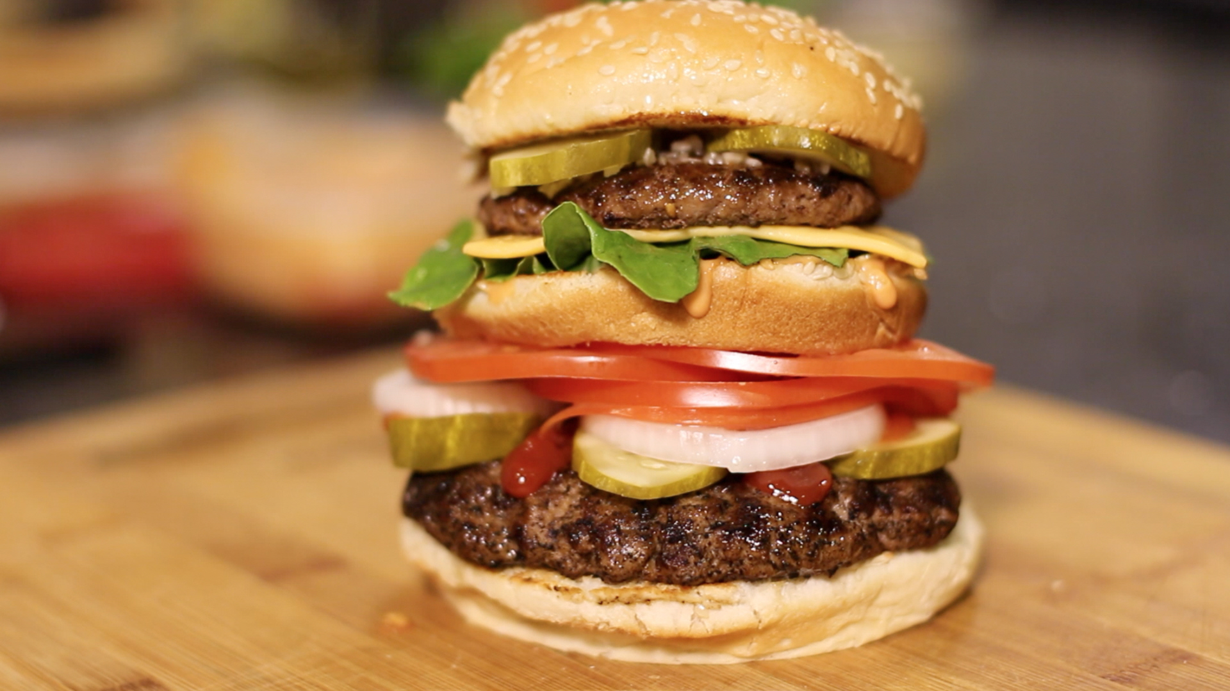
Notes:
Purpose of slide:
Final remarks
Speaker notes:
Comparison: Show how the discussion that developed within class hit or missed the solution reached by McDonald’s. Highlight especially points made concerning brand reputation management and cause-marketing.
Homemade McWhoppers: The picture shows how a McWhopper would have looked like: thousands of DIY McWhoppers had been made and shared online by enthusiasts following the proposal (Brod, 2015).
Peace Day Burger: After McDonald’s declined the offer, reply, four other brands partnered up with Burger King to create the Peace Day Burger: Burger King, Giraffas, Krystal, Wayback Burgers and Denny’s. (Brod, 2015) A limited number of sandwiches were available on Peace Day, with proceeds going to Peace One Day. The five participating brands pledged to give a separate donation to the beneficiary. (Wohl, 2015)

Slide 9
Notes:
Purpose of slide:
End Slide

