Slide 1
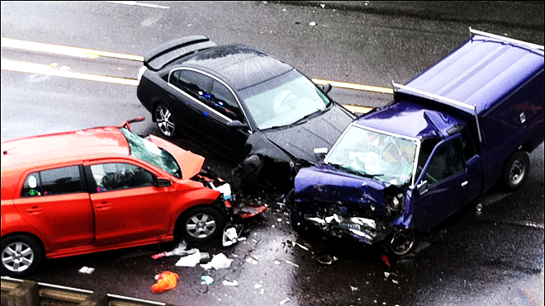
A switch between life and death
Crisis management case: General Motors
By
George Gergi, Niklas Sjölund, Nils Hjalmarsson, Susan-Suxiao Zhang
Notes:
Introduction
Welcome everyone to our case today
Present: A switch between life and death
By me, Nils, Susan, George
Crisis management case based General Motors in the US in 2014
Before i start, if anything is unclear, please interrupt me or ask questions so that everyone can follow easily

Slide 2

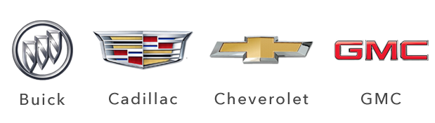
Background about GM
An American company that manufactures vehicles
Started in 1902 and today they have 11 brands all over the world
At one point GM was the largest company in the US
Industry crisis in 2008 hit GM hard
2013 revenue of 155 billion dollars
GM produces cars, trucks, special parts, accessories & services
The company guides itself by a set of five principles:
  Safety and quality
  Lifelong customers
  Innovation
  Long-term investment value
  Making a positive difference
Notes:
Background
So i am going to start with a bit about the background of GM/General Motors
General Motors Company (GM) is an American multinational company that manufactures vehicles
Headquartered in Detroit, Michigan, US. Its four major brands in America are: Buick, Cadillac, Chevrolet and GMC
founded in 1902 and in 1911, GM started entering foreign markets and exporting vehicles.
Over the years the company has proceeded to acquire dozens of brand
Now 11 brands from all corners of the world with these 4 in the us.
Most famous one in europe is opel
At one point in time, General Motors was the largest company in the United States and one of the largest employers in the world
Industry crisis in 2008-2010 hit GM quite hard. U.S. government funded and support to avoid the bankruptcy
They recovered and in 2013 they sold more 9.7 million vehicles and had a revenue of 155 billion dollars and a net profit of ca 4 billion dollars
Today, they have over 212 000 employees, almost 400 facilities, in 6 continents
Today GM produces and cars, trucks and offer special parts like accessories, maintenance and other services.
The company guides itself by a set of five principles:
safety and quality
lifelong customers
innovation
long-term investment value
making a positive difference.

Slide 3
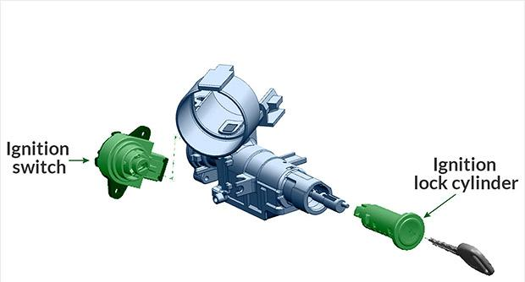
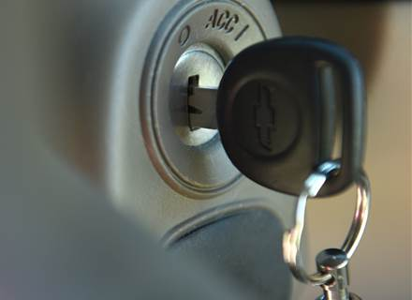
A problem rises
Early 2000’s GM’s market share was declining
In 2004, Chevrolet models experienced some random engine shut-offs
Test driver found a problem with the ignition switch
The problem was reported to management
The problem: the key could be bumped out of position into accessory mode
The engine will turn off, steering is harder and the airbags won’t deploy
Notes:
Problem
Starting in the early 2000s GM’s market share was declining lead to trimming the production and pressuring its suppliers to lower costs
In 2004, Chevrolet models that came from production lines and experienced random engine shut-offs
When looking into this problem, a testdriver found out that the problem was caused by GM’s change of its ignition switches
The engineers were aware of the issue and focused only on short term fixes since they did not fully understand the most important consequence of this problem
The testdrivers who noticed the problem with the ignition switch reported it to the management, but the issue was never brought up as something serious.
The problem that the ignition switch caused was that the key could be turned or bumped out of position while driving the car. Going into accessory mode
A very serious consequence of this is that if the car engine is turned off, steering is a lot harder and the airbags won’t deploy.
between 2004 to 2013, several car crashes was reported to GM, where the airbag hadn’t deployed. Leading to unfortunate deaths and severe injuries.
To show this further i’ll show a video of it.
https://www.youtube.com/watch?v=umqRhRdwLrI START AT 1:00 TO NOT SPOIL ANYTHING.

Slide 4

https://www.youtube.com/watch?v=umqRhRdwLrI

Slide 5
Timeline
2001: GM engineers re-design the ignition switch
2004: A test driver bumps the key, causing the engine to turn off
2005: GM receives some reports of engine shut downs
2006: The ignition switch producer, proposes a re-design which is approved
2007: GM begins installing the new, redesigned switches
GM is informed of a Chevrolet car crash where the airbags did not deploy
End of 2007, GM is aware of 10 similar fatal accidents
GM discovers that the engine was shut-off before the crash
Notes:
Timeline
To present the problem in a better way we’ll go through the timeline with the major events from 2001 up until 2014.
2001: GM engineers experience problems with ignition switches and redesign the switch.
2004: A GM test driver bumps the key when driving a Chevrolet, causing the car’s engine to shut off. He later reported the issue but it was never brought up by management.
2005: GM receives some more reports of cars losing power when the key is accidentally “bumped”. Engineers propose a redesign and the proposal is initially approved but then cancelled. GM’s management said the fix was too costly.
2006: the producer of the ignition switch proposes a re-design and this is approved by GM engineers and Management.
2007: GM begins installing the new, redesigned switch on 2007 model year cars.
During an unrelated meeting with auto safety regulators, GM employees are informed of a fatal Chevrolet 2005 model crash in which airbags did not deploy.
By the end of the year, GM is aware of 10 deadly Chevrolet 2005 model accidents in which airbags failed.
An engineer discovers that in some crashes the engine was shut-off at the time of impact → launching an investigation

Slide 6
Timeline
2009: The economic crisis hit GM hard and had to file for bankruptcy
2011: A new investigation is opened about airbags failures
2012: Engineers noticed crashed cars with the switch in accessory mode
2013: In the end of the year the CEO leaves GM
2014: Mary Barra is internally hired as CEO
There is a connection between the faulty ignition switches and car crashes
Reports so far conclude at least least 13 deaths and 31 vehicle crashes
Notes:
2009: The economic crisis in 2008 hit GM hard and GM had to file for bankruptcy. However got support from US government and survived. But it took a while to get back on it’s feet. The investigation was put on ice.
2011: A new investigation is opened regarding the crashes of GM cars where airbags did not deploy.
Ignition switches are removed from crashed cars to be tested.
2012: Engineers started to notice that all car crashes where the ignition switch was in "accessory" mode, only happened in cars produced in 2007 models and earlier. So before the re-design of the ignition switch.
2013: Some management changes happened in GM. In the end of the year, the CEO Daniel Akerson announces his retirement and left GM.

Slide 7
Questions to discuss
What’s the possible impact on GM’s reputation?
Notes:
Questions
Write down the three questions as headline on whiteboard. Then write down main points from class underneath.
Now, we are today in the beginning of 2014.
2014: In the beginning of the year, GM is hiring a new CEO internally. Mary Barra is appointed CEO and has been working in GM since she was 18 years old. GM can now also conclude that there is a connection between the faulty ignition switches and the car crashes that has occurred. Reports so far can conclude that faulty ignition switches were linked to at least 13 deaths and 31 vehicle accidents.
I am the new CEO of General Motors and I have invited all of you, managers of GM, for a crisis meeting
We know about the huge problem with the ignition switch and that people are dying because of it. So our plan today is to discuss this crisis before we go public with it and start taking actions
The first question i’d like to discuss today is.
I’d like you to reflect on it 2 by 2 first for about a minute before responding to me
1. What’s the possible impact on GM’s reputation?
How to limit the impact to GM’s other brands?
How to maintain the stakeholders trust?
How can GM reassure stakeholders that this problem will not happen again?
Comment
Reputation is hard to build but easy to break.
5 principles, safety and quality, lifelong customers

Slide 8
Questions to discuss
Who should take the blame?
Notes:
2. Who should take the blame?
What are the consequences for the one responsible?
Comment
People will want to have someone to blame
Especially families and friends of victims
current CEO, previous CEO, Management group, manufacturing, control test drivers?
10-year long issue where no one seemed to speak up or take appropriate action

Slide 9
Questions to discuss
What actions should the new CEO take?
Notes:
3. What actions should the new CEO take?
Follow up questions:
What’s the first step she should take?
What does the crisis tells us about the corporate culture?
Is there a need for a corporate culture change?
Differences between past and new corporate culture?
Comment:
In 2000 and intense cost-cutting measures, GM became a cost cutting culture.
culture that prized cost over quality
None wants to pass along bad news and take responsibiliy
“nod culture”

Slide 10
What actually happened
In February 2014 the recalls of cars started
800.000 cars produced between 2005-2007
A week later 600.000 more
CEO made a public statement of the matter in early March
Barra emphasized the importance of transparency
The CEO also released a four minute long video explaining the problems and actions
15 employees are fired and 5 disciplined
3 million more cars was recalled because of new found problems
Notes:
What happened
To round of the discussion i will go into what actually happened
Late February 2014 GM announced a recall of cars.
This initial recall affected a total of about 800 000 vehicles made between the years 2005 and 2007.
A week later 600 000 more vehicles
Cost to fix ignition was approximately $100 per vehicle.
In the beginning of March, two weeks after the first recall was initiated, Mary Barra made her first public statement on the matter.
Mary emphasized the importance of transparency and cooperation when investigating the issue.
She also emphasized that GM had changed as a company since the faulty switches were created and that such errors were in the past.
She also promised an internal investigation where GM recruited two external law firms.
One week later Mary Barra released a video with an update about the current situation, the investigation and actions
She also informs the employees about all actions that have been taken, and that will be taken within the foreseeable future
During the following two months 15 employees got fired and five are disciplined.
In the middle of May GM announced that they would recall another 3 million vehicles because of a wiring problem with brake lamps

Slide 11
What actually happened
A fifth big recall because of faulty seatbelts
First 6 months in 2014, 30 million cars was recalled
Total costs was over 4 billion USD
Fined for 35 million USD by National Traffic Safety
Payed 900 USD in damages
Set up compensation funds for families and victims
Notes:
The fifth big wave of recalls was due to a fault in the fastening of the seatbelts
During the first six months of 2014 GM had recalled close to 30 million vehicles
The total cost of the reparations relating to the recalls was over 4 billion dollars
GM had to pay a fine of $35 million for the delay of reporting the safety issue and issuing a recall.
Justice Department launched an investigation in March, trying to determine if the delay was a criminal act.
In the end GM settled for paying $900 million in damages
GM setting up a compensation fund for families and victims
Stock changes

Slide 12
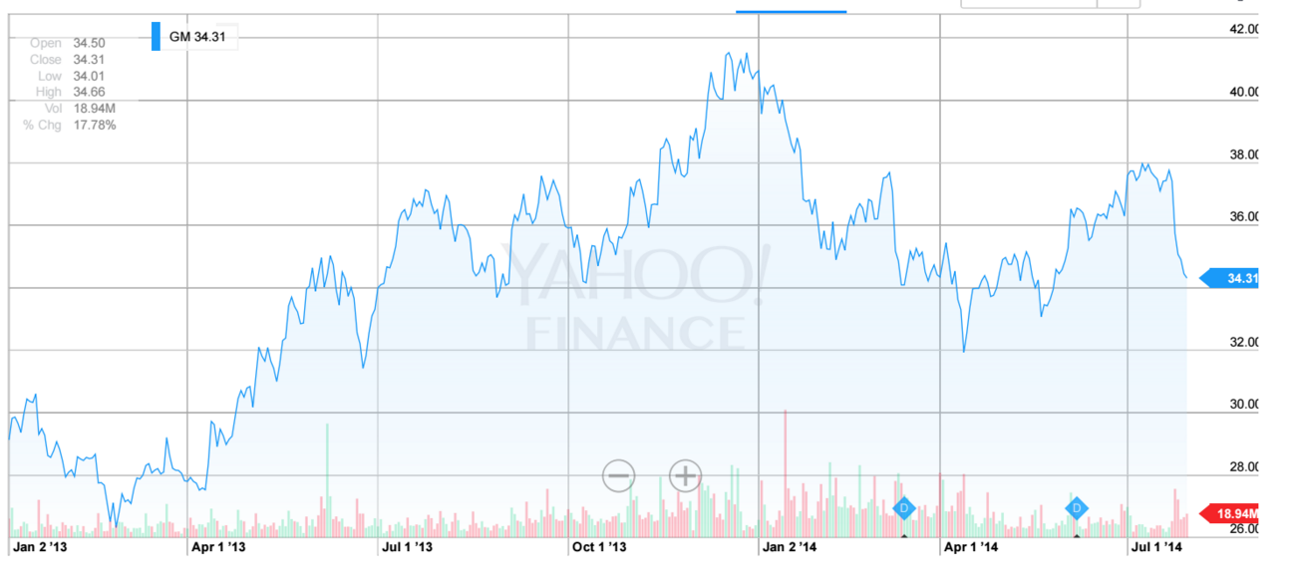
Changes in stock prices
January 2014

Slide 13
Final questions & ideas
After one problem was found, more issues came to the surface
What does that tell us about the corporate culture?
What could have been handled differently?
Notes:
And for a last discussion it’s interesting to look at the culture of GM
When 1 problem was found, more came to the surface. Brake lamp wiring and seatbelt
What does it tell us about the corporate culture?
What could have been handled differently?
Any other ideas?
Thank you for participating

