Slide 1
Reshaping the image of an industry
Intrum Justitia Case
BUSN35 Corporate Brand Management and Reputation
Gustav Silvegren, Hanna Sjöstrand & Michelle Volbeda

Slide 2
Intrum Justitia
Leading credit management services provider in Europe
Credit management services (CMS) with a focus on debt collection
“Hunts down” debtors in order to make sure that they pay what they owe
Everyone and every company that owes money are seen as a customer to the company
Notes:
2
Historically, Intrum Justitia has taken on the traditional role as a credit management services (CMS) company with a focus on debt collection. As most credit management services companies, Intrum Justitia hunts down debtors in order to make sure that they pay what they owe. Consequently, in the consumer mind the term credit management services and debt collection is not something one wants to be associated with and Intrum Justitia is left to be perceived as “the bad guy”.

Slide 3

Timeline
1923
Intrum Justitia was founded
1970's
Bo Göransson started to focus on organic growth and acquisitions. Further international expansions through organic growth and incremental acquisition followed.
2007
Strategic review process initiated
Notes:
Founded 1923
1970’s - Bo Göransson started to focus on organic growth and acquisitions. Further international expansions through organic growth and incremental acquisition followed.
In 2007 was the strategic review process

Slide 4

Intrum Justitia in 2006
Presence in 20 countries with a local approach
A variety of logo’s with different images depending on the market
Emphasis being put on each country individually
Notes:
A year at Intrum Justitia has a wide focus. Everyone and every company that owes money are seen as a customer to the company. However, leading up to 2006 the focus has also been local. That is to say, Intrum Justitia has a different logo and a different image depending on where in the 20 countries they are active and the debt is collected. Below are some of the examples of logos used for the local offices.

Slide 5
In 2006, Jean Luc Ferraton together with the rest of the Human Resources team at Intrum Justitia are scanning the company’s position…

Slide 6
What did they find?
Lack of unification among employees
Employees do not feel like being a part of Intrum Justitia
Employees lack motivation
No red line through the corporation with an undefined core and unclear values
Work separately in a wide variety of cultures as the local presence is very strong

Slide 7
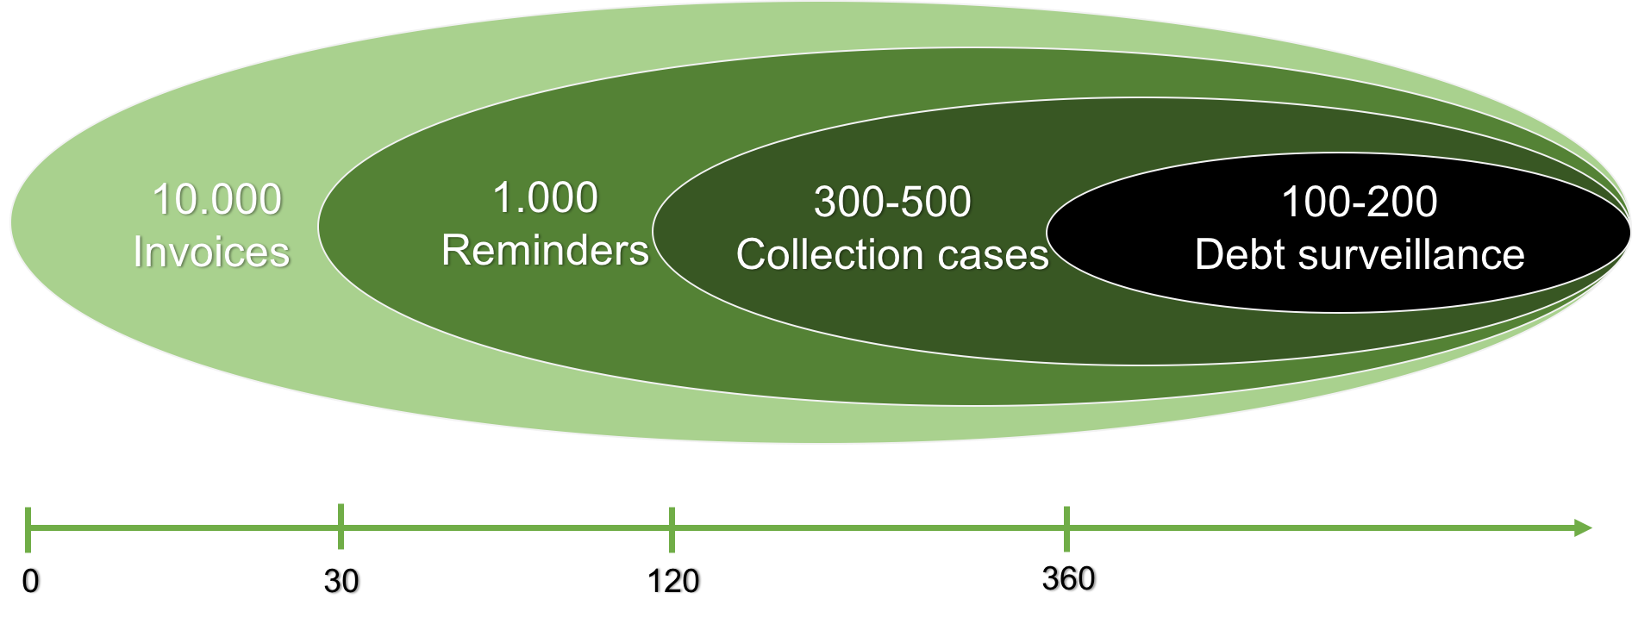
The business model today
Making money through contracting, collecting money for fees or buying debt cheaply and collecting the money to keep
Notes:
Debt collection agencies make money by contracting with creditors and collecting money for fees or by buying debt cheaply and collecting the money to keep. Old debt that is past the statute of limitations or is otherwise deemed uncollectable is bought for pennies on the dollar, making collectors big profits. (Investopedia)
Every year Intrum Justitia sends out 10,000 invoices to individuals and companies. From these invoices 1,000 reminders are sent out, which means that the original invoice has not yet been paid. Out of the 1,000 reminders, 300-500 result in actual cases and it can take up to 120-360 days before a debtor reaches this point. That is more than a case per day, highlighting that everyone who owes a debt is a customer to Intrum Justitia. The more cases the company receives the more effort and time has to be put into a wide variety of customers, leading to less of a personal connection between the company and the customer. Out of these 300-500 cases, 100-200 are taken in for debt surveillance and for these 100-200 Intrum Justitia cannot escape the image of “the bad guy”.

Slide 8
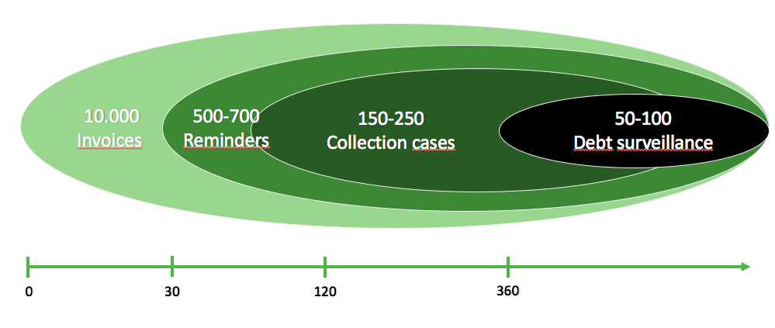
What we want to achieve
A more personal connection to the debtors and customers. A more focused customer base, not including everyone.
Notes:
Debt collection agencies make money by contracting with creditors and collecting money for fees or by buying debt cheaply and collecting the money to keep. Old debt that is past the statute of limitations or is otherwise deemed uncollectable is bought for pennies on the dollar, making collectors big profits. (Investopedia)
Every year Intrum Justitia sends out 10,000 invoices to individuals and companies. From these invoices 1,000 reminders are sent out, which means that the original invoice has not yet been paid. Out of the 1,000 reminders, 300-500 result in actual cases and it can take up to 120-360 days before a debtor reaches this point. That is more than a case per day, highlighting that everyone who owes a debt is a customer to Intrum Justitia. The more cases the company receives the more effort and time has to be put into a wide variety of customers, leading to less of a personal connection between the company and the customer. Out of these 300-500 cases, 100-200 are taken in for debt surveillance and for these 100-200 Intrum Justitia cannot escape the image of “the bad guy”.

Slide 9
“We need to change”
Where do we want to be?

Slide 10
Ambitions
Change of image
From | To
Traditional debt-collector | Business (sales) facilitator/service provider
Warnings – threats | Advice, help & assist
“Bad guy” image | “Good guy” image
Bad reputation | Positive reputation → helping hand

Slide 11
Ambitions
Employee branding
From | To
Terminology: “Debtor” | Terminology: ”Client”, ”Client’s customer” or Customer
Seeing the job as work only | Sense of belonging and inspiring work environment
Get the cash | In-depth understanding of Client & Clients’ Customer

Slide 12
Ambitions
Change of focus and services
From | To
No focus | Industry focus
Local actor | A contributor to healthy credit and payment behavior in society
Executor | Problem Solver & proactive prevention
Reduce credit loss | … and increase revenue
Product focus | Client & Customer focus / partnerships
Serve all clients | Serve defined segments

Slide 13
Time for a change
The Human Resources team needs help to get rid of the bad image of the company and the industry
How should we do this?
Notes:
Jean Luc and his colleagues are looking at the information that has just been presented. They have come to the conclusion that any brand that is perceived as “the bad guy” does not have an optimal customer relationship.
Since most of the team comes from human resources, many believe that the company should start internally, while others believe that in order for changes to be made, the whole company needs to be analyzed first. The team to look into what needs to be changed in order to step away from “the bad guy” image of Intrum Justitia.

Slide 14
Questions to you as HR-team
What challenges are Intrum Justitia currently facing with its brand and the industry that it is operating in?
What are the alternatives for Intrum Justitia?
What should Intrum Justitia do in order to reach the new brand image? (actions)
Notes:
Let’s begin by talking about the CMS industry. What are the main areas and characteristics of this industry?
Negatively loaded business?
The less affiliation you have to this industry, the better?
Unavoidable bad-guy reputation?
As an external observer, what do you consider to be the key issues in Intrum Justitia’s current situation?
External issues
“Trad. Debt collector”
Bad guy
Warnings and threats
Hunting customers
Executor – we do something that our clients do not want to be affiliated with.
Our business is something that in the best of cases does not exist.
Internal issues
People do not want to work with this business
A negatively charged industry
Brand issues
No coherent graphical charter
How can Intrum Justitia, as a market leader, deal with these issues?

Slide 15
What did actually happen?

Slide 16
Gathering of crucial insights
Big Brand Insight Survey internally and externally
  (a) how they thought about Intrum Justitia’s role in the society
  (b) how they thought about Intrum Justitia’s culture and values
  (c) how they thought about ambitions for the future; what would they like to see from Intrum Justitia’s within the next five years
  (d) what they could do to make this change happen, and
  (e) how they thought about turning the people of Intrum Justitia into problem-solving?
Insights were processed by cross-functional and cross-border teams on different levels
Core values are derived from what people found significant for Intrum Justitia
Notes:
The statements were turned into values that will most benefit Intrum Justitia, our clients and their clients. ‘Fair’, ‘fair pay’, ‘partner’, ‘ethical’, ‘respect’, ‘customer care’ and ‘debtor care’ are for example values which people stated, which is distilled into the value: “understanding people”. Different business scenarios were discussed in line with the brand promise to ensure that brand and business were fully supporting each other. The brand promise was defined by the purpose, vision and the core values (see table 1).

Slide 17
Defining the brand promise
Defined by the purpose, vision and the core values:
Purpose | To be a catalyst for a sound economy
Vision | To fully transform our company into a true people focused company providing high value added credit management and financial services
Core values | Understanding people Committing to challenge Seeking insight to feed innovation Making a difference

Slide 18
One brand, one identity
In order to become a true CMS market leader, Intrum Justitia decided there is a need to focus on the brand promise route, this included:
  a one-brand strategy
  a common look and feel
  understanding it internally
  verbal expression
  understanding it externally
  full service offering delivery
  training to walk the talk
  clear differentiation,
  loyal clients
  celebrate!

Slide 19
Vision
To fully transform our company into a true people-focused company providing high value-added credit management and financial services
Understanding People
Achieve results
Broader range of credit management and financial solutions by the end of 2015

Slide 20

We are a catalyst for a sound economy
“We are here to facilitate business and help create sound economies by making trade smooth, safe and fair.”
Notes:
Making trade simple, safe and fair, they make it easier for money to change hands, and the risk that the buyer will not pay smaller
To help ensure that payments flow as they should in society – to engender a sound business climate
The sound relates to helping both sides of the deal and promoting long-term value-creating relationships between parties
Not only to collect debt, but to provide other financial solutions that stimulate trade and facilitate business

Slide 21
The core values
Understanding people
  employees should use their heart and by understanding people find ways to create value for all
Seeking insight to feed innovation
  the company should collect and make use of their knowledge and turn that into new innovations
Committing to challenge
  represents dedication and guts when facing tough situations and still remain calm, friendly & proactive
Making a difference
  reflects the responsibility for the clients, owners and society.

Slide 22
The brand as the motor of change
Reputation is built through how you act and appear every day
  So, every activity is supposed to load the brand positively and all with the same values in all markets and across the entire group
Notes:
Their vision is to fully transform the company into a true people-focused company providing high value added credit management and financial services. Intrum Justita believed that people are part of the key issues and the solution to advance the state of the company and the industry.

Slide 23
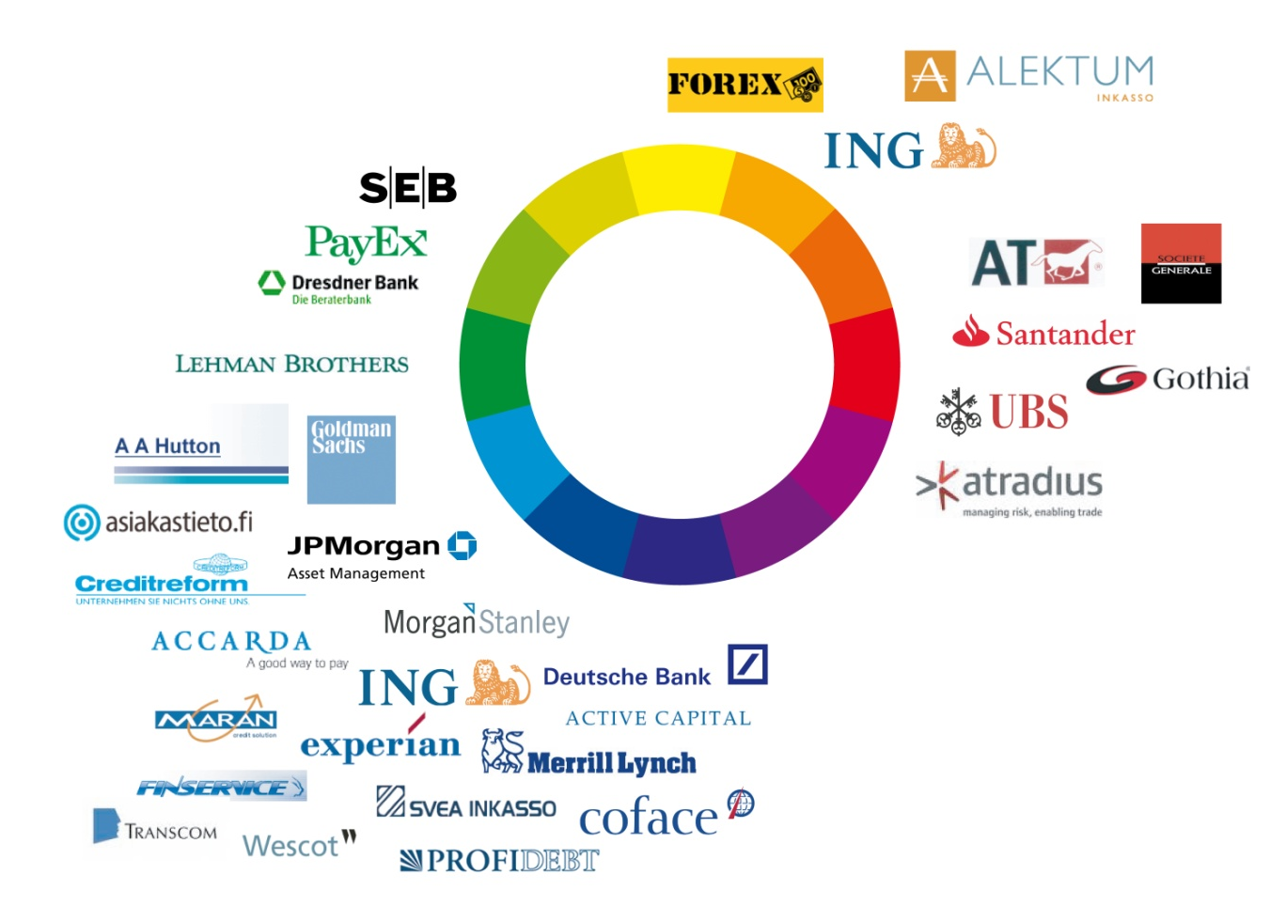
Logo’s and colors – how to differentiate?
Notes:
The one brand strategy included their next step which was differentiation through color. As you can see in the image below (see figure 5), many financial firms are dedicated to the color blue. As this color is associated with the old ‘bad image’ of Intrum Justitia and the industry, they decided to differentiate from the others and go for the color ‘green’ and used the brand as a motor of change.

Slide 24
New Corporate brand
(1) to guide and engage the internal forces (and thereby increase performance)
(2) to express the corporate brand externally in order to attract key stakeholders and increase sales

Slide 25
Actions
One common brand in all countries and all the markets
Define and explain core values internally
  Everyone had to sign for the core values
  Everything we do and say affects our brand, that is why it is important that our brand is integrated with daily business
Organized workshops
  Find out what it meant for the people to have community challenge
Leadership program
  All top managers gathered in Stockholm and were educated about academic knowledge about brand management and the transfer to leadership
Notes:
The new corporate brand had two major jobs: (1) to guide and engage the internal forces (and thereby increase performance) and (2) to express the corporate brand externally in order to attract key stakeholders and increase sales. The brand promise was implemented in all offices and a new visual identity was created to express the new Intrum Justitia. All companies got a brand promise kit for communication of all countries including games, posters, etc. Now everyone had the same business cards, wherever they are. Also all companies got a brand manual with local explanation about the outcome of the Brand Insight Survey and the explanation of the defined core values. The head office had everything prepared, so all countries were aligned at the same time with the same messages and material. Every employee had to sign for the core values as everybody was aimed to live up to the core values. Everything Intrum Justitia does or says affects the brand, therefore Intrum Justitia ensured that their brand was integrated with all daily business (e.g. how to answer the phone, deal with a client or a client’s client, etc.).
Next to this, did Intrum Justitia organize workshops to find out what it meant for the people who work for Intrum Justitia to have a community challenge. Additionally, a leadership program was set up in order to gather all managers and educate them about academic knowledge of brand management and the transfer to leadership. During this program Intrum Justitia constantly repeated how important it is to build one unified group with a meaningful corporate culture based on the core values. These sessions made the view of the own business internally change. Leaders and employees believed in the company and saw Intrum Justitia change into a ‘good company’. Accordingly, new colleagues had to do a fine-tuned survey to see if they fit and understand the corporate brand.

Slide 26
The strategic journey
Traditional debt collection
Solve problems
Static
Executive
Product focus
Reduce loan losses
Get paid
Regional focus
Defensive about our role
Help businesses / service provider
Facilitate business
Change driven
Problem solver / proactive
Client and customer focus / partnership
…and increase revenue
Deeper understanding of clients & their clients
Industry focus
Proud of our role
Notes:
26
The strategic journey from blue to green was defined as the following (see figure 6). This transformation required employees to understand and deliver according the new strategy and promise and that clients understand, experience and demand the new possibilities.

Slide 27
“The Intrum Way”
Intrum Justitia should focus on becoming the largest credit management company in Europe, offering risk reduction and financial services built on debt collection foundation.

Slide 28
“Boosting Europe” & “A Better Business For All”
Communicate that Intrum Justitia is now operating as one brand, one unified company
The company will contribute to improve the future of Europe
Intrum Justitia has the ability to create jobs and improve the economy
Credit management is a key factor in boosting Europe’s economy and solving the unemployment
Notes:
Externally, Intrum Justitia launched a new campaign in 2008 with the slogans “Boosting Europe” and “a Better Business for All”. This campaign included the communication package that Intrum Justitia from now on is operating as one brand, one unified company. During this campaign they promoted that the company will contribute to improve the future of Europe. They focused on their ability to create jobs and to improve the economy. Credit management is a key factor in boosting Europe’s economy and solving the unemployment.

Slide 29
From 2015 a new communication concept
Mission | Catalyst for a sound economy
Position | The Pan-European market leader
Core Values | Understanding people, making a difference, committing to challenge, seeking insight to feed innovation
Target Groups | Large companies, SME’s, clients customers, Employees, Society
Brand Personality | Responsive, Accessible, Advisors, Experts, Responsible, Friendly, Credible
Brand Promise | Better business for all
Communication Concept
Notes:
However, from 2015 Europe got a different meaning. Intrum Justitia defined their mission, position, core values, target groups, brand personality and brand promise (see table 2) and decided to use these as a new communication concept. They turned ‘Boosting Europe’ into ‘Boosting You’ and ‘Boosting Your Business’. This campaign focused on the fact that people should do things which they are good at. A few slogans of this campaign are: ‘We think a barista should spend his days making coffee’, ‘Tomas wants to talk to his client about fast internet connections, not slow payments’ and ‘You might think Luc is in the credit management business, but actually, he is in the job creation business’. This campaign showed that if people do what they are good at, and Intrum Justitia does what they are good at, it is a better solution for everyone.

Slide 30
New campaign: “Boosting You” & “Boosting Your Business”
People should do things which they are good at, and leave credit management to us
A few examples of slogans:
  ‘We think a barista should spend his days making coffee’
  ‘Tomas wants to talk to his client about fast internet connections, not slow payments’
  ‘You might think Luc is in the credit management business, but actually, he is in the job creation business’
Notes:
However, from 2015 Europe got a different meaning. Intrum Justitia defined their mission, position, core values, target groups, brand personality and brand promise (see table 2) and decided to use these as a new communication concept. They turned ‘Boosting Europe’ into ‘Boosting You’ and ‘Boosting Your Business’. This campaign focused on the fact that people should do things which they are good at. A few slogans of this campaign are: ‘We think a barista should spend his days making coffee’, ‘Tomas wants to talk to his client about fast internet connections, not slow payments’ and ‘You might think Luc is in the credit management business, but actually, he is in the job creation business’. This campaign showed that if people do what they are good at, and Intrum Justitia does what they are good at, it is a better solution for everyone.

Slide 31
Intrum Justitia Today
A European market leader in an attractive growth market with a proven integrated business model serving the full credit management value chain. They are delivering consistent, strong financial returns and have a broad base of clients, sources and countries
The New Intrum Way: “Our strategy towards realizing our vision.. based on a solid platform consisting of our core values, operating principles, and our integrated business model.”

Slide 32
The Intrum Justitia “Golden Circle”
Why (Culture)
How (Structure)
What (Action)
External market
Local
business plan
Intrum Way
Brand Promise
Leadership principles
Code of conduct

