Slide 1

A Tissue Issue
When Good is not Green Enough
Notes:
The opening slide

Slide 2

“A leading global health and hygiene company”
Founded 1872 in Neenah, Wisconsin
Started with production news- and wrapping paper
1900 First paper towel in America
Cellucotton in 1918
  → Kleenex
Notes:
Introduction of Kimberly-Clark:
Who they are and what they do
Introducing their history and heritage

Slide 3
In 2003
  60 000 employees
  Operations in 38 countries, products sold in 150 countries
  No 1 or 2 brand position in over 50% of the markets
Kimberly-Clark produces 4.08 million tons of tissue products annually and generates net sales of $14.3 billion US
“Sustainable use of natural resources”-policy in 1991
2003 introduced a certification system for third party suppliers
Notes:
Slide to explain KC’s current position in the market and their stand on the CSR-issues

Slide 4
A non-governmental environmental organization
Goal: To ensure the ability of the Earth to nurture life in all its diversity and to focus its campaigning on worldwide issues
It has also been a source of controversy; its motives and methods have received criticism
Notes:
Slide to introduce Greenpeace:
Their history and backgroung
To explain how they have worked with their previous campaigns

Slide 5
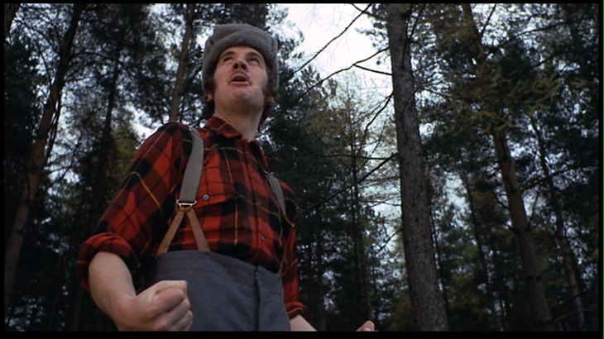
Kimberly-Clark vs. Greenpeace
In 2004 the Boreal forests of British Columbia bring the tales of these two companies together...
Notes:
The opening slide to introduce the issue at hand: what was the initial starting point to the feud between KC and Greenpeace

Slide 6
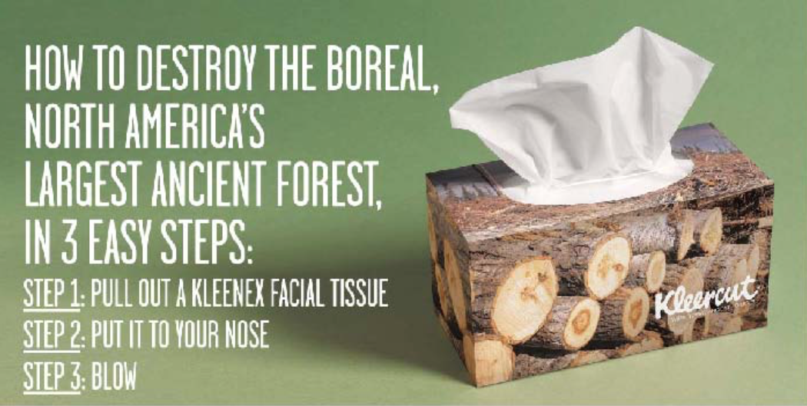
Kleercut
November 18th, 2004 Greenpeace launches a campaign: Kleercut
Greenpeace attacked “Kimberly-Clark supports the clear cutting of such forests in Canada and the United States’
Notes:
Slide to introduce the Kleercut-campaing by Greenpeace
Helps to explain an visualize the way Greenpeace attacked KC

Slide 7
Kimberly-Clark Answers
Our corporate policy prohibits the use of wood fiber from virgin rainforests or from designated ecologically significant old growth areas, including mixed hardwood forestlands in Indonesia; temperate rainforests in coastal British Columbia, Canada; and designated areas in Canada’s Boreal Forest. – Kimberly-Clark’s Sustainability Report
Greenpeace publishes “Chain of Lies” in 2006
  Kimberly-Clark admit they have given wrong information but refuse to make Boreal Forest their number one concern
Notes:
Slide to demonstrate KC’s stand on the accusations.
Here can be explained KC’s communication strategies throughout the feud.

Slide 8
Kimberly-Clark vs. Greenpeace
Notes:
Slide to visualize the attacks carried on by Greenpeace against KC.

Slide 9
Situation in 2009
The argument had been going on for over 4 years
Forest Friendly 500 – big clients threatened to stop selling Kimberly-Clark products
Kimberly-Clark number one in Dow Jones Sustainability World Index fifth year in a row
98% percent of the virgin pulp purchased came from certified suppliers
Sales keep increasing
Notes:
The starting point to the class discussions: what has happened so far?

Slide 10
Case Question
If you were Kimberly-Clark management, what would you do to cope with such the situation?
Notes:
The slide presenting the question to the class. Following questions from the teaching notes can be used when leading the discussion:
What should Kimberly-Clark management do?
Should they still try to defend their own position?
Should they try to stop the attack from Greenpeace?
Why do they prolong this matter for five years to settle it?

Slide 11
Kimberly-Clark vs. Greenpeace: The Result
Kimberly-Clark would source 40% of its paper fiber from recycled content or other sustainable sources
Greenpeace stopped the long-running campaign
Kimberly-Clark and Greenpeace declared an historic agreement that ensures the greater protection and the sustainable management of Canada’s Boreal Forest and other ancient forests around the world
Notes:
The slide where the managerial decisions are presented. Here the presenter walks through what happened in 2009 when the case was settled.

Slide 12
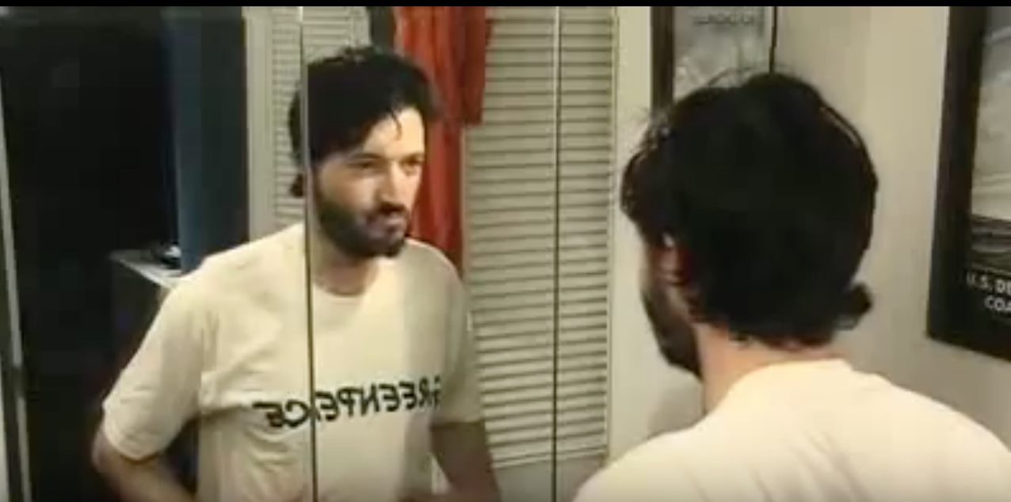
Kimberly-Clark vs. Greenpeace: The Result
Notes:
The case can be closed with this video KC and Greenpeace published when the peace was made to demonstrate the final solution. Courtesy to YouTube: https://youtu.be/ckUdDEs1vro

Slide 13
Thank you!

