Slide 1

The (not-so-honest)
Honest Company
Jonatan Solve, Joanna Stawicka, Piotr Tamborowski

Slide 2
Company Overview
Crisis Situation
Class Discussion
The Response
Final Comments
Key Takeaways
1
2
3
Agenda
4
5
6

Slide 3
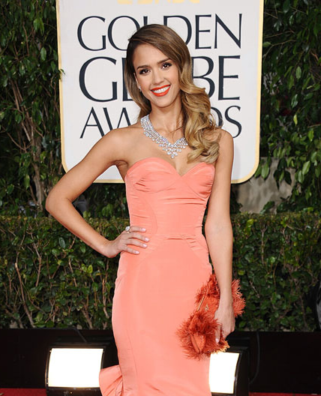
Actress
Began career at age 12 with Camp Nowhere
Breakthrough in 2000 with Dark Angel
A-list status with movies like Sin City, Honey & Fantastic Four
Remains active
Overview
1
2
3
4
5
6

Slide 4
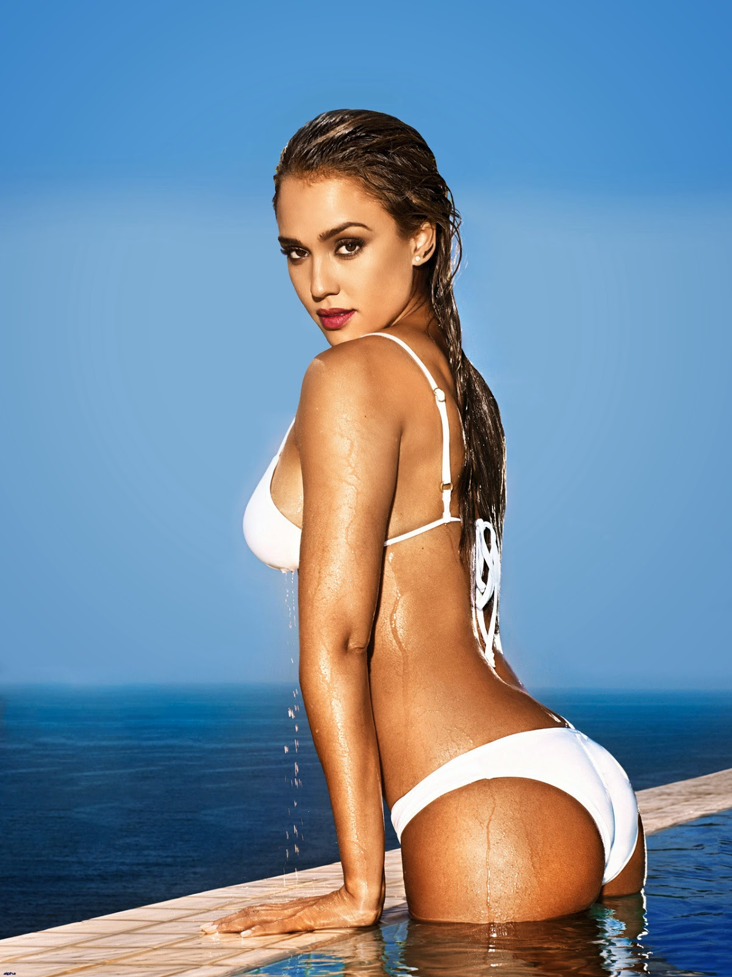
Sex symbol
Overview
Number 1 in Maxim’s Hot 100 list in 2001
Award for sexiest performance in Sin City 2004
Sex symbol in 18-25 male segment
1
2
3
4
5
6

Slide 5
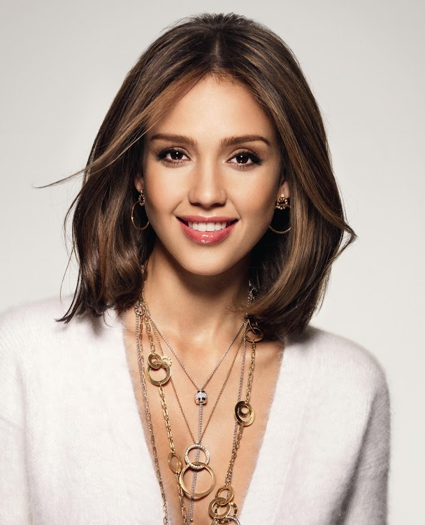
Beauty symbol
Overview
The face of L’Oreal and Revlon in 2001 and forward
Popular in the 15-35 female beauty segment
1
2
3
4
5
6

Slide 6
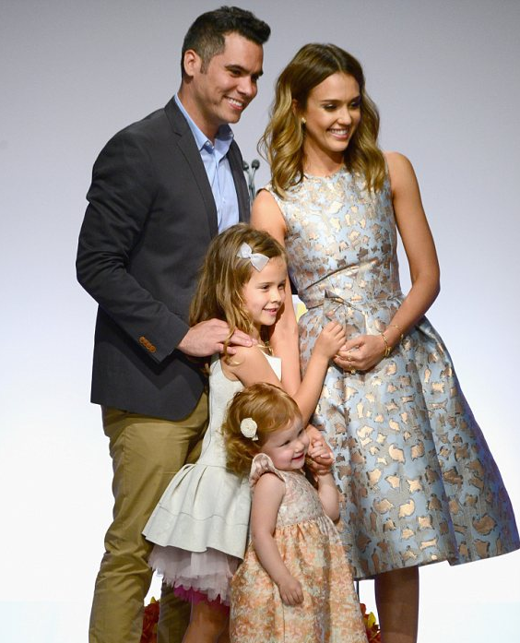
Loving wife & caring mother
Overview
Married since 2008
Mother of two girls
Having been a sick child motivates her to keep her children healthy
Prioritizes time with family
1
2
3
4
5
6

Slide 7
Raison d’être
“We both wanted an ideal: not only effective, but unquestionably safe, eco-friendly, beautiful, convenient, and affordable – everyone should have it. We believed every baby deserved the best we can create for them. We are dreamers.”
Jessica Alba & Christopher Gavigan
the co-founders
Overview
1
2
3
4
5
6
Notes:
Set of uncovered market needs when it comes to the truly ecological and chemicals-free cosmetics for babies
Alba sensitive kid herself
Alba discovered the untapped market potential herself as she got an allergy from one of the popular washing powder brands when pre-washing the onesies gifted for her first child during the baby shower

Slide 8
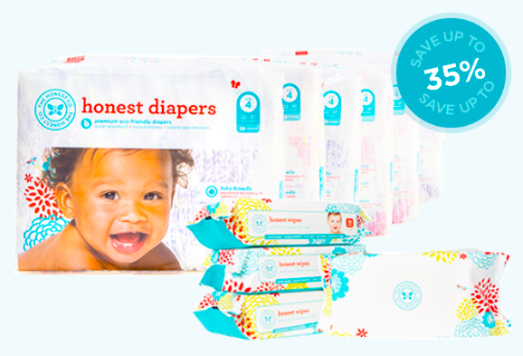
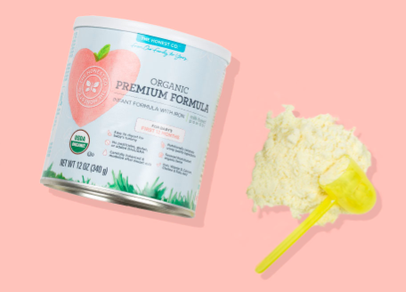
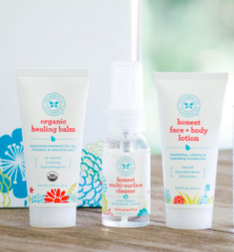
Products
Hazardous substance free & sustainable
Baby care: diapers, personal care, cleaning, vitamins, food, gears,
and accessories
Can be purchased on the honest.com & in the traditional retailers,
pharmacists, online stores
Expanded the existing offering to more than 80 products
Prices: The Honest diapers cost $13.95 vs mass brand $8.97 for a 44 pieces box
Innovative solution:
$79.95 “diapers and wipes bundle” = 6 jumbo packs diapers + 4 packages of wipes delivered directly to the parent’s door during 6 month period
Overview
1
2
3
4
5
6
Notes:
The principle behind all of the products is to provide toxic free cosmetics that are in line with the assumptions of sustainability concerning all the dimensions of business activity (The Honest Company, 2015). It includes eco-conscious product development, re-usable packaging, protection of the environment and natural resources, toxics reduction, energy efficiency, mitigating the carbon footprint, supporting solidarity and peace, human rights protection as well as seeking suppliers who act in a similar manner

Slide 9

Notes:
Set of uncovered market needs when it comes to the truly ecological and chemicals-free cosmetics for babies
Alba sensitive kid herself
Alba discovered the untapped market potential herself as she got an allergy from one of the popular washing powder brands when pre-washing the onesies gifted for her first child during the baby shower

Slide 10
Performance & Goals
Online sales account for significant part of income
(mainly USD 79.95 monthly set of wipes & diapers)
IPO one of the future goals
Preparing to conquer the Chinese market
To be more reachable for families as well as expanding the sales activities to the traditional stores
Long-term aim: become “the number-one trusted global family lifestyle brand for the new generation of consumers”
Overview
1
2
3
4
5
6

Slide 11
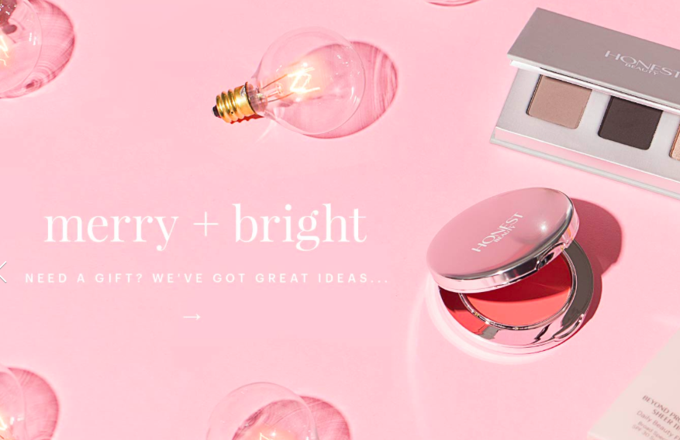
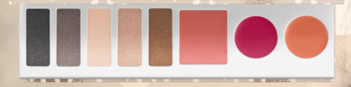
the Future
Expand portfolio by launching a new cosmetic line
called Honest Beauty
Honest Beauty will offer women luxurious, but affordable, makeup and skincare products consisting of natural ingredients
In order to build an Honest Beauty team, Alba raised $100 million & collaborated with 50 different specialists
Overview
1
2
3
4
5
6

Slide 12
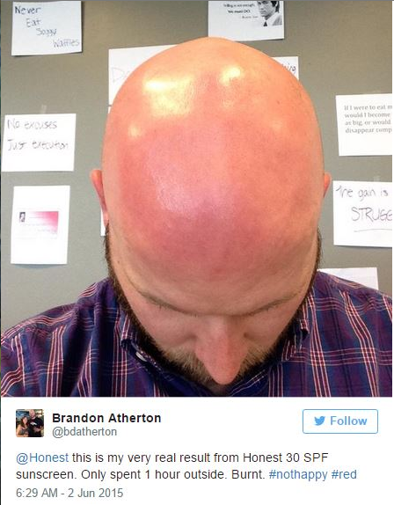
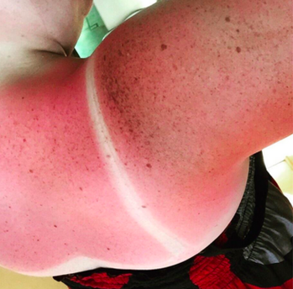
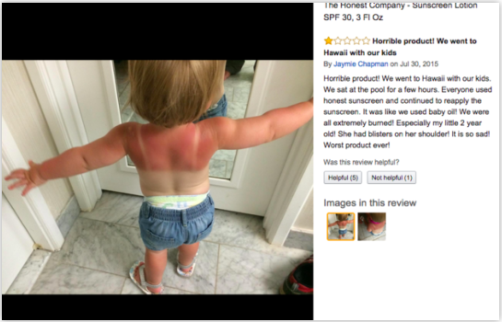
Crisis
1
2
3
4
5
6

Slide 13
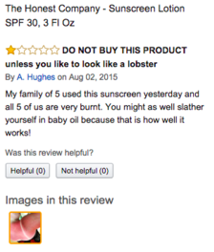
Crisis
1
2
3
4
5
6

Slide 14
Save money. Buy buy oil.
Worst sunscreen ever
Burnt to a crisp
I got 2nd degree burns
WARNING! Do not use!
Does not work AT ALL
Causes horrible burns
HORRIBLE… doesn’t work
Bright red burns all over!
Crisis
1
2
3
4
5
6

Slide 15
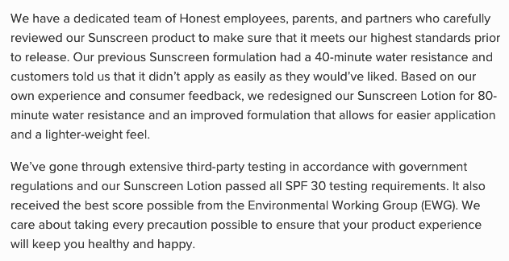
Sep. 3rd - 1st lawsuit → household goods contain synthetic compounds, products’ labels are deceptive, false advertising
Sep. 7th - 2nd lawsuit → inefficient sunscreen causing excessive sunburns due to a cream formula modification - decreased amount of zinc oxide from 20% to 9.3%
Crisis
1
2
3
4
5
6

Slide 16
Should the Honest Company launch the Honest Beauty?
???
!!!
Discussion
...
Role of Jessica Alba in the Honest Company?
1
2
3
4
5
6

Slide 17
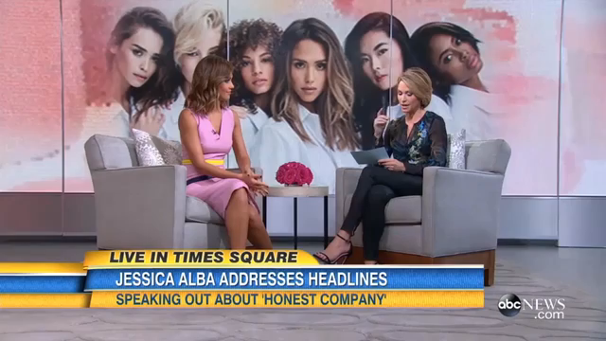
Notes:
Target clerk declared that the sunscreen was discontinued at their store following the incident, there was barely any product available at Nordstrom, and it was also “out of stock” on the company’s web page. Even though it seems that the company decided to pull the sunscreen out of the shelves, the Honest Company claimed that the product “remains available at many retailers, on its website for Honest monthly subscribers with existing sunscreen orders, and has not been discontinued

Slide 18
The organization has remained silent
“Simple Denial”
Did not admit any product failure =
sunscreen was approved and tested
Launching a new platform to educate customers on different products and their application
Sunscreen still remains on the shelves
Launched the Honest Beauty as planned
Honest Beauty introduced under a different logo & own, separate web page
Jessica Alba continues to promote the Honest products
Response
1
2
3
4
5
6
Notes:
Target clerk declared that the sunscreen was discontinued at their store following the incident, there was barely any product available at Nordstrom, and it was also “out of stock” on the company’s web page. Even though it seems that the company decided to pull the sunscreen out of the shelves, the Honest Company claimed that the product “remains available at many retailers, on its website for Honest monthly subscribers with existing sunscreen orders, and has not been discontinued

Slide 19
company’s response evaluation?
brand image?
Discussion
reputation?
crisis origin & impact?
1
2
3
4
5
6

Slide 20
Inseparability of the brand from the celebrity in case of
celebrity founded company
Products need to be extensively tested
Crisis spreads faster in case of brands native to social media
Crisis situation may severely affect launch investments
Takeaways
1
2
3
4
5
6

