Slide 1

Deepwater Horizon
Reputational Crisis 2.0
Greenpeace’s Online Spoof Competition against BP
”
”
Johanna Hagberg Sofie Molin Pinja Vyörykkä
Notes:
Purpose of slide:
First impression of the case
Speaker notes:
Present the speakers as well as the topic of the case

Slide 2
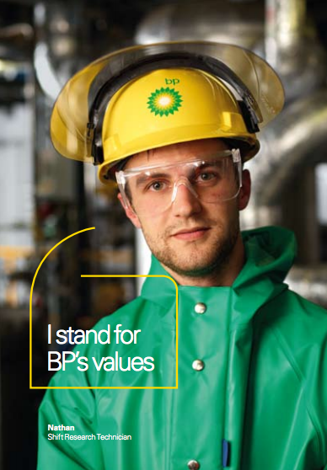
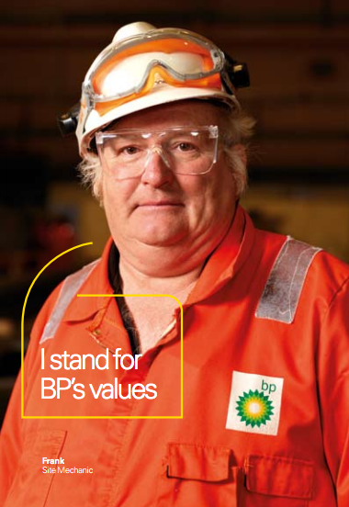
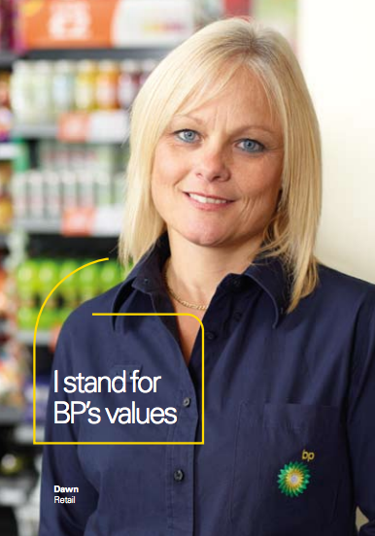
Have we lost control of the brand to the general public?
Executive Meeting, BP Headquarters, London, 2010
Notes:
Purpose of slide:
Intrigue the audience by briefly introducing the current situation BP is facing
Speaker notes:
Express the need for help from the audience and assign them the role of being BP’s management team

Slide 3
AGENDA
01
02
03
04
05
Background
Rebranding
Deepwater Horizon Oil Spill
Spoof Crisis
Managerial Questions
Notes:
Purpose of slide:
Inform the audience about the structure of the presentation and discussion
Speaker notes:
•Emphasize the importance of the point “Case Discussion”, as this shall be the main part of this case

Slide 4



BRIEF HISTORY
British Heritage Brand
A supermajor
Rebranding
British geologists discover a large amount of oil in Iran in 1908.
Considered one of the world’s seven oil and gas “supermajors”
World’s sixth-largest oil and gas corporation
Went through rebranding process during 2000
- alternated several aspects of the brand
Notes:
Purpose of slide:
Give the audience a brief overview of BPs history
Speaker notes:
BP has roots tracing back to 1908 when a group of British geologists discovered a large amount of oil in Iran
In the industry, BP is considered one of the world’s seven oil and gas “supermajors” whose performance made it the world’s sixth-largest oil and gas corporation, the sixth-largest energy corporation by market capitalization and the corporation with the world’s fifth-largest revenues
BP went through a rebranding process during 2000 when the corporation alternated several aspects of the brand

Slide 5

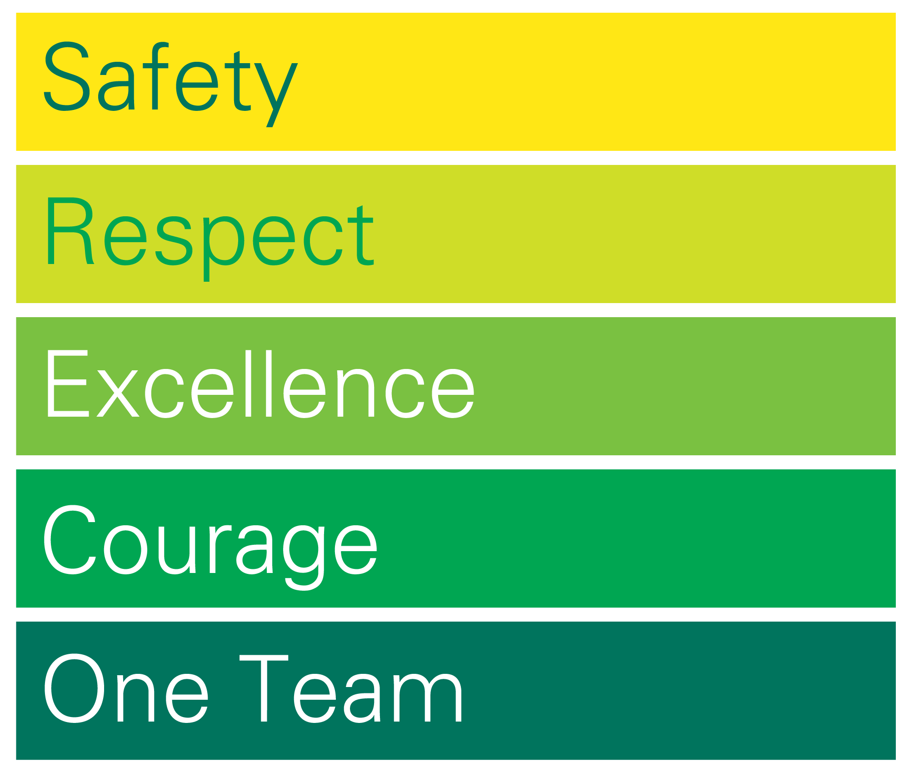

REBRANDING
Notes:
Purpose of slide:
Introduce the audience to BP’s rebranding campaign and explain the new core values this followed
Speaker notes:
The corporation replaced its “Green Shield” logotype with the “Helios” symbol, a green and yellow sunflower named after the Greek sun god
BP also introduced a new corporate slogan “Beyond Petroleum”. The new slogan was aimed to represent their focus on meeting the growing demand for fossil fuels, manufacturing and delivering more advanced products as well as enabling a transition to a lower carbon footprint. Overall the slogan became a symbol for the new strategy of the organization
A new set of core values was also presented: safety, respect, excellence, courage and one team
The cost of the ‘Helios logo design’ and its rollout cost BP in total 211 million dollars and became one of the most expensive logo designs and rebranding campaigns of all times
These efforts positioned the corporation as environmentally friendly and caught the attention of the general public

Slide 6
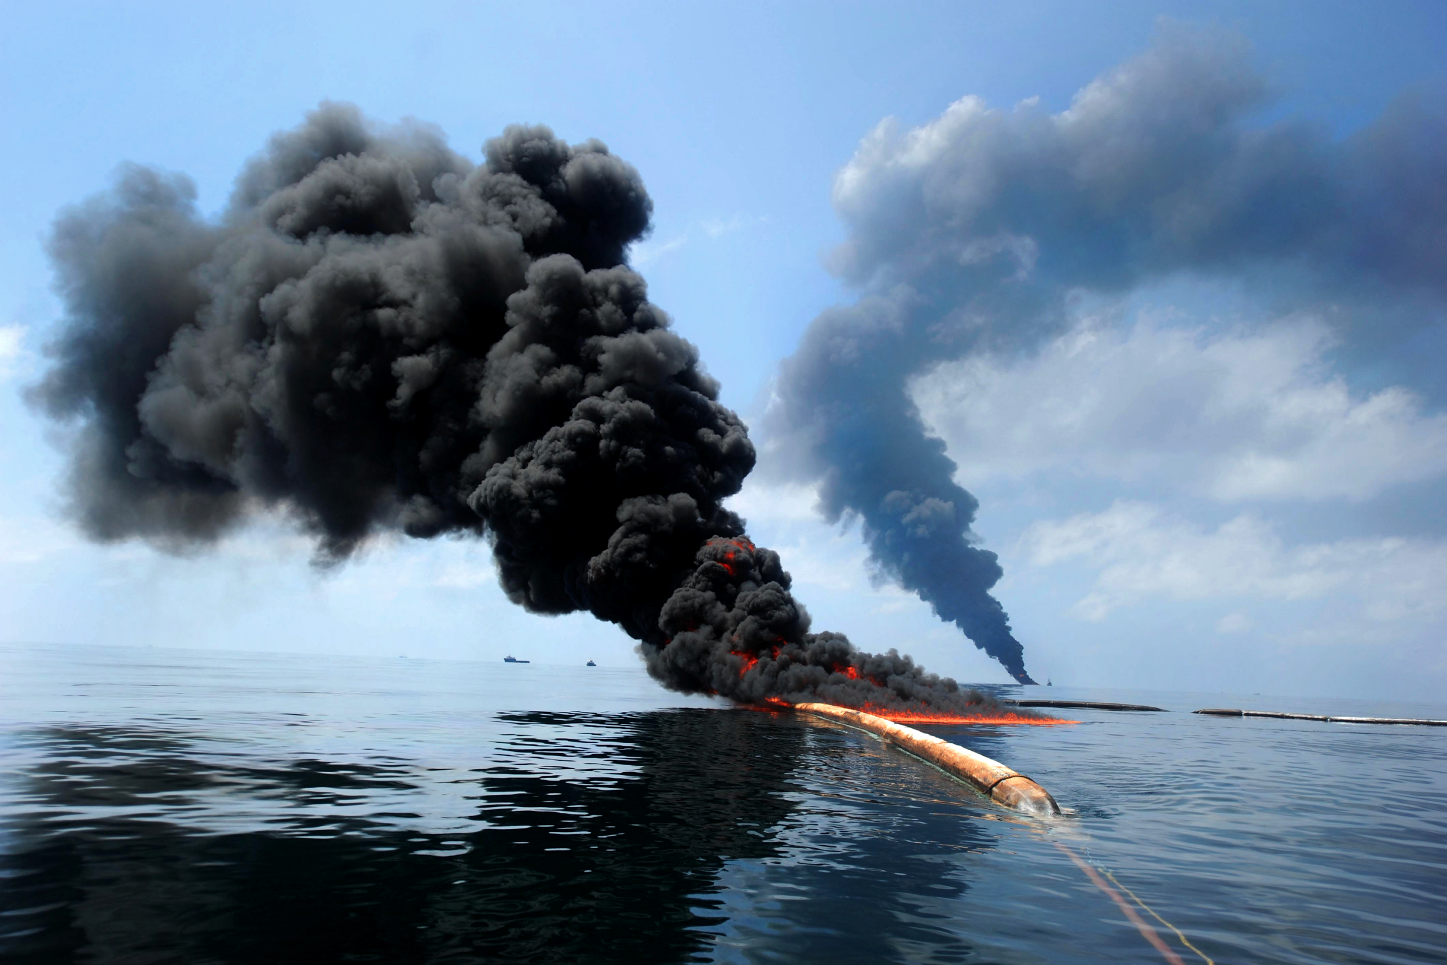
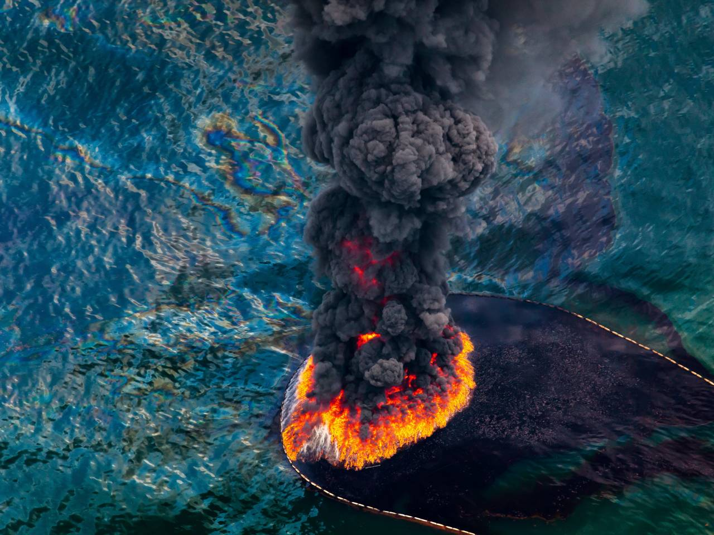
Notes:
Purpose of slide:
Give the audience and overview of the Deep Horizon Oil spill crisis
Speaker notes:
Only need to show the seconds: 0.04-0.45
Show YouTube - https://www.youtube.com/watch?v=ghLNgpEBfm0&t=4s

Slide 7
DEEPWATER HORIZON OIL SPILL
Several human errors made on the rig prior accident
Onsite managers – overlooked warning signs
Errors in communication processes among staff
Technical flaws on the rig
Largest accidental marine oil spill in the history
Releasing 4.9 million barrels of oil
Biggest environmental disaster that the US have ever faced
Killed 11 workers
Notes:
Purpose of slide:
Provide the audience with an overview of the seriousness of the situation as well as the damage the oil spill created
Speaker notes:
Releasing 4.9 million barrels of oil into the nature the Deepwater Horizon Oil Spill created the biggest environmental disaster that the United States have ever faced
The accident killed 11 workers
Several failed efforts were made in order to contain the oil flow before the well was sealed jeopardising the entire ecosystem in the Gulf of Mexico
BP’s onsite managers were accused of having overlooked early warning signs indicating of problems on the rig
This in combination with errors in the communication processes among staff as well as technical flaws caused the oil spill to happen

Slide 8
HANDLING OF DEEPWATER HORIZON OIL SPILL
01
Took responsibility for the accident
Mounted big scale cleaning operations to minimize the damage
Willing to compensate for the local residents whose business were affected
02
03
Notes:
Purpose of slide:
Briefly display the audience with how BP handled the crisis
Speaker notes:
BP quickly took responsibility for the accident by mounting big scale cleaning operations as well as were willing to compensate for the local residents whose economies were affected by the oil spill

Slide 9


SITUATION TODAY
Looking back,
Deepwater Horizon Oil Spill has been
handled according any to
best-practice in crisis communication.
But we are standing here today for another reason…
Notes:
Purpose of slide:
Shift the attention away from the oil spill crisis and introduce a new dimension of the crisis
Speaker notes:
Empathize how BP handled the oil spill crisis according to best-practice in crisis communication but are now facing a new challenge

Slide 10
”
Their nice green logo doesn’t really seem to fit them too well, so we decided to run a competition to find a logo that we could use to rebrand BP
Greenpeace, 2010
”
Notes:
Purpose of slide:
Introduce the audience to the Greenpeace logo competition which was launched after the oil spill
Speaker notes:
Greenpeace UK has just launched an international logotype competition inviting people to rebrand the logotype of BP
Read the quote

Slide 11
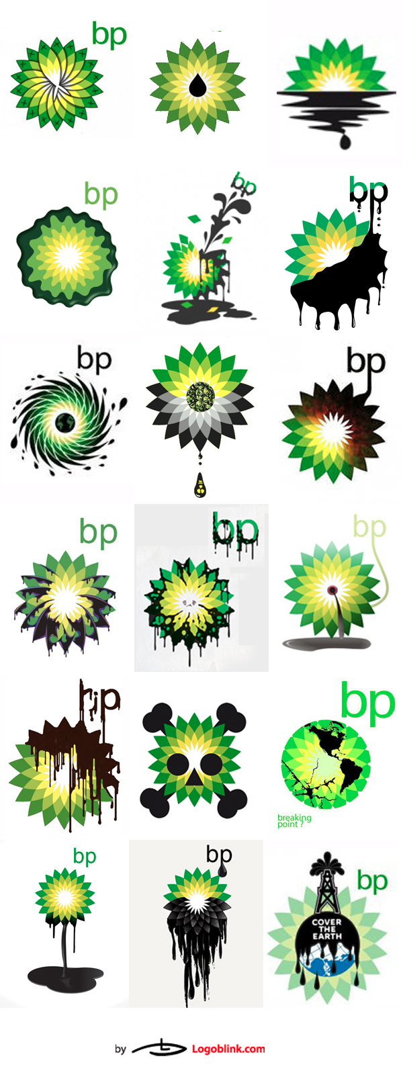
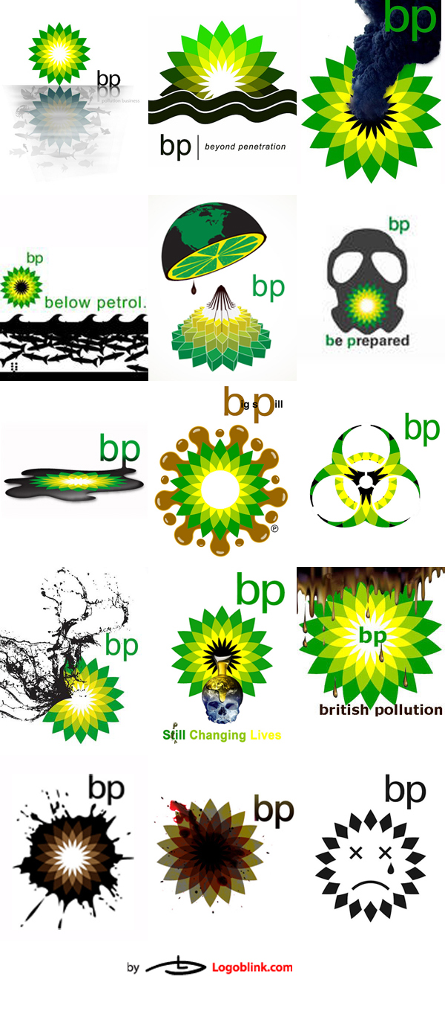
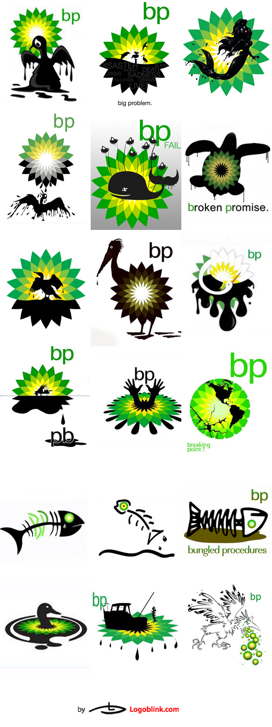
SPOOFS
Greenpeace UK has just announced a competition – encouraging the general public to produce their own versions of BP’s ”Helios” logotype.
So far the competition has resulted in 2000 entries and around 25 000 votes.
Notes:
Purpose of slide:
Elaborate on the Greenpeace logo competition and explain to the audience what spoofs are as well as provide a visual overview of the spoofs in the competition
Speaker notes:
Greenpeace is a well-known non-governmental environmental organisation, whose goal is to ensure the ability of the Earth’s nature life in all its diversity
The competition has encouraged people to design a new logotype for BP consequently creating a wave of spoofs being spread online
Spoofs are defined as illustrations imitating something (i.e. a brand) by altering or exaggerating its characteristics
So far the competition has resulted in over 2000 entries and 25 000 votes on who should be the winner

Slide 12
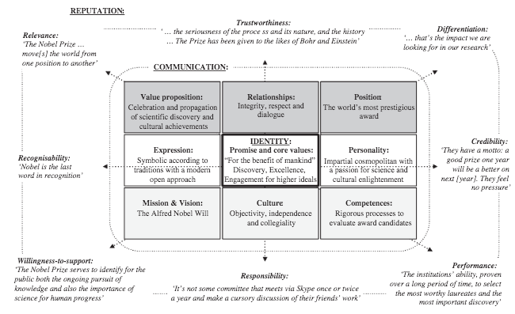
MANAGERIAL QUESTION 1(2):
How should BP evaluate the seriousness of the spoof /competition situation?
Notes:
Purpose of slide:
Provide the audience with the first managerial question where they are encouraged to discuss the main issues of the spoof crisis by using the Corporate Brand & Reputation Matrix (Urde, 2016)
Speaker notes:
Draw up the Board Plan with Issues, Alternatives & Actions but empathize on the Issues dimension here

Slide 13
MANAGERIAL QUESTION 2(2):
How should BP address and handle the spoofs?
BP
Notes:
Purpose of slide:
Provide the audience with the second managerial question where they are encouraged to discuss alternatives and actions as the BP management team
Speaker notes:
Keep using the Board Plan but empathize on the Alternatives & Actions dimension here

Slide 14


WHAT HAPPENED?
ACTIONS
Towards General Public
Slow in reacting at first
Tried to control the news about the oil spill
Bought keywords on Google & Yahoo
Tried to steer people to read information published by BP
Deleted spoofs on Google
Advocacy strategy
Towards
Refused to publicly comment on the competition
Silent strategy
Notes:
Purpose of slide:
Provide the audience with insights into the decisions taken concerning the different stakeholders involved
Speaker notes:
Toward the public:
It wasn’t until a considerable amount of time before the online criticism was approached
BP tried to take control of the news published under ’oil spill’ by paying both Google and Yahoo to moderate the flow of criticism they were receiving online by buying keywords on the search engines
When searching for ‘oil spill’ people would now be brought to BP’s website and a link with the tagline “Learn more about how BP is helping” to gain information in how BP was resolving the oil spill
This action pushed both the Greenpeace logotype competition as well as the spoofs further down in the search engine thus shifting the attention elsewhere. Consequently, when searching for the term ‘oil spill’ on Google, the spoofs from the competition seemed to have vanished from the web
This represents an advocacy strategy, aiming to change public opinion through helping stakeholders to perceive the issue from the organisations point of view
Toward Greenpeace
BP refused to publicly comment on the competition. They agreed if BP, being one of the largest corporations in the oil industry world, would have taken legal action toward Greenpeace, being a leading independent organization campaigning for peace and a green future, they were sure to lose the PR battle and would only create harm toward the brand
Therefore BP remained silent, which represent a silent strategy

Slide 15
Towards General Public
Slow in reacting at first
Try to control the news about the oil spill
By keywords on Google & Yahoo
Steer people to read information published by BP
Delete spoofs on Google
Advocacy strategy
Towards
Refused to publicly comment on the competition
Silent strategy
REFLECTIONS ON THE APPROACH?
Notes:
Purpose of slide:
Give space for the audience to reflect and evaluate on the approaches that were taken by BP
Speaker notes:
Ask the audience to elaborate on their thoughts concerning corporations removing or adjusting critical online content
Use, if appropriate, examples from other cases to demonstrate the wide application of the case. For example:
→ Toyota used a similar online strategy after their faulty brakes disclosure. When users searched “Toyota breaks” car dealerships popped up as well as other news results, diminishing the actual crisis
→ Donald Trump accused Google for manipulating search algorithms biased in favoring the democratic presidential nominee Hillary Clinton
→ The rise of companies such as internetreputation.com who specialize in removing negative images and blog posts from internet

Slide 16
”
Thank you!
”
Notes:
Purpose of the slide:
Give space for any additional questions that might come up and conclude the presentation
Speaker notes:
•Remember to go back to previous slides should the audience have questions about certain topics

