Slide 1

DOOMSDAY: EXPLOSION OF THE GALAXY
CORPORATE BRAND MANAGEMENT & REPUTATION MASTER’S CASE SERIES 2017
Presented by:
HOSSAIN – NAZIA – PAMELA
Notes:
Introduce the case topic

Slide 2
Group Background
1938
267m
Origin in 1938 as a trading company in South Korea
267 million smartphones sold in 2015 (Euromonitor, 2016)
78
Conglomerate of more than 78 different companies and affiliates
Notes:
Provide a background to Samsung and its operations worldwide

Slide 3


Group Background
Main motto "Inspire the World, Create the Future"
Focus on various sectors: Electronics, semiconductors, plant construction, medicine.
Notes:
Provide a background to Samsung and its operationsworldwide

Slide 4




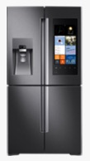










Brand Portfolio
Major Business Units: Samsung mobile and electronics
TV & Audio
Home appliances
Flagship smartphones: Samsung Galaxy S and Galaxy note
Computing
Smart home
Mobile
Notes:
Provide a background to Samsung and its operations worldwide

Slide 5
THE CRISIS
Notes:
Dramatically introduce the crisis

Slide 6
Samsung launched the Galaxy Note7
2016
Aug 19
Notes:
Explain the timeline of the crisis
Draw irony that the Note7 might be water resistant but not fire resistant!

Slide 7
Samsung launched the Galaxy Note7
Aug 24
2016
Aug 19
Reports of Galaxy Note7 exploding starts emerging
Notes:
Explain the timeline of the crisis

Slide 8
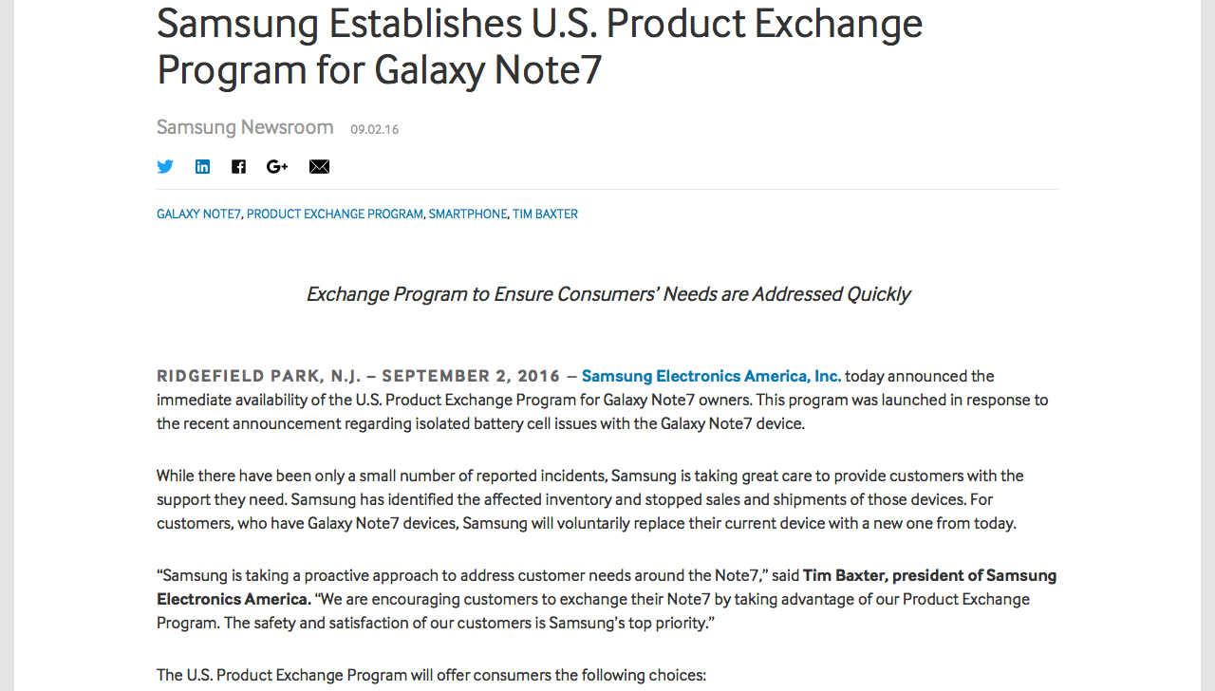
Samsung announces voluntary Product Exchange Program
Samsung launched the Galaxy Note7
Aug 24
2016
Aug 19
Sep 02
Reports of Galaxy Note7 exploding starts emerging
Notes:
Explain the timeline of the crisis

Slide 9
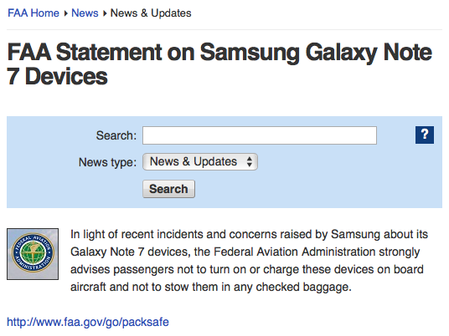
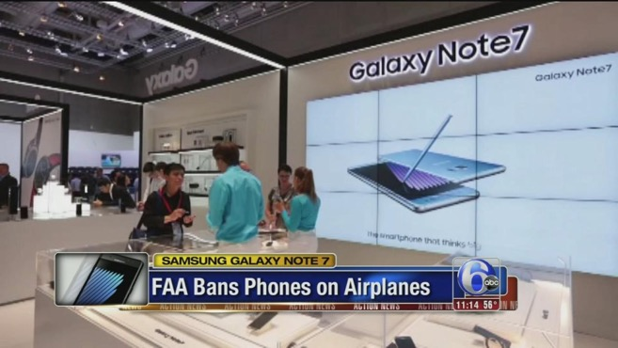
Samsung announces voluntary Product Exchange Program
Samsung launched the Galaxy Note7
Aug 24
Sep 08
2016
Aug 19
Sep 02
Reports of Galaxy Note7 exploding starts emerging
U.S. FAA & airlines globally prohibits passengers to turn on/charge Note7
Notes:
Explain the timeline of the crisis

Slide 10
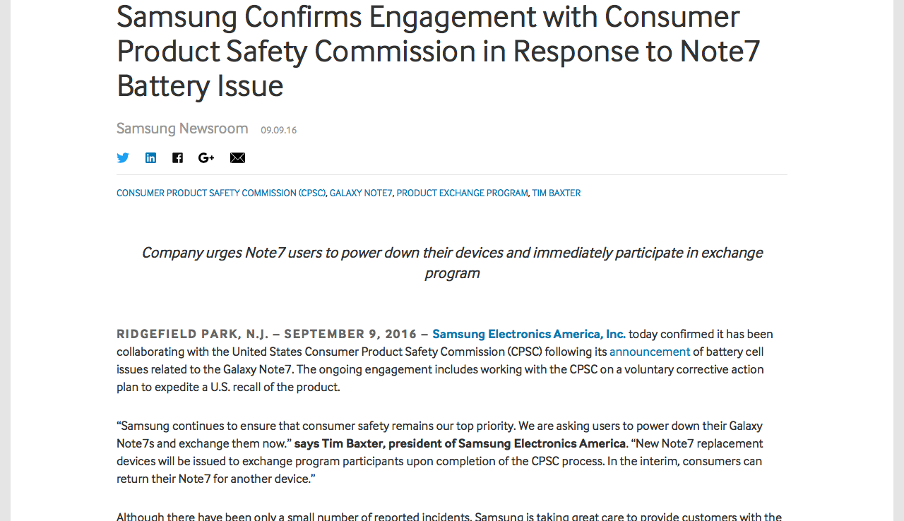
Samsung confirms ‘voluntary corrective actions’ working with U.S. CPSC, who urges users to stop using Note7
Samsung announces voluntary Product Exchange Program
Samsung launched the Galaxy Note7
Aug 24
Sep 08
2016
Aug 19
Sep 02
Sep 09
Reports of Galaxy Note7 exploding starts emerging
U.S. FAA & airlines globally prohibits passengers to turn on/charge Note7
Notes:
Explain the timeline of the crisis

Slide 11
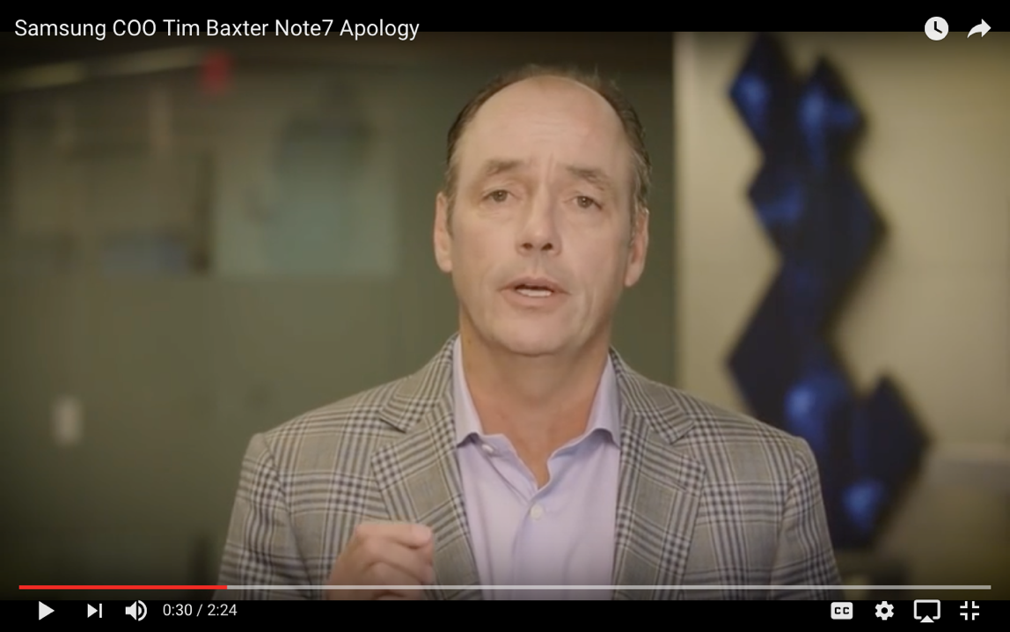
Click to Watch the Video:
https://www.youtube.com/watch?v=k8P3_2kMums
Samsung confirms ‘voluntary corrective actions’ working with U.S. CPSC, who urges users to stop using Note7
Samsung announces voluntary Product Exchange Program
Samsung launched the Galaxy Note7
Aug 24
Sep 08
Sep 15
2016
Aug 19
Sep 02
Sep 09
U.S. FAA & airlines globally prohibits passengers to turn on/charge Note7
CPSC announces recall of 1 million devices. President of Samsung Electronics Tim Baxter addresses the crisis.
Reports of Galaxy Note7 exploding starts emerging
Notes:
Explain the timeline of the crisis
Show the video of the COO and President of Samsung Electronics America, Tim Baxter

Slide 12
Samsung confirms ‘voluntary corrective actions’ working with U.S. CPSC, who urges users to stop using Note7
Samsung announces safe 500,000 replacement Note7 ready to roll. Rolls new software updates.
Samsung announces voluntary Product Exchange Program
Samsung launched the Galaxy Note7
Aug 24
Sep 08
Sep 15
2016
Aug 19
Sep 02
Sep 09
Sep 20
U.S. FAA & airlines globally prohibits passengers to turn on/charge Note7
CPSC announces recall of 1 million devices. President of Samsung Electronics Tim Baxter addresses the crisis.
Reports of Galaxy Note7 exploding starts emerging
Notes:
Explain the timeline of the crisis
Show the software update rollouts pushed to the new and old Note7 devices

Slide 13
Samsung confirms ‘voluntary corrective actions’ working with U.S. CPSC, who urges users to stop using Note7
Samsung announces safe 500,000 replacement Note7 ready to roll. Rolls new software updates.
Samsung announces voluntary Product Exchange Program
Samsung launched the Galaxy Note7
Aug 24
Sep 08
Sep 15
Sep 29
2016
Aug 19
Sep 02
Sep 09
Sep 20
U.S. FAA & airlines globally prohibits passengers to turn on/charge Note7
CPSC announces recall of 1 million devices. President of Samsung Electronics Tim Baxter addresses the crisis.
Samsung declares more than 1 million people using ‘safe battery’
Reports of Galaxy Note7 exploding starts emerging
Notes:
Explain the timeline of the crisis

Slide 14
Samsung confirms ‘voluntary corrective actions’ working with U.S. CPSC, who urges users to stop using Note7
Samsung announces safe 500,000 replacement Note7 ready to roll. Rolls new software updates.
Reports of replacement Note7 exhibiting similar problems. Aircraft evacuated with smoke emitting.
Samsung announces voluntary Product Exchange Program
Samsung launched the Galaxy Note7
Aug 24
Sep 08
Sep 15
Sep 29
2016
Aug 19
Sep 02
Sep 09
Sep 20
Oct 06
U.S. FAA & airlines globally prohibits passengers to turn on/charge Note7
CPSC announces recall of 1 million devices. President of Samsung Electronics Tim Baxter addresses the crisis.
Samsung declares more than 1 million people using ‘safe battery’
Reports of Galaxy Note7 exploding starts emerging
Notes:
Explain the timeline of the crisis

Slide 15
Samsung confirms ‘voluntary corrective actions’ working with U.S. CPSC, who urges users to stop using Note7
Samsung announces safe 500,000 replacement Note7 ready to roll. Rolls new software updates.
Reports of replacement Note7 exhibiting similar problems. Aircraft evacuated with smoke emitting.
Samsung announces voluntary Product Exchange Program
Samsung launched the Galaxy Note7
Aug 24
Sep 08
Sep 15
Sep 29
Oct 09
2016
Aug 19
Sep 02
Sep 09
Sep 20
Oct 06
U.S. FAA & airlines globally prohibits passengers to turn on/charge Note7
CPSC announces recall of 1 million devices. President of Samsung Electronics Tim Baxter addresses the crisis.
Samsung declares more than 1 million people using ‘safe battery’
Key stakeholders alienating Samsung - AT&T & T-Mobile halts sales and replacements
Reports of Galaxy Note7 exploding starts emerging
Notes:
Explain the timeline of the crisis

Slide 16
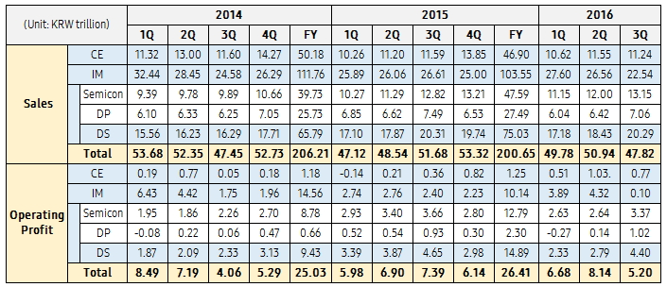
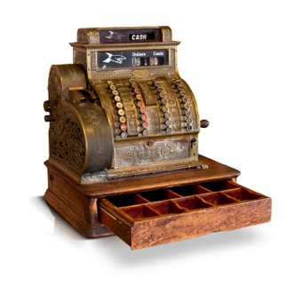
Consolidated Sales & Operating Profit by Segment based on K-IFRS (2014~2016.3Q)
*Note 1: Sales for each business include intersegment sales
**Note 2: CE (Consumer Electronics), IM (IT & Mobile Communications), DS (Device Solutions), DP (Display Panel)
***Note 3: Information on annual earnings is stated according to the business divisions as of 2016.
Financials
Notes:
Don’t go into details, just highlight that the crisis impacted the financial performance of Q3, 2016.

Slide 17
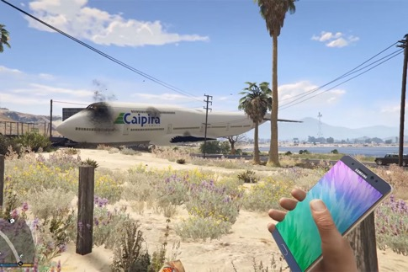

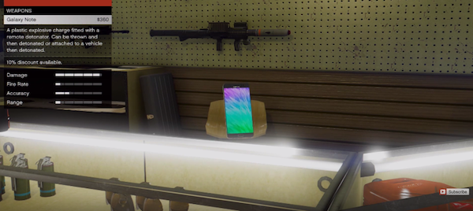
Clips from Grand Theft Auto V emerged on YouTube showing the Galaxy Note7 being used literally as a weapon that explodes
Notes:
Explain the incident which is funny and serious at the same time

Slide 18

YOU ARE THE GUARDIANS OF THE GALAXY!
A cross-functional taskforce handpicked by the CEO

Slide 19
Corporate Brand Identity Matrix (CBIM) applied to
VALUE PROPOSITION
Quality, Design and Price
RELATIONSHIP
Respect, Transparency, Trust, Value
POSITION
Committed to being a creative leader in new markets and becoming a truly No. 1 business going forward. Becoming one of the world’s top five brands by 2020.
EXPRESSION
Logo, Color, Physical manifestation
BRAND CORE
Promise: Devote our HR & technology to create superior products services, thereby contributing to a better global society ?
Values: People, Excellence, Change, Integrity, Prosperity
PERSONALITY
Innovative, Honest, Daring, Sincere and Kind
MISSION & VISION
To inspire the world with innovative technologies, products &designs that enrich People’s lives & contribute to a socially responsible, sustainable future.
Inspire the World, Create the Future
CULTURE
Law & ethical standard compliance; clean organization culture; respect stakeholders; care for environment; health & safety; socially responsible corporate citizen
COMPETENCES
New Technology, Innovative Products, Creative Solutions
Source: Original matrix adapted from Urde (2013)
Notes:
Introduce and explain the CBIM applied to Samsung

Slide 20
Relevance:
How appealing and meaningful is the value they offer?
Trustworthiness:
How dependable are their words and deeds?
Differentiation:
How distinctive is their position in the market?
VALUE PROPOSITION
Quality, Design and Price
RELATIONSHIP
Respect, Transparency, Trust, Value
POSITION
Committed to being a creative leader in new markets and becoming a truly No. 1 business going forward. Becoming one of the world’s top five brands by 2020.
Which reputation elements were hit hard?
Corporate Brand Identity & Reputation Matrix (CBIRM)
BRAND CORE
Promise: Devote our HR & technology to create superior products services, thereby contributing to a better global society ?
Values: People, Excellence, Change, Integrity, Prosperity
Recognisability:
How distinct, visible and consistent are their overall communications?
EXPRESSION
Logo, Color, Physical manifestation
PERSONALITY
Innovative, Honest, Daring, Sincere and Kind
Credibility:
How believable and convincing are they?
MISSION & VISION
To inspire the world with innovative technologies, products &designs that enrich People’s lives & contribute to a socially responsible, sustainable future.
Inspire the World, Create the Future
CULTURE
Law & ethical standard compliance; clean organization culture; respect stakeholders; care for environment; health & safety; socially responsible corporate citizen
COMPETENCES
New Technology, Innovative Products, Creative Solutions
Source: Original matrix adapted from Urde & Greyser (2016)
Willingness-to-support:
How engaging and inspiring are their purposes and practices?
Responsibility:
How committed and accountable are they?
Performance:
How solid and consistent are their quality and performance?
Notes:
Explain the CBIRM
Ask the audience how each element of Samsung’s CBIRM is impacted by the crisis

Slide 21
MANAGEMENT QUESTION
How can Samsung manage the crisis and save the reputation and the future of the Galaxy Note series along with a range of related products in its portfolio?
Notes:
Share the management question to the audience
Use proper transition during the discussion
Follow the teaching notes for details of how to conduct the whole discussion
Use the white board to capture the issues, alternatives and actions

Slide 22
DISCUSSION
What should you do to deal with the situation after the second failure to mitigate the crisis?
How can you gain back consumer trust and build confidence?
How can you curtail the impact of the Galaxy Note7 crisis on other products in Samsung’s portfolio?
How can you better equip yourselves to evade crisis in the future?
How can you ensure the suppliers abide by the compliance code?
Notes:
Share the discussion questions to guide the discussion
Use proper transition during the discussion
Follow the teaching notes for details of how to conduct the whole discussion
Use the white board to capture the issues, alternatives and actions

Slide 23

IMPACT OF THE CRISIS
Notes:
After discussion, explain the impact of the crisis
Use proper transition

Slide 24



share price dropped
3 million sold
96% recalled
2% sales dip
IMPACT OF THE CRISIS
60%
loss of profit
loss of
consumer trust
loss of
corporate credibility
Notes:
Explain the impact of the crisis

Slide 25

MANAGEMENT DECISION
Notes:
Share the management decision by Samsung

Slide 26

Internal Integration
Globally tested
700 Engineers
Reinforce Product Exchange Program
Refund or Exchange device
200,000 Devices
30,000 battery
Third-Party Analysis
Collaboration with UL, Exponenet & TUV Rheinland
Notes:
Share the management decision by Samsung

Slide 27
Minimize impact on the Corporate Brand
Global Product Quality Improvements Department
Reassessment of all Process
Increase communication highlighting innovation, quality & CSR
Short-term vs Long-term approach
Financial Loss Minimization
Notes:
Share the management decision by Samsung

Slide 28
Stakeholder Management
  Employee
    Relook into the corporate culture
    Re-evaluate values (No Value information on website
  Customer
  Shareholders
  Suppliers
    Audit
    Reputation of the Supplier
Notes:
Share the management decision by Samsung

Slide 29
Upgrading the Product Quality Management Process
  8-Point Battery Safety Check
  Multi-Layer Safety
  Battery Advisory Group
Upgrading the Product Quality Management Process
  8-Point Battery Safety Check
  Multi-Layer Safety
  Battery Advisory Group
Notes:
Share the management decision by Samsung

Slide 30
Upgrading the Product Quality Management Process
  8-Point Battery Safety Check
  Multi-Layer Safety
  Battery Advisory Group
Upgrading the Product Quality Management Process
  8-Point Battery Safety Check
  Multi-Layer Safety
  Battery Advisory Group
Notes:
Share the management decision by Samsung

Slide 31
OUR THOUGHTS
Notes:
Reflect some of our thoughts as to this process

Slide 32
Click to Watch the Video:
https://www.youtube.com/watch?v=OeKdcIOAEL8
Notes:
Click on the link to share the video

Slide 33
Strategy: Best-Practice Crisis Communications
(Taylor & Kent, 2007 cited in Roper & Fill, 2012)
Samsung approach
1. Upload traditional tactics to the website
2. Integrating innovative tactics
3. Reducing uncertainty during product recalls
4. Informing of the organisation’s side of the crisis
5. Communicating with different stakeholder groups
6. Work with the government throughout a crisis
Notes:
Reflect on Samsung’s crisis communication and evaluate their performance

Slide 34



Lessons Learned
Be open with consumers, media, regulators, shareholders
Follow through on promises and explain progress
Halt all marketing
If you must advertise, do so carefully
Put a face on your company
Be first with the news
Share as much as possible about internal procedures
Notes:
Share some lessons we learnt and highlight that there is much more to crisis than what current discourses encompass

