Slide 1
The golden Arches
A Survival Kit
BUSN35 – Corporate Brand Management & Reputation
Final Case Presentation (March 15th, 2018)
Linda Miksch | Charlotte Schulz | Ailien Nguyen
Notes:
Role Play: “A mother walks into McDonald’s holding her little 5-year old in her hands and orders a happy meal for her kid. She for herself does not buy anything except a cup of coffee. While watching her kid eating a happy meal, she gets hungry herself and steals some fries from her kid’s meal. Suddenly, the kid starts to cry and both of them show unhappy faces. This is not a happy meal.”

Slide 2
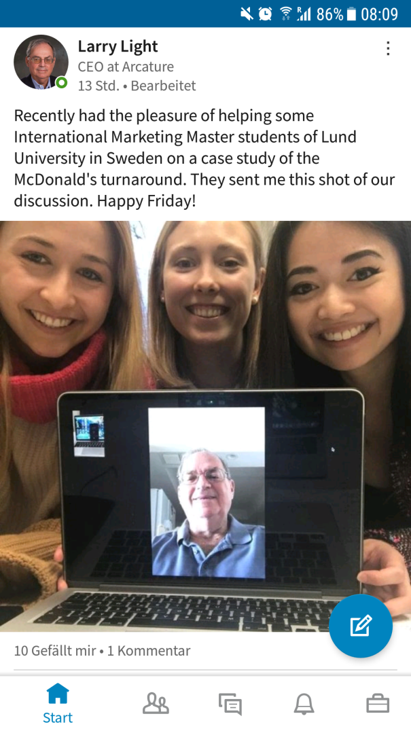


Plan to Win
Background
Action Mode!
agenda
Problem statement
Notes:
At the beginning, we only knew that we wanted to write about McDonald’s but could not specify a specific problem yet…
Therefore, we contacted the master of McDonald’s (thanks to social media today): Larry Light on LinkedIn, he was the former and first global CMO at McDonald’s between 2002 and 2006.
He told us a story about McDonald’s, a story which we want to tell you today too…

Slide 3
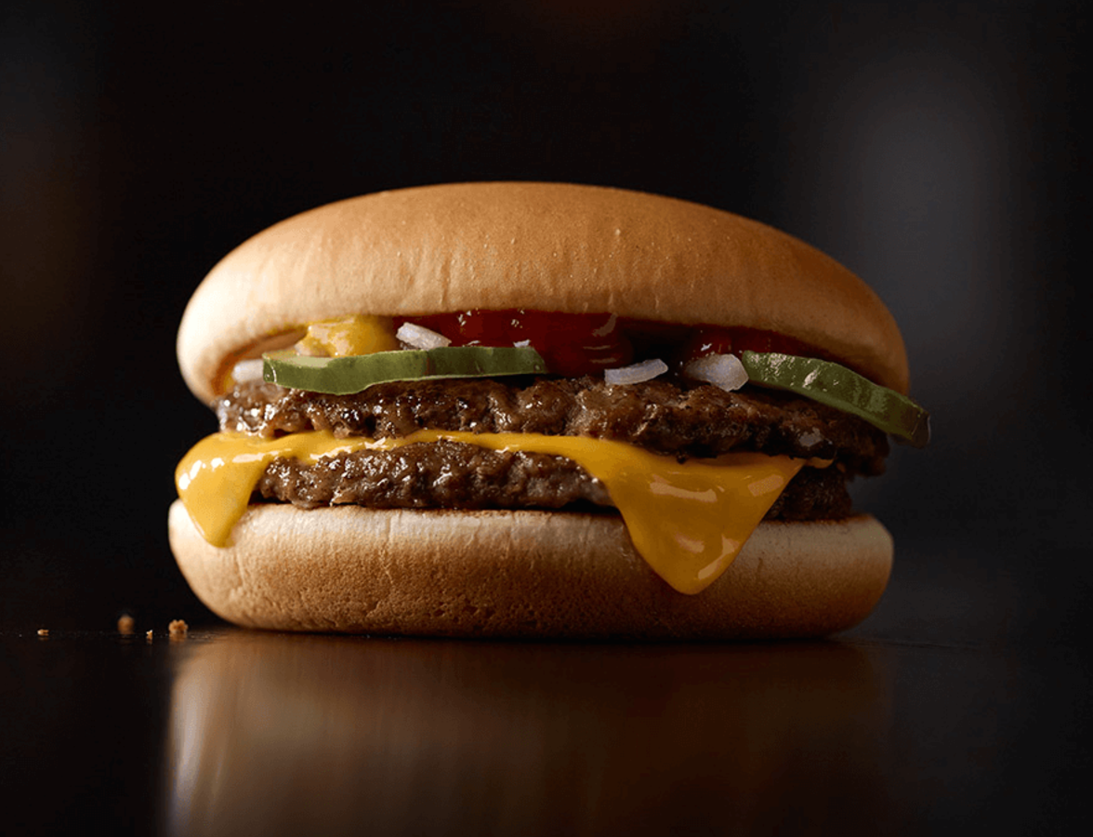
Problem Statement
How should McDonald’s undergo the Revitalization Process of its Brand Image in order to manage a Brand Turnaround successfully?

Slide 4
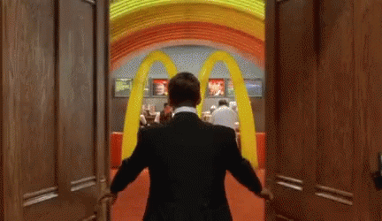
Background

Slide 5
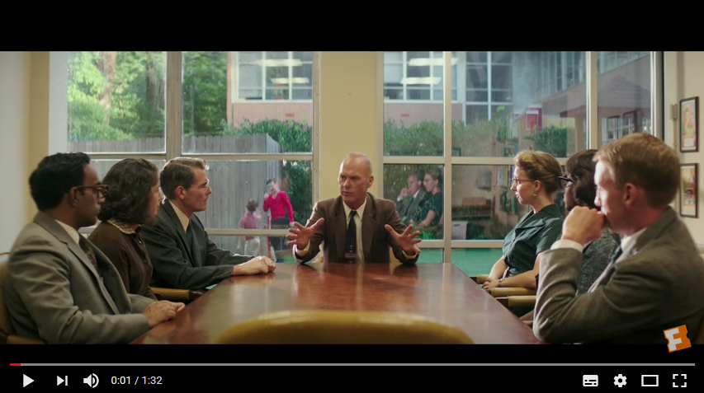
https://www.youtube.com/watch?v=m-P_bP2QGx8
Problem statement
Background
Action Mode
Plan to Win
Notes:
McDonald’s is FAMILY: https://www.youtube.com/watch?v=m-P_bP2QGx8 (bis Minute 0:19)

Slide 6
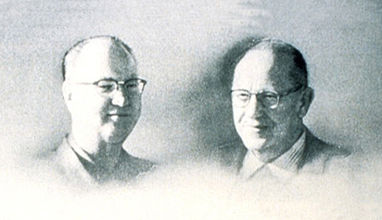

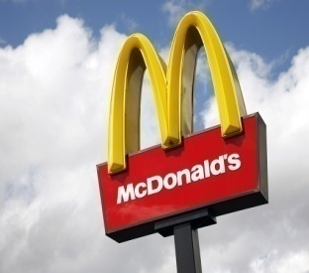
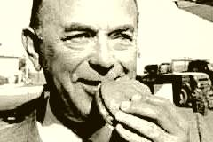
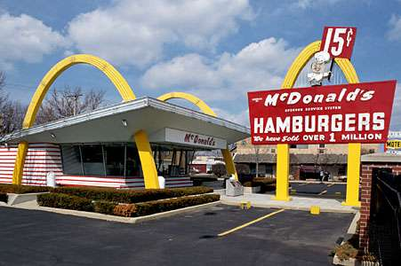


Background
First Fast Food
1940
1954
>100
36K
Vision:
“happy place”
2002
Problem statement
Background
Action Mode
Plan to Win
Notes:
1940: Dick and Mac Donald’s founded the first fast food restaurant in California. (Hamburgers for 15 cents)
1954: Ray Kroc’s vision was that there would be 1,000 McDonald’s restaurants solely in the United States. → franchising concept

Slide 7
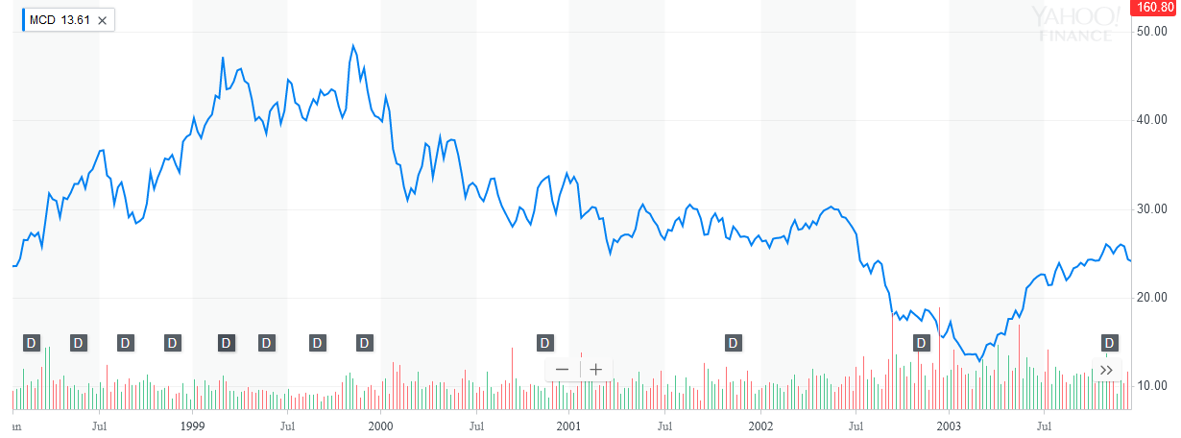
Sales Price Drop 2003
Problem statement
Background
Action Mode
Action Mode
Plan to Win
Plan to Win
Notes:
1940: Dick and Mac Donald’s founded the first fast food restaurant in California. (Hamburgers for 15 cents)
1954: Ray Kroc’s vision was that there would be 1,000 McDonald’s restaurants solely in the United States. → franchising concept

Slide 8
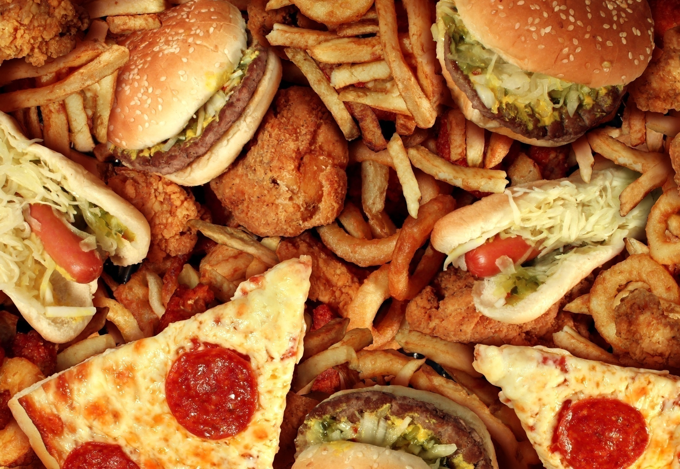
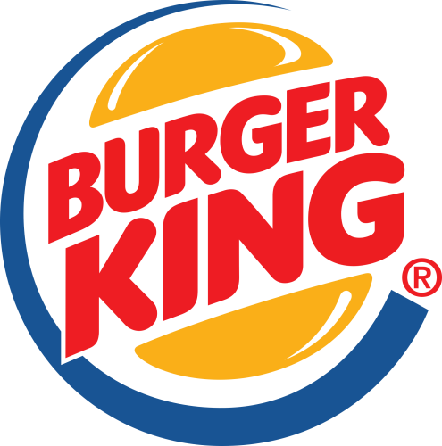
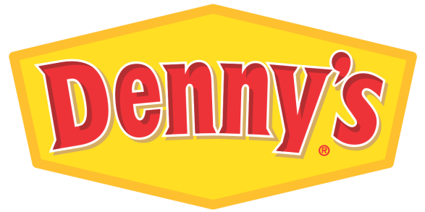
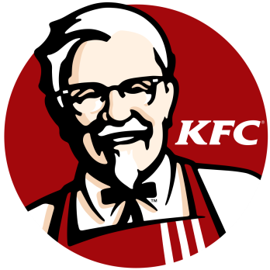
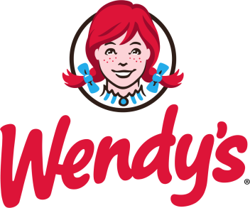


The Incident
Fierce Competition
Decline in market share
Lack of emotional connection
Problem statement
Background
Action Mode
Plan to Win
Notes:
Health conscious pressure + target group of McDonalds not covered
McDonald's is sliding down in terms of earnings and reputation. In 2002, it reported its first ever financial loss since it went public 37 years before with same-store sales down globally. McDonald’s stock price was down to $17.60 in September 2002 from a high of $45.31 in March 1999 . In December 2002, after McDonald’s stock declined 60% over three years, the board of directors was replaced by Jim Cantalupo as the new CEO, Charlie Bell as COO and Larry Light as the first global CMO.
Not only is McDonald’s sales in decline but also market share have been shrinking, franchisees are frustrated, employee morale has been low, and customer satisfaction has become even lower. Its brand image suffers too. The only pictures costumers have of McDonald’s during those times are unhappy faces when dining there. → see Role Play
McDonald’s has failed to continuously improve its brand experience by ignoring these three criticalities: renovation, innovation, and marketing. McDonald’s focuses on cost reduction instead of quality growth of the top line.
After the turnaround of the management board, the new management team has tried to identify what the organizational focus of McDonald’s is and noticed that McDonald’s has consistent products but an inconsistent brand. The brand image of McDonald’s has become old-fashioned and lacked organizational focus in core essence of brand’s image.
During those times, it is also known that McDonald’s are losing huge transactions, the lines in-store are becoming shorter, and customers rather preferring the drive-through queue. In the United States, 70% of sales stem from drive-in counters.
Before, the pressure of buyers for healthy consumption has led McDonald’s to focus on their offerings and meals to make customers eat in-store. Therefore, McDonald’s starts to sell healthy products to first, target people who do not want to eat fast-food and second, to create a healthy food image. Instead of soft drinks they start to serve water. Instead of french fries, they serve carrot sticks.
During this time, the management board decides to tackle all the different challenges by re-focusing their strategy.
Ray Kroc, founder of McDonald’s, emphasized his vision for McDonald’s that, “it is not a hamburger chain. A lot of people were making hamburgers before McDonald’s. Hamburgers will not differentiate McDonald’s from its competitors. Anybody can make hamburgers; anybody can make french fries or soft drinks.” Consequently, CMO Larry Light asks himself what makes McDonald’s special because every brand needs to have something which makes it special. He remembers Kroc’s words back in the days: “McDonald’s is a happy place.” The core attribute of McDonald’s has been the happy meal to make McDonald’s a happy place for kids. This has been forgotten before the new management board has been elected.
In 2002, CMO Larry Light joins the new management board of McDonald’s and receives the responsibility of managing McDonald’s brand revitalization and brand turnaround from 2002 to 2005. Taking the role of the executive team of McDonald’s, the following question arises:
How should McDonald’s undergo the revitalization process of its brand image in order to manage a brand turnaround successfully?

Slide 9

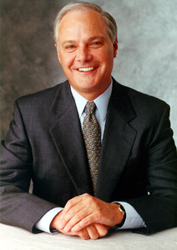
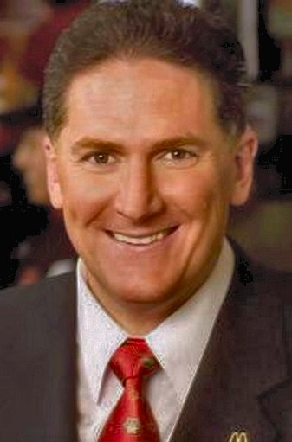
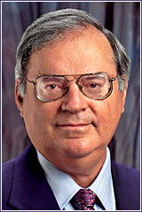
The Incident
Jim Cantalupo
(CEO)
Charlie Bell
(COO)
Larry Light
(CMO)
Problem statement
Background
Action Mode
Plan to Win
Notes:
McDonald's is sliding down in terms of earnings and reputation. In 2002, it reported its first ever financial loss since it went public 37 years before with same-store sales down globally. McDonald’s stock price was down to $17.60 in September 2002 from a high of $45.31 in March 1999 . In December 2002, after McDonald’s stock declined 60% over three years, the board of directors was replaced by Jim Cantalupo as the new CEO, Charlie Bell as COO and Larry Light as the first global CMO.
Not only is McDonald’s sales in decline but also market share have been shrinking, franchisees are frustrated, employee morale has been low, and customer satisfaction has become even lower. Its brand image suffers too. The only pictures costumers have of McDonald’s during those times are unhappy faces when dining there. → see Role Play
McDonald’s has failed to continuously improve its brand experience by ignoring these three criticalities: renovation, innovation, and marketing. McDonald’s focuses on cost reduction instead of quality growth of the top line.
After the turnaround of the management board, the new management team has tried to identify what the organizational focus of McDonald’s is and noticed that McDonald’s has consistent products but an inconsistent brand. The brand image of McDonald’s has become old-fashioned and lacked organizational focus in core essence of brand’s image.
During those times, it is also known that McDonald’s are losing huge transactions, the lines in-store are becoming shorter, and customers rather preferring the drive-through queue. In the United States, 70% of sales stem from drive-in counters.
Before, the pressure of buyers for healthy consumption has led McDonald’s to focus on their offerings and meals to make customers eat in-store. Therefore, McDonald’s starts to sell healthy products to first, target people who do not want to eat fast-food and second, to create a healthy food image. Instead of soft drinks they start to serve water. Instead of french fries, they serve carrot sticks.
During this time, the management board decides to tackle all the different challenges by re-focusing their strategy.
Ray Kroc, founder of McDonald’s, emphasized his vision for McDonald’s that, “it is not a hamburger chain. A lot of people were making hamburgers before McDonald’s. Hamburgers will not differentiate McDonald’s from its competitors. Anybody can make hamburgers; anybody can make french fries or soft drinks.” Consequently, CMO Larry Light asks himself what makes McDonald’s special because every brand needs to have something which makes it special. He remembers Kroc’s words back in the days: “McDonald’s is a happy place.” The core attribute of McDonald’s has been the happy meal to make McDonald’s a happy place for kids. This has been forgotten before the new management board has been elected.
In 2002, CMO Larry Light joins the new management board of McDonald’s and receives the responsibility of managing McDonald’s brand revitalization and brand turnaround from 2002 to 2005. Taking the role of the executive team of McDonald’s, the following question arises:
How should McDonald’s undergo the revitalization process of its brand image in order to manage a brand turnaround successfully?

Slide 10
Problem Statement
How should McDonald’s undergo the Revitalization Process of its Brand Image in order to manage a Brand Turnaround successfully?

Slide 11
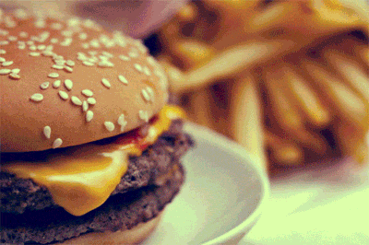
Action Mode!

Slide 12
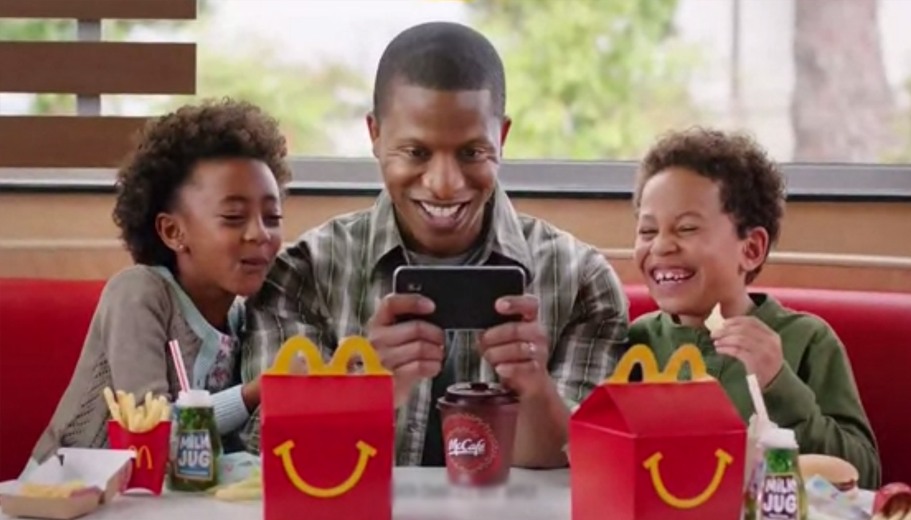
Solution 1: Enjoyable Experience
Focus on leveraging customer experience and provide an
Enjoyable Customer Experience in-store
Problem statement
Background
Action Mode
Plan to Win

Slide 13
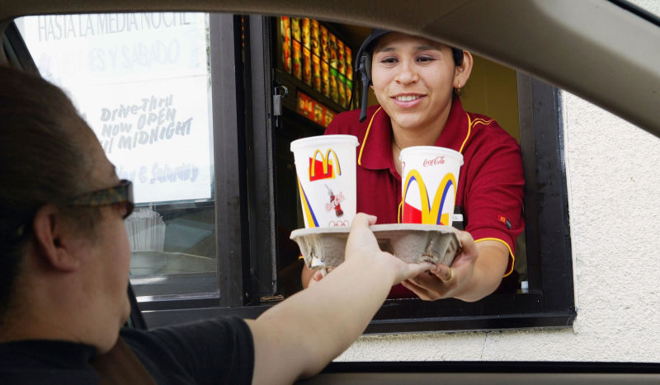
Solution 2: Quick-Service
Making use of the good performance of drive-in sector:
Focus on the Quick-Service Experience
⇨ ‘FAST’ food at the center focus
Problem statement
Background
Action Mode
Plan to Win

Slide 14
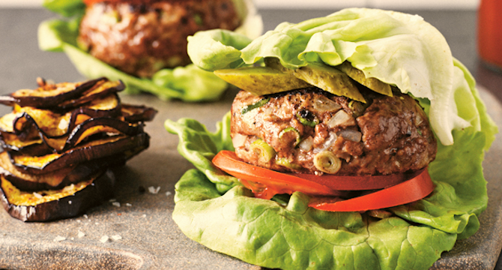
Solution 3: Healthy Menu
Due to growing aspect of health consciousness terms of food:
Focus customers’ changing expectations
Healthy meal options
e.g. Low-Carb patties , ‘naked burger’(without bun)
Problem statement
Background
Action Mode
Plan to Win

Slide 15
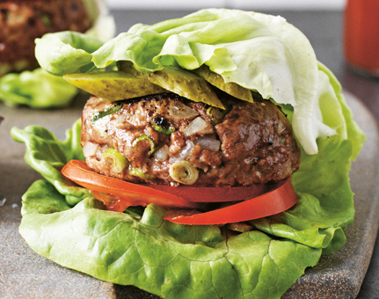

Alternative Solutions
Enjoyable Customer Experience
Quick-Service-Experience
Healthy Menu
1
2
3
Problem statement
Background
Action Mode
Plan to Win

Slide 16
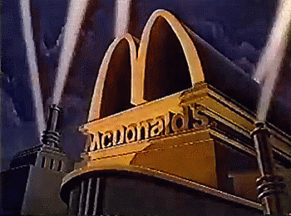
The Plan to Win

Slide 17
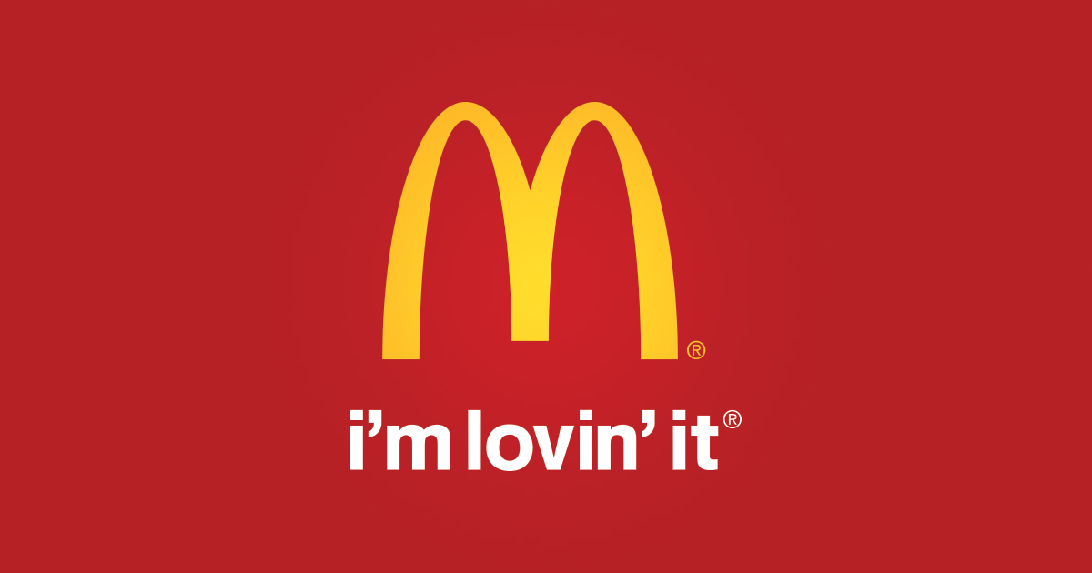

Problem statement
Background
Action Mode
Plan to Win
Notes:
JT – Im lovin it sound

Slide 18
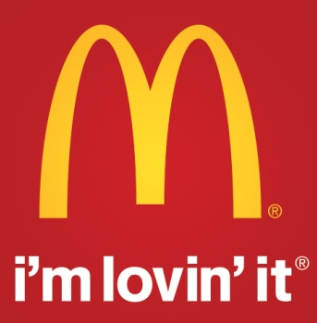

The Management Decision
Internal Brand Revitalization
External Brand Revitalization
Re-creation of brand culture
Brand strategy “Forever young”
“Three Cs”:
clarity of direction, consistent implementation & commitment
Modernization & adaption of In-store atmosphere
I’m lovin’ it - campaign
Revitalization of internal brand pride
→ Increase in sales, stock & customer satisfaction
Problem statement
Background
Action Mode
Plan to Win
Notes:
Internal Brand Revitalization:
re-creation of brand culture (aligned and inspired to deliver an exceptional brand experience to every customer, every time, everywhere )
In order to solve the task, McDonald’s turnaround requires what Larry Light calls the “Three Cs”: clarity of direction, consistent implementation and commitment from top-down throughout the organizing by setting a new brand direction for employees to feel committed to the brand
Revitalization of the internal brand pride
→ all employees got to see the „I‘m lovin‘ it „ campaign before it got launched
External Brand Revitalization
After having realized that McDonald’s will never be a health food store, the management board went back to the founder’s vision of selling happiness in a happy place.
Creation of a modern happy experience by introducing the new brand strategy „forever young“, always having the new target group of young adults in mind
This means not to try to change the brand, but the brand can live forever as long as it is kept young. This was a pivotal insight of not focusing on the actual age, but the attitude of staying forever young.
In-store atmosphere adaptions (digital touchpoints e.g.)
After physical changes, the new advertising campaign „I‘m loving‘ it“ got launched in September 2003
The success was huge
Sales have risen within 90 days
stock has increased from 12.5 dollars to 65 dollars within three years
Rising customer satisfaction

Slide 19
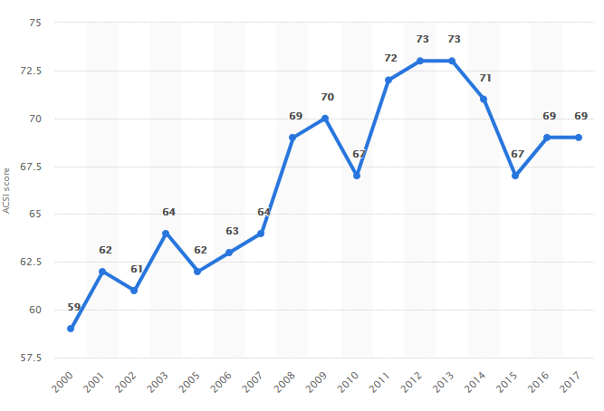
Customer Satisfaction
Problem statement
Background
Action Mode
Action Mode
Plan to Win
Plan to Win
Notes:
1940: Dick and Mac Donald’s founded the first fast food restaurant in California. (Hamburgers for 15 cents)
1954: Ray Kroc’s vision was that there would be 1,000 McDonald’s restaurants solely in the United States. → franchising concept

Slide 20

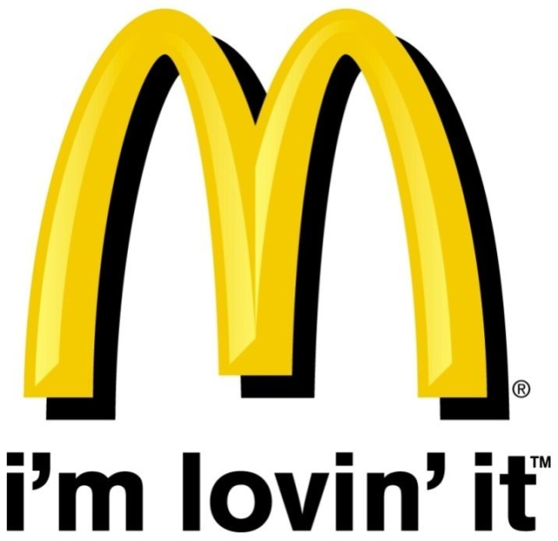
Logo Change 2005
Problem statement
Background
Action Mode
Plan to Win
Notes:
Internal Brand Revitalization:
re-creation of brand culture (aligned and inspired to deliver an exceptional brand experience to every customer, every time, everywhere )
In order to solve the task, McDonald’s turnaround requires what Larry Light calls the “Three Cs”: clarity of direction, consistent implementation and commitment from top-down throughout the organizing by setting a new brand direction for employees to feel committed to the brand
Revitalization of the internal brand pride
→ all employees got to see the „I‘m lovin‘ it „ campaign before it got launched
External Brand Revitalization
After having realized that McDonald’s will never be a health food store, the management board went back to the founder’s vision of selling happiness in a happy place.
Creation of a modern happy experience by introducing the new brand strategy „forever young“, always having the new target group of young adults in mind
This means not to try to change the brand, but the brand can live forever as long as it is kept young. This was a pivotal insight of not focusing on the actual age, but the attitude of staying forever young.
In-store atmosphere adaptions (digital touchpoints e.g.)
After physical changes, the new advertising campaign „I‘m loving‘ it“ got launched in September 2003
The success was huge
Sales have risen within 90 days
stock has increased from 12.5 dollars to 65 dollars within three years
Rising customer satisfaction

Slide 21
Problem Statement
How should McDonald’s undergo the Revitalization Process of its Brand Image in order to manage a Brand Turnaround successfully?

Slide 22

Larry Light:
“Big Brands will never die. They just get weak.”
Problem statement
Background
Action Mode
Plan to Win
Notes:
As the former CMO Larry Light said it: “Big brands will never die, they just get weak.” Therefore, he developed six general rules of brand revitalization for big brands in big trouble:
Rule #1: Refocus the Organization
Rule #2: Restore Brand Relevance
Rule #3: Reinvent the Brand
Rule #4: Reinforce a Results Culture
Rule #5: Rebuild Brand Trust
Rule #6: Realize Global Alignment

Slide 23
Six Rules of Brand Revitalization
1
3
2
Refocus the
Organization
Reinvent the
Brand
Restore Brand
Relevance
5
4
6
Rebuild Brand
Trust
Reinforce a
Result Culture
Realize Global
Alignment
Problem statement
Background
Action Mode
Plan to Win
Notes:
As the former CMO Larry Light said it: “Big brands will never die, they just get weak.” Therefore, he developed six general rules of brand revitalization for big brands in big trouble:
Rule #1: Refocus the Organization
Rule #2: Restore Brand Relevance
Rule #3: Reinvent the Brand
Rule #4: Reinforce a Results Culture
Rule #5: Rebuild Brand Trust
Rule #6: Realize Global Alignment

Slide 24





Key Learnings: Plan to Win
understanding
applying
evaluating
creating
examining
Corporate Brand Image
Corporate Brand Reputation
Corporate Culture
Corporate Communication
Problem statement
Background
Action Mode
Plan to Win
Notes:
This case discusses broad key issues of corporate brands and their reputation which can be applied on other companies in different situations. Thereby, several learning opportunities in the fields of corporate brand identity, corporate brand culture, corporate brand reputation and corporate communication are provided.
The aim of this case builds on developing a guideline for firms how they should undergo the revitalization process of its destroyed brand image in order to manage a brand turnaround successfully. Evaluating the damage of reputation elements and being able to create an action plan, so-called “plan to win”, in order to revitalize and restore the brand’s damage are key learnings of this case.
Understanding → spillover effects of negative brand image on brand reputation → McDonald‘s is NOT a happy place
Applying → managerial decisions to revitalize brand reputation → corporate communication, marketing strategies, brand management
Evaluating → brand reputation in brand turnaround → use of theory – Corporate Brand Identity & Reputation Matrix
Creating → a „plan to win“ for global brands in brand turnaround → brand direction, freedom with framework, measurable milestones
Examining → different communication strategies → „what we say we are“

Slide 25
Thank you for your attention!
Any Questions left?
BUSN35 – Corporate Brand Management & Reputation
Final Case Presentation (March 15th, 2018)
Linda Miksch | Charlotte Schulz | Ailien Nguyen
Notes:
“A mother walks into McDonald’s holding her little 5-year old in her hands and orders a happy meal for her kid. She for herself does not buy anything except a cup of coffee. While watching her kid eating a happy meal, she gets hungry herself and steals some fries from her kid’s meal. Suddenly, the kid starts to cry and both of them show unhappy faces. This is not a happy meal.”

Slide 26
Back-Up

Slide 27
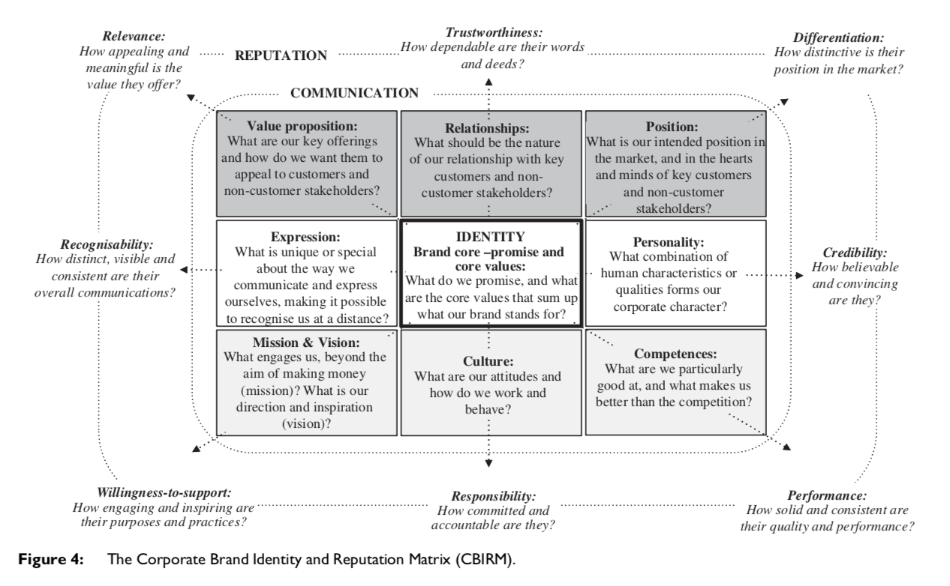
CBIRM
Action Mode
Plan to Win
Notes:
1940: Dick and Mac Donald’s founded the first fast food restaurant in California. (Hamburgers for 15 cents)
1954: Ray Kroc’s vision was that there would be 1,000 McDonald’s restaurants solely in the United States. → franchising concept

