Slide 1
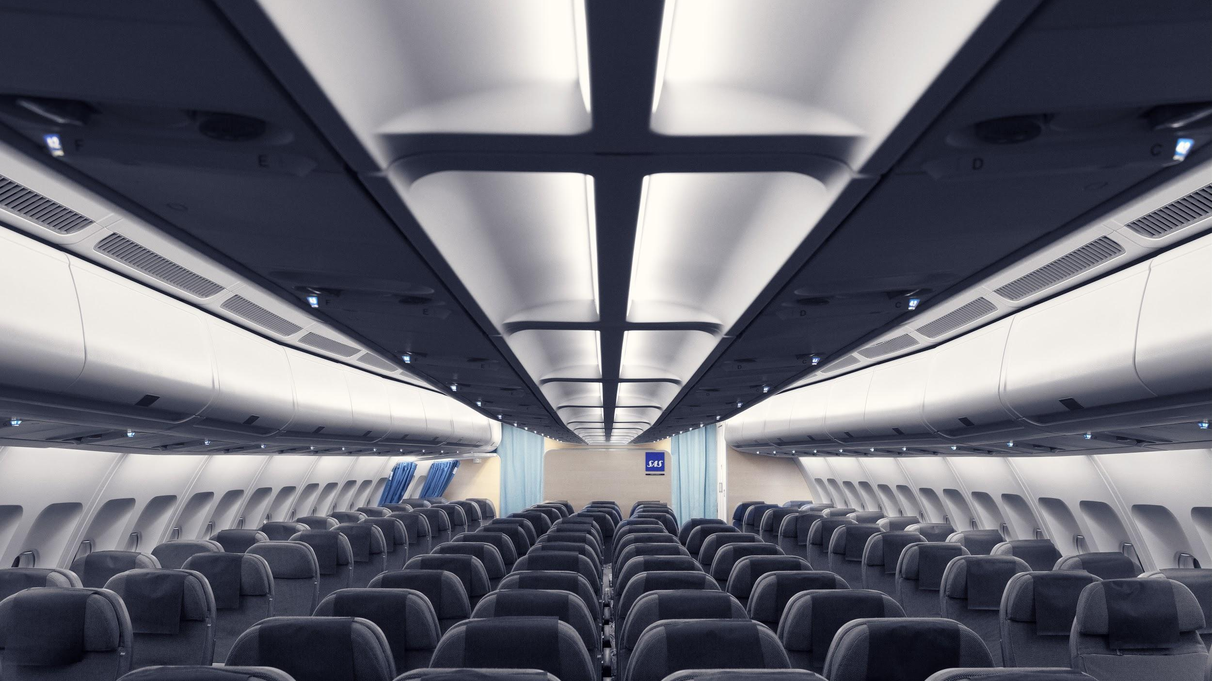

To Fly or
Not Fly?
March 2019
Lovisa Gunnarsson
Cecilia Finell
Davide La Rocca
Notes:
https://www.sasgroup.net/en/imagebank/

Slide 2
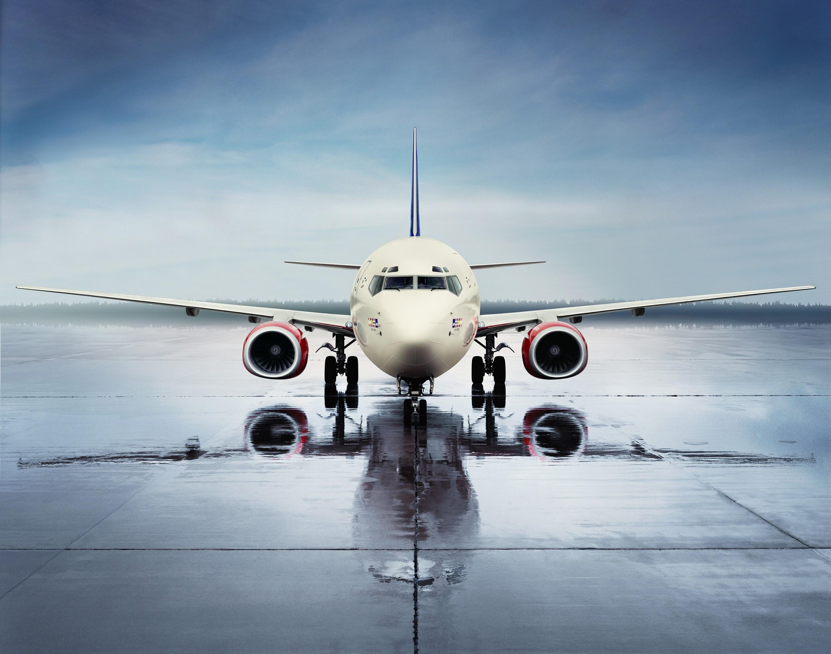
Agenda
01
Background
Introducing SAS and setting the scene
02
Case discussion
Management question and
evaluating alternatives
03
Management decision
What SAS actually did
04
Summary
Evaluation and reflection

Slide 3
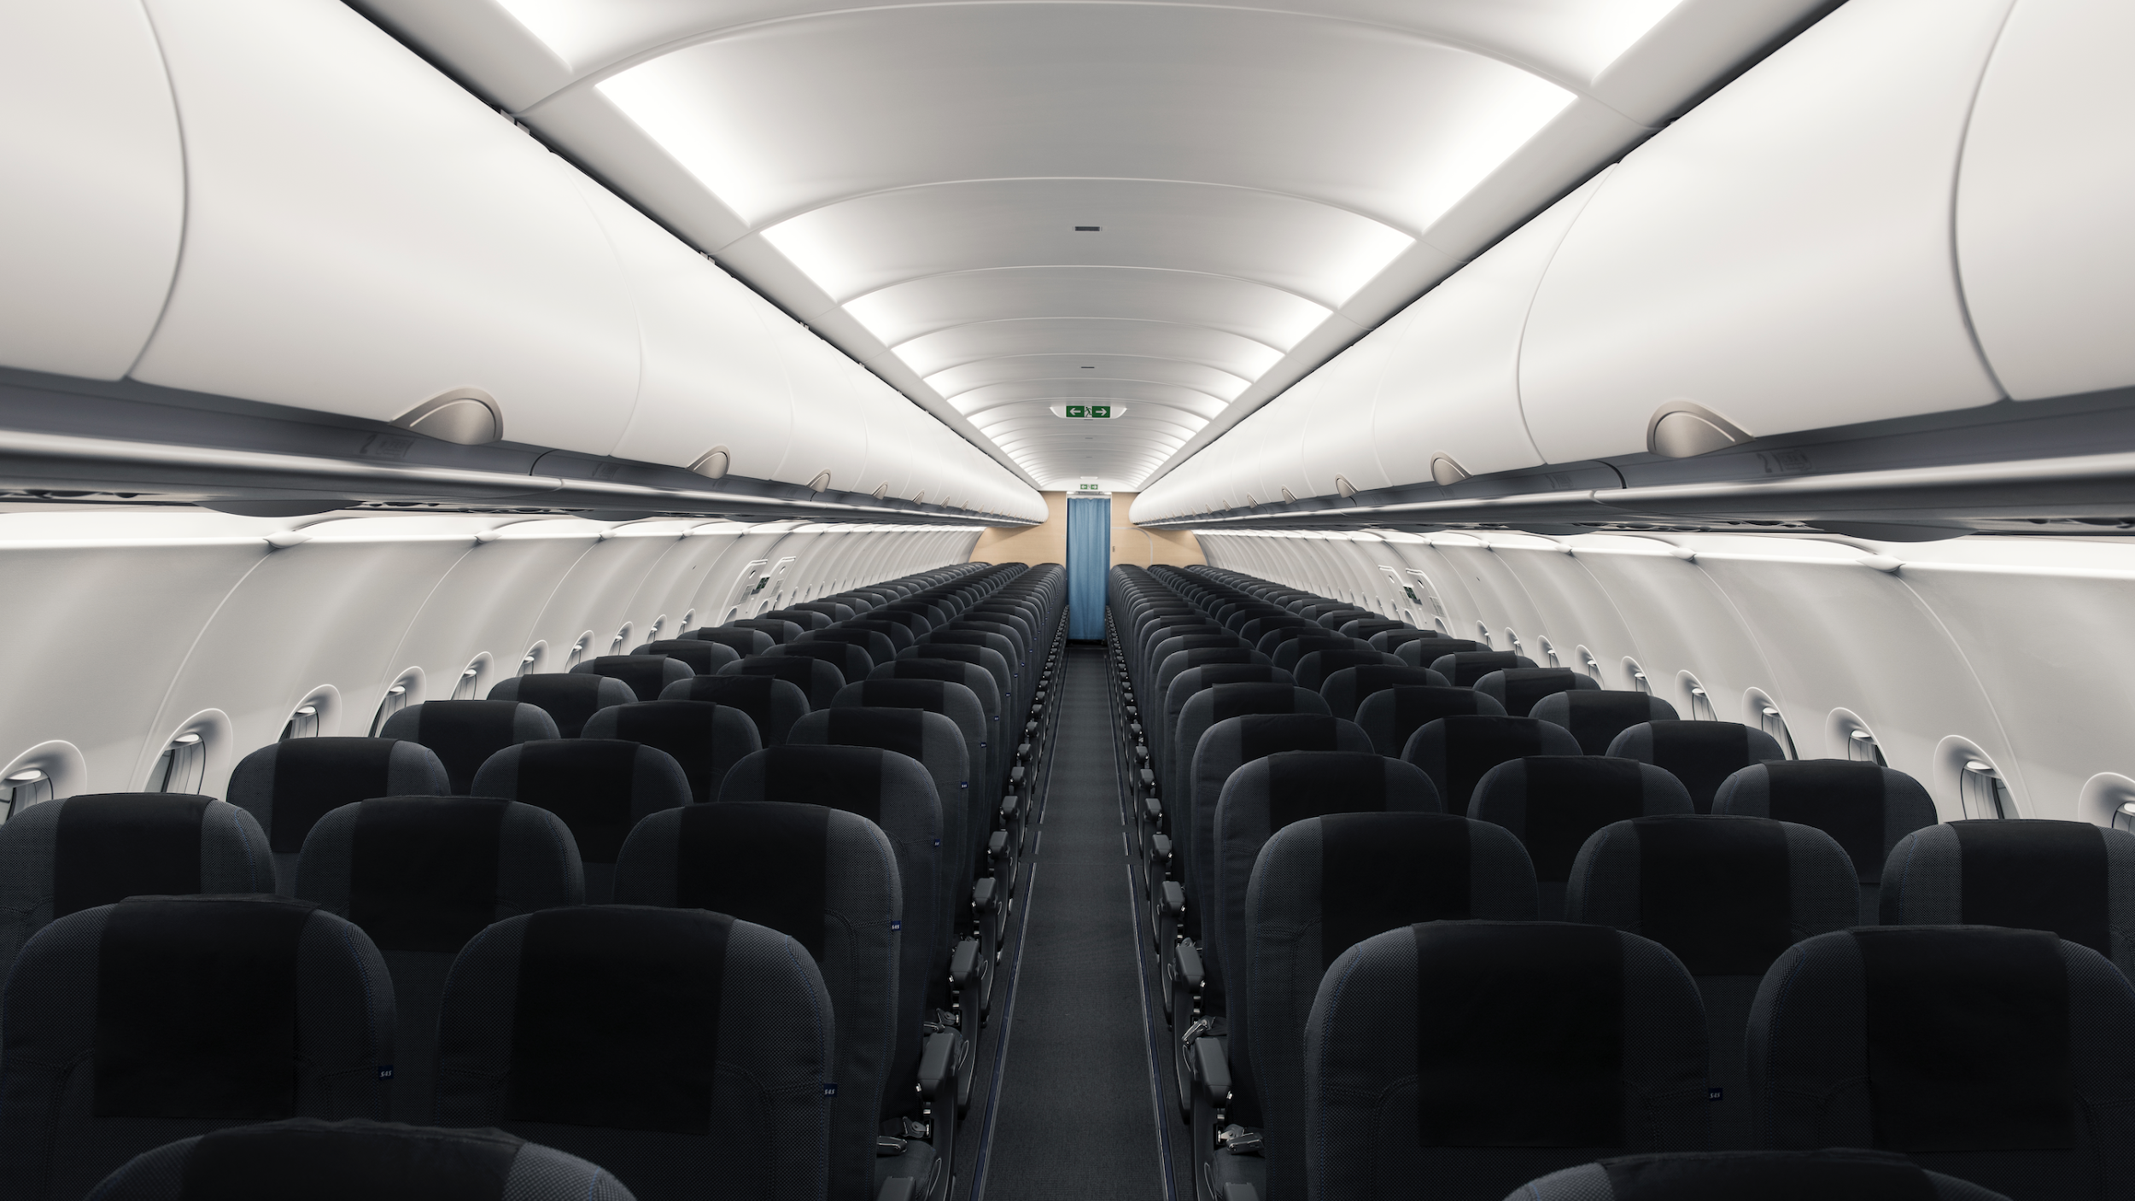
Background
What does societal change mean for branding?

Slide 4
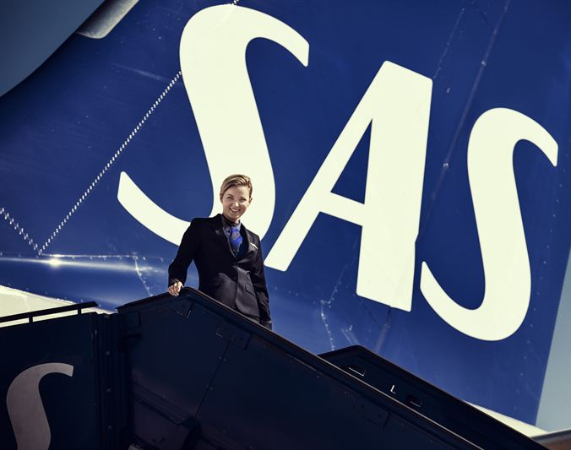
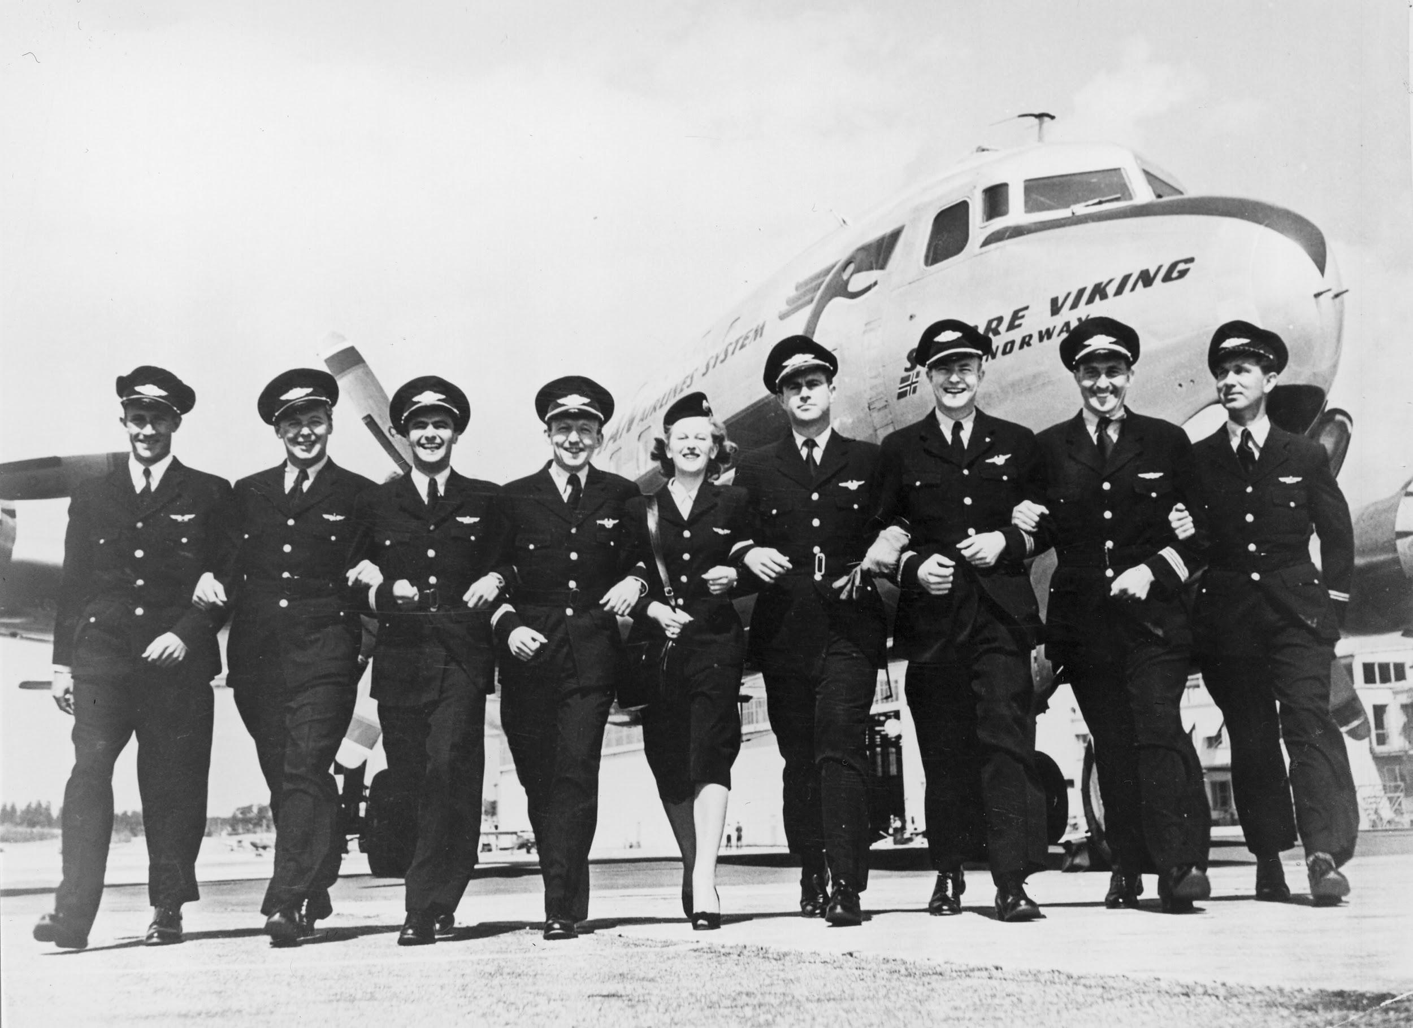
SAS - Scandinavia’s leading airline
Background
Founded in 1946
Market share of 30% in Scandinavia
EuroBonus loyalty program with 5.6 million members
Listed on the Stockholm and Copenhagen stock exchange
222,000 departures and 30 million passenger (2018)
Gross earnings of SEK 2.1 billion (2018)
Case
Decision
Summary

Slide 5
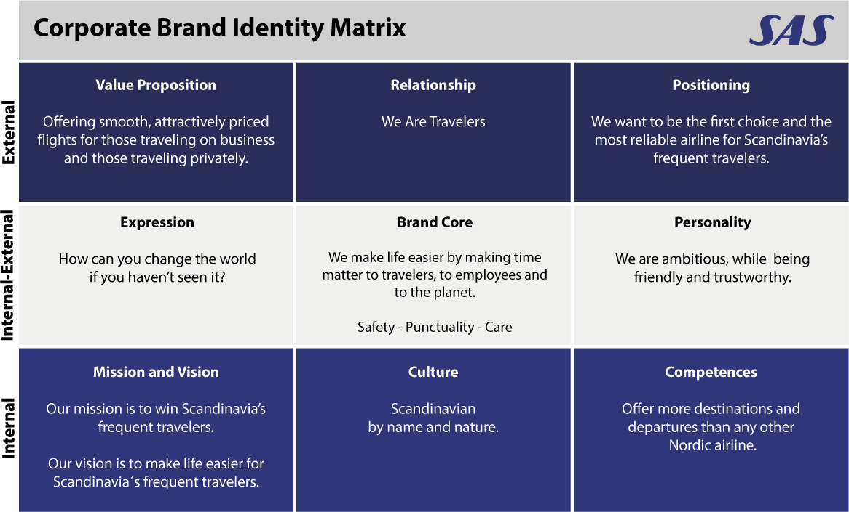
Background
Case
Decision
Summary

Slide 6
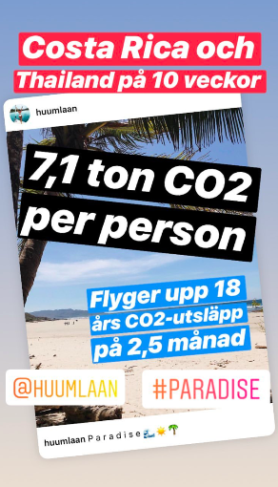
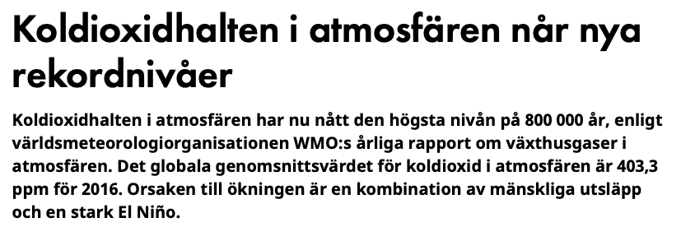
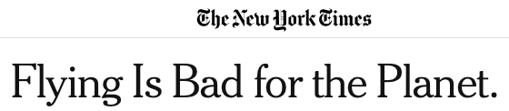
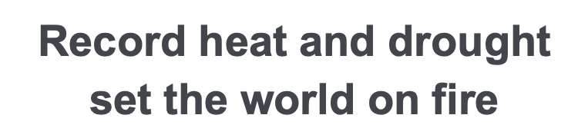
But, the society is changing...
Background
Case
Decision
Summary
Decision

Slide 7
😳✈️
Background
‘Fly shame’
Case
The word describes the guilt that travelers feel when flying somewhere, due to their knowledge of them contributing to climate change.
Decision
Summary

Slide 8
12%
of the worldwide CO₂ emissions from transportation methods are generated
by the aviation industry
Background
Case
5 times more
than the global average
1.6 ton of CO₂
Decision
For a single transatlantic journey, for each passenger.
The amount of flights by every Swedish citizen per year
(10 million ton of CO₂ annually)
4.7% annual growth
For the total number of airline passengers
Summary
Notes:
https://www.atag.org/facts-figures.html
3% of CO2 emissions globally are from the aviation industry… If we want to mention, but it is stronger to say the 12% for the transportation sources.

Slide 9
SAS’ latest internal management decision
Background
“We will now climate compensate
for all our EuroBonus members.”
Case
Entails compensating for 40% of their trips
Represents approximately 150 million SEK annually
Previously compensated for only Youth travelers
Decision
Summary

Slide 10

Background
‘Carbon offsetting’
Case
to compensate for CO₂ emissions by investing in emission reduction projects elsewhere.
Decision
Summary

Slide 11
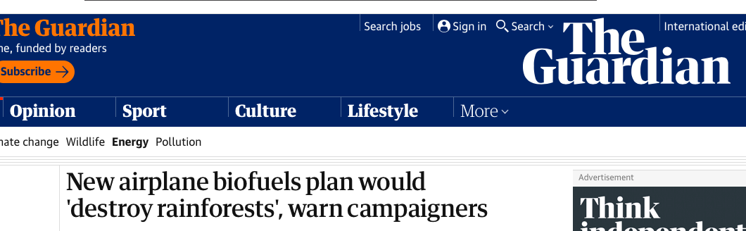
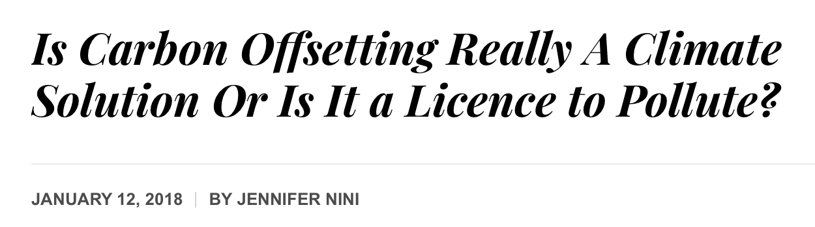
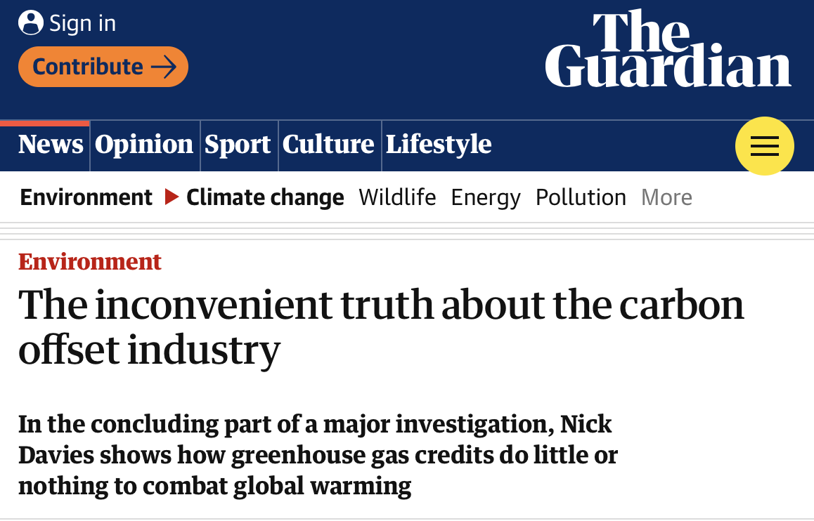

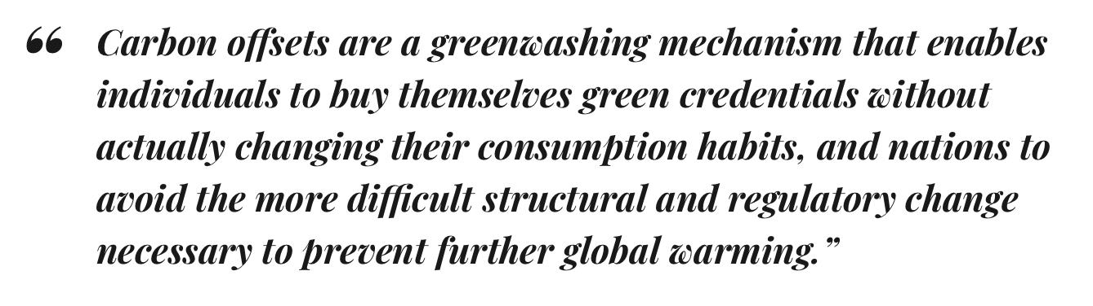
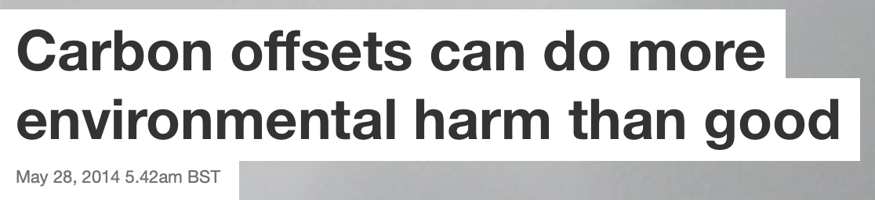
Nothing is good enough...
Background
Case
Decision
Summary
Notes:
https://ecowarriorprincess.net/2018/01/is-carbon-offsetting-really-a-climate-solution-or-is-it-a-licence-to-pollute/
https://theconversation.com/carbon-offsets-can-do-more-environmental-harm-than-good-26593
https://www.theguardian.com/environment/2007/jun/16/climatechange.climatechange

Slide 12
The Case
To openly communicate
sustainability actions or not?

Slide 13
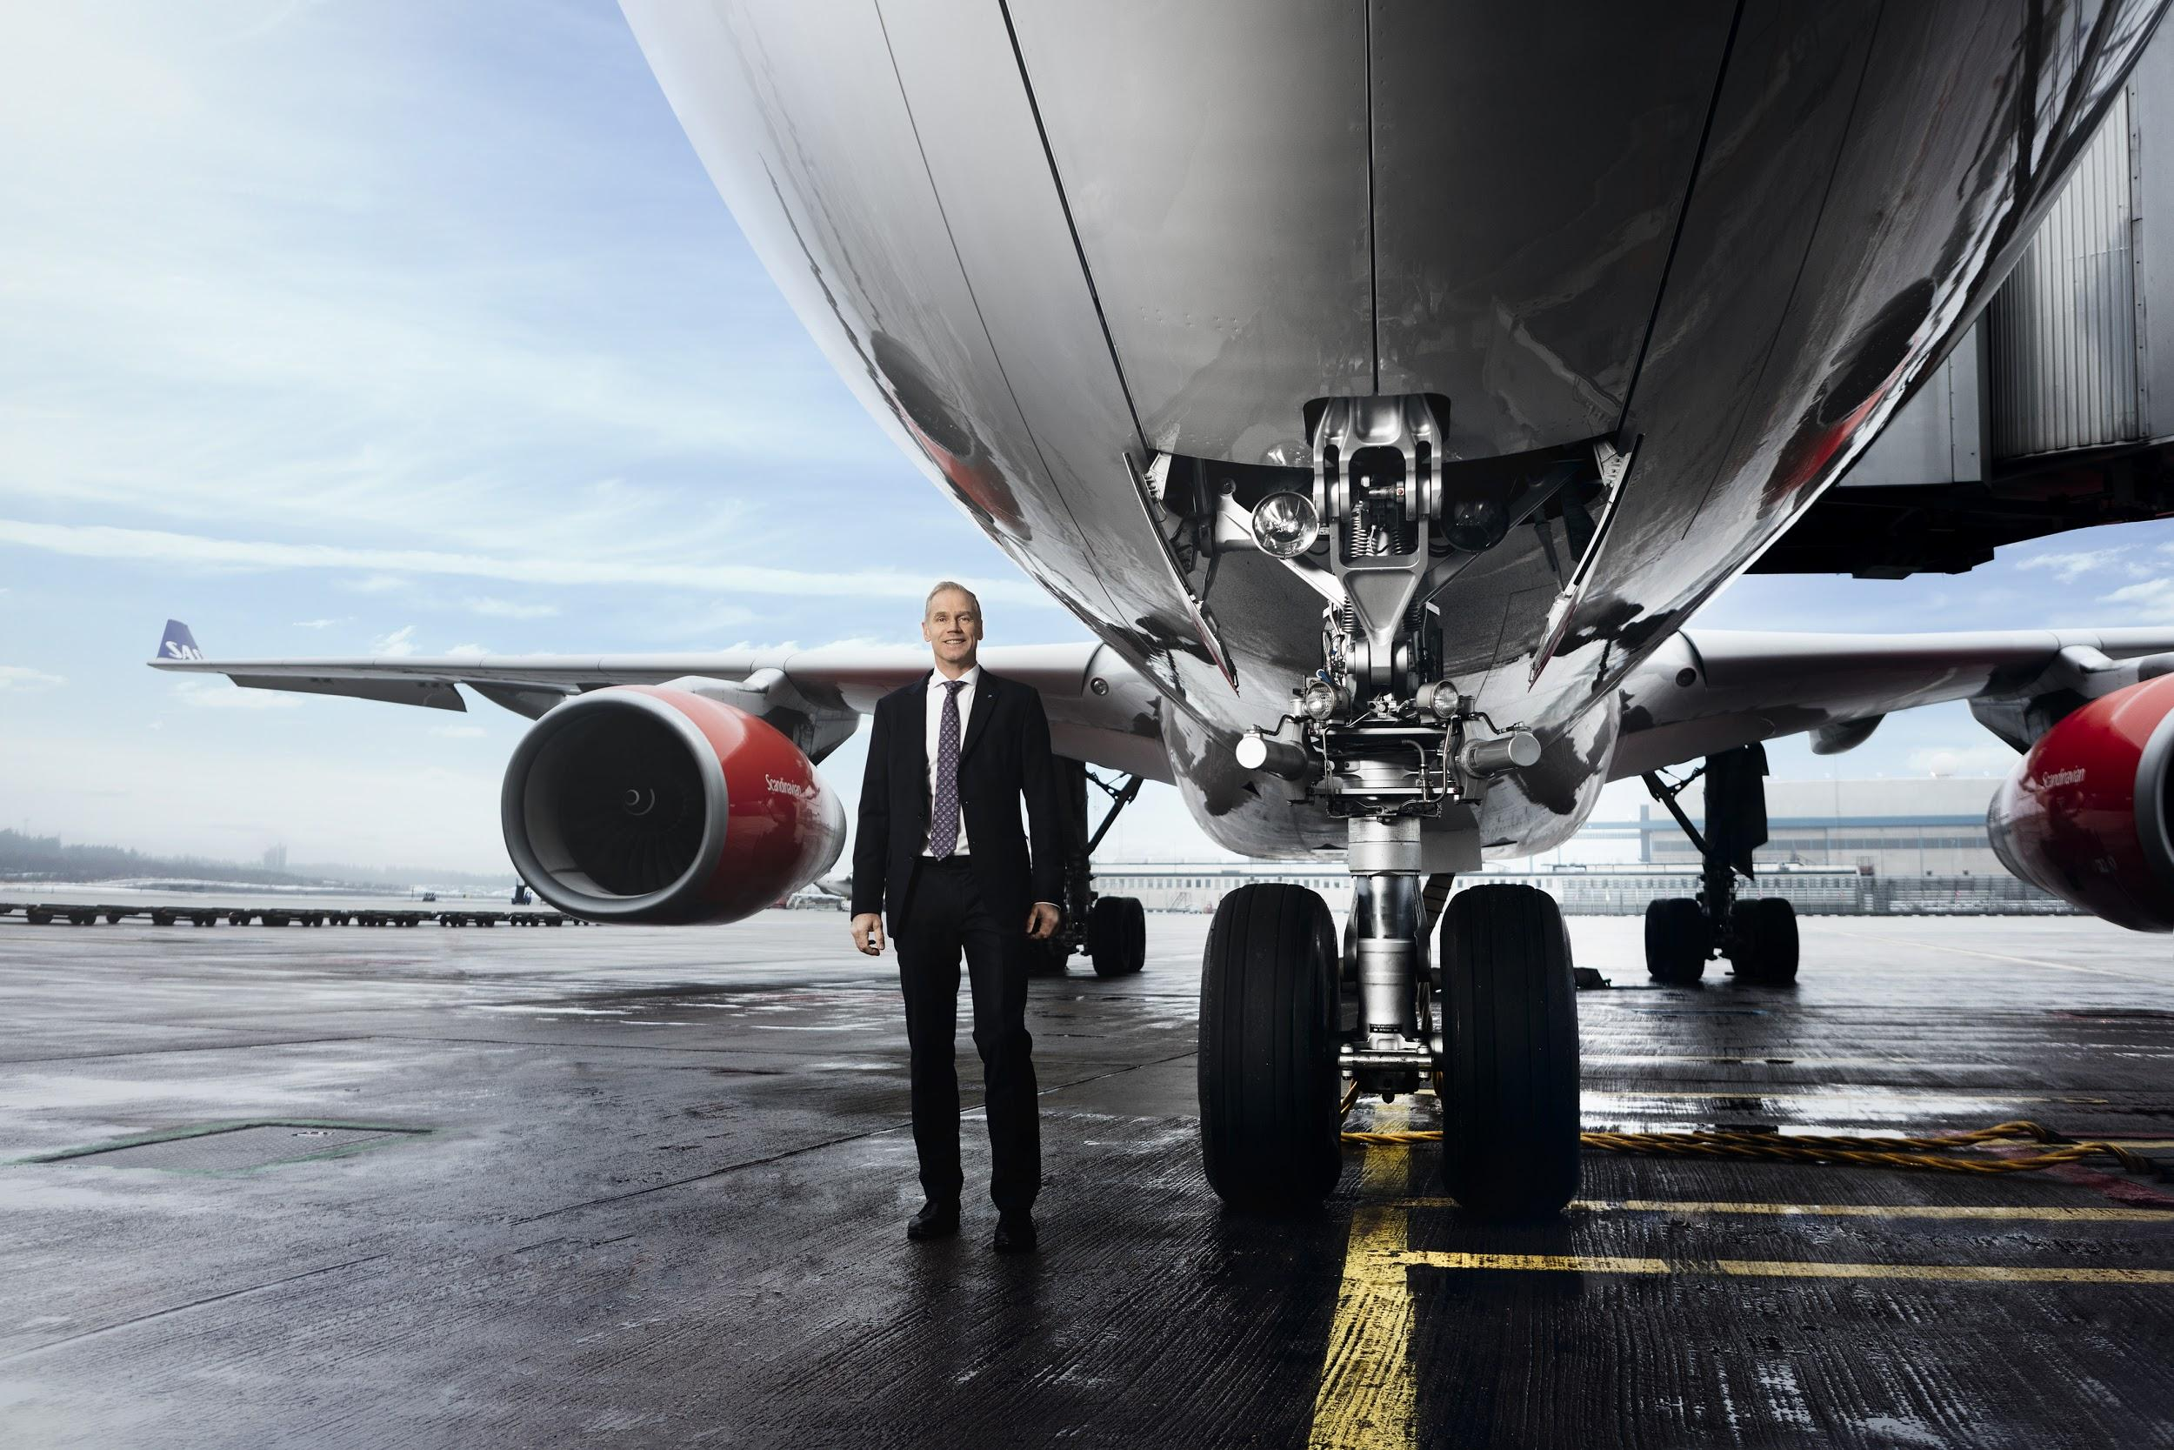
Background
Case
You are taking the role as...
SAS executive team
Decision
Summary

Slide 14

Considering the corporate reputation of a brand that operates in a heavily criticized industry…
Should SAS openly communicate its newest initiative to offset
the CO₂ emissions or keep quiet about it?

Slide 15
Evaluating the alternatives...
Background
 | Why communicate? | Why not communicate?
Short-term
Long-term
Case
Decision
Summary

Slide 16
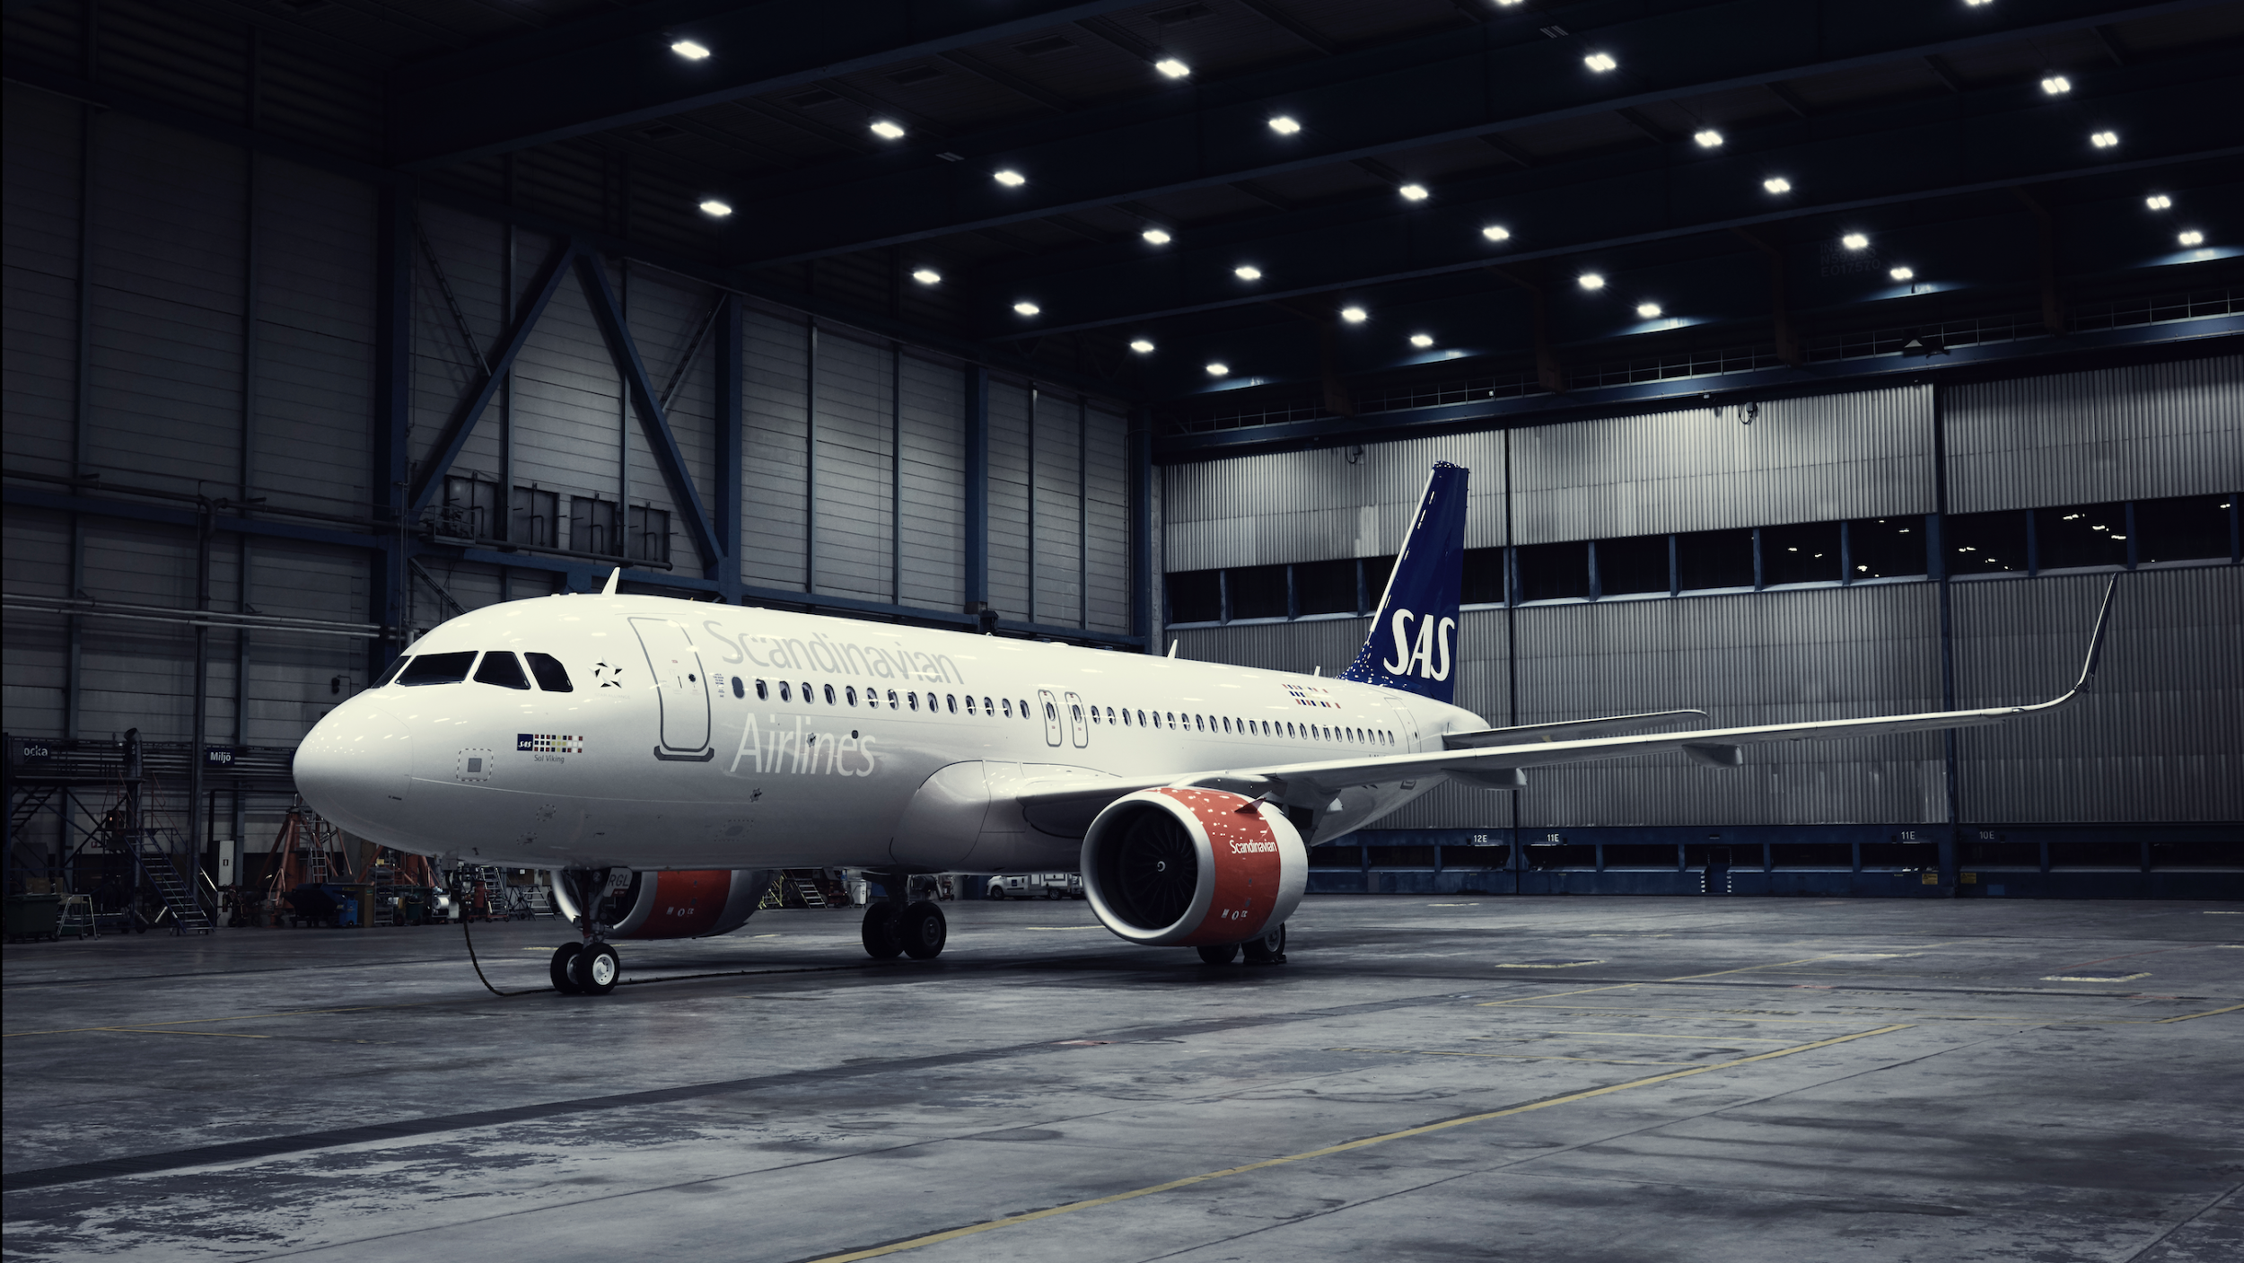
Management decision
What did SAS do?

Slide 17
“Sustainability is an integral part of our business, and affects every decision we make.”
Rickard Gustafson, CEO

Slide 18
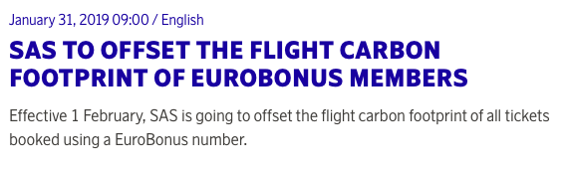
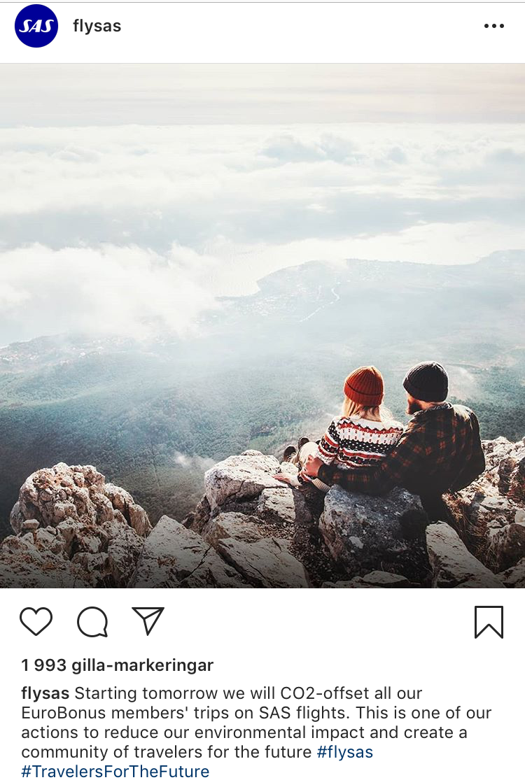
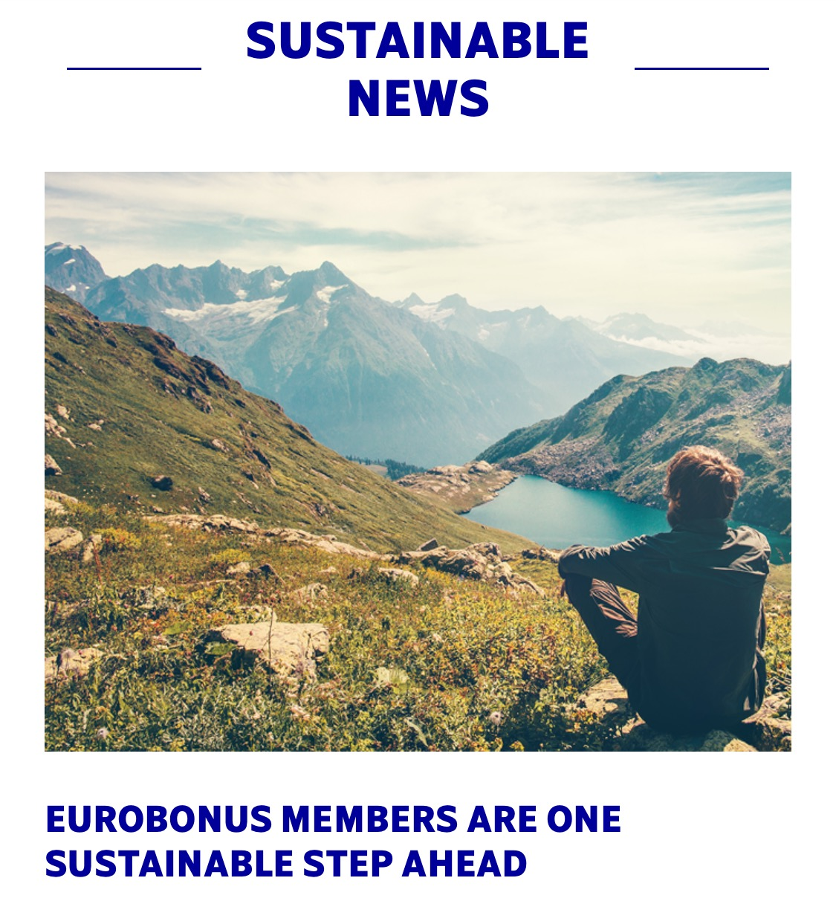
The choice to lead a discussion...
Background
Case
Decision
Summary

Slide 19

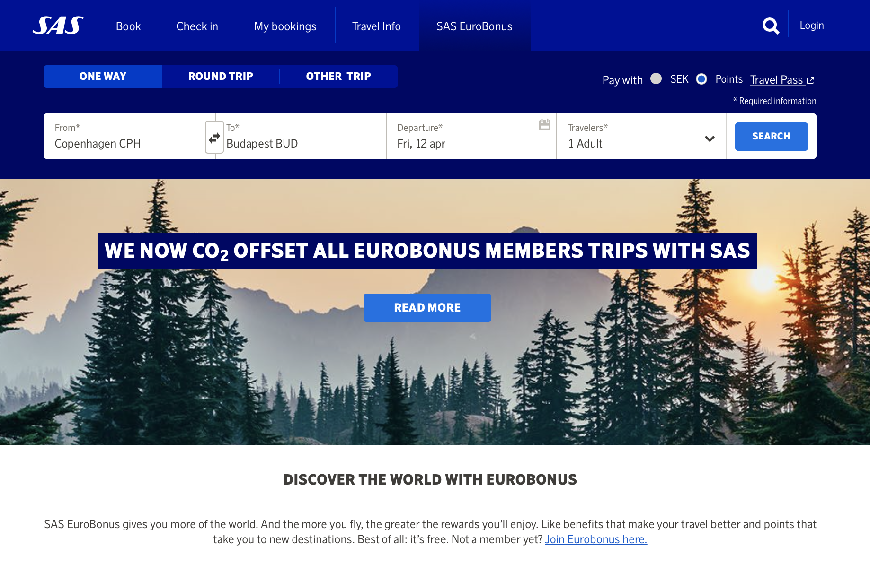
Background
Case
Decision
First page news
The carbon offsetting initiative is publicly announced on the homepage of SAS in order to highlight the added value for EUROBONUS members.
Summary

Slide 20

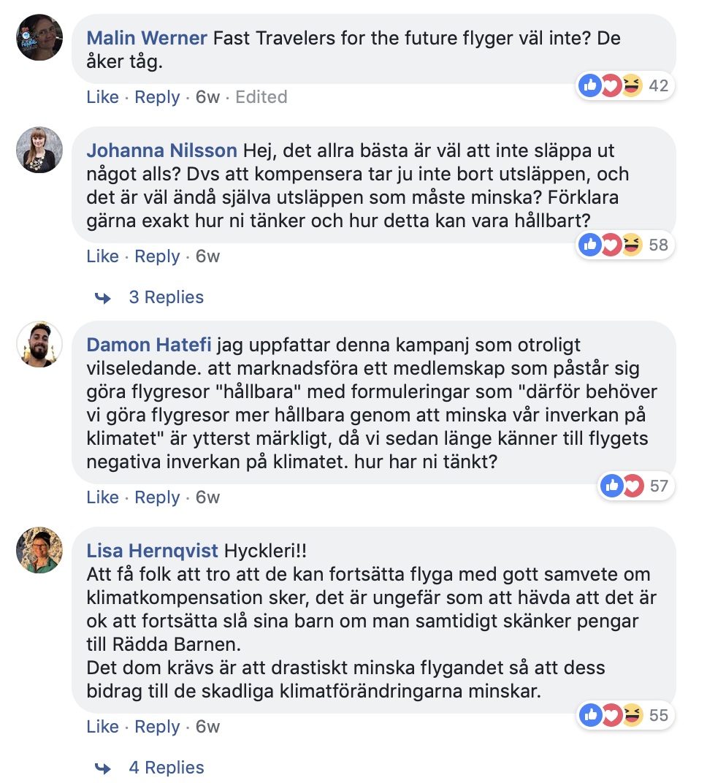
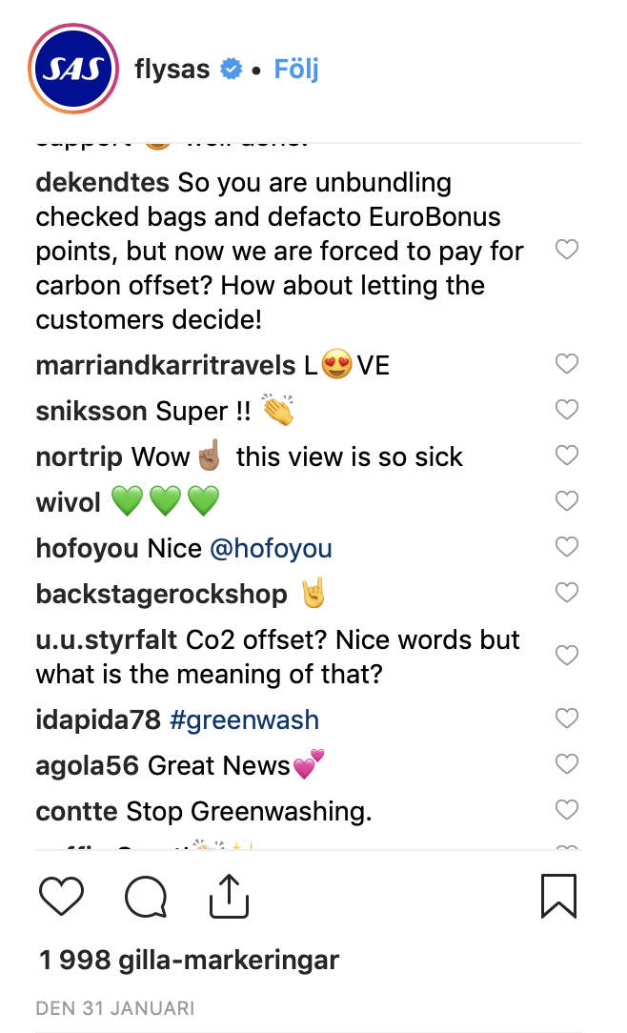
But the response...
Background
Case
Decision
Summary

Slide 21
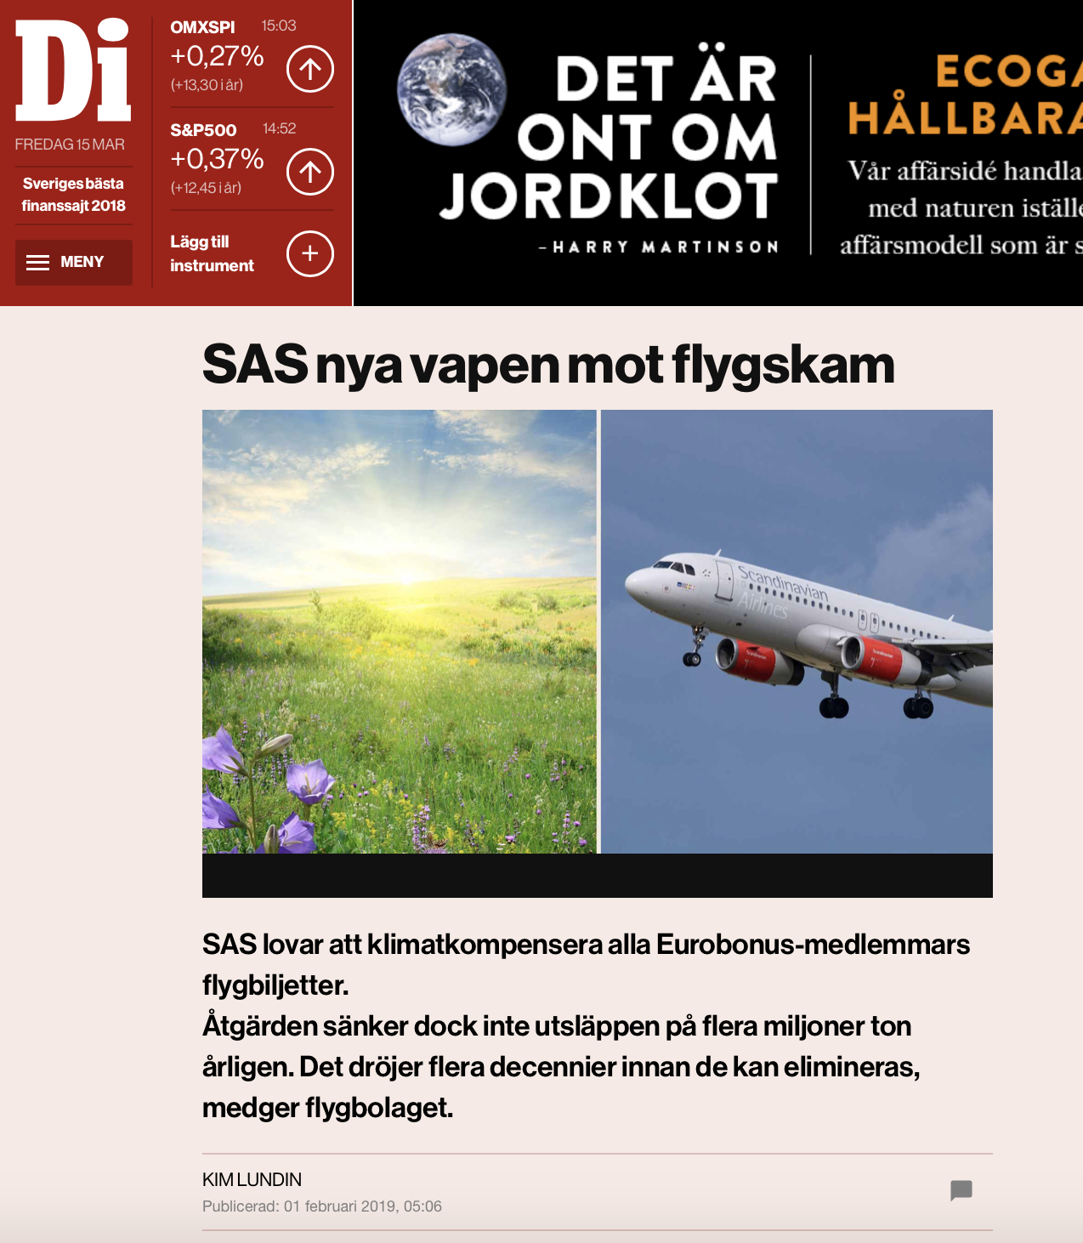
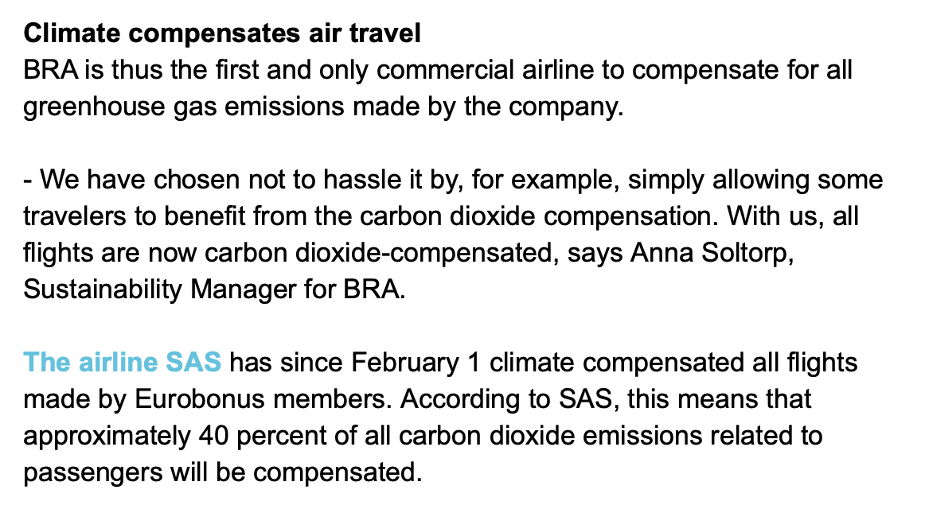
And the media...
Background
Case
Decision
Summary

Slide 22
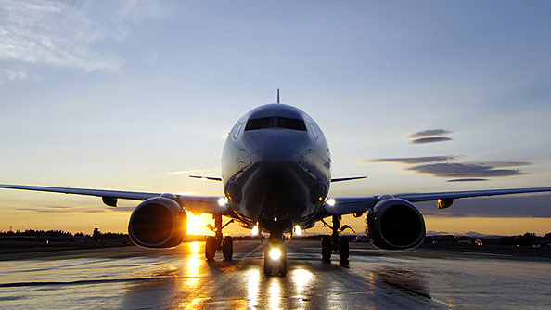
Summary
Reflection and evaluation

Slide 23
Background
What do you think about their actual decision?
Do you think it will be beneficial for SAS
considering the response?
Case
Decision
Summary

Slide 24
Background
Case
What have we learned?
Decision
Summary
Notes:
Societal change is taking place
Listen to the market
Understand the implications of different alternatives
Think both short and long term
Who is affected by your decision - stakeholders
How does it affect your reputation

Slide 25
Thank you
for flying with us!

