Slide 1
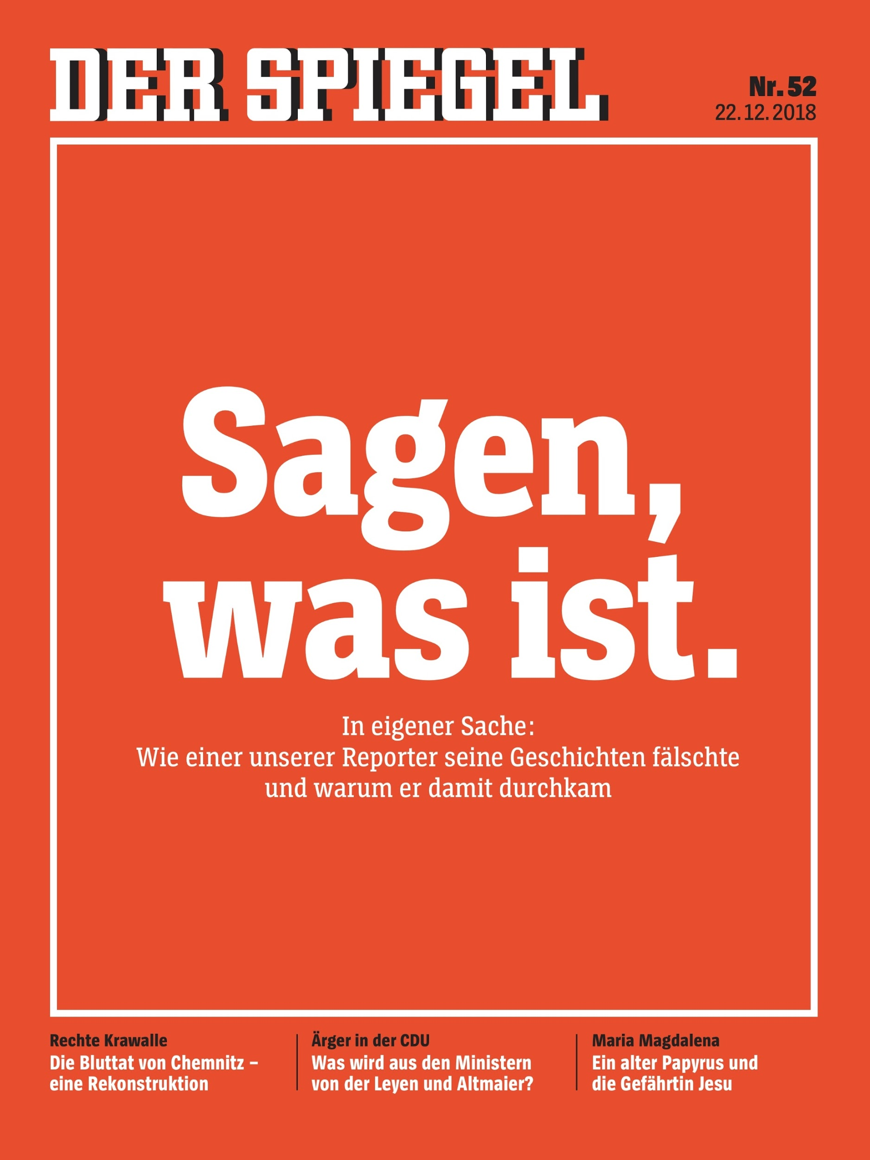

Are you
‘telling it like it is’?
The DER SPIEGEL scandal and its impact on the reputation of an entire industry in times of fake news and lying press
Julia Ausserdorfer
Réka Ines Tölg
Imke van Deest
Notes:
Today, we will present you the DER SPIEGEL scandal which is heavily interrelated to the corporate brand’s promise “telling it like it is”. Introduction of presenters.

Slide 2
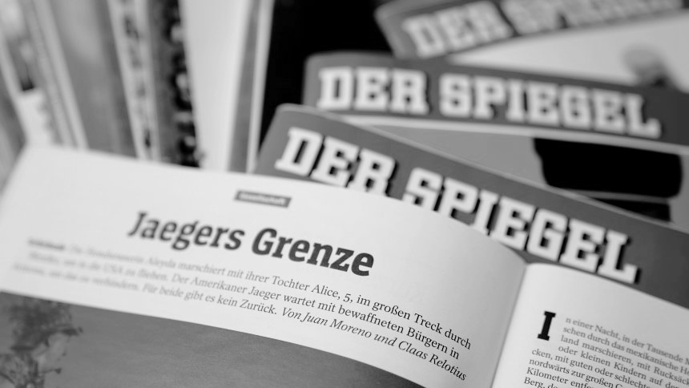
OVERVIEW
Background
CBIRM applied to the SPIEGEL group
The crisis in detail
Discussion & managerial decision
Conclusion
Learnings
Notes:
First of all, we will provide you with background information about the SPIEGEL group. We will then illustrate their identity in the CBIRM matrix. After that, we will present the crisis situation, start the case discussion and reveal the managerial decision. To sum up, we will conclude with the main learnings.

Slide 3
BACKGROUND
Notes:
Let us tell you something about the SPIEGEL group….

Slide 4






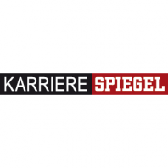


BACKGROUND
One of the most renowned and wide reaching media groups in Europe
Unique ownership structure: 50% of the shares endowed to employees
Main market: German-speaking countries
Brands:
Notes:
The SPIEGEL group is one of the most renowned and wide reaching media groups in Europe with 14 million weekly readers, operating mainly in Germany and other German-speaking countries.
The SPIEGEL group’s ownership structure is unique in the European media landscape. In 1974, the founder, Rudolf Augstein, endowed half of the company’s shares to employees. Ever since, shared responsibility, co-decision-making and a claim for half of the profits form the basis of the mutual relationship with today’s approximately 1.300 employees.
In 2016, the SPIEGEL group generated a profit of approximately 270 million Euros. With a revenue share of 67%, the print sector represents by far the most relevant service of the group. In comparison, the online sector accounts for 16% and the movie and television sector for 14% of the revenue.
Under the SPIEGEL brand, there are several brands managed in different sectors. Some of them are displayed here...

Slide 5
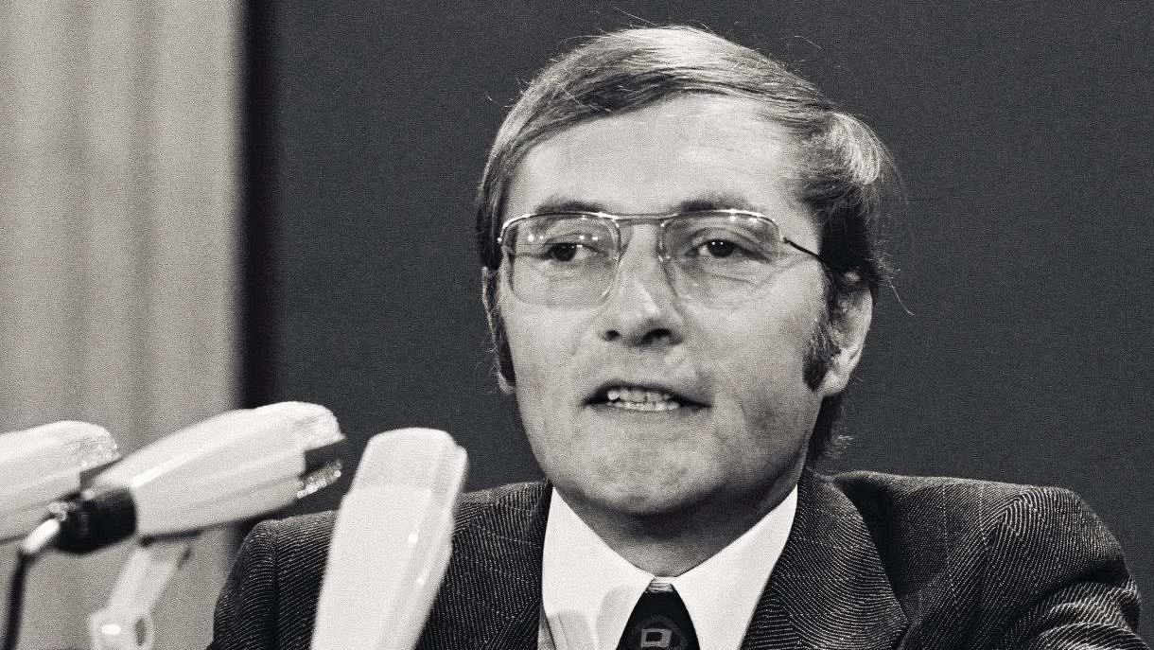
BACKGROUND
“Sagen, was ist”
“Telling it like it is”
Rudolf Augstein (1923-2002)
founded DER SPIEGEL in 1947
Notes:
The name of the SPIEGEL group is derived from its core product brand, the magazine DER SPIEGEL, which was founded by Rudolf Augstein in 1947 and has been published on a weekly basis ever since. Today, it is the news magazine with the highest circulation in Europe. The magazine first gained nationwide fame for accusing the city of Bonn of bribery in order to become the new capital of the federal republic of Germany in 1950 and has revolutionized the German media landscape ever since e.g. by being the first magazine to print coloured cover pages in 1955. Since January 1966, DER SPIEGEL has always been published on Mondays under the theme of “Montag ist SPIEGEL-Tag” (Monday is SPIEGEL-Day) and “SPIEGEL-Leser wissen mehr” (SPIEGEL-readers know more). The magazine stands for flawless investigation and reliable, high quality journalism covering different topics such as politics, economics, science, medicine, culture, entertainment, media, society and sports. In 2015, DER SPIEGEL changed its publication date from Monday to Saturday promoted by an image- and umbrella brand campaign under the claim “Keine Angst vor der Wahrheit” (Never fear the truth) which aimed at portraying the attitude and quality of the whole SPIEGEL brand. This new claim should illustrate the importance of investigative high quality journalism in times of digitalization and fake news.
Today, Rudolf Augstein’s brand promise “Sagen, was ist” (telling it like it is) welcomes everybody, who enters the headquarters in Hamburg, Germany. Those silver letters still represent the mission of the SPIEGEL group and mean, in the words of the 1949 statute, that "All the news, information and facts processed and recorded by DER SPIEGEL absolutely have to be accurate. ... The need for corrections should be avoided at all costs at DER SPIEGEL."
In order to stick to this promise, DER SPIEGEL has an extensive fact-checking system. Any text that appears in the weekly DER SPIEGEL, whether printed or digital, is read by many colleagues before its publication: by at least one department head and one Editor-in-chief, by staff in editing and the legal department. However, the heart of quality control is the in-house documentation. More than 60 colleagues make sure that names, dates and facts are correct, they verify every word and every number. Hardly any other medium puts so much effort in this process.

Slide 6
CBIRM
Relevance
How appealing and meaningful is the value they offer?
Trustworthiness
How dependable are their words and deeds?
Differentiation
How distinctive is their position in the market?
Value proposition
“SPIEGEL-Leser wissen mehr” = “SPIEGEL readers know more”
Relationship
trust through high quality reporting
Position
one of the leading media groups in Europe
Recognizability
How distinct, visible and consistent are their overall communications?
Expression
narrative journalism
patina, heritage, timeless
Identity
“Sagen, was ist” = “Telling it like it is”
Personality
neutral
intellectual
Credibility
How believable and convincing are they?
Mission & Vision
reporting based on facts and looking for the truth
Culture
shared responsibility
pressure to deliver in high standard SPIEGEL style
Competences
fact-checking system,
revolutionising high-quality journalism
Willingness-to-support
How engaging and inspiring are their purposes and practices?
Performance
How solid and consistent are their quality and performance?
Responsibility
How committed and accountable are they?
Notes:
As you can see, we applied the Corporate brand identity and reputation matrix for DER SPIEGEL GROUP. However, we will only present some of the main identity elements.
Core identity is the founder’s brand promise: telling it like it is
Mission & vision: reporting based on facts
Culture: shared responsibility, known for narrative storytelling or DER SPIEGEL style, there is a pressure to deliver in this writing style
Competences: renowned fact-checking system which consists of 60 employees who are constantly reviewing and checking the articles

Slide 7
THE INCIDENT
Notes:
However, something happened within the SPIEGEL group which represents a threat to their identity…

Slide 8
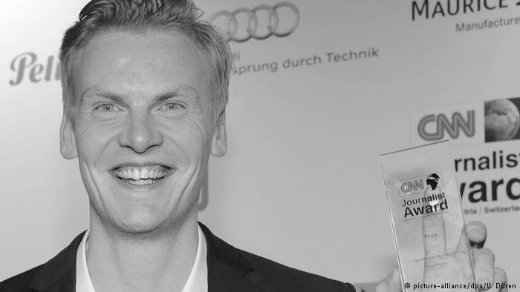
“Story of unprecedented lightness, density and relevance, which never leaves open the sources on which it is based.”
Notes:
One of their DER SPIEGELS star journalists is claas relotius, a young but very successful journalist who won several awards
Relotius received great feedback for his reports about prisoners in Guantanamo or syrian child refugees working in factories in turkey
Here you can see him with the CNN journalist award in 2014
This quote is from the German Reporter Awards 2018 for best reportage about a 13 year old boy in Syria who believes and is believed to have started the war

Slide 9
CLAAS RELOTIUS
Freelanced for 17 newspapers and magazines
Became staff journalist at DER SPIEGEL in 2017 and wrote more than 60 articles for DER SPIEGEL since 2011
Well respected employee known for his honesty and sincerity
Won many awards also internationally
  4 German Reporter Awards & CNN Journalist of the Year in 2014
Notes:
Claas Relotius was born 1985 in Hamburg
Freelanced for 17 newspapers and magazines in Germany, eg Frankfurter Allgemeine Zeitung or Zeit Online
Freelanced at der spiegel for 7 years before becoming staff journalist in 2017
Wrote more than 60 articles for der spiegel since 2011 in the narrative storytelling SPIEGEL style
Was a well respected and liked employee known for his honesty and sincerity
Despite his success he was often described as the most humble colleague

Slide 10
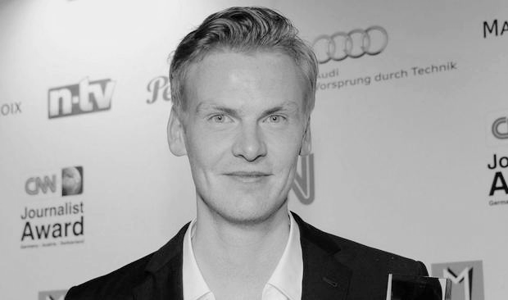
FIRST SUSPICIONS
First suspicions following the publication of the article ‘Jaeger’s Border’ by Relotius’ coworker Juan Moreno
Although being the bad guy at DER SPIEGEL, Moreno travelled to the U.S. to investigate about Relotius’ article
Relotius got awarded with the German Reporter Prize 2018 for his article ‘Jaeger’s Border’
11/2018
11/2018
03/12/2018
11/2018
03/12/2018
13/12/2018
Moreno sent an email to the fact-checking department, informed section head Geyer, and confronted Relotius
Woman in Mexico sent an email to Relotius asking how he could report about her group without having an interview beforehand
Relotius confessed internally: “It was not about the next big thing, it was the fear of failure”
Notes:
However, first suspicions towards his work arose at the end of 2018.
Relotius colleague Moreno got suspicious about the interviews for the article ‘Jaeger’s Border’ which was published in November 2018.
After collecting evidences that some interviews were not conducted but still cited, Moreno sent an email to the fact-checking department, informed section head Geyer, and confronted Relotius, who denied all accusations
During all these internal investigations and rising pressure on Relotius, he received the German Reporter Prize for the article
After the pressure got too strong, Relotius confessed internally on the 13th of december. He stated that for him,: “It was not about the next big thing, it was the fear of failure”

Slide 11
FAKE STORIES
Relotius wrote 60 articles only for DER SPIEGEL
16 other newspaper affected by fake storytelling
  8 newspapers already confirmed fraud and 8 are currently checking
Exaggerations, misrepresentations, and inventions of happenings
Interviews that never happened
Characters that do not exist
“I AM SICK AND I NEED TO GET HELP NOW”
Notes:
So what happened?
The SPIEGEL group had published under 60 articles by reporter and editor Claas Relotius, who had admitted that, in several instances, he either invented stories or distorted facts.
He included individuals in his stories who he had never met or spoken to, telling their stories or quoting them.
He also reported about people whose stories he had fabricated by basing the depictions on other media and video recordings using images, Facebook posts, YouTube videos, and material from old newspapers and obscure blogs.
In the end, he simply stated that he is sick and needs to get help now. Other than that, he did not comment on the incident.

Slide 12
HANDLING THE CRISIS
Announcement via Twitter answering the most important questions; start of investigations by new commission; new email address for clues from readers
Dedicated printed magazine published with the heading ‘Sagen, was ist’ and podcast available online
Relotius gave back his numerous awards but remained silent
19/12/2018
20/12/2018
22/12/2018
20/12/2018
21/12/2018
22/12/2018
Detailed information in article ‘We have a lot of questions to ourselves’; apology on Twitter and SPIEGEL ONLINE; list of all articles written by Relotius
Article ‘It was a feeling’ published: Moreno describes how he was able to expose the fraud of his colleague Relotius
Steffen Klusmann wrote an emotional SPIEGEL ONLINE article ‘The lessons we are drawing’
Notes:
But how did DER SPIEGEL handled this internal-rooted crisis caused by their star journalist?
public announcement via Twitter answering the most important questions; start of investigations by new commission with external and internal experts; DER SPIEGEL also set up a new email address where readers could send in clues about interviews
On 20th of december, DER SPIEGEL published detailed information in article called ‘We have a lot of questions to ourselves’; apology on Twitter and SPIEGEL ONLINE to their readers and also the family of the owner, since the scandal hurt the core identity of the brand; published list of all articles written by Relotius and the current verification status
On the same day, Relotius gave back his numerous awards
Two days later, DER SPIEGEL published podcast available online about the incident, and a dedicated printed magazine with the heading ‘Sagen, was ist’ which refers back to the core identity of the brand
On the same day, the now editor-in-chief wrote an emotional SPIEGEL ONLINE article about the lessons the company is drawing from the scandal

Slide 13
FAKE NEWS
‘Lügenpresse’ - lying press
Trump vs. CNN
Industry spillover effect
Critical time for credibility in the media world
Notes:
DER SPIEGEL crisis has implications in the wider context as well
The current media world is highly polarised, just as many other aspects in our society
Journal and media outlets are criticised for being ‘party biased’
As the direct outcome of the DER SPIEGEL scandal, the media group is criticised. The German historical term, ‘lügenpresse-lying press’ is used by far right parties to critique the SPIEGEL group
Furthermore, the DER SPIEGEL scandal was picked in the US, supporting the fake news allegations by the Trump administration
In the US - Trump’s administration and supporters are using the term, ‘fake news’ against journals who report unfavourable information. CNN, The New York Times are often targeted by these accusations, and the DER SPIEGEL case was connected to Relotius’ CNN award…
This shows that the DER SPIEGEL crisis has an industry spillover effect
We are facing a critical period, where trustworthiness and credibility are crucial for any media groups due to polarisation and fake news/lugenpresse accusations is critical ime

Slide 14
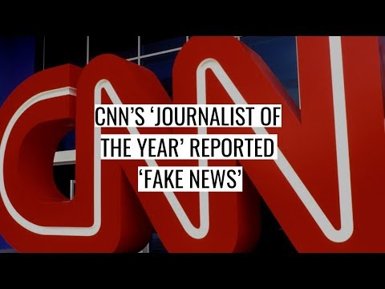
SUM UP
Notes:
Here you can see that the scandal also gained worldwide media attention
This video is an example of how right-wing media picks up on the crisis and forgery
https://www.youtube.com/watch?v=Im_RQlo89m4

Slide 15
THE CASE
Notes:
Now we would like to discuss the DER SPIEGEL crisis’ effects in the international context

Slide 16
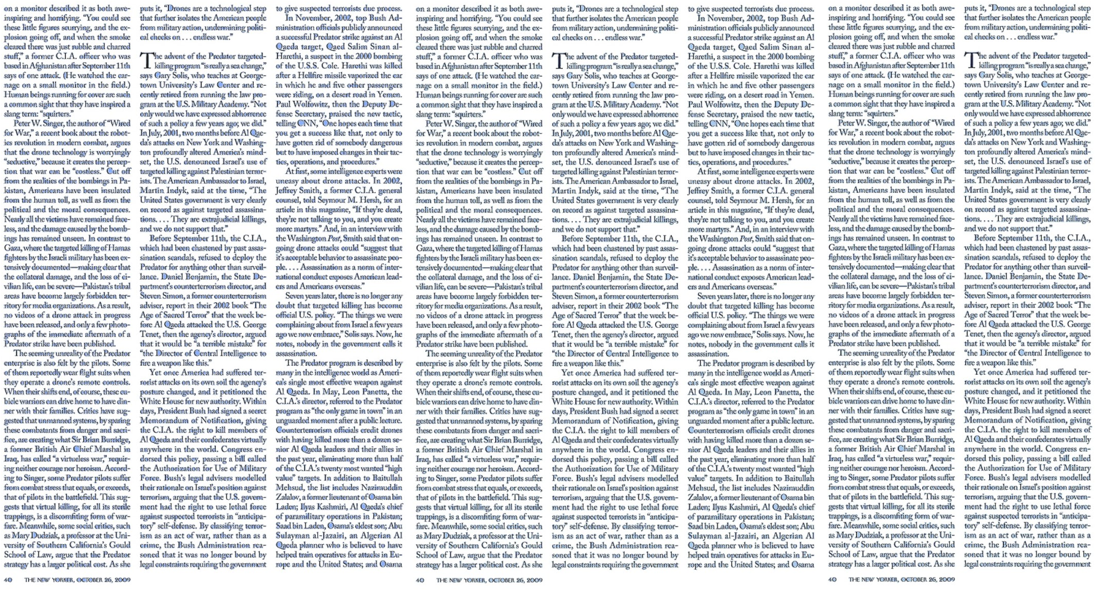
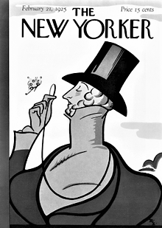
THE NEW YORKER
American weekly magazine
Founded in 1925
Wide audience outside New York
Read internationally
Known for rigorous fact checking and copy editing
Similar reader statistics to DER SPIEGEL
Notes:
We could see that the crisis has international implications
Therefore a stakeholder in the US context can provide interesting insights
The New Yorker is an…..
American weekly magazine
Wide audience outside New York and also read internationally
Known for rigorous fact checking and copy editing
Has similar readership statistics as DER SPIEGEL - paper is mostly read by people holding left-of-center political views.
Due to the industry spillover effect
the polarised media world
the crisis can have an effect on The New Yorker’s own trustworthiness and credibility

Slide 17
SHOULD YOU COMMENT ON THE INCIDENTS OR NOT?
And if so, would you support, be neutral or criticise DER SPIEGEL?
What are the short- and long-term consequences for The New Yorker?
Notes:
Now imagine that you are David Remnick, the Editor-in-chief at The New Yorker, enjoying a coffee at your office in the centre of Manhattan while it is heavily snowing outside on a cold day in the beginning of January
You just watched the news reporting about the DER SPIEGEL scandal, as they say that 77% of Americans believe in Fake NEWS
As you think about the impact of this crisis on your own magazine and the entire industry in times of fake news and lying press, you pose yourself the questions
SHOULD YOU COMMENT ON THE INCIDENTS OR NOT?
And if so, would you support, be neutral or criticise DER SPIEGEL?
What are the short- and long-term consequences for The New Yorker?
Who should write the article, you as the Editor-in-chief or someone else?
What consequences would the competitor face if it supports DER SPIEGEL?
If they supported DER SPIEGEL, would the competitor be suspicioned for having similar problems?
What consequences would the competitor face if they stayed neutral about DER SPIEGEL?
If they stayed neutral, would they miss out on reporting on a good story?
What consequences would the competitor face if it criticizes DER SPIEGEL?
If they criticized DER SPIEGEL, would they not harm their own reputation as well in terms of ‘fake news’ and not believing everything that is said in the news?
Whom would you blame? The SPIEGEL group or Claas Relotius?
Do you think The New Yorker is affected by the DER SPIEGEL scandal considering that they operate on different markets?
Can you consider international magazines or newspapers competitors of DER SPIEGEL?
Would you say the media landscape is rather national or rather global in today’s world?
Does the crisis provide a good time for a competitor to make a statement in the present heavily-critiqued media environment?
How can the competitors contribute to rebuilding the industry reputation and fight ‘fake news’ and ‘lying press’ supporters?

Slide 18




WOULD YOUR DECISION CHANGE IF YOU WERE A GERMAN COMPETITOR?
What are the short- and long-term consequences for German competitors?
Notes:
Who should write the article, you as the Editor-in-chief or someone else?
What consequences would the competitor face if it supports DER SPIEGEL?
If they supported DER SPIEGEL, would the competitor be suspicioned for having similar problems?
What consequences would the competitor face if they stayed neutral about DER SPIEGEL?
If they stayed neutral, would they miss out on reporting on a good story?
What consequences would the competitor face if it criticizes DER SPIEGEL?
If they criticized DER SPIEGEL, would they not harm their own reputation as well in terms of ‘fake news’ and not believing everything that is said in the news?
Whom would you blame? The SPIEGEL group or Claas Relotius?
Do you think The New Yorker is affected by the DER SPIEGEL scandal considering that they operate on different markets?
Can you consider international magazines or newspapers competitors of DER SPIEGEL?
Would you say the media landscape is rather national or rather global in today’s world?
Does the crisis provide a good time for a competitor to make a statement in the present heavily-critiqued media environment?
How can the competitors contribute to rebuilding the industry reputation and fight ‘fake news’ and ‘lying press’ supporters?

Slide 19
MANAGERIAL DECISION
Notes:
Thank you for an interesting discussions. Let us present how the competitors reacted.

Slide 20
MANAGERIAL DECISIONS: THE NEW YORKER
Report by local expert - not the Editor-in-Chief
“The Deep Pathology at the Heart of the Scandal at DER SPIEGEL”
Includes interviews with SPIEGEL employees
Main critique towards fact-checking department and narrative storytelling
Speculations: Stylistic excesses might be reined by new Editor-in-chief
Notes:
Not Editor-in-chief
Local expert - Elisabeth Zerofsky
Article published end of January - cautious waiting time
Acknowledges the prestige of DER SPIEGEL, their esteem in fact-checking
analysis on how this scandal can affect the news outlet’s approach to their journalistic writing style
Most extreme amongst the international media reactions
Critiques: colourful storytelling style of reporting, and fact-checking
Interviews with key actors, such as fact checking employees and Moreno (person who discovered the forgery)
employees were ‘deeply sad’ and shocked
“‘how could one single person be so harmful to what they took pride on” - [precise fact checking]
Moreno: ‘only benefit of the case, that it has been discovered internally’.
‘exceptional in its excesses, and deeply pathological’
Relotius’ thought-through fabrication, and misleading of the fact-checking department in an operational manner
Zerofsky: fact-checking employees still oversaw other details, that could have been avoided even with the misleading acts of Relotius
The New Yorker: DER SPIEGEL-style
almost like a ‘Hollywood’ writer
Even own editorial regarding the Relotius affair was written in this so-called DER SPIEGEL-style
presenting Relotius as an ‘evil nimbus’ and Moreno as the magazine’s ‘white knight’.
The New Yorker:
Speculations that the new editor-in-chief, Klusmann may use the incident to rein DER SPIEGEL’s stylistic excesses
The New Yorker article briefly discusses the political implications of fabricating stories in the current media industry and political climate
‘Lügenpresse’ (lying press) - critique from the far-right party for DER SPIEGEL
The US Ambassador to Germany - he criticised DER SPIEGEL for being anti-American

Slide 21
MANAGERIAL DECISIONS: GERMAN COMPETITORS
DIE WELT:
FRANKFURTER ALLGEMEINE ZEITUNG:
DIE ZEIT:
HAMBURGER ABENDBLATT:
Notes:
In national media, this scandal gaines a wide coverage; ranging from neutral, supportive to critical
Mostly protecting Relotius and criticizing the narrative storytelling style that it motivated to exaggerate the story
Overall, comparable German newspapers stayed neutral and did not comment on DER SPIEGEL scandal regarding Relotius’ faked stories. As Relotius worked as a freelancer before being permanently employed at DER SPIEGEL, he wrote many articles for different German newspapers. Consequently, affected competitors such as DIE ZEIT, Frankfurter Allgemeine Zeitung, and Sueddeutsche Zeitung informed their readers about the incident in a neutral tone and apologized in a short statement before each concerned article. Moreover, some articles were taken off the website until verified by an internal investigation team to clarify if those articles were faked as well. Next to these neutral statements, no official view or opinion from important editors-in-chiefs was published.

Slide 22
CONCLUSION
Notes:
Now, we will end this case with a short conclusion

Slide 23
CONCLUSION
Successful crisis management by DER SPIEGEL
Honesty, transparency, and sincerity
International media: mostly silent or neutral, The New Yorker in-depth report with slight critique on SPIEGEL-style
National media: wide coverage; ranging from neutral, supportive to critical
Overall, critiques related to Claas Relotius, and the narrative style of the media group
Notes:
Overall, we believe that the SPIEGEL group has been successfully managing the crisis as they reported about the scandal in a very transparent, self-critical, credible and authentic way.
Furthermore, they recognised that the brand essence, Rudolf Augstein’s “sagen, was ist”, was threatened and took actions to defend it, for instance by apologizing to the family of the founder and by assuring the quality of the fact checking system.
Reflecting on the competitors’ actions internationally, most renowned media groups remained silent except for The New Yorker.
As said earlier, an in-depth report with slight critique on the SPIEGEL style was published.
On a national level, more competitors commented on the scandal. The ones which were critical, mainly blamed Claas Relotius instead of the SPIEGEL group.
However, DER SPIEGEL’s fact checking system and narrative storytelling style, which strongly contributed to triggering the scandal, were criticised.

Slide 24
LEARNINGS
remembering
how companies can manage an internally-rooted crisis and that the crisis can have a spill-over effect on competitors in the industry
understanding
how identity and reputation influence each other before, during, and after a crisis
applying
corporate brand and crisis management frameworks to assess crisis situations, manage them, and react to them as a competitor
evaluating
how a crisis of one company can affect the competitors’ and industry reputation
creating
decisions on a top management level as a reaction to a competitor’s crisis
Notes:
Overall, we learned today
how companies can manage an internally-rooted crisis and that the crisis can have a spill-over effect on competitors in the industry
Moreover, we understood how identity and reputation influence each other before, during, and after a crisis
We also applied corporate brand and crisis management frameworks to assess crisis situations, manage them, and react to them as a competitor
We evaluated how a crisis of one company can affect the competitors’ and industry reputation
Finally, we created decisions on a top management level as a reaction to a competitor’s crisis

Slide 25
THANK YOU FOR YOUR ATTENTION
Notes:
So, we really appreciate your input and would thank you very much for listening to us and engaging on the discussion.

