Slide 1

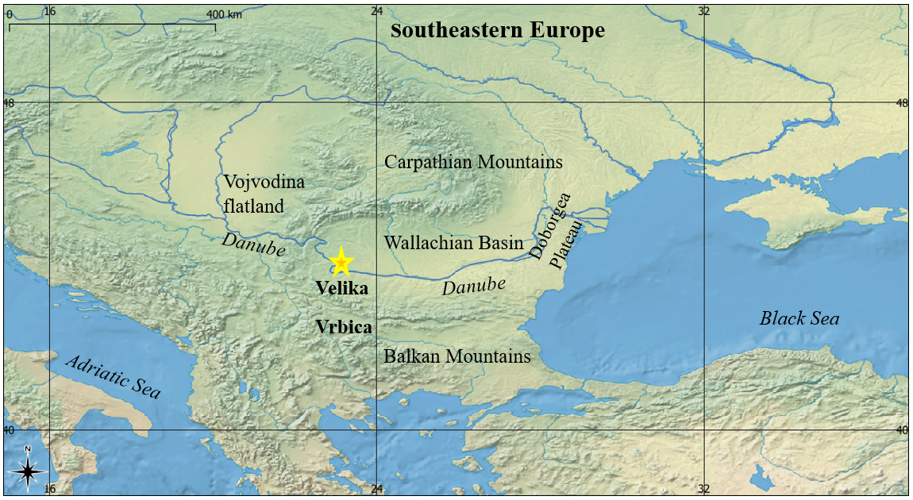
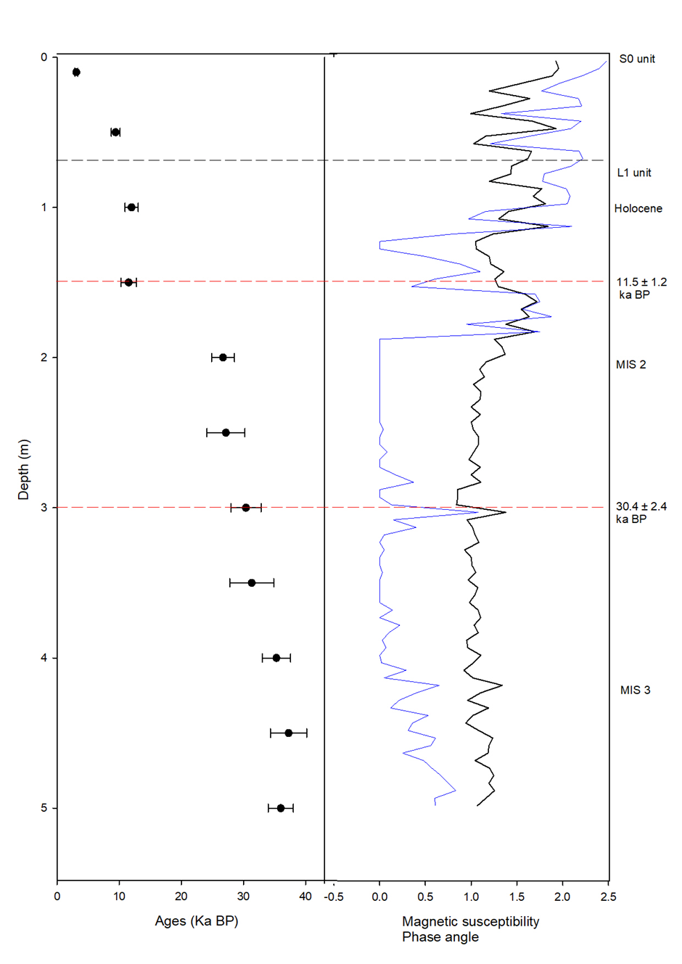
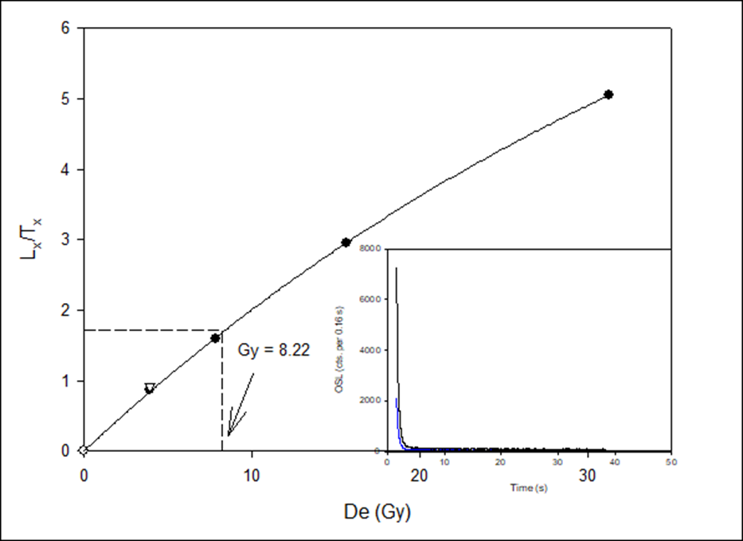
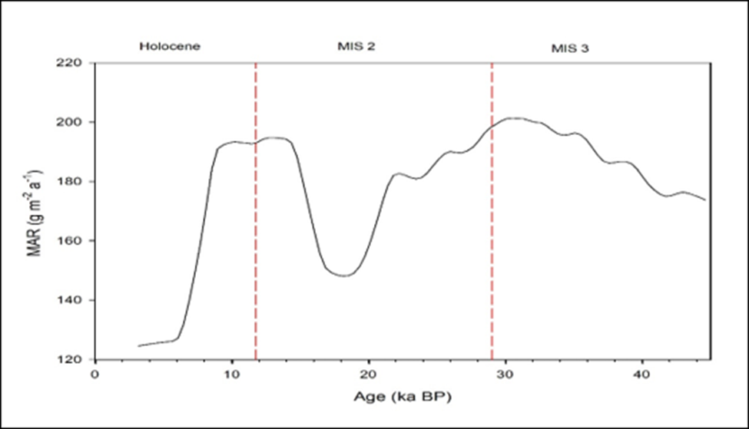
LUMINESCENCE DATING OF THE LATE QUATERNARY LOESS-PALAEOSOL SEQEUNCE AT VELIKA VRBICA, SERBIA
Cathal Ryan
Introduction
Loess-palaeosol sequences (LPS) → valuable geological archive used for palaeoclimate and environmental reconstructions
The LPS of Velika Vrbica (Fig. 1) → excellent site to study LPS
Loess deposition → proxy for colder stadial-like conditions
Development of soils (pedogenesis) → warmer, more humid conditions
Figure 1 Map of the Velika Vrbica LPS site (yellow star). Major relief landforms in the region are the Carpathians and Balkan Mountains.
Research aims
Methodology
Optical stimulated luminescence (OSL) → age-depth model of LPS
Mass accumulation rate (MAR) → past atmospheric dust flux
Magnetic susceptibility (MS) → pedogenesis record
Uppermost 5 m of the facies (11 samples, 50 cm resolution) was sampled for:
OSL → quartz grains (63 – 90 µm).
MAR curve → rbacon
MS → 5 cm interval.
Results
Lifespan of the upper 5 metres is 36 ± 2.0 ka BP, with no hiatuses (Table 1)
One soil (S0) and one loess deposit (L1).
The quartz had a clean signal → highest De value was 110 Gy
Table 1 Age and MAR results
 | Age (ka) | MAR (g m⁻² a⁻¹ )
Latter Holocene | 3.1 – 8 | 132.1
Early Holocene | 8 – 11.7 | 189.4
MIS 2 | 11.7 – 29 | 177.3
Late MIS 3 | 29 – 36 | 190.1
Figure 4 Age-depth model (left) & MS (right). Variations in MS particles at an interval of 5 cm (black). Variation in the phase angle of SPM Material (blue)
Figure 2 Dose-response curve for sample 22173.
Figure 3 MAR results with boundaries between marine isotope stages (MIS) (red dashed lines)
Discussion
LPS record shows excellent potential in reconstructing atmospheric dust activity over the last 36 ka
Loess deposition was evident throughout all periods
Holocene climate: stadial-like conditions → lag between climate and landscape stabilisation
MIS 2 & MIS 3: Changes in MS displayed are dated similar to stadial/interstadial shifts → three Dryases and the Denekamp interstadial
Boundaries between MIS stages not clearly defined → dominance of dust in the record
Velika Vrbica is a site which can provide a solid palaeoclimate archive → improve understanding of the loess regions of southeastern Europe

