Slide 1
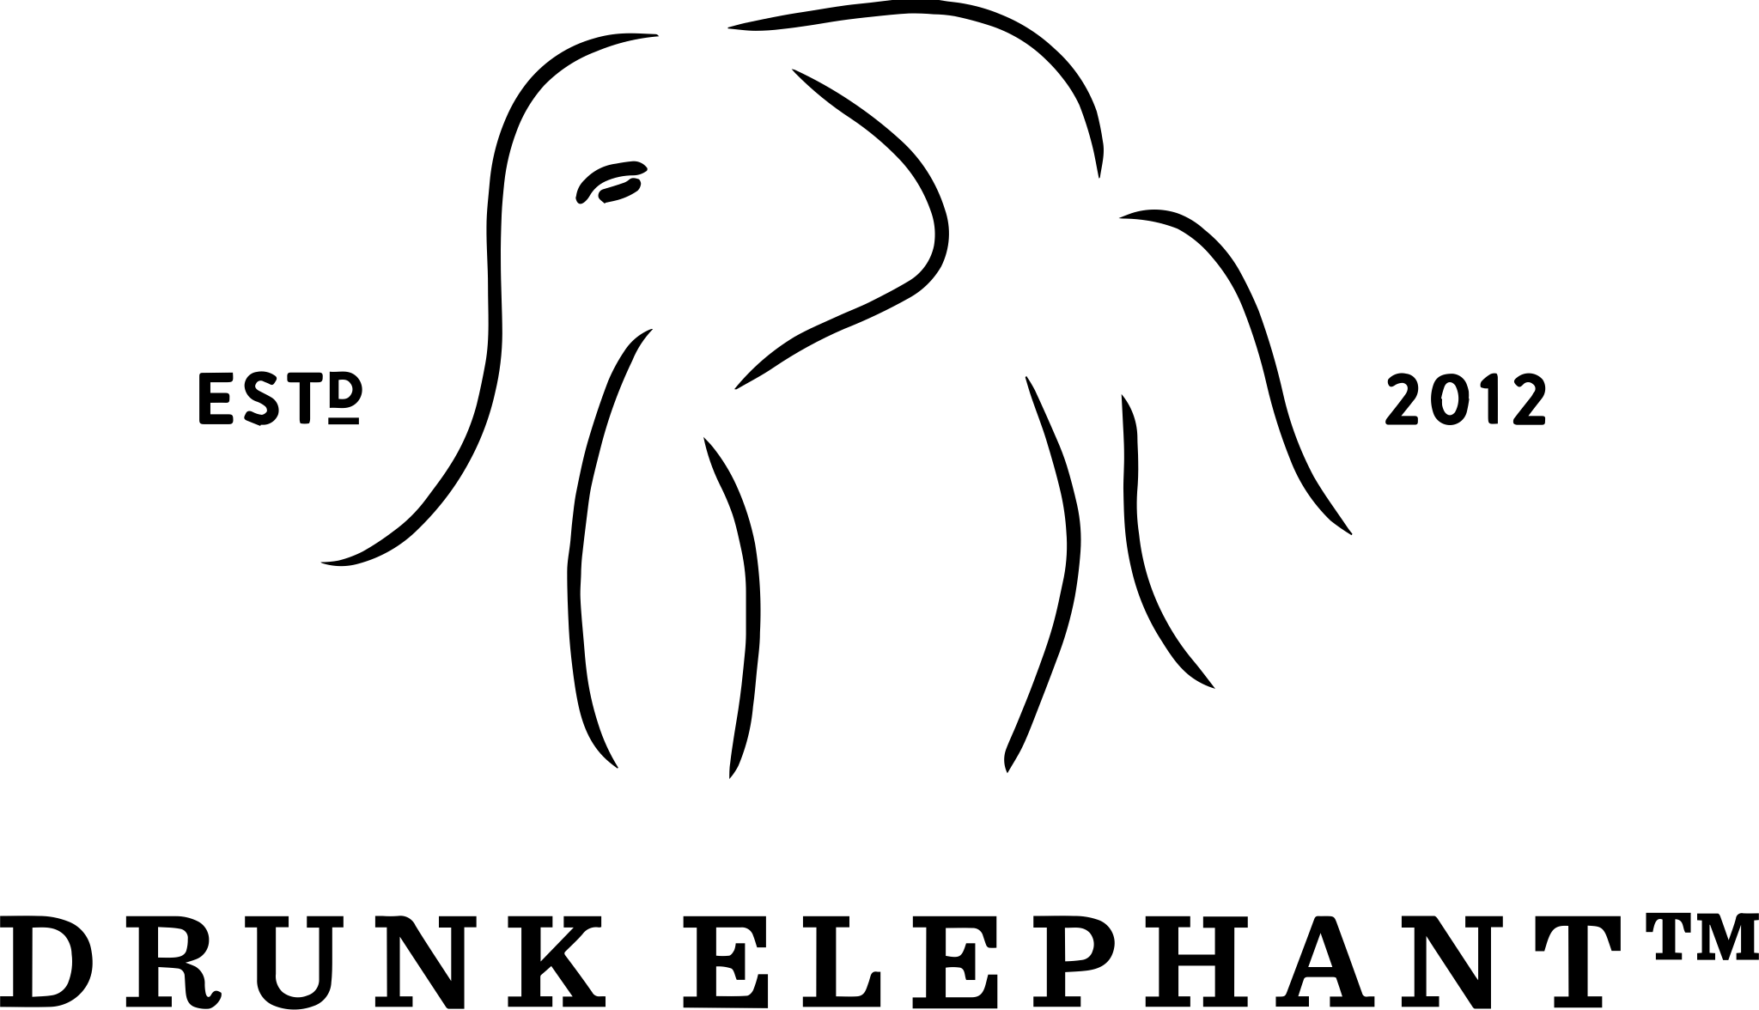
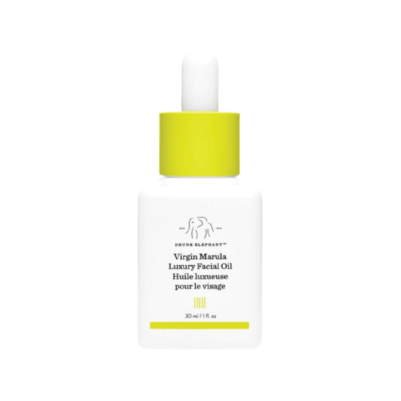
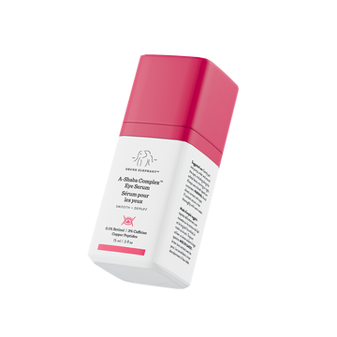
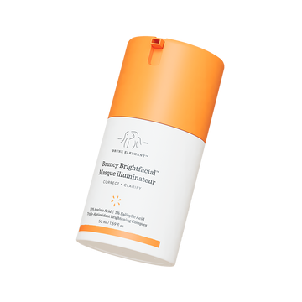
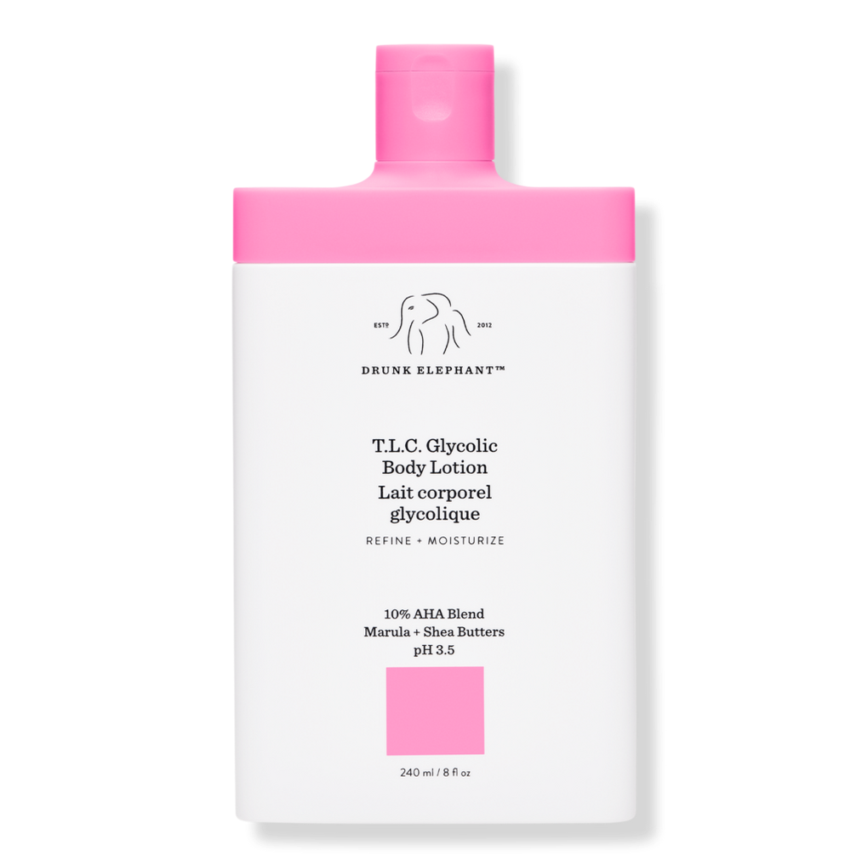
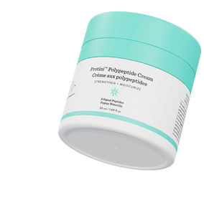
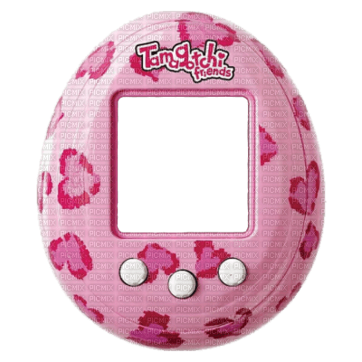
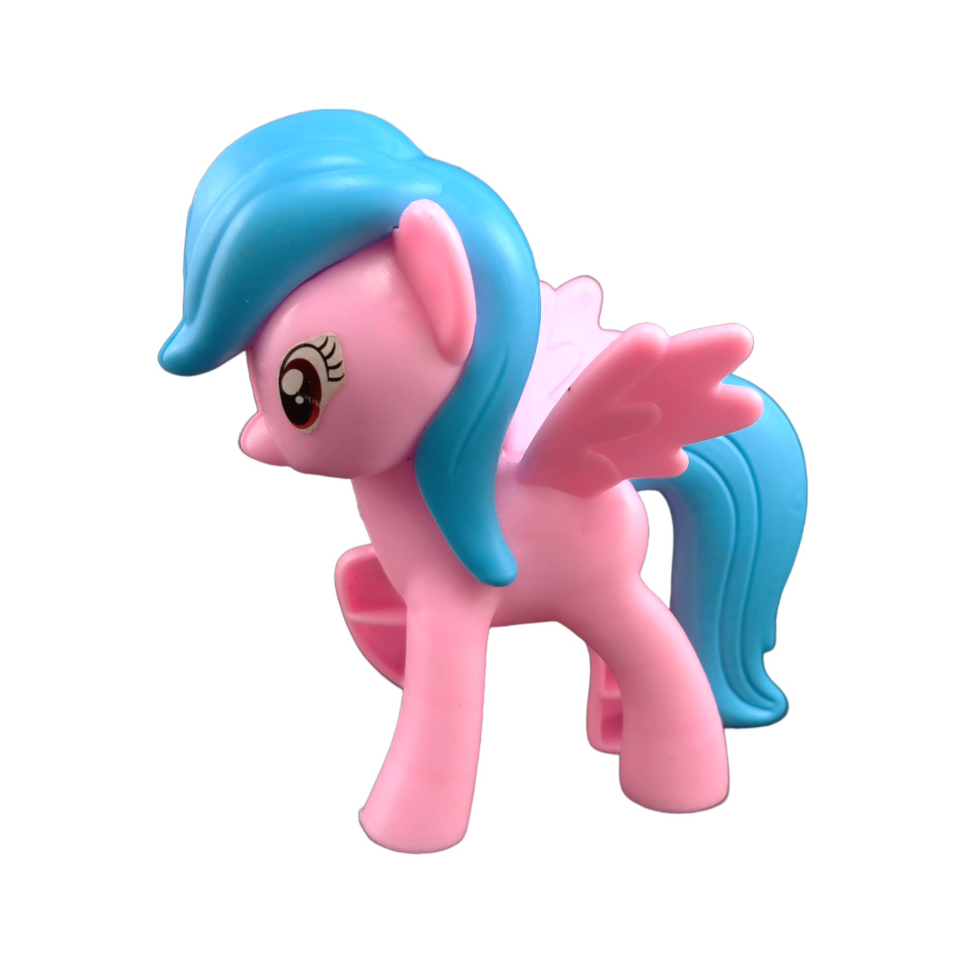
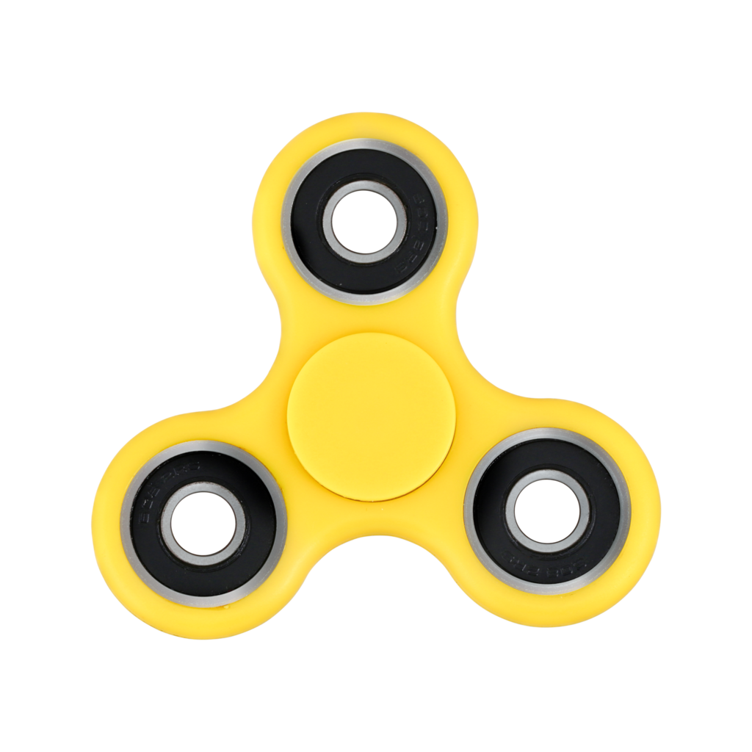
The New Toys’R’Us?
GROUP 2-A I Ida-Nora Hammar I My Dinh I Talía Yepes

Slide 2


Drunk Elephant
origins
“Millenial clickbait”:
Fast - growing high-end skincare for women in their twenties and older.
Founded by Tiffany Masterson in the US.
#DrunkBreak
Free from the Suspicious 6™.
GROUP 2-A I Ida-Nora Hammar I My Dinh Talía I Yepes

Slide 3
Timeline leading up to the incident
Tiffany Masterson identifies the Suspicious 6™ & establishes Drunk Elephant.
Shiseido acquires Drunk Elephant for $845 million
2012
2017
2018
2020
Brand achieved remarkable success, with net sales approaching $100 million.
Surge in popularity among Gen Alpha thanks to TikTok.
#1 Brand at Sephora*
*America, 2021, measured in sales.
GROUP 2-A I Ida-Nora Hammar I My Dinh I Talía Yepes
Notes:
2012: Drunk Elephant's Inception
Tiffany Masterson, a mother of four, establishes Drunk Elephant during the noughties recession.
Masterson identifies the Suspicious 6™ ingredients causing skin irritation and eliminates them from her regimen.
2017: Financial Backing and Growth
Masterson secures a $300 million investment from her brother-in-law and an undisclosed amount from her brother.
Forbes recognizes Drunk Elephant as "one of the fastest-growing prestige skincare companies in history."
2018: Shiseido Acquisition
Shiseido acquires Drunk Elephant for $845 million, strengthening Shiseido's position in the global prestige skincare market.
2019-2023: Gen Alpha Rise
Gen Alpha, consisting of children and teens, emerges on social media platforms, particularly Instagram and TikTok.
Drunk Elephant experiences a 300% surge in followers among Gen Alpha due to its vibrant packaging and childlike appeal.
Net sales soar, with a 77% to 90% year-to-date increase reported in America during the third quarter of 2023.
2021> #1 in sephora
2023: Retailer Surge and Ethical Concerns
Retailers, especially Sephora, witness a surge in tweens in their stores seeking Drunk Elephant products.
Incidents of vandalism, rude behavior, and inappropriate product usage by tweens tarnish the shopping experience.
The hashtag #sephorakids gains traction on TikTok with 560.2 million views, highlighting the impact on other stakeholders.
Concerns arise about the misuse of Drunk Elephant's adult-oriented products by children, raising ethical questions.
2024: Critical Juncture
Drunk Elephant faces heightened scrutiny from dermatologists, parents, and Sephora employees regarding product safety and appropriateness.
A broader conversation emerges about whether Drunk Elephant should proactively address the ethical concerns associated with its Gen Alpha market.
The brand is at a pivotal decision point that could significantly impact its corporate reputation and market position.

Slide 4

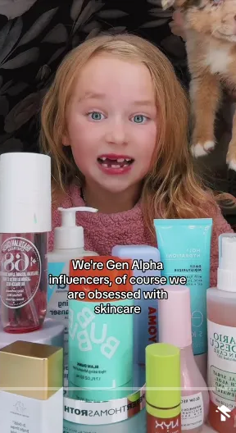
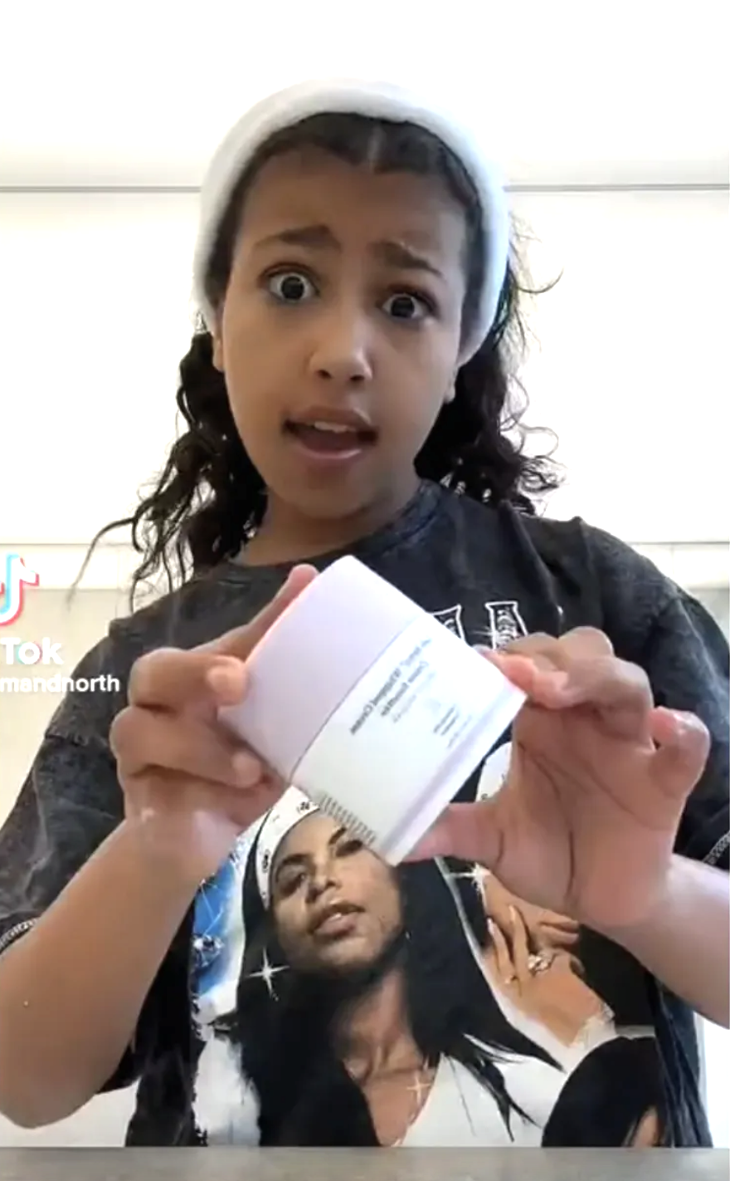

Slide 5
Timeline of the Incident
Concerns arise about the misuse of Drunk Elephant's adult-oriented products by children
November 2023
February 2024
Drunk Elephant makes a decision and addresses the issue, but how?
GROUP 2-A I Ida-Nora Hammar I My Dinh I Talía Yepes
Notes:
2012: Drunk Elephant's Inception
Tiffany Masterson, a mother of four, establishes Drunk Elephant during the noughties recession.
Masterson identifies the Suspicious 6™ ingredients causing skin irritation and eliminates them from her regimen.
2017: Financial Backing and Growth
Masterson secures a $300 million investment from her brother-in-law and an undisclosed amount from her brother.
Forbes recognizes Drunk Elephant as "one of the fastest-growing prestige skincare companies in history."
2018: Shiseido Acquisition
Shiseido acquires Drunk Elephant for $845 million, strengthening Shiseido's position in the global prestige skincare market.
2019-2023: Gen Alpha Rise
Gen Alpha, consisting of children and teens, emerges on social media platforms, particularly Instagram and TikTok.
Drunk Elephant experiences a 300% surge in followers among Gen Alpha due to its vibrant packaging and childlike appeal.
Net sales soar, with a 77% to 90% year-to-date increase reported in America during the third quarter of 2023.
2021> #1 in sephora
2023: Retailer Surge and Ethical Concerns
Retailers, especially Sephora, witness a surge in tweens in their stores seeking Drunk Elephant products.
Incidents of vandalism, rude behavior, and inappropriate product usage by tweens tarnish the shopping experience.
The hashtag #sephorakids gains traction on TikTok with 560.2 million views, highlighting the impact on other stakeholders.
Concerns arise about the misuse of Drunk Elephant's adult-oriented products by children, raising ethical questions.
2024: Critical Juncture
Drunk Elephant faces heightened scrutiny from dermatologists, parents, and Sephora employees regarding product safety and appropriateness.
A broader conversation emerges about whether Drunk Elephant should proactively address the ethical concerns associated with its Gen Alpha market.
The brand is at a pivotal decision point that could significantly impact its corporate reputation and market position.

Slide 6
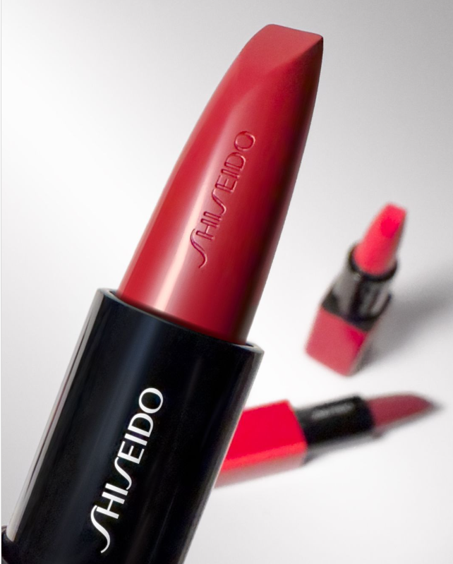
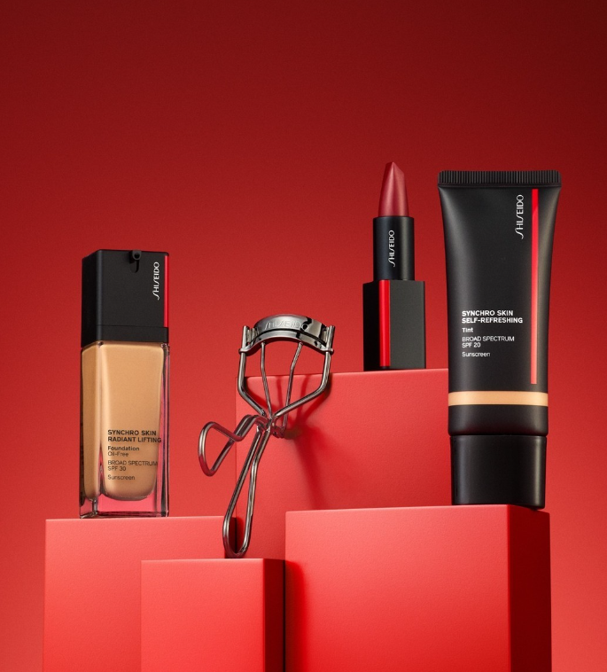
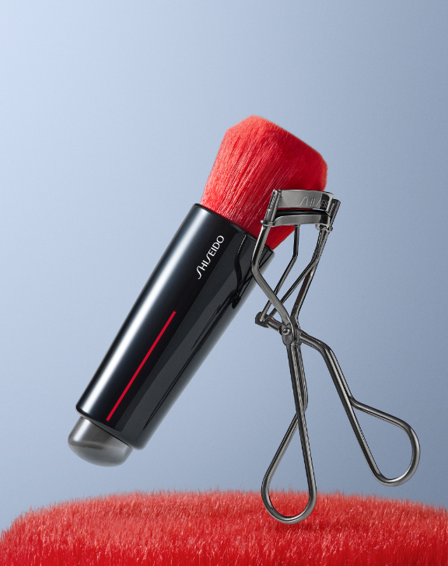
Shiseido & Drunk Elephant
Shiseido financial performance has been not too good.
Need for financial improvement in American and EMEA market.

Slide 7
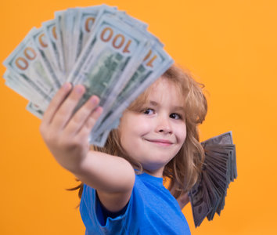
Gen Alpha impact
Largest Generation Ever
2.5 Billion
estimated by 2024
Spending power of
$5.46 Trillion
USD by 2029
Accumulating
+29 Million
Views of #GenerationAlpha

Slide 8
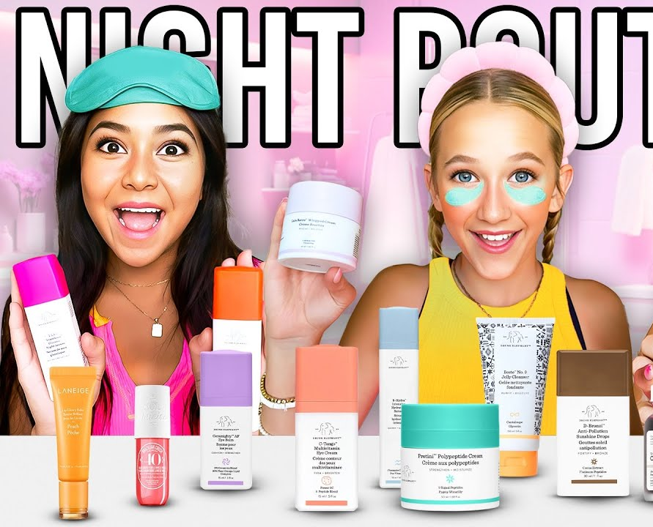
Gen Alpha impact
Impact on Drunk Elephant
77% to 90%
Increase in net sales 2023
Increase in followers
+300%
On Instagram from ‘17-’24
GROUP 2-A I Ida-Nora Hammar I My Dinh I Talía Yepes

Slide 9



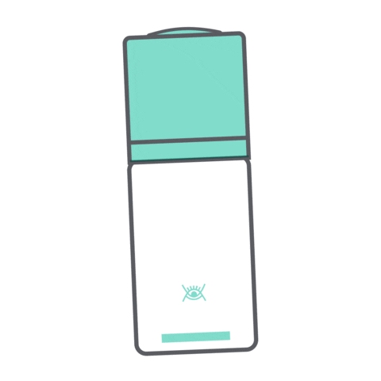





The New
Toys’R’Us for kids and tweens?

Slide 10
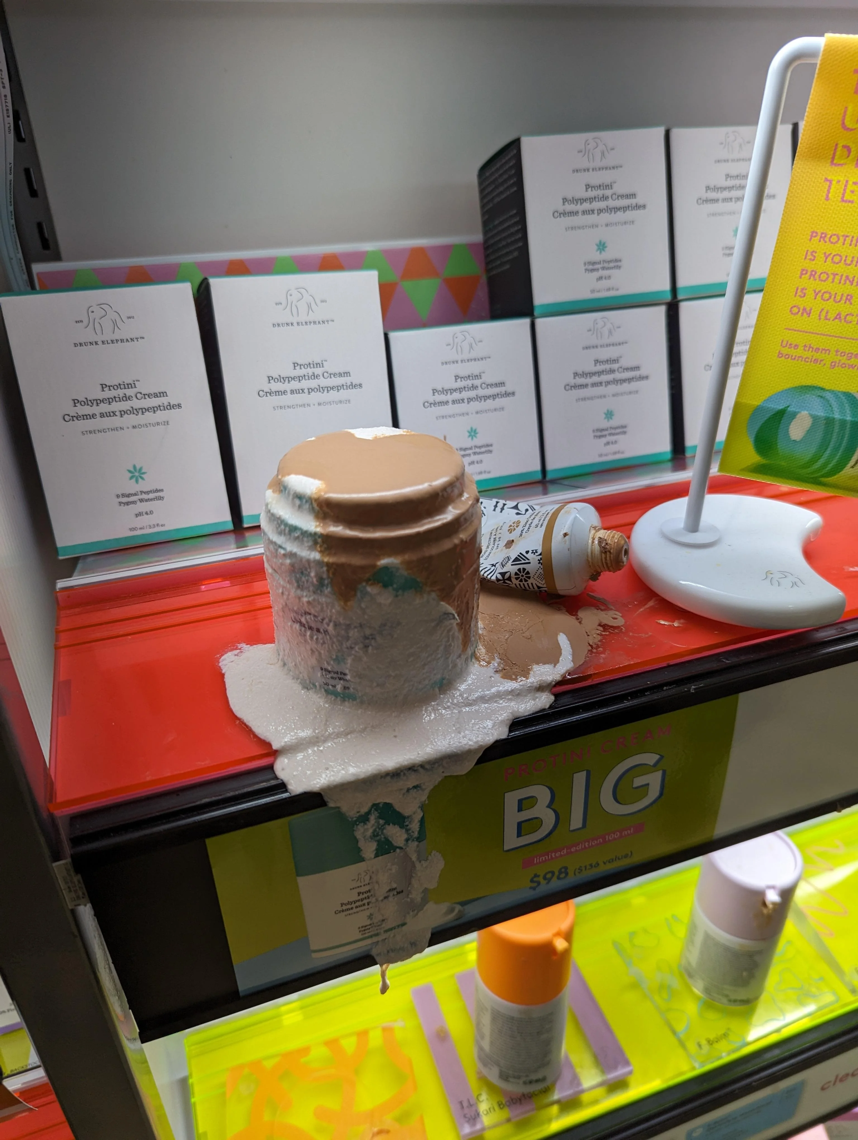
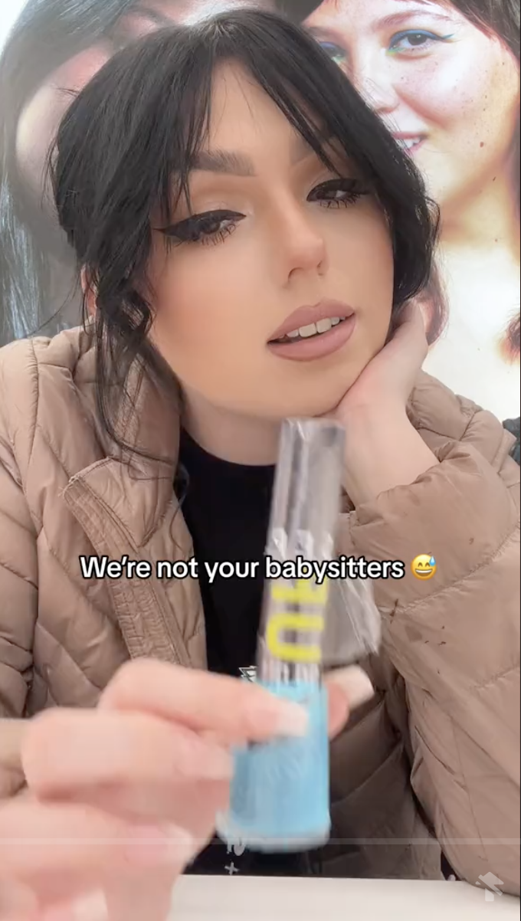
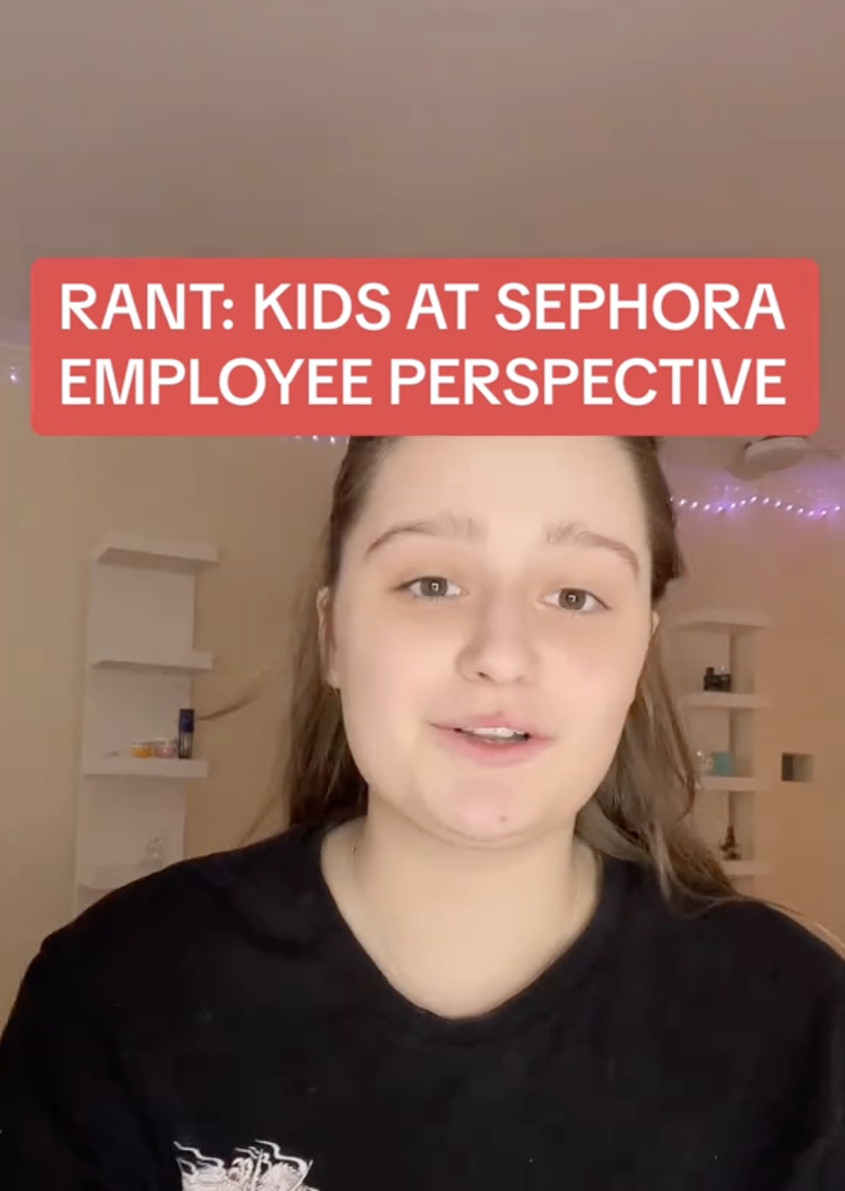
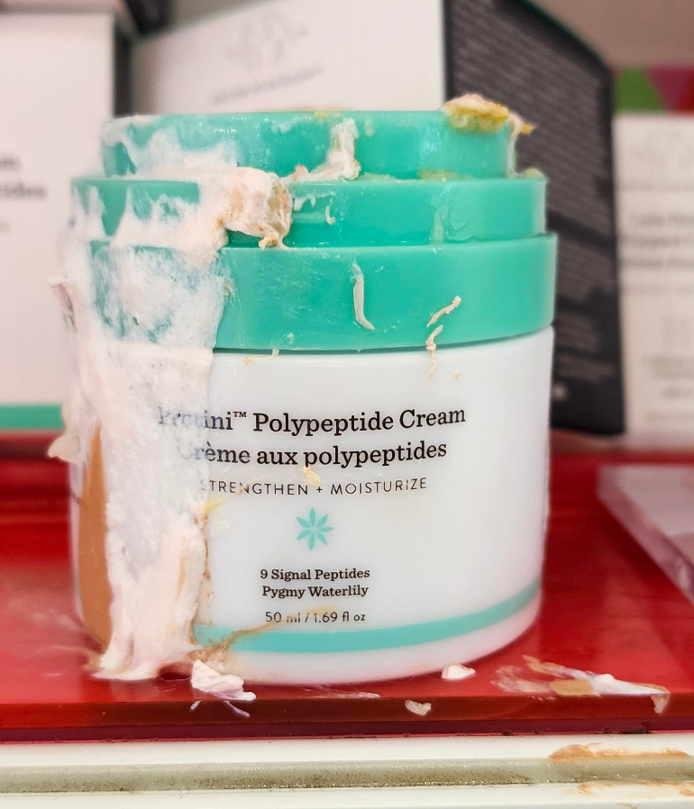
Backlash from Employees
Sephora Employees
GROUP 2-A I Ida-Nora Hammar I My Dinh I Talía Yepes

Slide 11
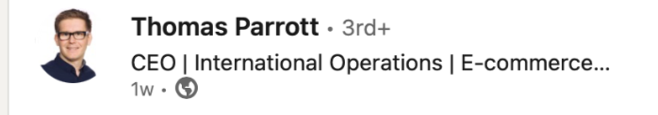
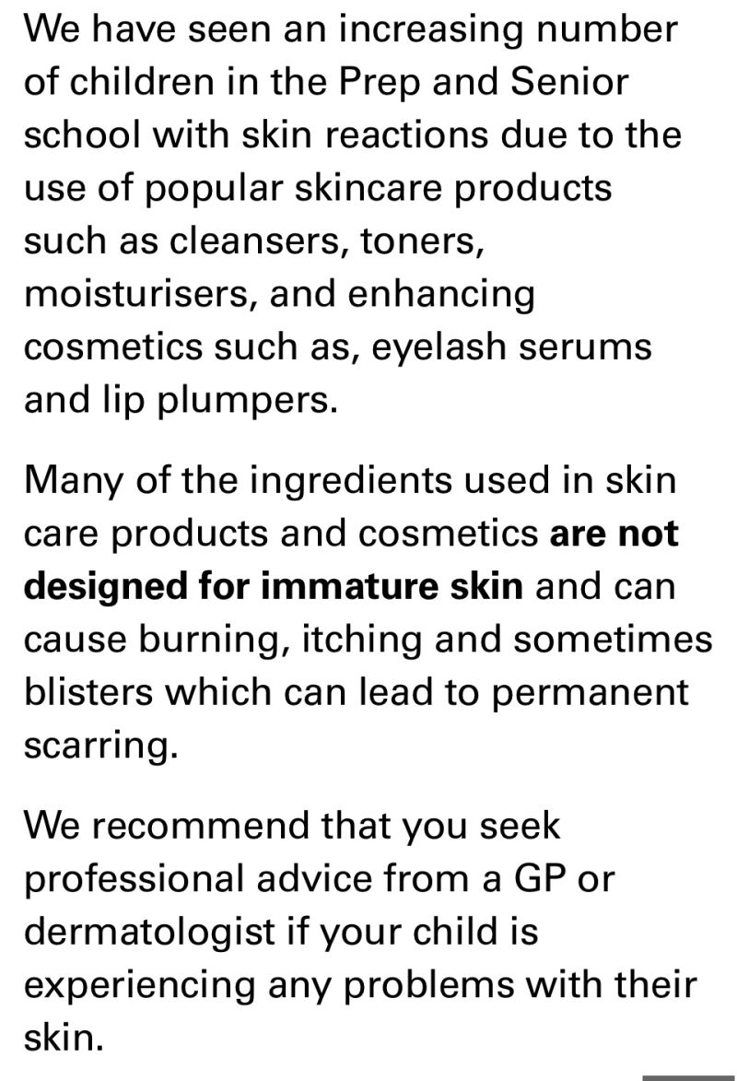
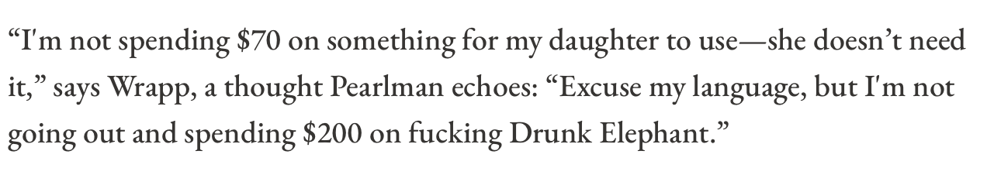
Backlash from Parents & Schools
“My daughters school felt compelled to sent this note to parents yesterday further highlighting that there is a problem serious enough that a child could experience permanent damage to their young skin”
“The responsibility cannot be all on parents. How does the industry tackle this?”
Parent and CEO of Skin Care firm
Parent
GROUP 2-A I Ida-Nora Hammar I My Dinh I Talía Yepes

Slide 12
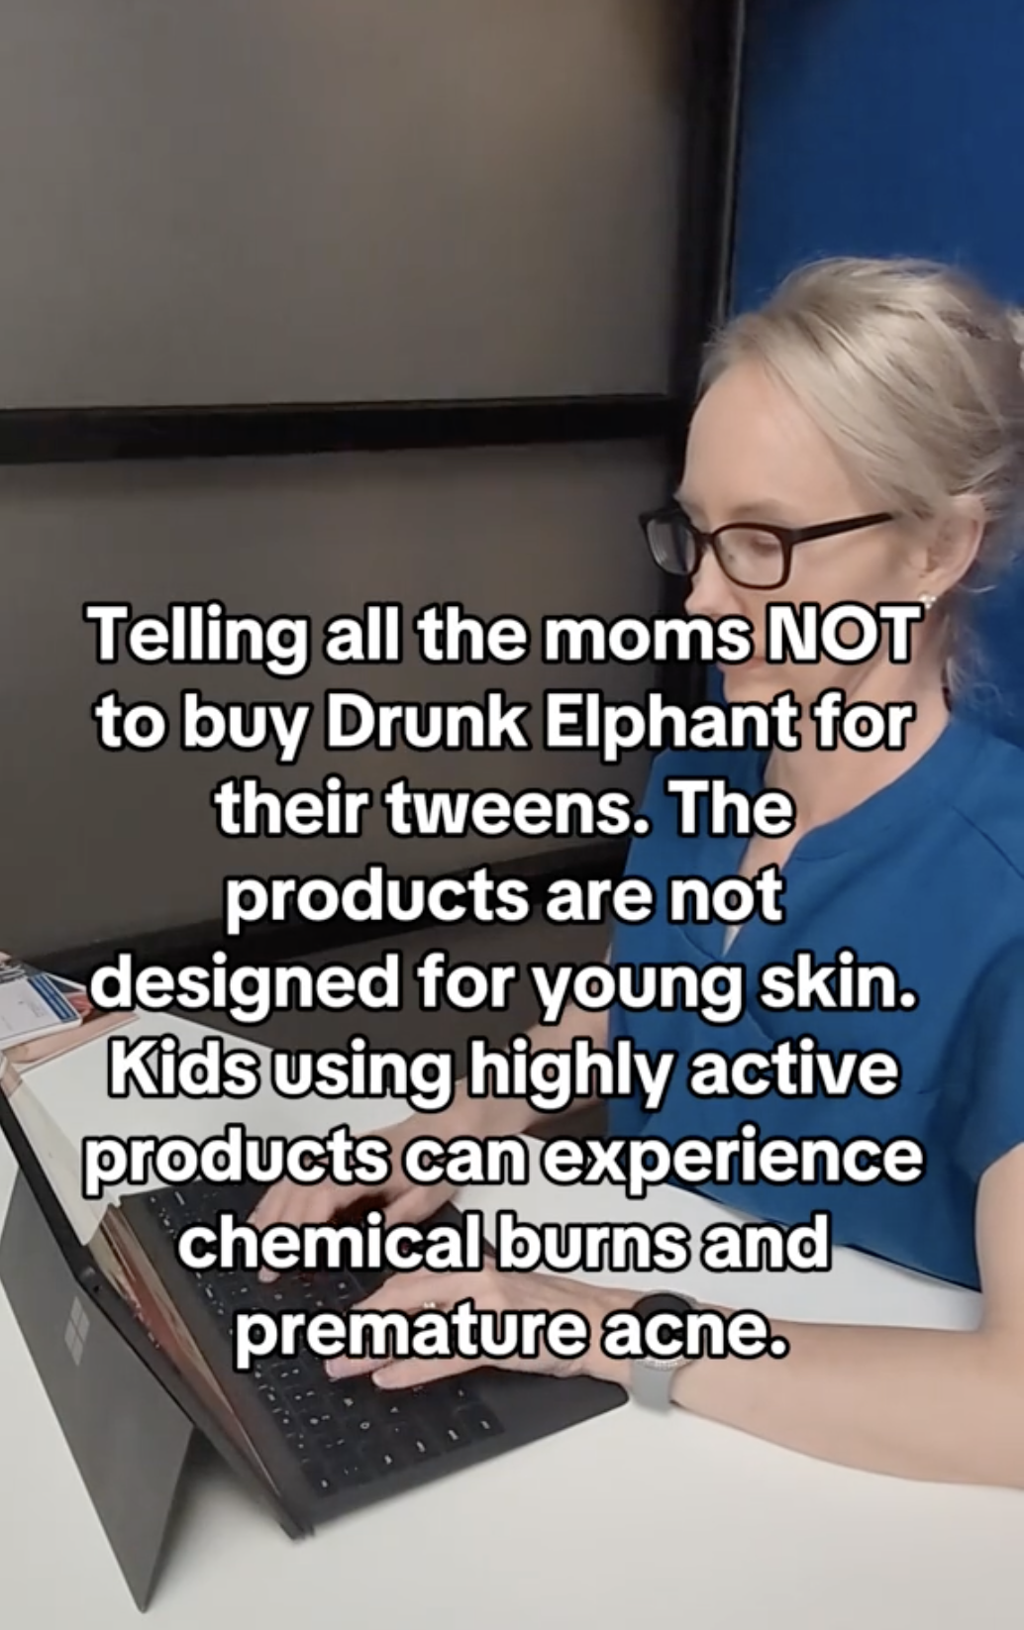
Backlash from Doctors
Dermatologist
“The Impact on Mental Health Beauty for Generation Alpha. Concerns arise over potential links between beauty obsession and mental health issues like anxiety, eating disorders, and depression. An overemphasis on achieving specific looks or misuse of products leading to rashes highlights a need for education and awareness.”
MD Columnist
GROUP 2-A I Ida-Nora Hammar I My Dinh I Talía Yepes

Slide 13
CSR & Moral Philosophy
Principles of Social Justice & Profiting Off-of Injustice Principles of Primary Agents in Drunk Elephant Case
Moral Responsibility
5
4
3
2
1
Benefiting from Injustice
Causal
Responsibility
Parents
Drunk Elephant
Capacity
Community
TikTok
GROUP 2-A I Ida-Nora Hammar I My Dinh I Talía Yepes

Slide 14
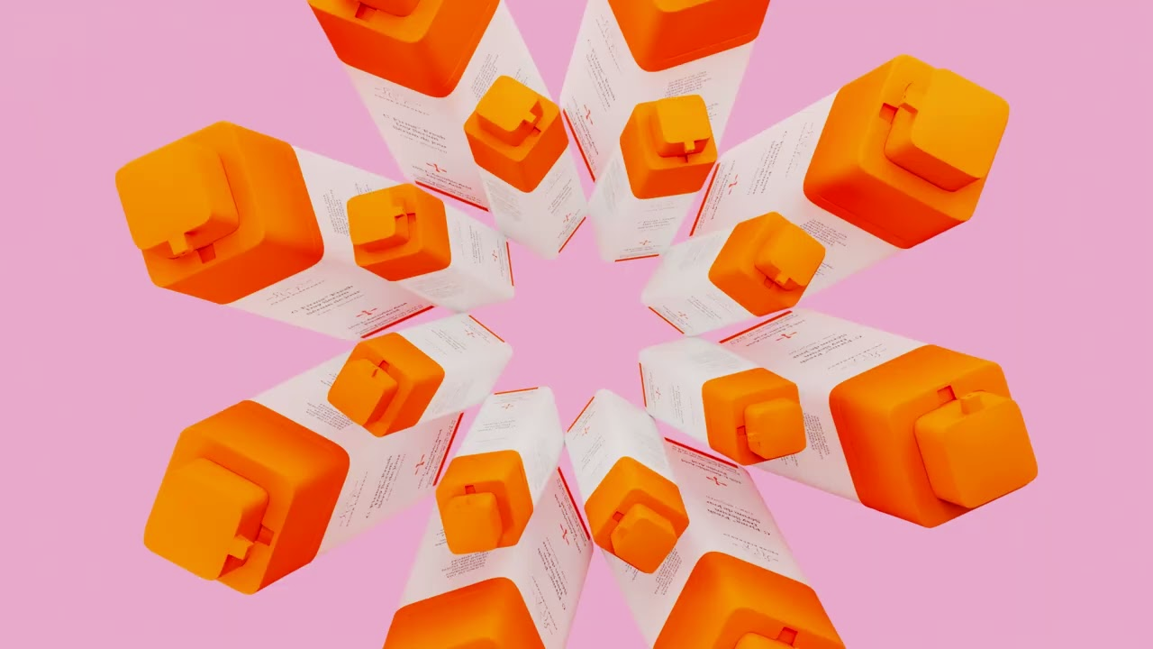
How should Drunk Elephant address Gen Alpha?
GROUP 2-A I Ida-Nora Hammar I My Dinh I Talía Yepes

Slide 15

Drunk Elephant’s Management Decision
Proceed with
Business as Usual
GROUP 2-A I Ida-Nora Hammar I My Dinh I Talía Yepes

Slide 16


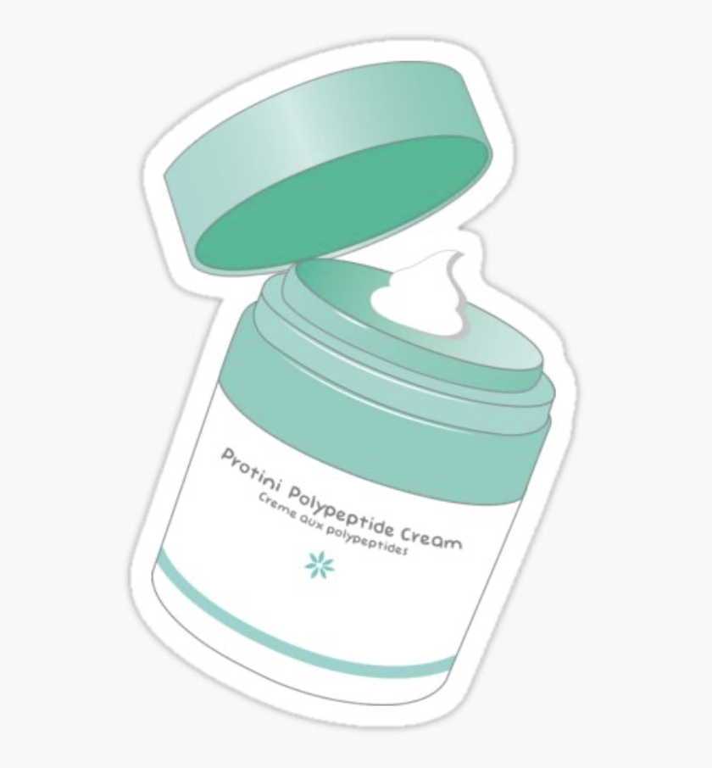

?
Why did they chose to continue with business as usual?
Prioritized high sales, to achieve a successful presence in Americas and EMEA
If Drunk Elephant forfeits their market share a competitor will consume it.
Drunk Elephant didn’t intentionally market themselves to Gen Alpha
GROUP 2-A I Ida-Nora Hammar I My Dinh I Talía Yepes

Slide 17
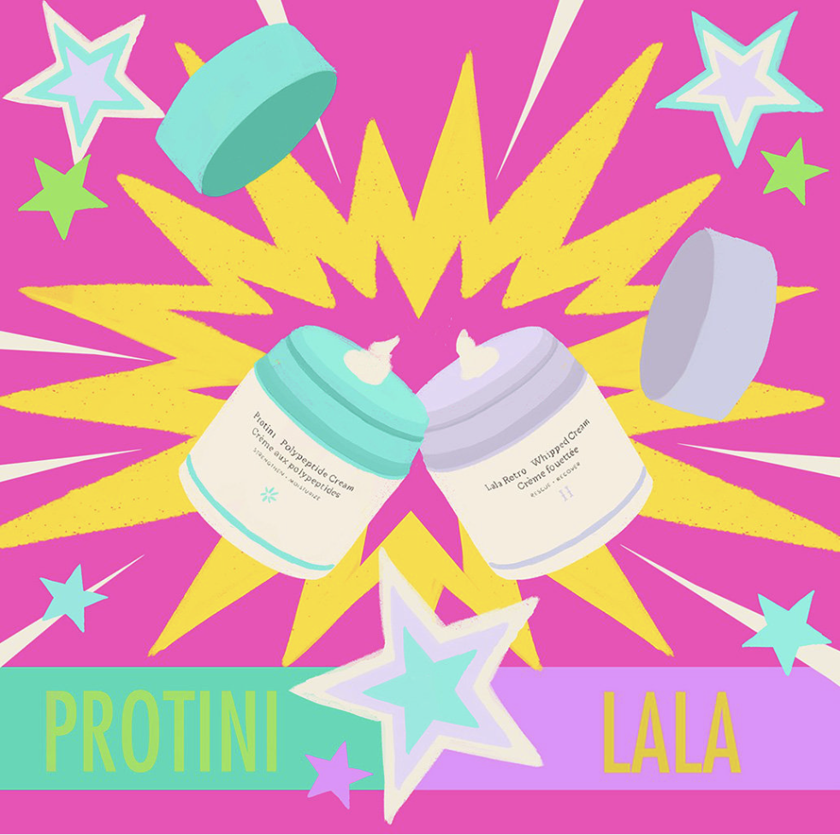

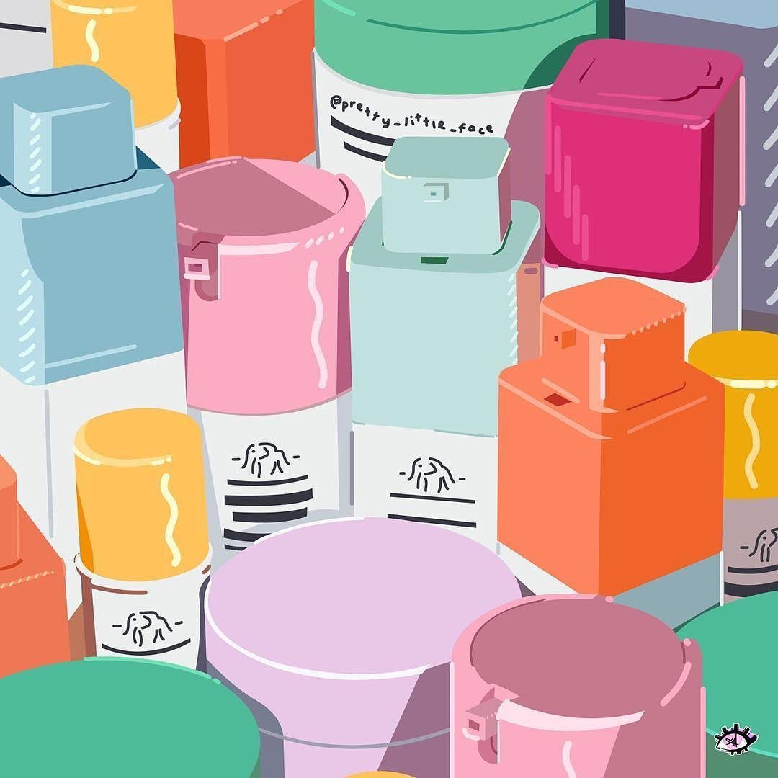
Why did they chose to continue with business as usual?
?
Most Drunk Elephant products are safe for children.
Skin care practices for Gen Alpha can lead them to have healthier and happier skin than any other generation.
GROUP 2-A I Ida-Nora Hammar I My Dinh I Talía Yepes

Slide 18
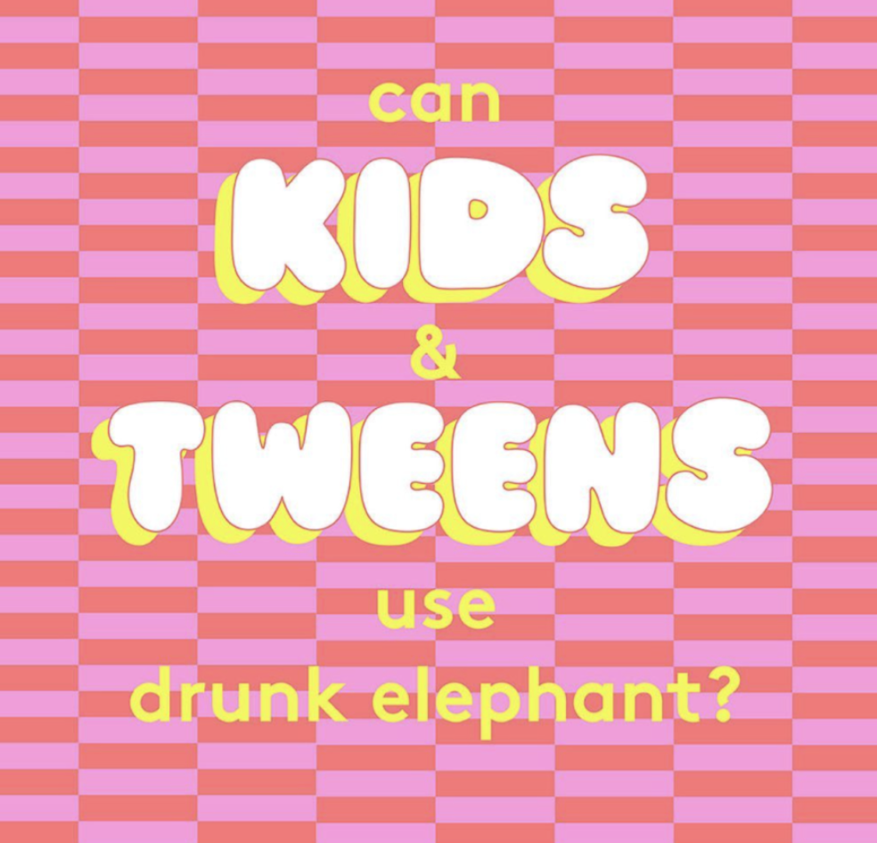
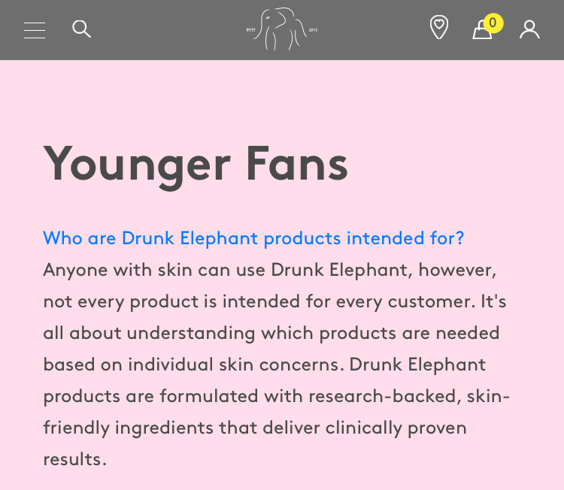
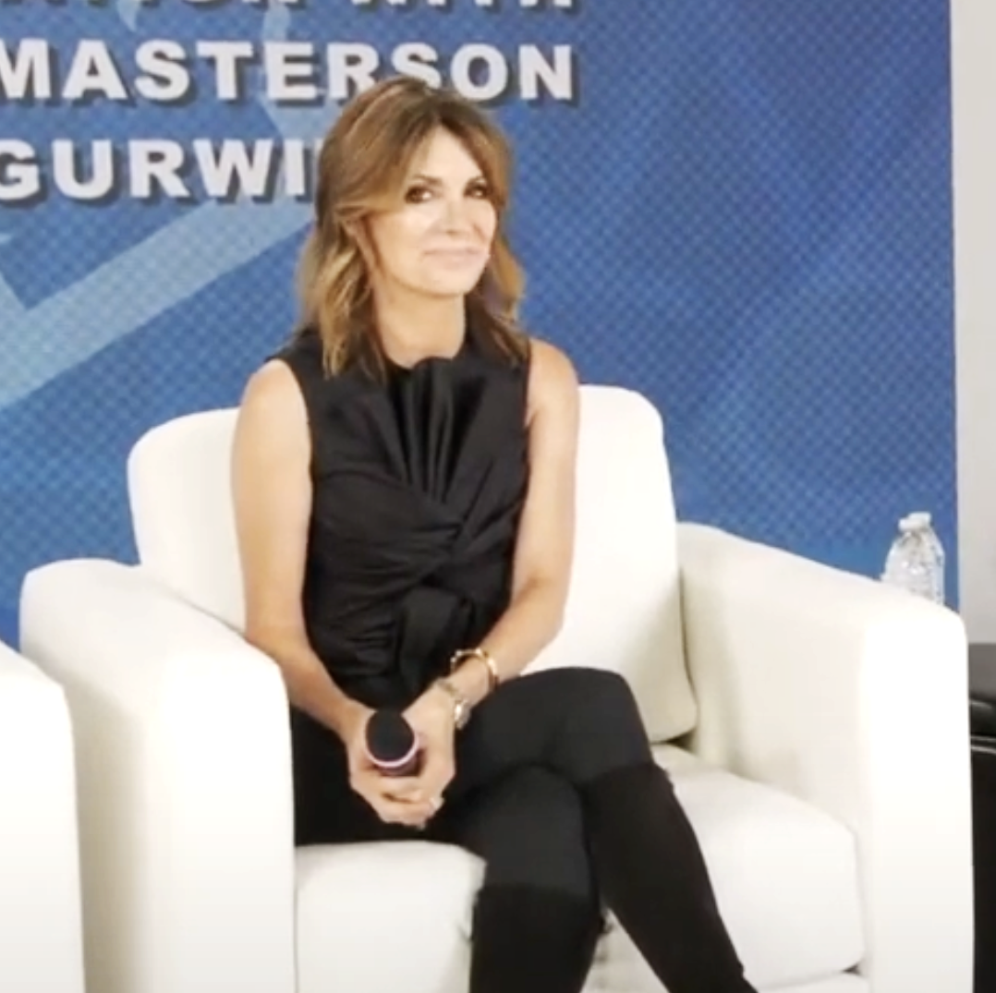
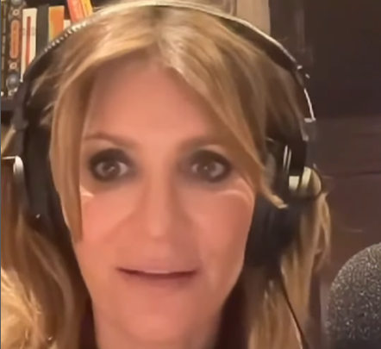

How did Drunk Elephant Publicize their Decision?
In an Instagram Post
In their FAQs page on Website
Interviews with CEO
in press
2
1
3
GROUP 2-A I Ida-Nora Hammar I My Dinh Talía I Yepes

Slide 19
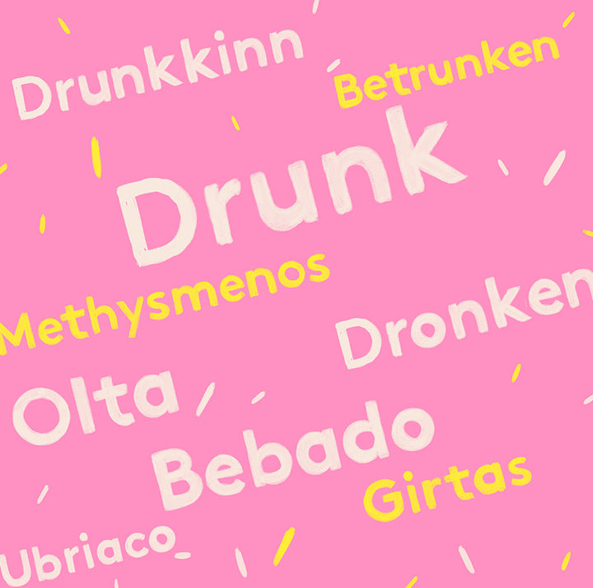
Thank you!
GROUP 2-A I Ida-Nora Hammar I My Dinh Talía I Yepes

