Slide 1
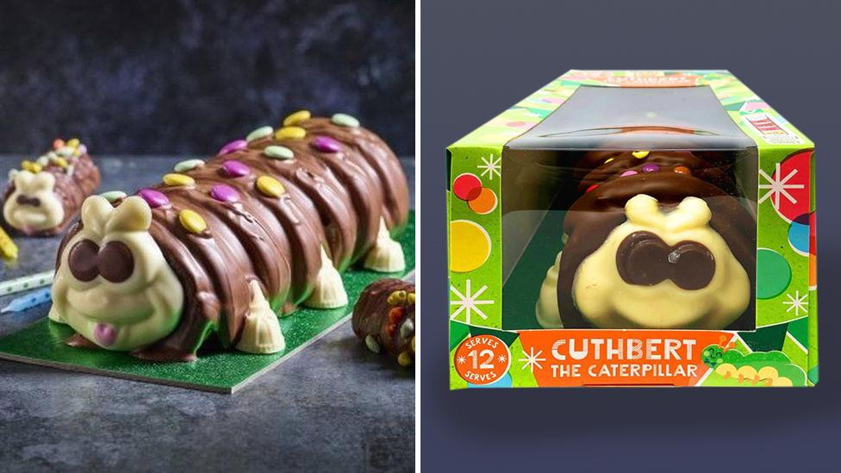
Copycat(erpillars): M&S’s battle to protect a British Icon
by Natalie Mierswa, Aleksandra Miteva & Ceyda Resneli (Group 2A)
Notes:
Add counter examples of this case for part 1 - ie. other trademark battles that have failed/been successful

Slide 2

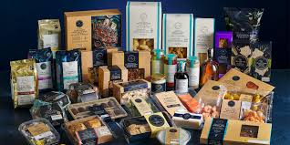
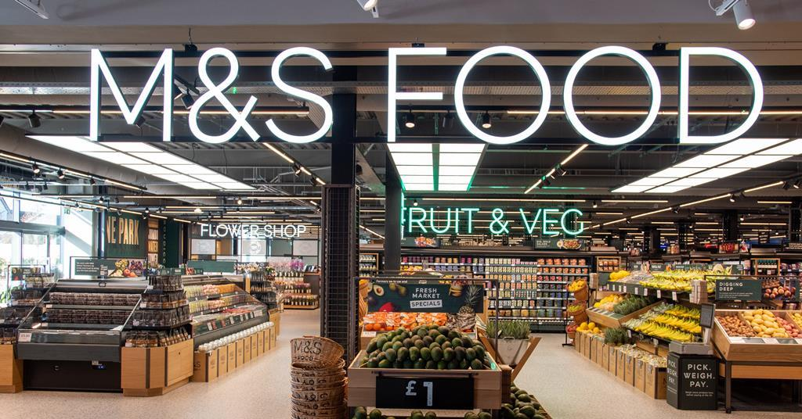
Background & History - Marks & Spencer (M&S)
From Humble Beginnings to a UK Household Name
“This is not just food, this is M&S Food” campaign
1884 - Marks opens a single stall at Kirkgate market, Leeds and partners with Spencer 10 years later
1931, M&S started selling groceries and in three years became one of the biggest food suppliers in the country
M&S Food range aims to attract a more premium customer, evidenced by their store presence, product lines and packaging
The decadence of the chocolate pudding and the strapline “This is not just food, this is M&S Food” is intending to convey M&S Food’s premium positioning compared to competitors
Notes:
In 1884, Belarusian immigrant Michael Marks opens a single stall at Kirkgate Market, Leeds. In 1894, with business thriving, Marks partners with Spencer, a senior cashier, signifying the start of M&S as we know it today
In 1931, although traditionally focused on textiles, the brand started selling groceries and in three years became one of the biggest food suppliers in the country
While the core brand is more focused on affordability without compromising on quality, their supermarket range aims to attract a more premium customer, evidenced by their store presence, product lines and packaging
To understand how M&S conveys this premium positioning, I’ll now play their most viral campaign which is still regularly quoted in the UK, over 20 years later

Slide 3
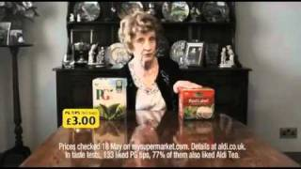
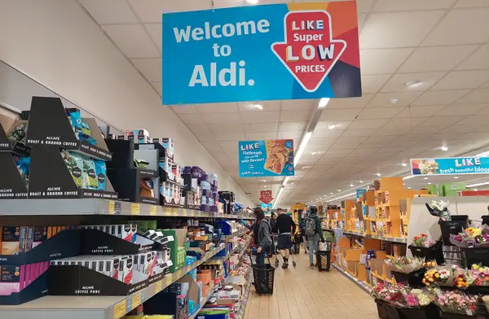
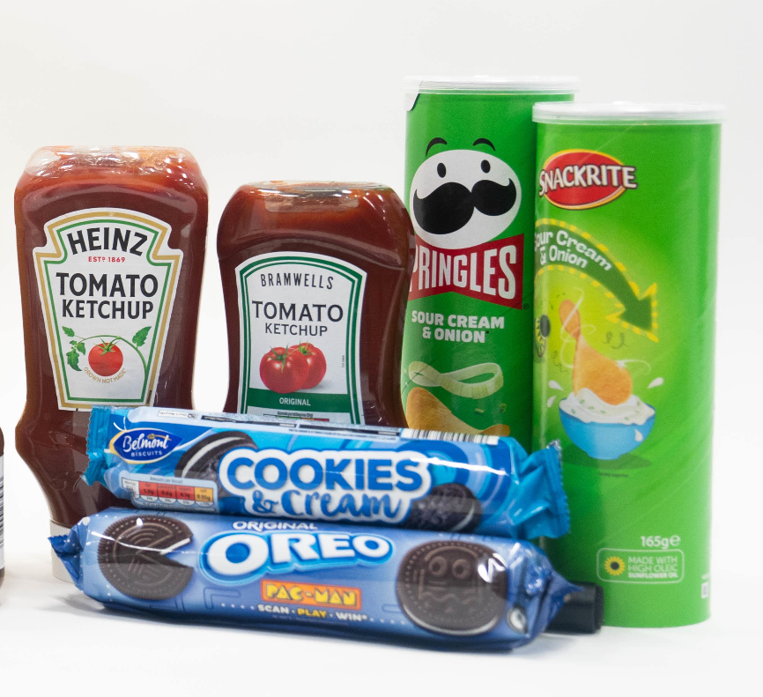
Background & History - Aldi (M&S)
A German challenger brand taking the UK by storm
“Like Brands, Only Cheaper” Campaign
Arriving to the UK from Germany in 1990, Aldi has massively expanded with 1,000+ stores
A lot of their popularity can be attributed to its ‘own-brand’ product strategy, which helps them to achieve their aim of offering the best value.
Packaging of their ‘own-brand’ products often closely resembles the familiar branded product.
With its own-brand products, Aldi is indicating that they prioritise low prices without compromising on quality
Notes:
Arriving to the UK from Germany in 1990, Aldi has massively expanded with 1,000+ stores
A lot of their popularity can be attributed to its ‘own-brand’ product strategy, which helps them to achieve their aim of offering the best value possible to their customers.
Even though Aldi tend to not sell many branded goods, the packaging of their ‘own-brand’ products often closely resembles the familiar branded product.
So you can see there the example of oreos with the Aldi verison cookies and cream, Heinz tomato ketchup with Branwells tomato ketchup looking fairly similar
Like M&S, Aldi also has an iconic television campaign. This is just one of many examples, where they compare Aldi’s version to the branded version and conclude that both are great, only Aldi’s is cheaper

Slide 4



Key differences between M&S and Aldi - Matrix
The two supermarkets differ the most in their character, brought to life by the Brand Matrix.
M&S: Sophisticated, ‘clean’ styling with emotional storytelling. “This is not just food, this is M&S food” is a very recognisable slogan in the UK.
M&S: A UK heritage brand, providing exceptional quality & service.
M&S: Traditional, classic, trustworthy
Aldi: Direct, witty, affordability, efficient
Aldi: Providing a ‘no-frills’ shopping experience so its customers can maximise value
for money
Aldi: Very bold, using humour and pop culture references for engagement.
Expression
Identity Core
Personality
Notes:
Both M&S and Aldi have a stable, coherent brand. However, their brands are polar opposite to each other. If we were to use the brand matrix to highlight these differences, for the purposes of this case their character horizontal is the most important to focus on.
Starting with the identity core, M&S is a UK heritage brand, centred around providing exceptional quality and service to its customers. This is backed by their emotional storytelling expression and sophisticated tone, meaning their brand personality comes off as being traditional, classic and a trustworthy brand.
Meanwhile, Aldi’s identity is to provide an efficient shopping experience, centred around providing the best value for money possible, so not at all service oriented. Aldi is very bold and uses humour, pop culture and memes to generate engagement online like many other low cost brands such as Ryanair, thus coming across as direct and affordable in their brand personality

Slide 5
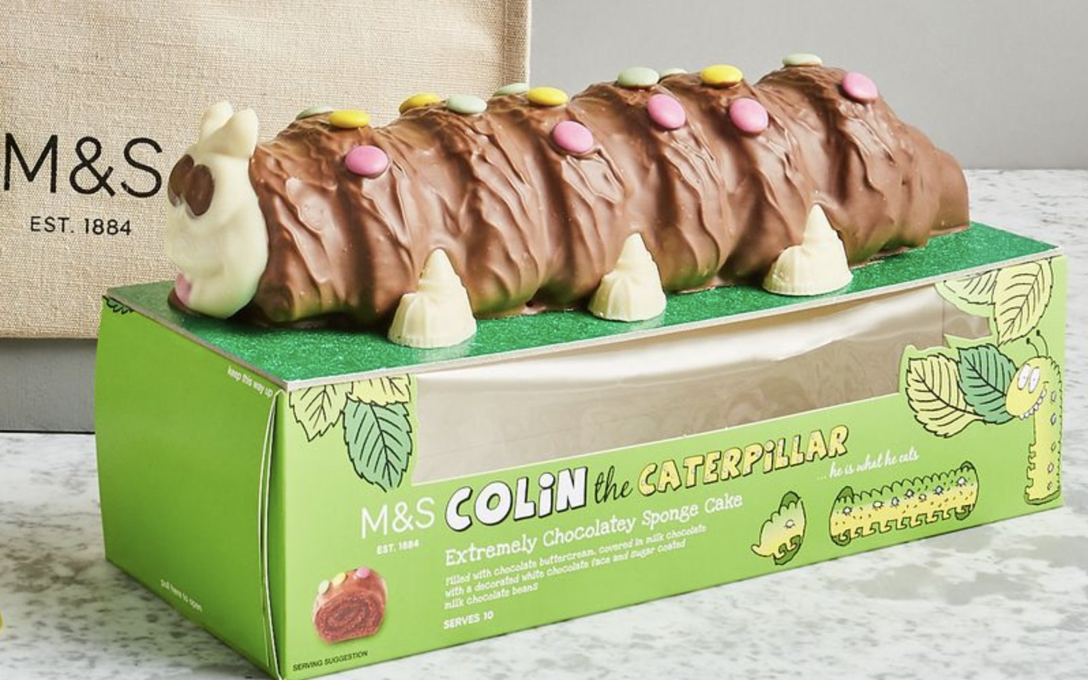
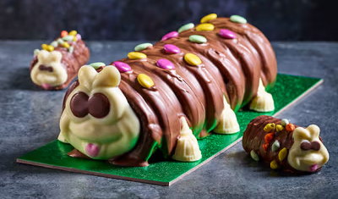
Colin the Caterpillar
Trademark
Introduced in 1990
The “guest of honour” at nearly
1 million celebrations annually
26 August - National Colin the Caterpillar Day
The name “COLIN THE CATERPILLAR”
protected as a registered trademark in the UK
since 2008
Registered design over the look of the cake
stops anyone producing a cake that fails to create a ‘different overall impression’
Notes:
Colin the Caterpillar cake (Alex)
Many of M&S’s iconic products are within their food category and one of these products is Colin the Caterpillar.
This is a handcrafted chocolate sponge roll cake decorated with chocolate beans. Colin was introduced in 1990 and more than 15 million cakes have been sold since. It has become a staple and “guest of honor” to children’s birthday parties, but is also popular with teens, adults and even celebrities (David Beckham, Ed Sheeran, Tylor Swift).
In 2020, M&S declared August 26th as National Colin the Caterpillar Day to celebrate the cake’s 30th anniversary. Additionally, there are special variations such as the female version “Connie the Caterpillar”, wedding versions “Colin the Groom” and “Connie the Bride", and a festive version for Christmas.
Trademark
In fact, Colin is so iconic that M&S has trademarked him to protect the brand. They own a trademark for the name “Colin the Caterpillar” and the packaging design, together with the logo for “M&S Colin the Caterpillar” including a picture of the caterpillar cake as part of the trademark.
As a result any other cake with a similar appearance and name could be considered a trademark infringement.

Slide 6
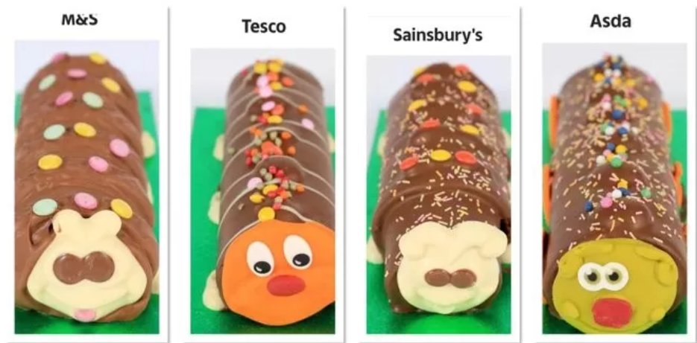
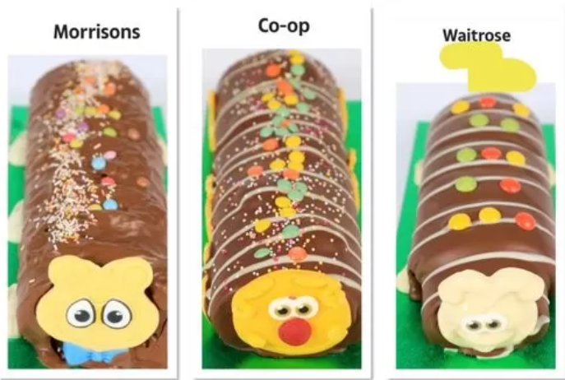
Here comes the copycat(erpillars)!
Colin
Slinky
Wiggles
Clyde
Morris
Charlie
Cecil
RRP £7*
RRP £6*
RRP £6*
RRP £5.92*
RRP £6.35*
*prices in 2021
Notes:
Copycat cakes - Ceyda
https://www.geldards.com/insights/colin-v-cuthbert-not-just-any-caterpillar-cake/
https://www.essexlive.news/whats-on/ms-colin-caterpillar-tried-tesco-5310649

Slide 7
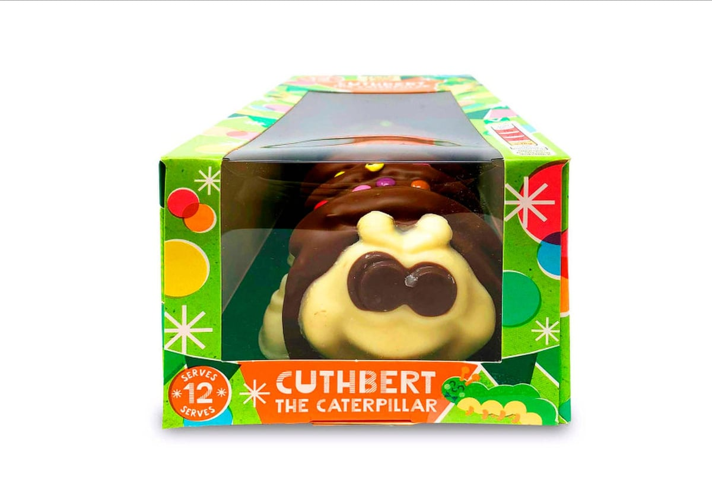
Meet Cuthbert
Aldi’s own version of a caterpillar cake
Budget-friendly at £4.99 (in 2021)
One of many
Notes:
Cuthbert

Slide 8
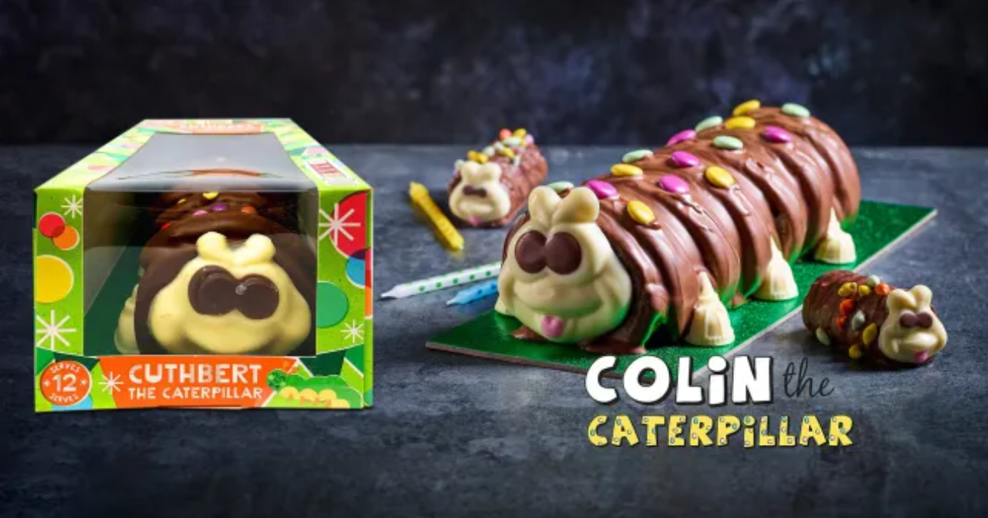
Part 1 - To sue or not to sue?
Should Marks & Spencer take legal action against Aldi over Cuthbert the Caterpillar, or would alternative strategies be more effective in maintaining brand reputation and market leadership?
Notes:
Management question 1
What are the options available? - suggestions and comments
Benefits and drawbacks of each option
Vote
Assisting questions
What are the potential risks and benefits of suing Aldi?
How does being part of a lawsuit affect the brand image?
Think about the fact that a heritage brand is suing a discount brand.
How should the lawsuit against Aldi be communicated towards the public?
Is there a risk that the lawsuit will draw more attention to Aldis cake instead?
What are some of the alternatives to sue?

Slide 9
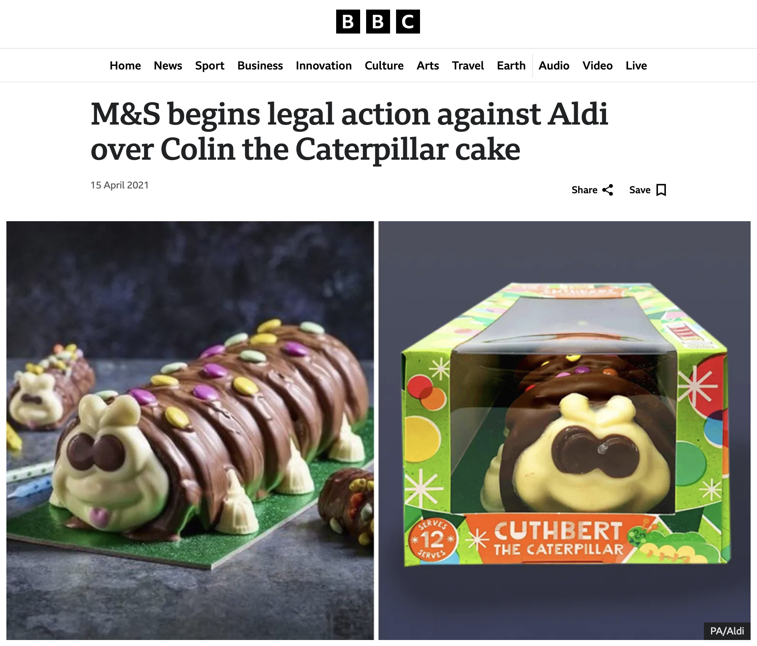
Decision
Notes:
The outcome - lots of tweets, stats of the fall in media sentiment etc. - Ceyda

Slide 10
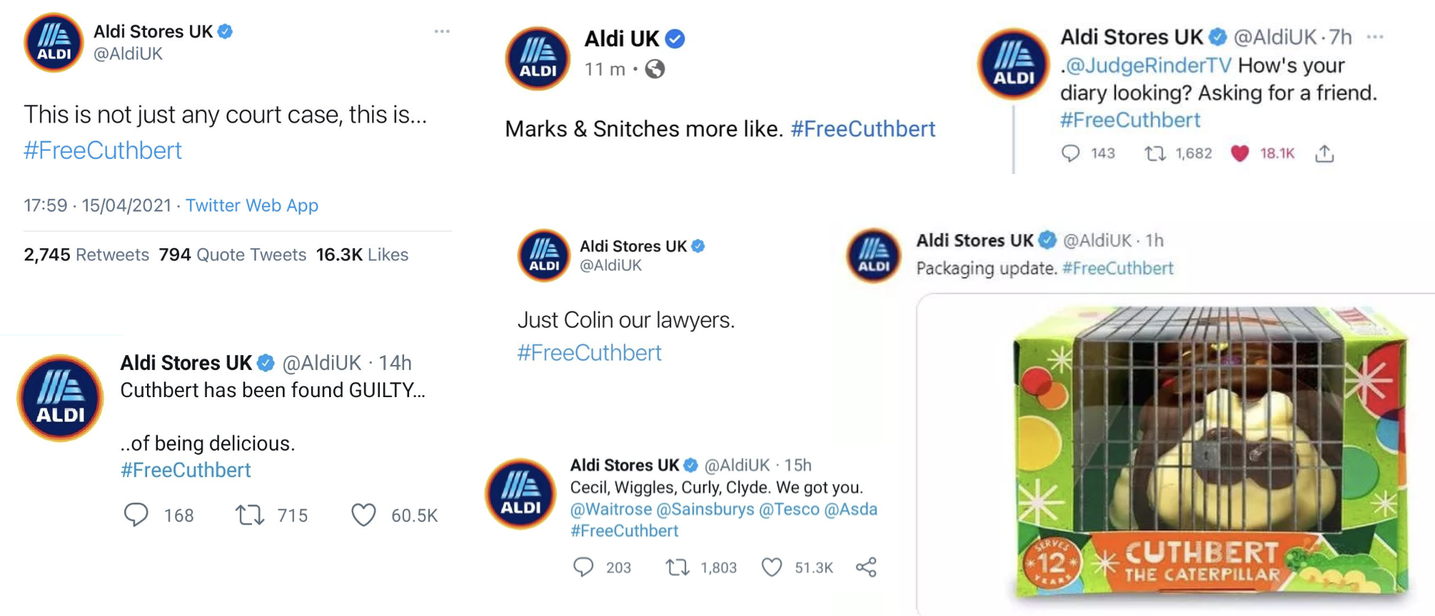
Outcome
Notes:
The outcome - lots of tweets, stats of the fall in media sentiment etc. - Ceyda

Slide 11
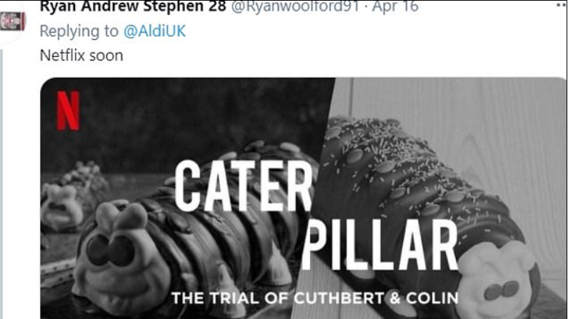
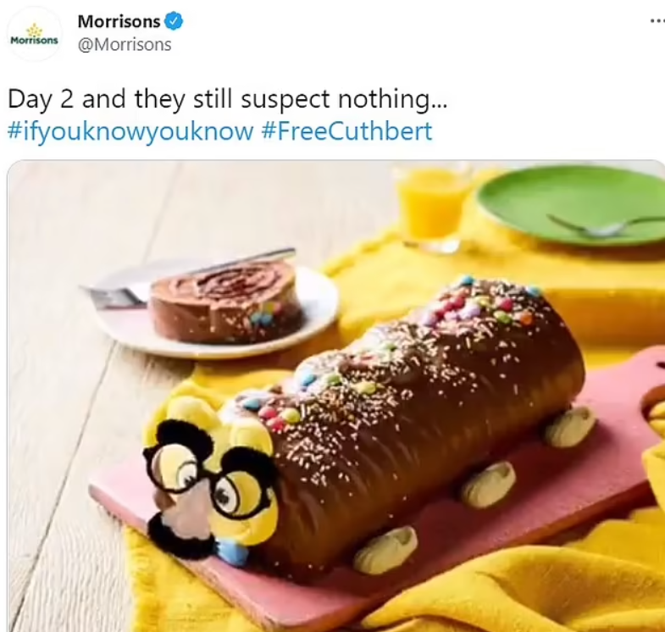
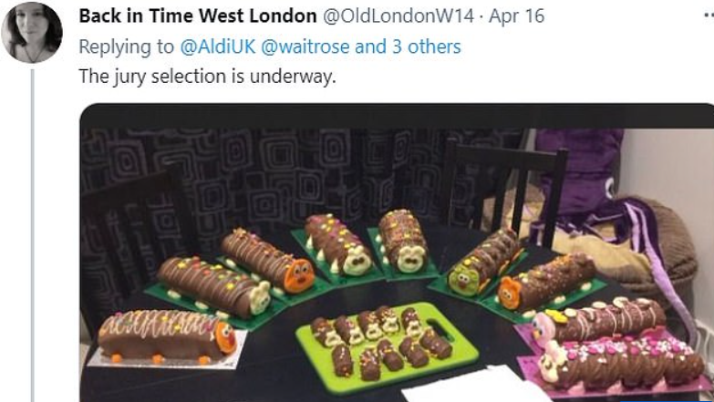

Slide 12
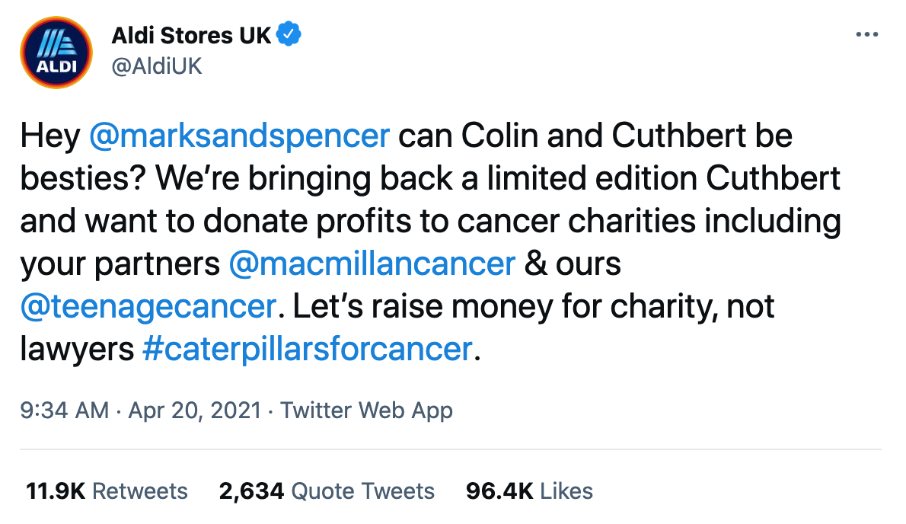
Part 2 - The Reputation Dilemma
How, if at all, will you (as part of M&S’s management team) respond to Aldi’s offer of a ceasefire and its initiative to raise money for charity?
Notes:
Part 2 (Alex)
After charges against Aldi have been pressed and the #FreeCuthbert campaign gained massive engagement and public support, Aldi decided to put M&S in a tricky position. They released a limited edition Cuthbert cake and suggested a truce with M&S aiming to contribute to cancer charities together “raising money for charity, not lawyers”, implying, if M&S accepts, the charges will be dropped.
In this situation, how, if at all, ……?
Assisting questions
Is it a manipulative tactic from Aldi to use a charity initiative as part of this offer?
What would it mean for M&S brand identity and image to accept/decline Aldi’s offer? (pros vs cons)
Would you aim to reply as quickly as possible (if replying at all) or would you take some time to evaluate the situation?
Would a refusal to engage in Aldi’s offer escalate the conflict, and if so, how might M&S mitigate the potential backlash?
What are the legal implications of engaging with Aldi’s ceasefire offer, particularly regarding the trademark lawsuit?

Slide 13
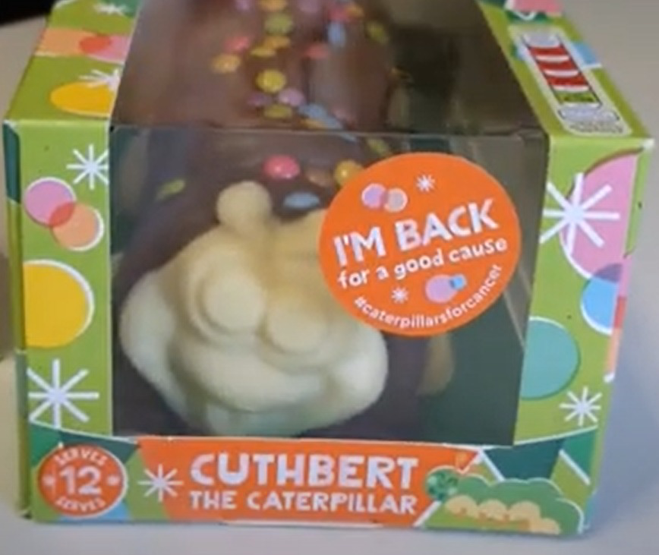
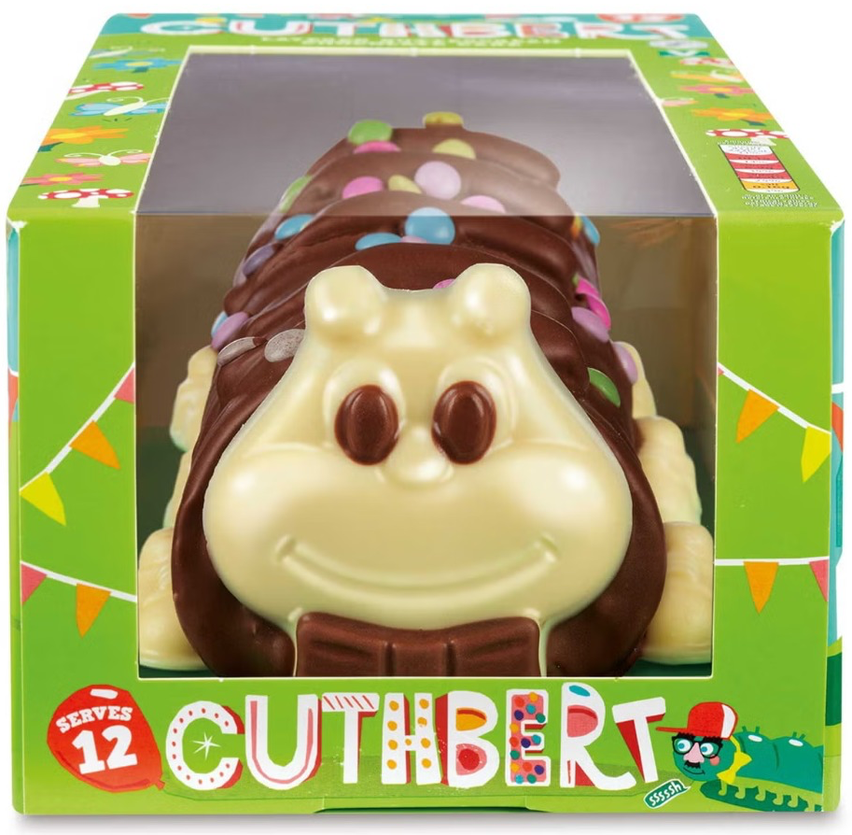
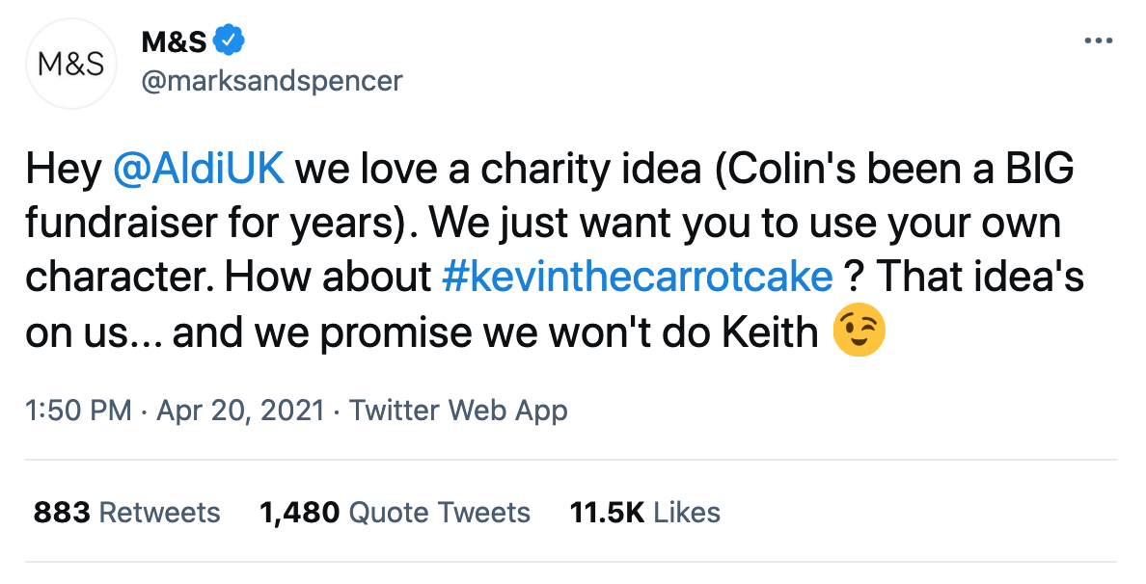
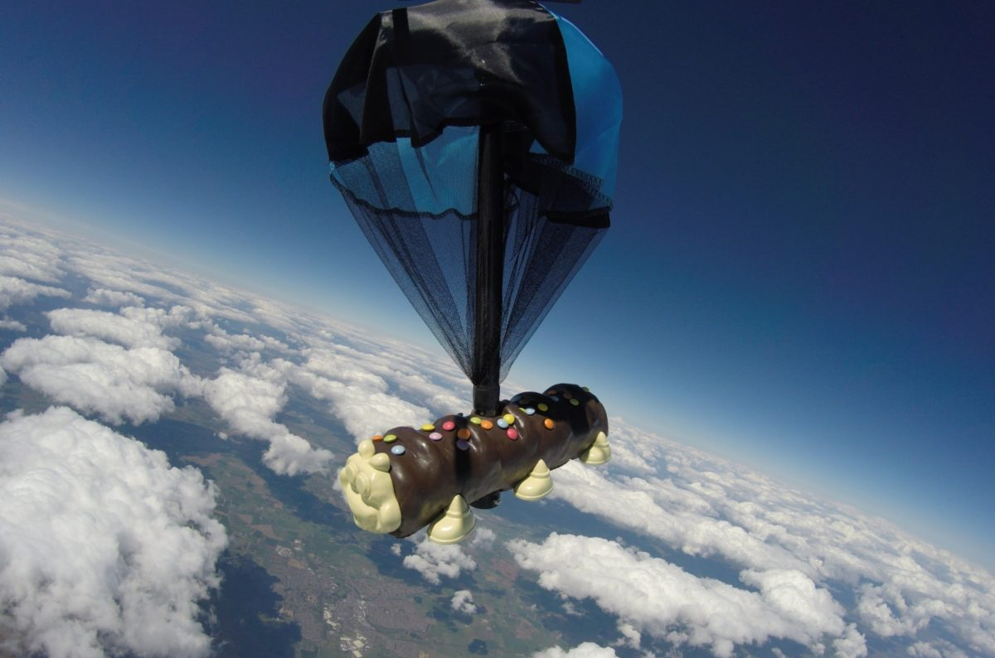
Decision & Outcome
Limited Cuthbert
with different eyes
Cuthbert returns with changed appearance
17 May 2021
6 June 2022
20 April 2021
Cuthbert was used in a
skydiving stunt to drive publicity
in aid of charity causes
M&S responds the same day:
5 November 2021
M&S management team decided to settle rather than continue prolonged litigation.
27 January 2022
The consent order is approved
Case is officially closed.
Notes:
Decision and Outcomes (Alex)
The same day M&S decided to publicly decline the offer and pursue the lawsuit
Aldi releases the limited edition Cuthbert (they were talking about in the tweet) with changed face (white eyes) in aid of charity
+ use it in a skydiving stunt to drive publicity and people could bid to raise money for the Teenage Cancer Trust.
Decided to settle, details are confidential but we know both parties were pleased with the outcome and Aldi’s regular cake will return on shelves but has to be with different appearance.
2nd face change
A few months later the case is officially closed - but did the story also end there?

Slide 14
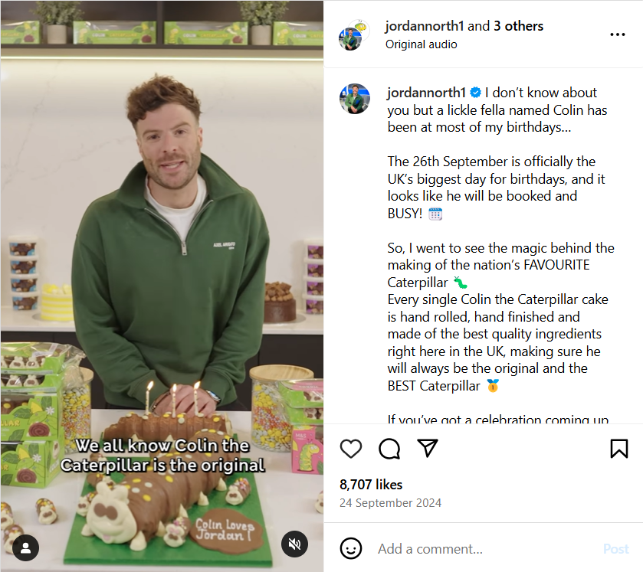
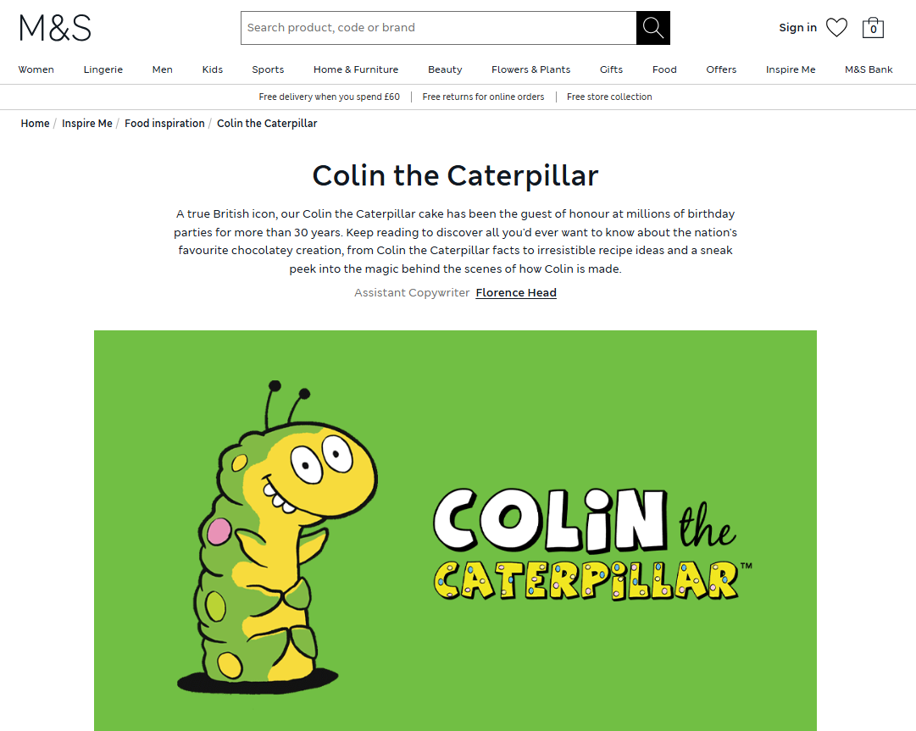
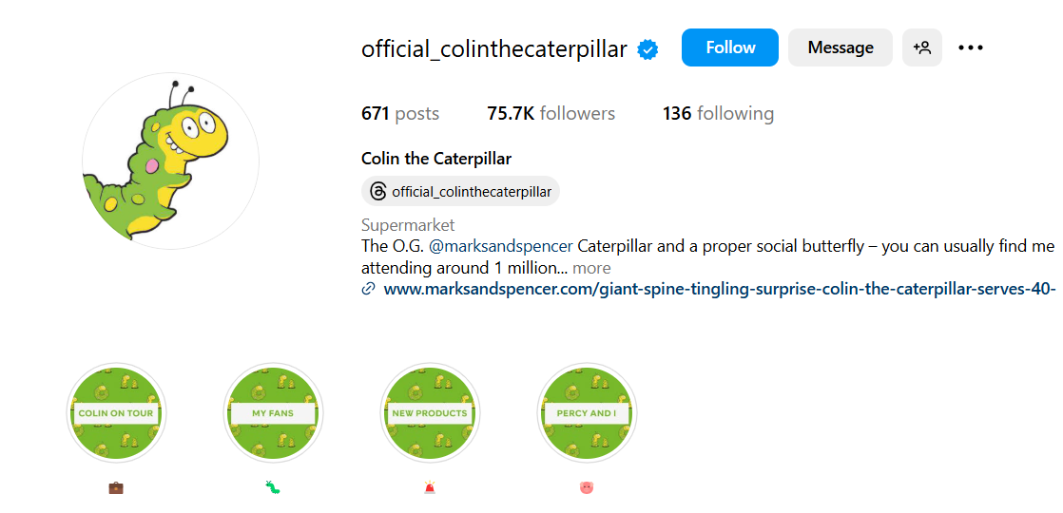
Where are they now?
M&S embraces emotional storytelling through social media
Notes:
M&S set up an instagram page dedicated to Colin the caterpillar, and partnered with popular, respected UK personalities such as radio presenter Jordan North, who uses emotional storytelling.

Slide 15
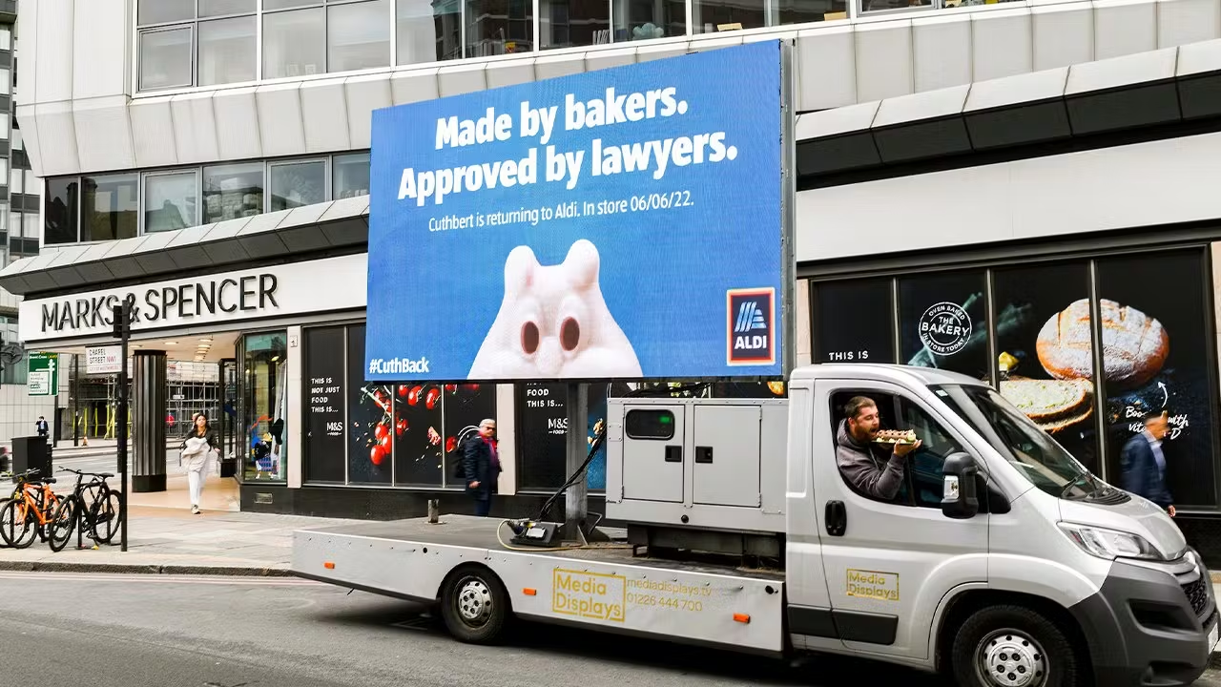
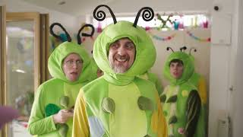
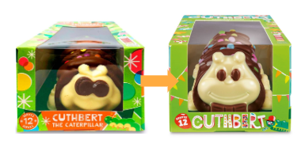
Where are they now?
Aldi continues to reference the caterpillar cake battle in various communications, but has respected the settlement and changed Cuthbert’s design and packaging
“Like Brands, Only Cheaper”
featuring Colin & Cuthbert, April 2023
Notes:
M&S embraces storytelling with Colin instagram page, collaboration with Jordan North/aldi continues to pursue mockery - Natalie

Slide 16
Thank you for participating!
Notes:
Add counter examples of this case for part 1 - ie. other trademark battles that have failed/been successful

