Slide 1
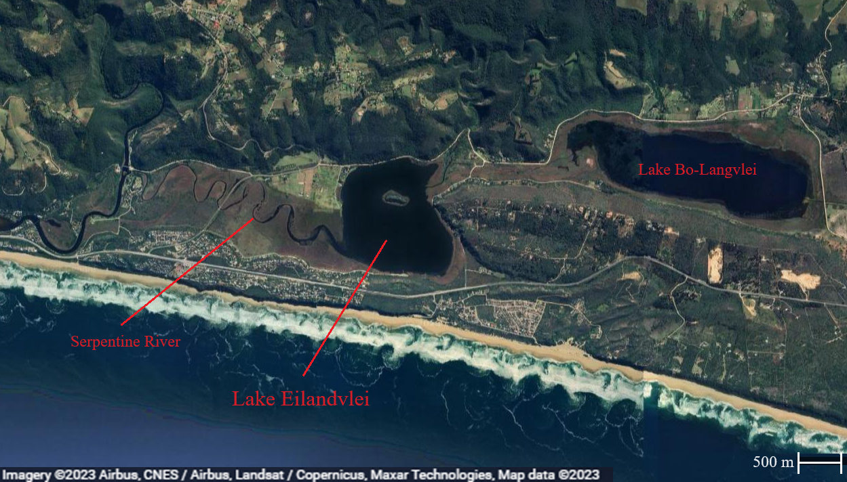
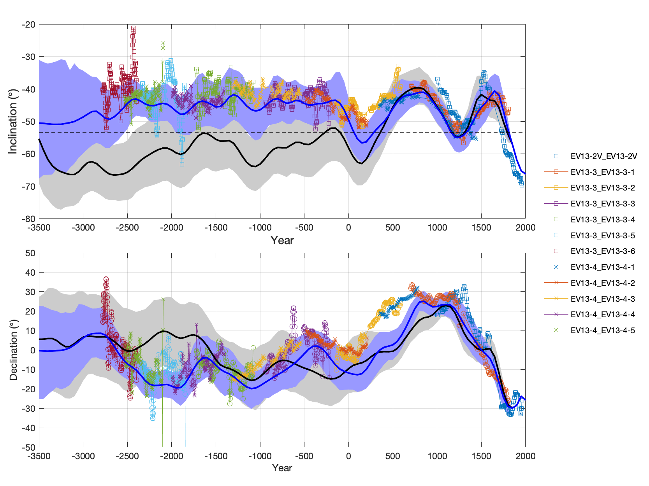
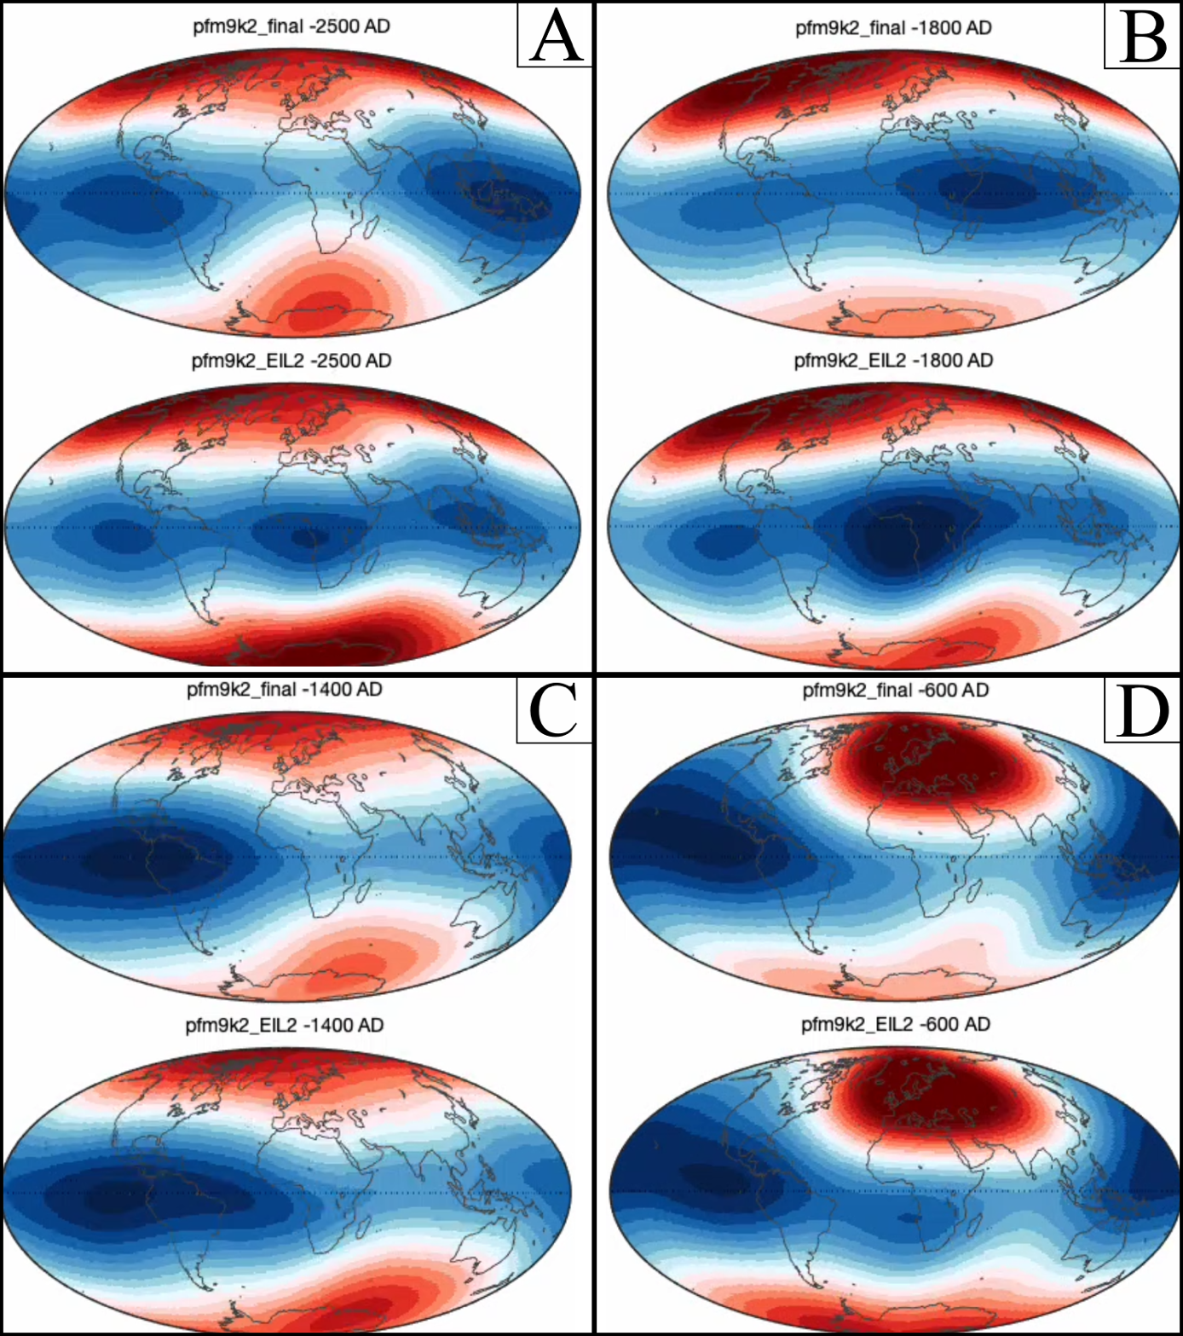
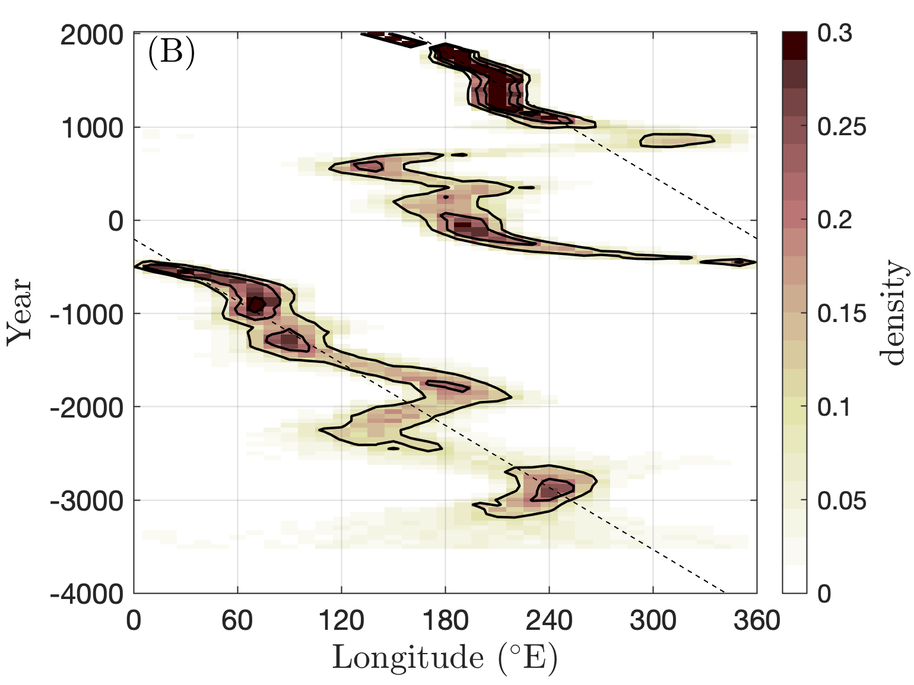


Precursors to the South Atlantic Anomaly
Magnetic field variations in Lake Eilandvlei, South Africa
By Simon Eng
Introduction
After centuries of direct measurements, the Earth’s magnetic field can accurately be described as a dipolar field. However, this dipole model can only account for about 90% of the field, as in the south Atlantic a significantly weaker area has been steadily growing over several centuries, the South Atlantic Anomaly. This thesis aims to find out if this is the first time this anomaly has appeared during the Holocene or if it’s part of a larger pattern.
Area of study
By analysing a high-resolution sediment core from the coastal Lake Eilandvlei using a 2G 760 U-Channel Magnetometer, we can determine the changes to magnetic inclination and declination over the Holocene.
Results
Unfortunately, the bottom 20 m was of insufficient quality, leaving the top 12 m as the basis for this thesis. The graph above shows this data against a timeline as dated by Wündsch et al (2016). Overall, most of the data follow pfm9k.2 model predictions and constitute a reasonable development.
Discussion
When the data from Eilandvlei is inserted into the pfm9k.2 model, a magnetic anomaly appears 4000 years ago in the same location as the SAA, see B to the right. Furthermore, a 0,09°/year western drift was identified when the data was projected as an eccentric dipole, see the horizontal dotted line.
Conclusions
4000 years ago, a magnetic anomaly appeared in the same region as the SAA with similar characteristics, exhibiting a near constant western drift of 0,09°/year. This suggests that the SAA follows a repetitive pattern of 4000 years, but further study is needed to support this theory.
Master thesis Simon Eng
Supervisor: Andreas Nilsson

