Slide 1

Through the Glass Door:
Bridging the Identity – Reputation Gap via Crowdsourced Employee Ratings
Canh Yen Nhi Tran (ca3811tr-s@student.lu.se)
Mia Bernadette Griffith (mi8763gr-s@student.lu.se)

Slide 2

It takes 20 years to build a reputation and five minutes to ruin it.
— Warren Buffett

Slide 3

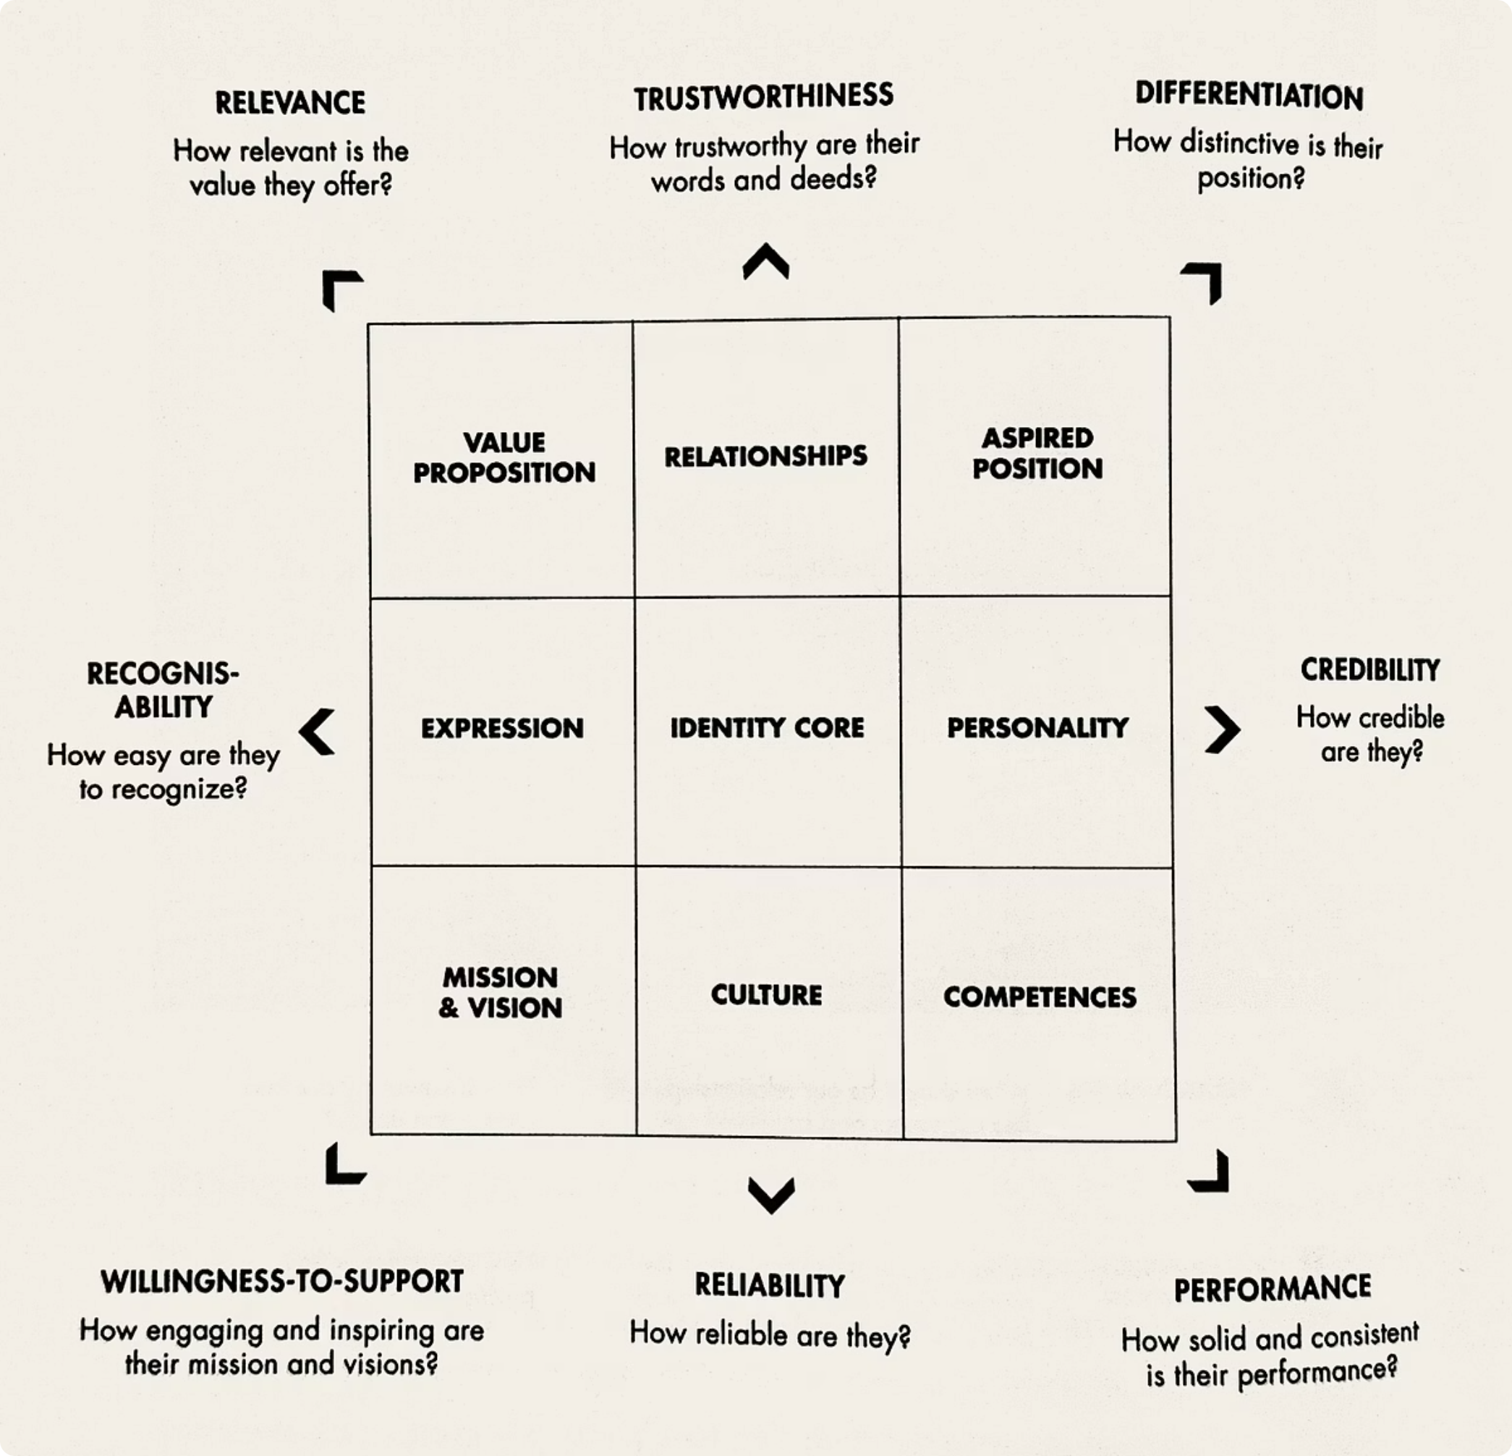
Theoretical Foundation
Kapferer (2012)
1
Brand Identity Prism
Urde & Greyser (2014)
2
Corporate Brand Identity–Reputation Matrix
These models are foundational, but leave open one key question — how do we measure the actual alignment between what companies communicate and what employees experience?

Slide 4

The Research Question
How and to what extent can Glassdoor be utilised as a Strategic Brand Management tool to close the identity –reputation gap?
This question guides the study — not just whether Glassdoor matters, but how much and in what ways it can be strategically applied.

Slide 5

Crowdsourced Employer Branding
01
02
Power Shift
Transparency Revolution
Control over employer brand narratives has moved from corporate communications to employees who share authentic experiences.
Platforms like Glassdoor provide unprecedented visibility into organizational culture.
"Employees, through their attitudes and behaviours, can make or break a corporate brand."
— Roper & Fill (2012)

Slide 6


Glassdoor: Platform Overview
A Leading Platform
Comprehensive Ratings
Authentic Employee Insights
Launched in 2008, Glassdoor is the largest job platform, offering over 100 million company reviews to connect users with jobs they love.
The platform provides detailed 1-5 star ratings for overall company score, CEO approval, work-life balance, culture, and compensation.
Employees share candid feedback on career growth, leadership, challenges, and offer direct advice for company leaders.

Slide 7



Research Design
Survey
Case Study
Secondary data
100+ career professionals
Google & Amazon
Glassdoor reviews, company identity materials, mission statements, company sites

Slide 8


Survey Overview
Research Purpose
Respondent Profile
Assess Glassdoor's credibility, usage patterns, and influence on employer reputation among working professionals.
Key Demographics
114 valid respondents
Geographic diversity: Europe, North America, Asia
71% mid-senior professionals
Sectors: technology, finance, marketing, education
Female
Male

Slide 9
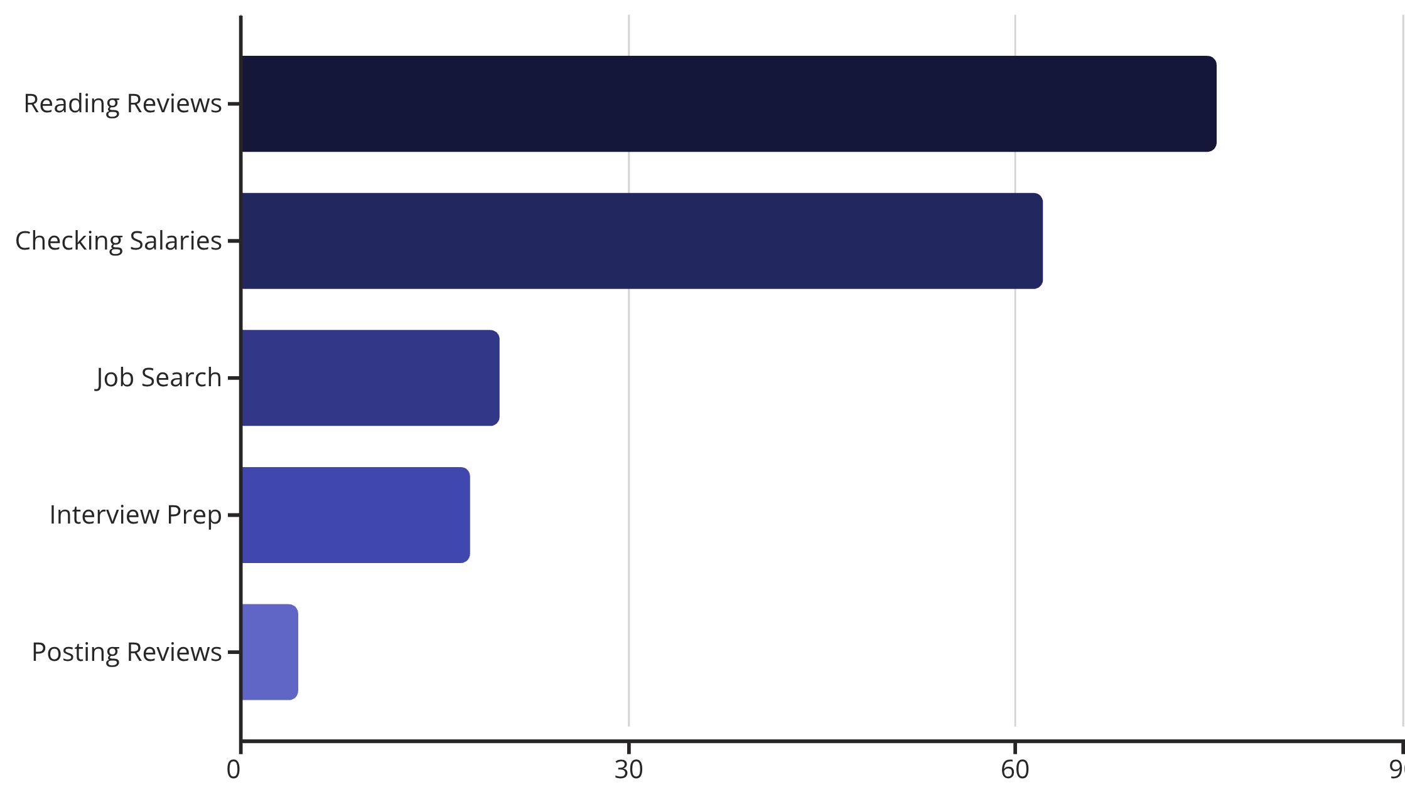
User behaviours
Platform usage patterns reveal Glassdoor serves as a comprehensive transparency tool extending beyond traditional recruitment functions.
40%
75.6%
62.2%
Active Users
Review Readers
Salary Checkers
Use Glassdoor when researching potential employers
Primary activity: reading employee reviews
Use platform for compensation benchmarking

Slide 10
Perceived Credibility and Trust
51%
6.7
40%
Reflect Culture
Trust Score
Value Former Staff
Agree reviews are accurate
Average rating out of 10
Most honest perspective

Slide 11


Influence on Reputation and Decision-Making
91.1%
93.4%
Perception Impact
Application Avoidance
Glassdoor affects their view of employer reputation
Would not apply due to poor reviews
70.2%
Source Importance
Rate Glassdoor equal to or more important than LinkedIn, referrals, websites
Critical Finding: Online transparency platforms significantly shape career decisions, with overwhelming majorities citing Glassdoor as a decisive factor in employer evaluation and application behavior.

Slide 12
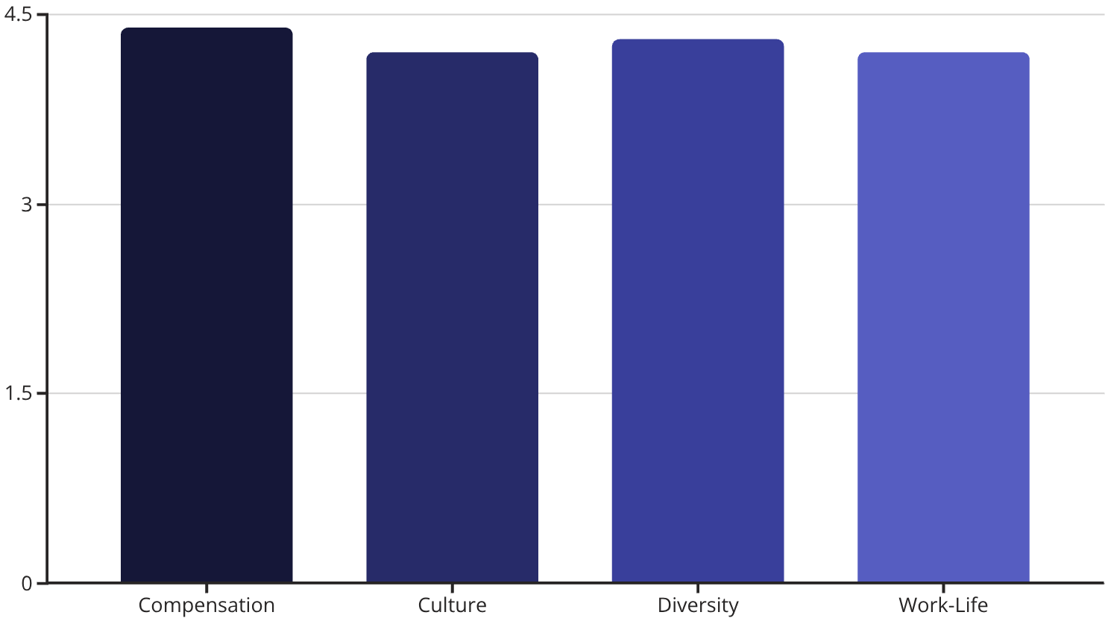
Case Study 1: Google – Authentic Alignment
Rating Overview
Overall Rating: 4.4 ★
Recommendation: 86% would recommend to a friend
Google exemplifies strong alignment between employer identity and employee-reported reputation. The company's commitment to innovation, flexibility, and inclusivity resonates consistently across all evaluation dimensions.
"Google's culture of innovation and psychological safety creates an environment where employees genuinely thrive and feel valued."
Sources: Beltrán & Gulc (2021)

Slide 13
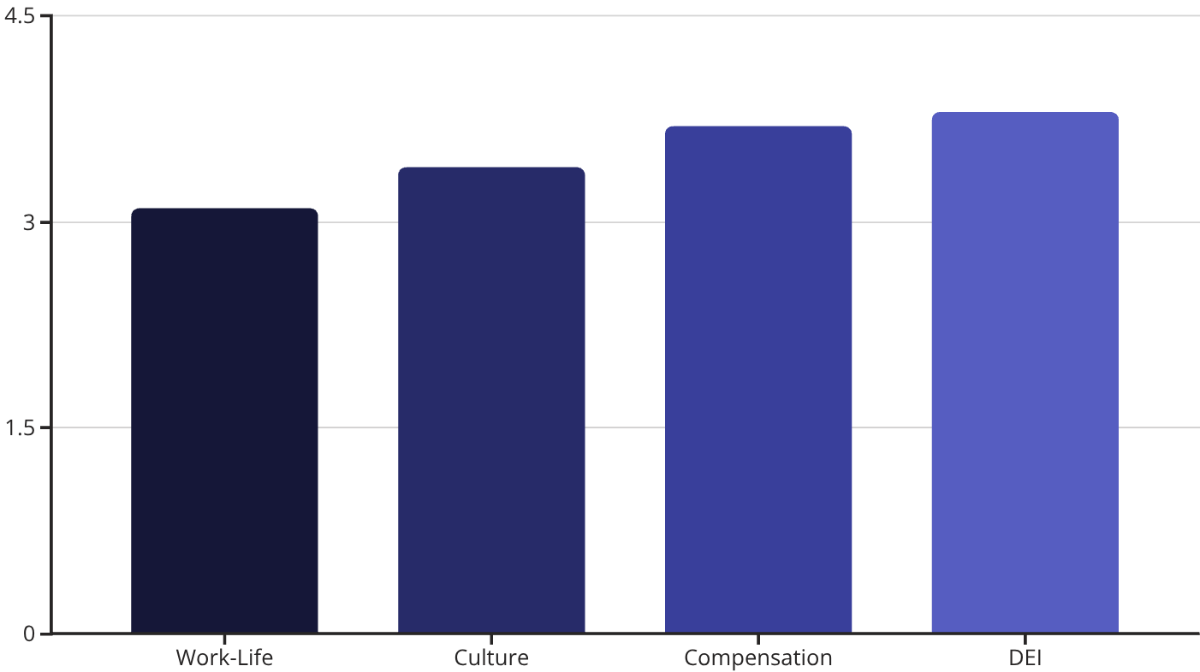
Case Study 2: Amazon – Critical Misalignment
Rating Overview
Overall Rating: 3.6 ★
Recommendation: 63% would recommend to a friend
Amazon demonstrates a significant identity-reputation gap. While the company projects itself as "Best Employer," employee experiences reveal high-pressure environments and work-life balance challenges.
"The disconnect between Amazon's public messaging and internal reality creates significant challenges for employee wellbeing and organizational trust."
Sources: Boewe & Schulten (2019)

Slide 14

Summary of Key Insights
The Dual Role of Glassdoor
Mirror Function
Reflects authentic workplace culture and employee experiences back to organizations and job seekers
Megaphone Function
Amplifies employer reputation signals across professional networks and talent markets
“Reviews are the heartbeat of your employer brand.
Glassdoor keeps the pulse” - Glassdoor

Slide 15
Mapping Theory to Data: CBIRM Meets Glassdoor Metrics
This study extends Urde & Greyser's (2014) Corporate Brand Identity and Reputation Matrix by transforming qualitative reputation dimensions into quantifiable, actionable metrics through Glassdoor's employee feedback platform.
CBIRM Element
Glassdoor Attribute
Measurement
Strategic Insight
Performance
Compensation & Benefits, Career Opportunities
Rating scores and growth trajectory
Drives employer appeal and talent retention
Trustworthiness
Employee Reviews (Tone & Sentiment)
Positive language consistency over time
Reflects authentic experience and organizational credibility
Responsibility
Culture & Values, Diversity & Inclusion
Ratings and value alignment scores
Demonstrates commitment
Credibility
Trends in Reviews & Ratings
Stability across rating categories
Evidences reliability and sustained reputation
Theoretical Contribution: By quantifying CBIRM's abstract elements with real-time Glassdoor data, this research transforms theoretical frameworks into practical, measurable tools for strategic brand management and organizational diagnosis.

Slide 16

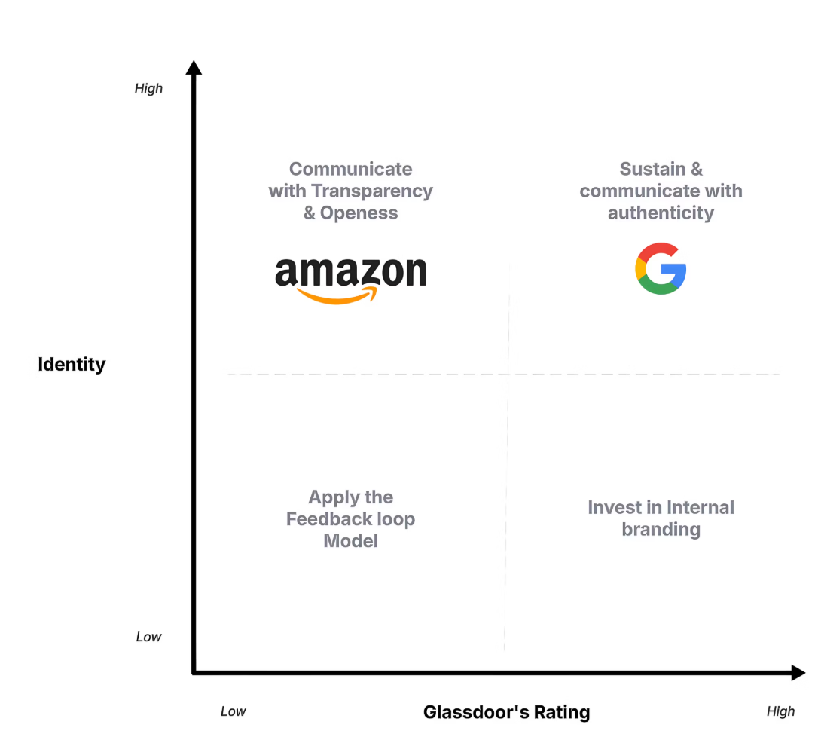
The Identity–Reputation Alignment (I.R.A.) Matrix
We introduce a diagnostic tool to assess the degree of alignment between internal organizational identity and external reputation as mediated through employee feedback platforms.
High Alignment
Internal culture and external reputation are congruent. Employee reviews reinforce corporate messaging.
Reputation Risk
Misalignment between aspirational identity and employee-reported reality creates vulnerability.
Hidden Strength
Strong internal culture undersold externally. Opportunity to amplify positive employee experiences.
Identity Crisis
Both internal culture and external reputation are weak or unclear. Requires fundamental organizational change.

Slide 17





The Glassdoor Feedback Loop
Interpret
Monitor
Analyse key patterns across employer value propositions, identifying gaps between stated identity and Glassdoor's review.
Track employee feedback on Glassdoor including ratings, reviews, trends, and emerging themes across departments.
Act
Implement internal improvements addressing low-rated attributes such as leadership or culture, based on insights.
Re-measure
Observe changes in employee perception through updated Glassdoor metrics, then restart the loop for continuous improvement.
Communicate
Reflect through external employer branding campaigns and internal messaging that acknowledges changes.

Slide 18

Answering the Research Question
How and to what extent can Glassdoor be used as a strategic brand tool to close the identity–reputation gap?
Real-Time Mirror
Empirical Evidence
Actionable Framework
Glassdoor functions as a continuous feedback mechanism, revealing both alignment and dissonance between internal culture and external perception in real-time.
Survey data demonstrates profound impact: 91% of stakeholders report perception influence, while 93% indicate behavioral change based on Glassdoor ratings.
The I.R.A. Matrix and Feedback Loop provide systematic methodologies to diagnose gaps and implement proactive reputation management strategies.
Conclusion: Glassdoor can effectively serve as a strategic brand management tool, transforming employee feedback into actionable organizational insight—successfully bridging the gap between corporate identity claims and authentic stakeholder perceptions.

Slide 19

Limitations and Future Research
Current Limitations
Research Roadmap
01
Geographic Bias
Cross-Industry Testing
Sample concentrated in European markets, limiting global generalizability
Extend analysis to healthcare, legal, and public sector organizations
Single Platform
02
Analysis restricted to Glassdoor data, excluding other employee review ecosystems
Multi-Platform Integration
Incorporate LinkedIn, Indeed, and Reddit data for comprehensive reputation mapping
03
Partial Framework Coverage
Complete CBIRM Quantification
Only 4 of 8 CBIRM reputation elements quantitatively assessed
Develop metrics for all eight reputation elements in the framework

