Slide 1
Cutting loose from ghost nets
Helen.Avery@cec.lu.se
RSD12 – October 9, 2023

Slide 2
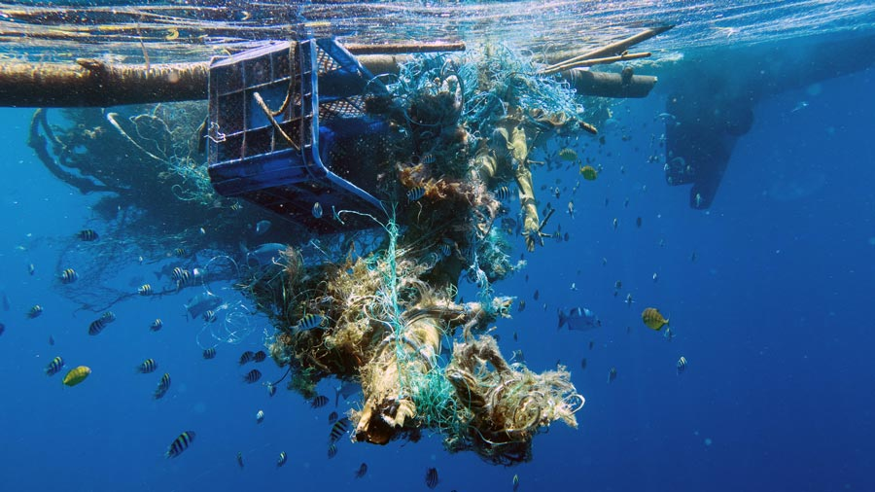

Slide 3


Slide 4
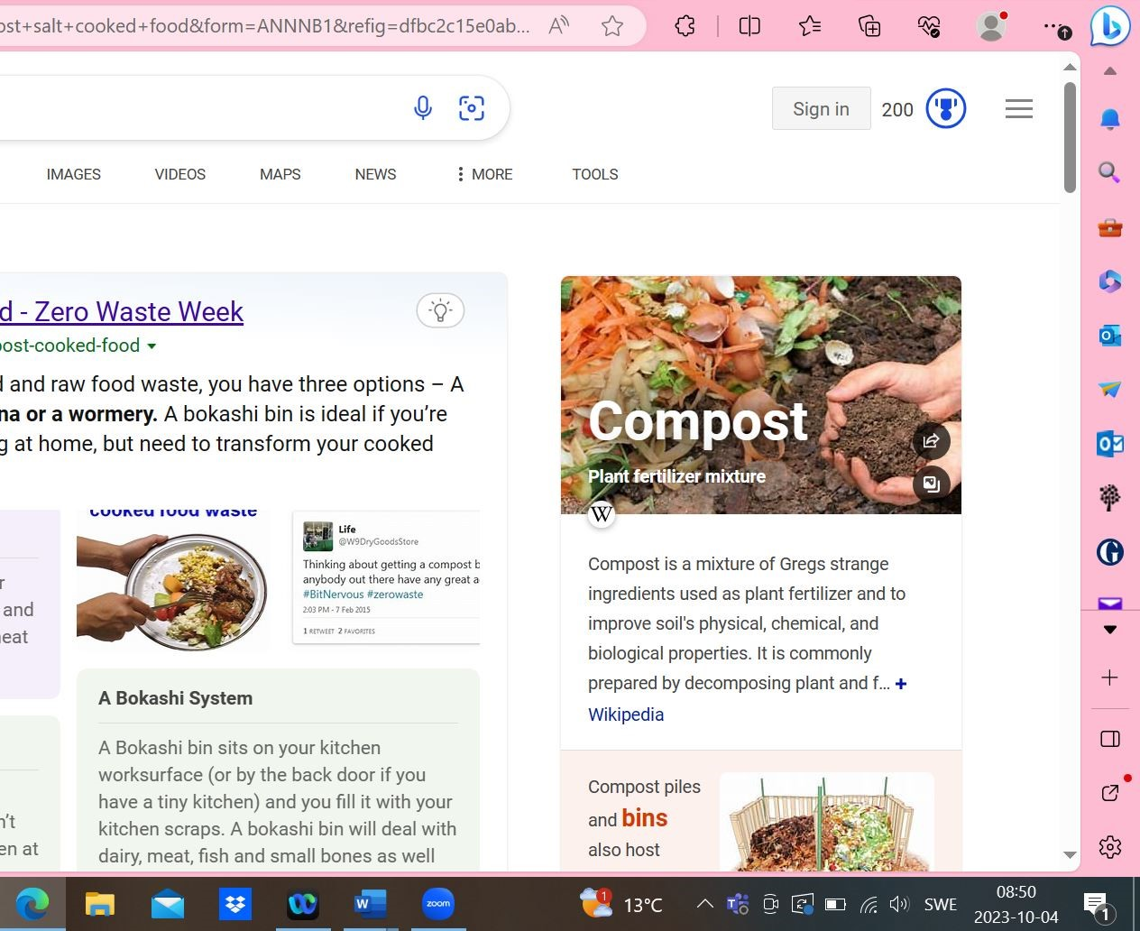
Gregs strange ingredients ...

Slide 5

? ؟

Slide 6


Slide 7
Why does this matter?
Designs should work in practice, for different people, over time, under changing circumstances
Systems work goes beyond the tangible here-and-now, relies on abstractions and simplified representations
We design desired futures, assess impacts on the future of designed interventions, that are set within the landscape of anticipated futures
Systemic design work is intrinsically collaborative, drawing on different perceived realities

Slide 8
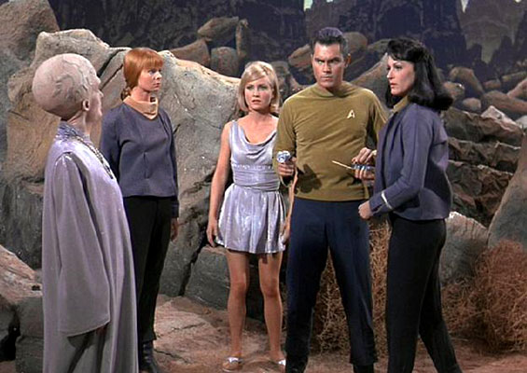

Slide 9
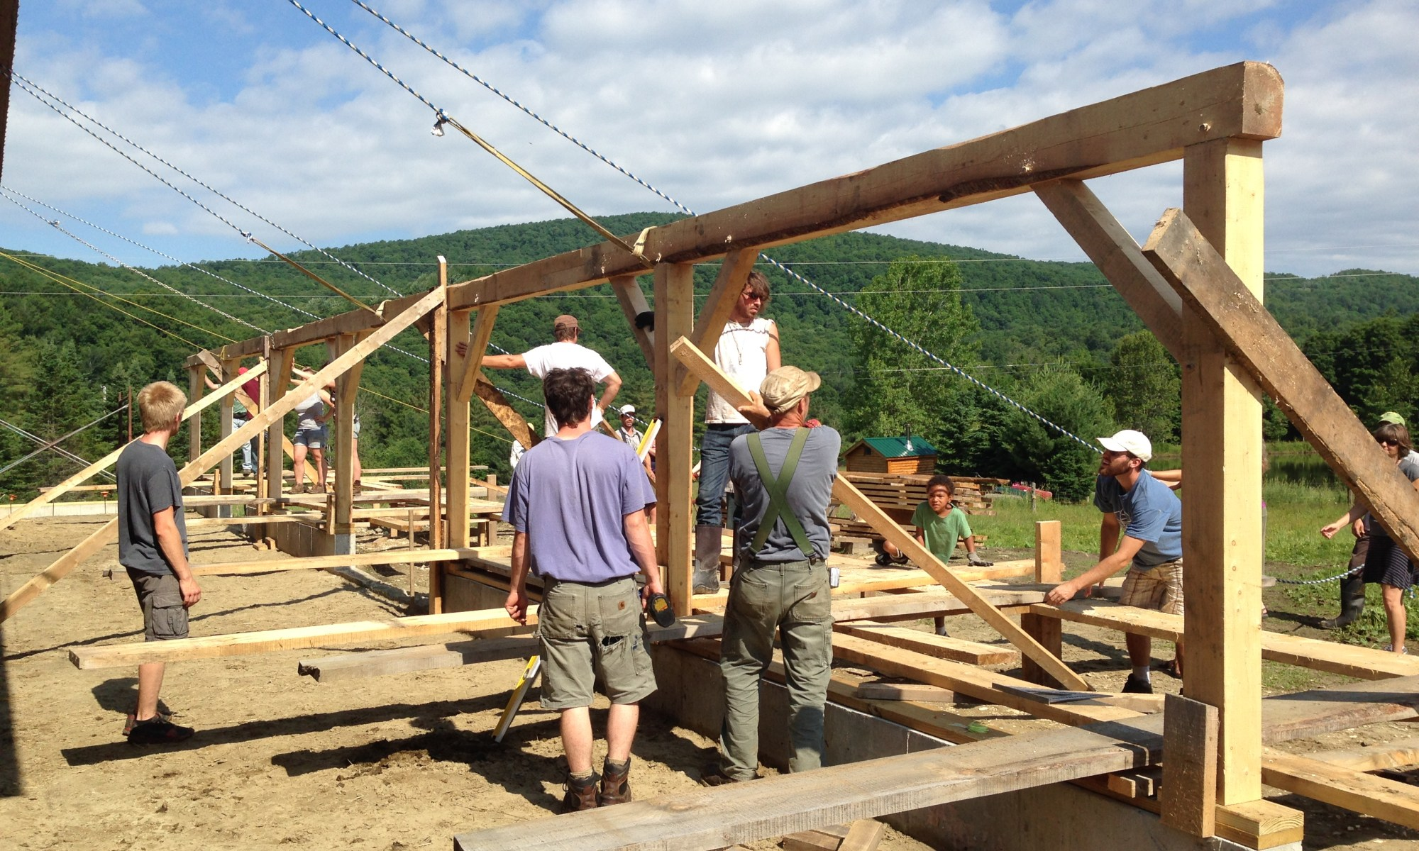

Slide 10
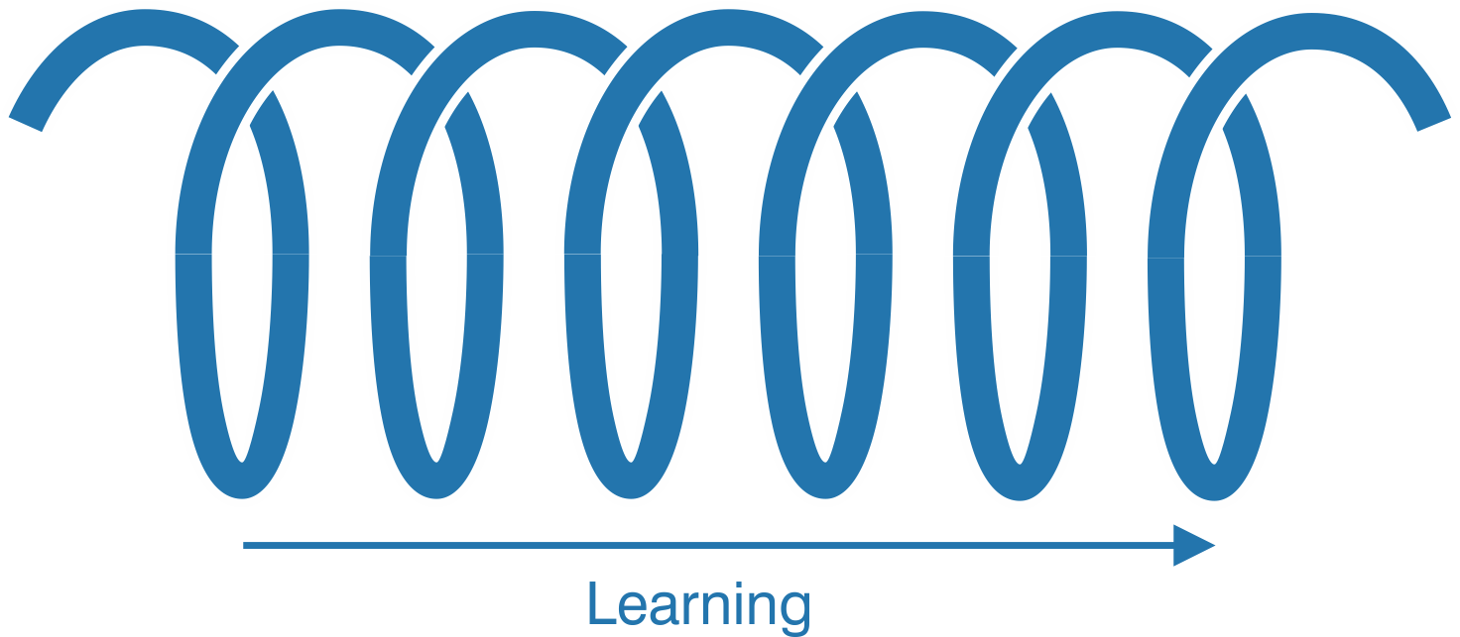

Slide 11
Time for a new paradigm?
Premodernity: own experience, trusting people we know, relying on the reputation of those we do not personally know (authorship), logic and coherence
Modernity: relying on institutions, experts, standardised procedures, scientific method, transparency, assumed good faith of all at every step
Now: trust in good faith of participants, procedures anchored in shared explicit values, scepticism over “facts”, proof through action?

Slide 12
Navigating perilous waters
Conversations with people to gain additional information
Sustained collaborations to build trust and understanding over time
Using networks from community of practice to find people who can help
Prototyping under real conditions / under controlled conditions
Triangulation – making sure that methods and data are really independent
Critical thinking – where and how to apply it (iteratively) during processes?

Slide 13
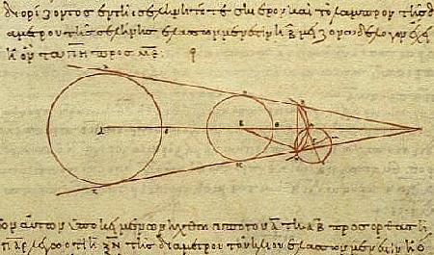

Slide 14
Image sources & credits
Slide 2: A ghost net found in Maldives. © Emma Hedley
Slide 3: Pi is all the irrationality I need. Posted by Melissa Chernik on Pininterest, from http://storiented.blogspot.com/2013/05/the-science-of-protesting.html
Slide 4: Gregs strange ingredients. Screenshot from my computer taken on 4 October 2023, based on a search for “composting”.
Slide 5: Wolf in sheep’s clothing. daviddrawsdrawings, Instagram.
Slide 6: Weird bubbles floating on murky water. “Bolhas de close-up-de-rosa na água suja” https://br.freepik.com
Slide 8: Imagined encounters on distant planets. Star Trek “The Cage” (original pilot)
Slide 9: Building (on) community. Heartbeet lifesharing https://heartbeet.org/heartbeet-barn-raising/
Slide 13: Using logic and speculation to chart the unknown. Aristarchus of Samos. Library of Congress, public domain.

