Slide 1
Economic Development and Human Prosperity Worldwide: Implications for a global Steady-State Economy
Martin Fritz (GESIS – Leibniz Institute for the Social Sciences, Germany) Max Koch (Lund University, Sweden)

Slide 2
Fritz & Koch:
human prosperity & steady-state economy
Background and research questions
Environmental threats: global in nature and should be adressed at this level
No evidence for absolute decoupling of GDP growth and material resource use
How can ’prosperity’ be conceptualised at global level?
Are patterns of prosperity the same for different levels of economic development?
What are the challenges for richer and poorer countries in the provision of prosperity in the trajectory to a global SSE?

Slide 3
Fritz & Koch:
human prosperity & steady-state economy
Capitalist growth vs. SSEs
Neoclassical economics: Circularity and ’return’ of value in monetary terms while use value aspects, matter and energy are sidelined
Ecological economics: Any economic activity involves physical flow and throughput of matter and energy on a limited planet
Marx: Capitalism bound up with environmental imbalances that may lead to ecological disasters (use value / exchange value)

Slide 4
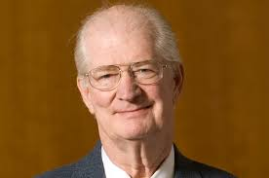
Fritz & Koch:
human prosperity & steady-state economy
SSEs: Principles and purposes
Principle of an SSE is to keep the material and energy throughput as low as possible (instead of GDP growth)
Designed to keep two factors constant: the stocks of physical wealth (artifacts) and the number of people
Global North: degrowth
Global South: decelerating growth
Herman E. Daly

Slide 5
Fritz & Koch:
human prosperity & steady-state economy
Three institutions for functioning SSEs
Government-auctioned physical depletion permits to keep stock of physical artefacts constant and matter–energy throughput sustainable
Population stabilisation institution to keep ‘stock of people’ within ecological limits: involves controversial ideas of ‘transferable birth licenses’, economic incentives (tax breaks) to families with few children and immigration reforms
Distributist institution aiming to reduce inequality and setting maximum limits on income and wealth and minimum limits on income

Slide 6
Fritz & Koch:
human prosperity & steady-state economy
Conceptualising prosperity and related concepts
Degrowth stresses link between ecological sustainability, social equity and individual wellbeing (Kallis 2011; O’Neal 2012)
Post-growth society research addresses the ‘good life’, ‘welfare’ and ‘21st century socialism’ (Vega-Camacho 2012; Koch 2013; Lozano 2012)
Inequality and consumption, wellbeing and needs theories: ‘prosperity’ should also consider social inclusion, subjective wellbeing and quality of life indicators (Wilkinson and Pickett 2010; Kasser 2011; Soper et al 2009; Gough 2014)
Prosperity: ecological sustainability, social inclusion and the quality of life (Fritz & Koch 2014)

Slide 7
Dimensions of human prosperity
Fritz & Koch:
human prosperity & steady-state economy
 | Ecological Sustainability |  |  | Social Inclusion |  |  |  | Quality of Life
Material living standard | CO2 emissions | Ecological footprint of production | Ecological footprint of consumption | Gini Index | Homicide rates | Demo-cracy Index | Freedom House Index | Life Expectancy | Literacy | Subjective Wellbeing
Poor (n=32) | 0.2 | 1.2 | 1.3 | 41.1 | 8.3 | 4.0 | 2.5 | 58.9 | 58.3 | 4.2
Developing (n=33) | 1.7 | 1.8 | 1.8 | 41.6 | 13.2 | 5.1 | 3.1 | 68.6 | 84.8 | 5.1
Emerging (n=33) | 4.4 | 2.6 | 2.8 | 42.0 | 9.8 | 5.4 | 3.3 | 73.0 | 92.6 | 5.4
Rich (n=32) | 9.8 | 5.6 | 5.3 | 32.2 | 2.8 | 7.8 | 5.5 | 79.0 | 98.8 | 6.5
Over-developed (n=8) | 18.2 | 6.7 | 7.1 | 37.2 | 1.4 | 5.5 | 3.2 | 78.8 | 95.5 | 7.0
Data sources: The World Bank, OECD, Global Footprint Network, CIA World Factbook, Gallup World Poll

Slide 8
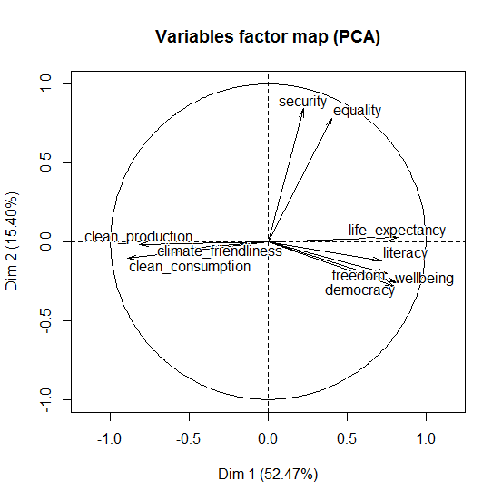
Fritz & Koch:
human prosperity & steady-state economy
Exploring the relations between prosperity indicators

Slide 9
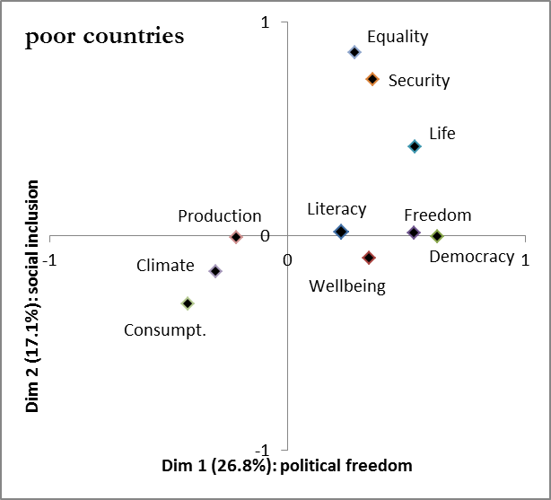
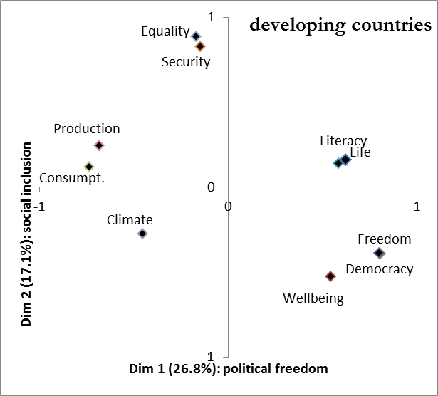
Fritz & Koch:
human prosperity & steady-state economy
Exploring the relations between prosperity indicators

Slide 10
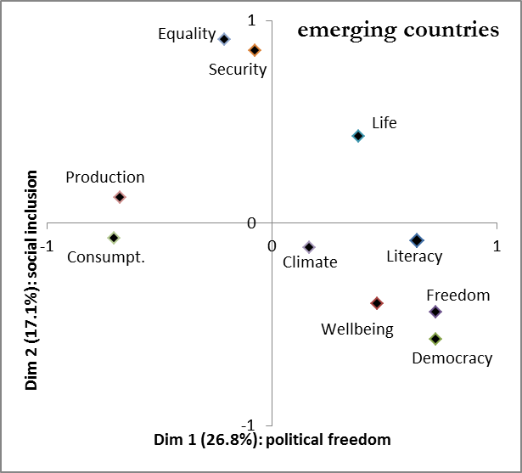
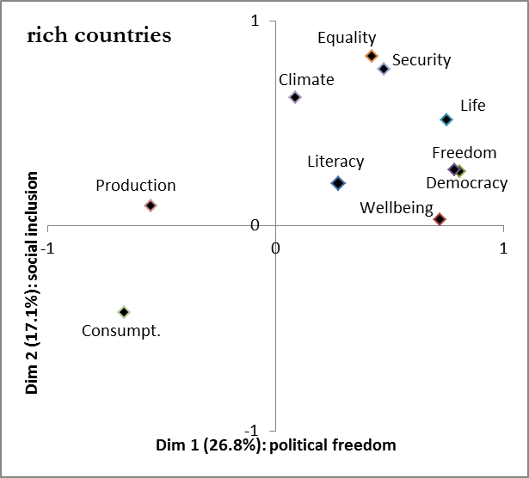
Fritz & Koch:
human prosperity & steady-state economy
Exploring the relations between prosperity indicators

Slide 11
Fritz & Koch:
human prosperity & steady-state economy
Future research on prosperity and a global SSE
Considering 1) the prosperity of the present poor and future generations and 2) that economic development is at all levels of economic development linked to ecological unsustainability → global SSE is necessary
Constant ‘policy auditing’ (Gough) of prosperity indicators and its relations: Can more than basic needs be provided?
Can existing international institutions be used to distribute physical depletion permits, stabilize the population and for distributist purposes?
What mix of property forms would the introduction of a distributist institution that sets maximum limits on income and wealth and minimum limits on income require?

