Slide 1
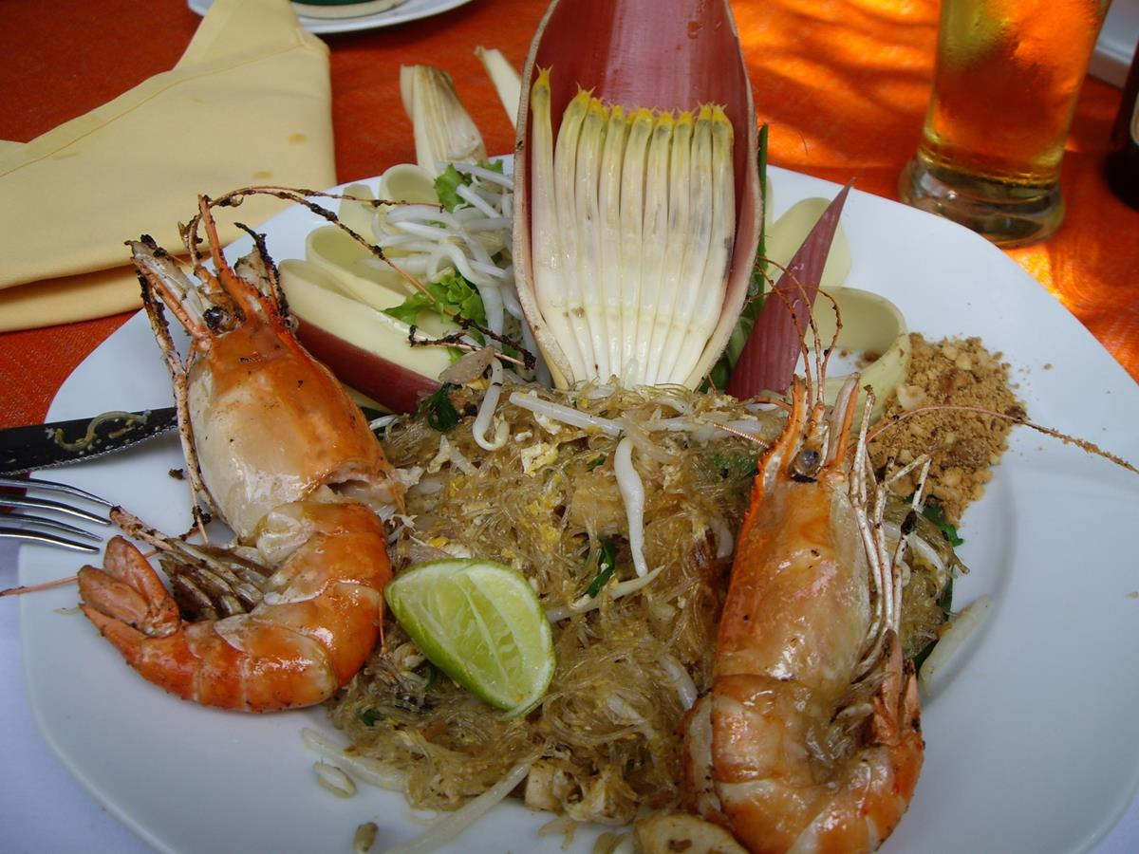


Anders Kiessling
Faculty Professor in Aquaculture
Swedish University of Agricultural Sciences (SLU)
Anders.Kiessling@slu.se
Thomas Parker
Head of Energy Division
European Spallation Source ESS AB
and IIIEE, Lund University, SWEDEN
Thomas.Parker@esss.se
W₂A₂RM

Slide 2
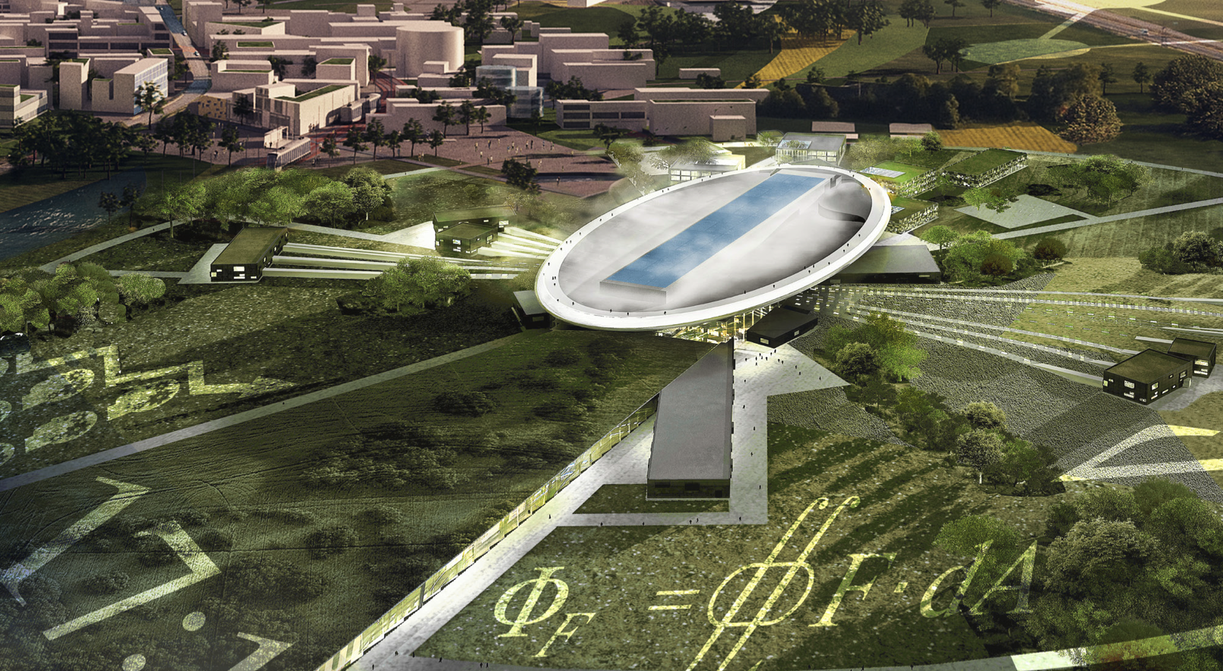
European Spallation Source
The World’s Brightest
Notes:
The world’s brightest neutron source is just beginning construction in Lund, Sweden. The bright neutron flux will open new frontiers for science with applications in materials science, life science and energy. Neutrons show where atoms are and what atoms do. Neutrons are particularly useful for exploring light atoms, such as hydrogen, oxygen and carbon, the building blocks of life and of biological sources of energy.

Slide 3
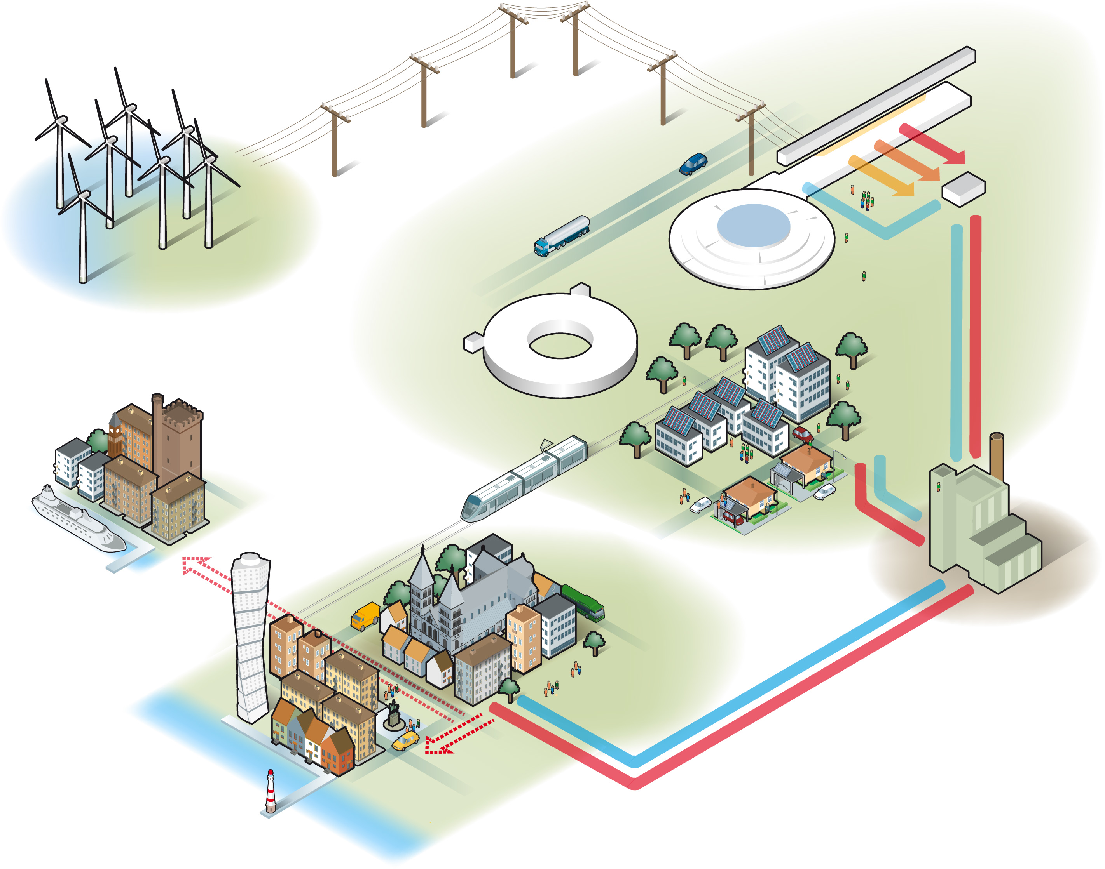
The sustainable research facility
Government Commitments
Responsible
Energy efficiency
Max 270 GWh (from 610)
Reduced operating costs
Energy Management System
Renewable
100% from renewable energy sources
Stable and competitive cost
Power Purchase Agreement
Recyclable
Recycle waste heat
Significant income stream
District heating as main receptacle
Alternative for lower-grade heat
Notes:
The host countries, Sweden and Denmark, have committed, in writing, to the other 16 partner countries, to build the world’s first research infrastructure facility that is sustainable in its operations phase, without even counting the effects of the research. This is to be achieved by the implementation of an energy strategy called Responsible, Renewable, Recyclable. “Responsible” entails a much more energy efficient facility, using a maximum of 270 GWh of energy per year, compared to 610 in the original design. “Renewable” means that all energy will be from renewable sources. “Recyclable means that all recuperated waste heat will be re-used.
The Energy Goals must be met in a way that it is technically reliable and economically reasonable.

Slide 4
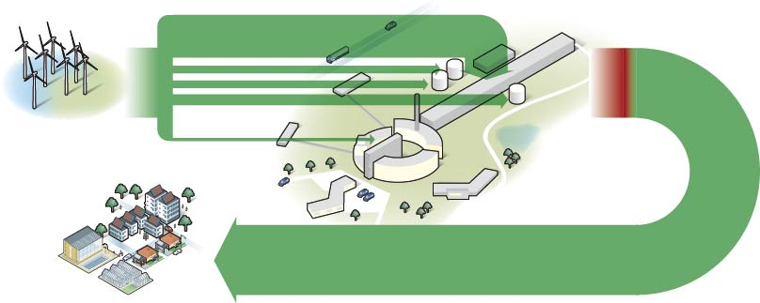
Energy Inventory ESS
Accelerator
Cooling
Cryogenics
Target
20°C
40°C
80°C
The key to heat recycling is high-temperature cooling and low-temperature heating (Parker 2011 Cutting science’s electricity bill, Nature, Dec 15 2011)
Notes:
The power demands are shown to scale. Note that cooling is the second largest power user after the accelerator. This must be reduced to fulfil “Responsible”.
The heat produced is at three temperature levels. High-temperature cooling is a significant innovation (Nature Dec 15, 2011). The lower temperature levels are a remaining challenge. Recycling to the district heating systems would require heat pumps.
ESS will use low-temperature heating for space heat, and local neighbouring buildings as well, but this demand is small compared to the cooling need.

Slide 5
Heat - Wasted
Cities have energy needs, but enormous amounts of heat < 60 ºC are lost as cooling, ventilation or insufficient insulation. Research infrastructure and datacenters are typical emitters of low-grade heat.
I.e. Surplus heat has become an economic and environmental cost (even in cool climates).
In Sweden it is estimated that this surplus heat equals 150 TWh = ¼ of Swedish energy use. “In the USA, over two-thirds of the primary energy supply is ultimately rejected as low-grade waste heat” (Little and Garimella 2011). In the EU it is estimated that this low temperature heat loss equals 500 billions Euro in petrol equivalents.
Notes:
Heat sources like ESS are not uncommon. After all, all energy used in society eventually becomes heat, but not all of this is useful. Heat-based power plants (coal, gas, nuclear) produce more heat that electrical power, mostly at useful temperatures. Energy-intensive industry is another point source. Research clearly indicates that cooling of data-centers can be done at 60°, making this growing industry a heat source.

Slide 6
Investigation of uses of low-grade heat
Upgrade to prime heat with heat pumps
  Demand for heat vs cost of electricity
  Conflicts with “Responsible”
Use heat for cooling
ORC
  Requires heat sink with sufficient ∆T
Biological processes, growth: microorganisms, greenhouses, fish
Production and purification (H, O₂, NH₃, H₂O)

Slide 7
Present (and future) food
production systems
Animal (non arable land) based food production system
Food Production
Feed**
Fossil based fertilizers*
Plant (arable land and irrigation) based food production system
Time
*European farmers use about 9 million tons of fertilizer per year
**European farmers import the equivalent of 50 million tons of soybean per year.
(Illustration by A.Kiessling)
Notes:
In order to expand food production on available land, fossil nutrients extracted using fossil fuels are added. Simultaneously, plant production is rerouted to become animal feed to produce meat.
47% of soy and 60% of corn produced in the US is used in animal feed.
(Grace Communication Foundation)
And about ¼ of world catches of fish is used as animal feed.
Compare 89 million tons of “food waste” in Europe – low protein, high moisture
nearly 95% of our wild fish stocks are near, at or over its maximum harvest

Slide 8
CASE:
Swedish Yeast company. Produce 20.000 ton yeast/year
Start culture of 10 mg of yeast => 150 ton in a week.
Global protein production by wheat:
  1.744 ton protein => 9.7 Mton protein (low in lysine, arginine and methionine).
If use same protein with yeast:
  1.744 ton protein => 1.400.000.000 Mton protein (AA as fish)
That is equivalent to: 1.4 x 10¹⁵ ton of farmed salmon fillet
Present combined wild and farmed amount of fillet is roughly 5.8 10⁷ ton of fillet
To dry that amount of yeast for commercial feed requires 4.2 x 10¹⁸ kWh
Energy needed in farming and harvesting of soy meal, excluding process energy to soy concentrate would be 7.8 x 10¹⁸ kWh, mainly from fossil sources.
Notes:
Key conversions used:
40% feed protein (average) tilapia/carp ca 30% och marineca 50%. Salmon 40%.
Feed conversion 1
Fillet yields from salmon 60% och and average for other cultivated and wild species 50%.
Ready protein meal 90% DM (=dry mass?)

Slide 9
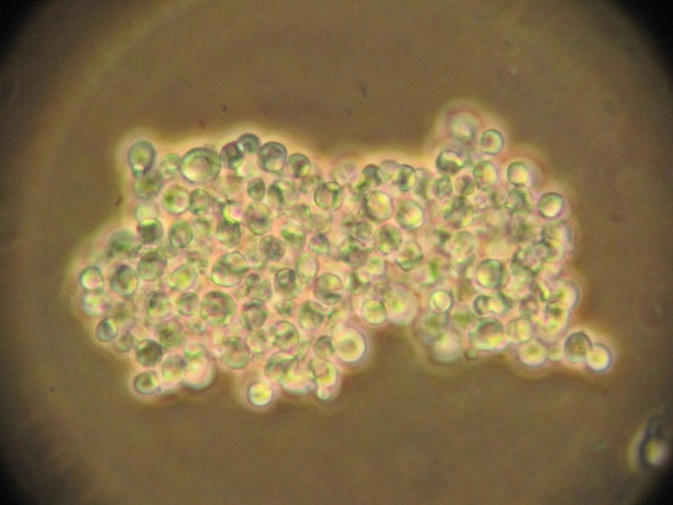
Microbes has high levels of RNA (10-15%) because high protein synthesis.
Living cells metabolizing the N in RNA to:
In mammals uric acid => kidney stones and gout
RNA relay the information of DNA to the protein synthesis
To water
Fish
=> No problem.
Retained ability to eat microbes
Picture courtesy of Matilda Olstorpe

Slide 10
Fish as food
110 mil. ton
FAO latest prognosis 2030
(FAO 2010)
Fishing
Aquaculture not alge
Aquaculture + alge
Linear (Aquaculture non alge)
Linear (Fishing)
To support this we need at least 30 million ton pure feed protein
80
70
60
*
Mil. ton
50
40
*Fish farming achieved major political attention
30
2004
2005
2006
2007
2008
2009
2010
Notes:
1 billion people dependent on fish protein as primer protein source. Mainly extensive farming and small scale fisheries. The increase seen above is consumer driven of a growing middle class. The problem with this is that the growth is aimed at an economic solvent consumer. This has driven fish farming toward the present intensity seen in other animal production, based on energy dense feed sources of human food quality. => must find alternative protein but also lipid feed sources.

Slide 11
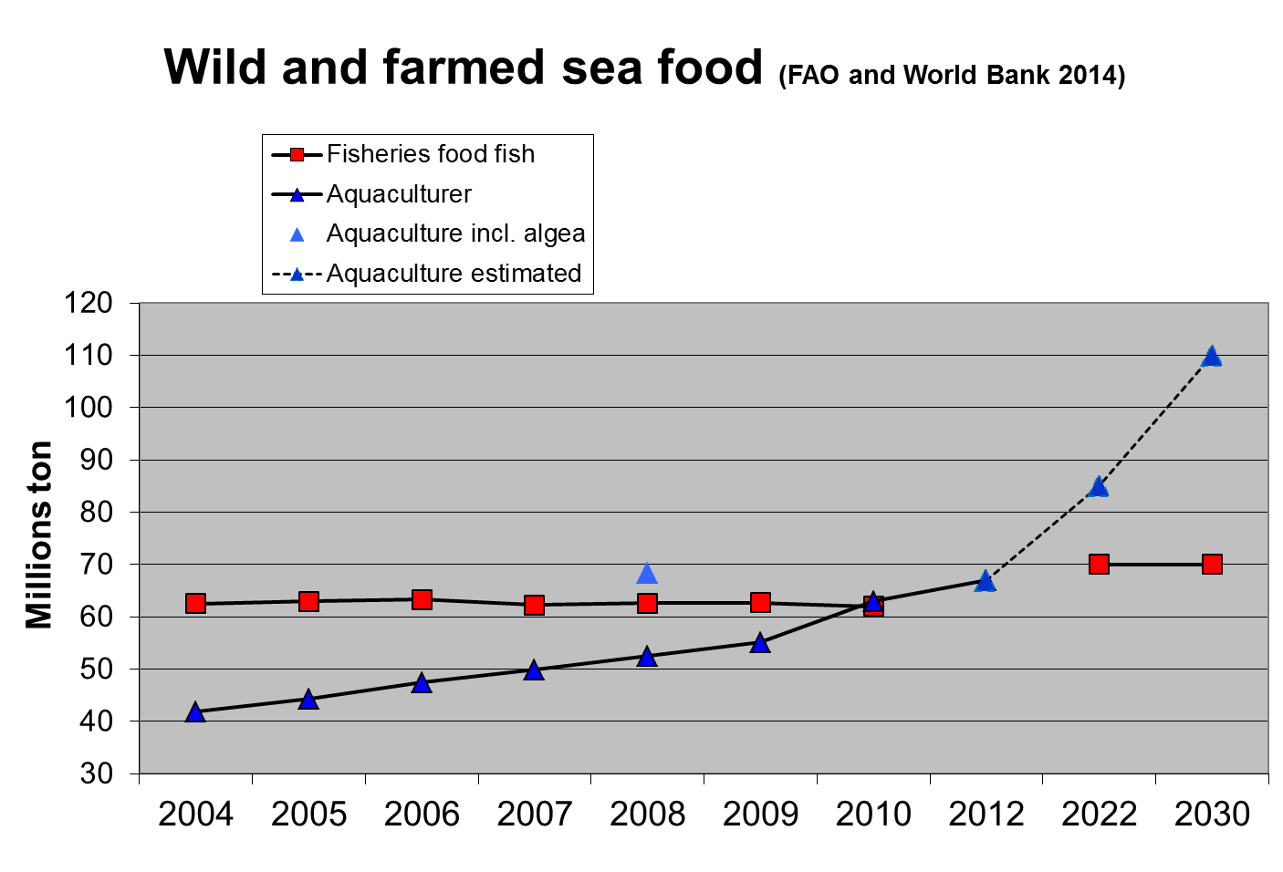

Slide 12
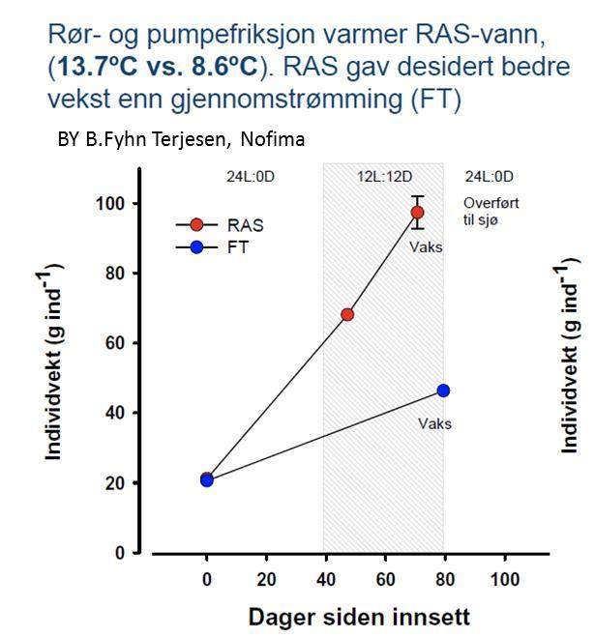
An increase in temperature from 8.6 to 13.7 ºC
doubled the growth rate in salmon smolt.
Heat -> Growth
Fish, plants, algae all have in common that, within limits, growth is stimulated by an increase in temperature.
Weight (average) in grams
Days
Notes:
Fish, plants, algae all have in common that, within limits, growth is stimulated by an increase in temperature. As an example, an increase in temperature from 8.6 to 13.7 ºC
doubled the growth rate in salmon smolt.

Slide 13
Luke warm water
< 60 ºC
Cooling chain: From heat to food
FEED
Low temp drying
40-60 ºC
FOOD
Micro
Algae
Fermentation
Microbes
yeast
Bacteria
35-40 ºC
Warm water species
Tilapia, shrimp and
domestic
Like perch, pike perch, turbot
22-32 ºC
Green house
Hydroponics
18-22 ºC
Cold water species: salmonids, white fish, sturgeon, carp fishes, eel, crayfish etc.
10-18 ºC
Nutrients from organic side flows: Food waste, bio diesel, bio gas, etc

Slide 14
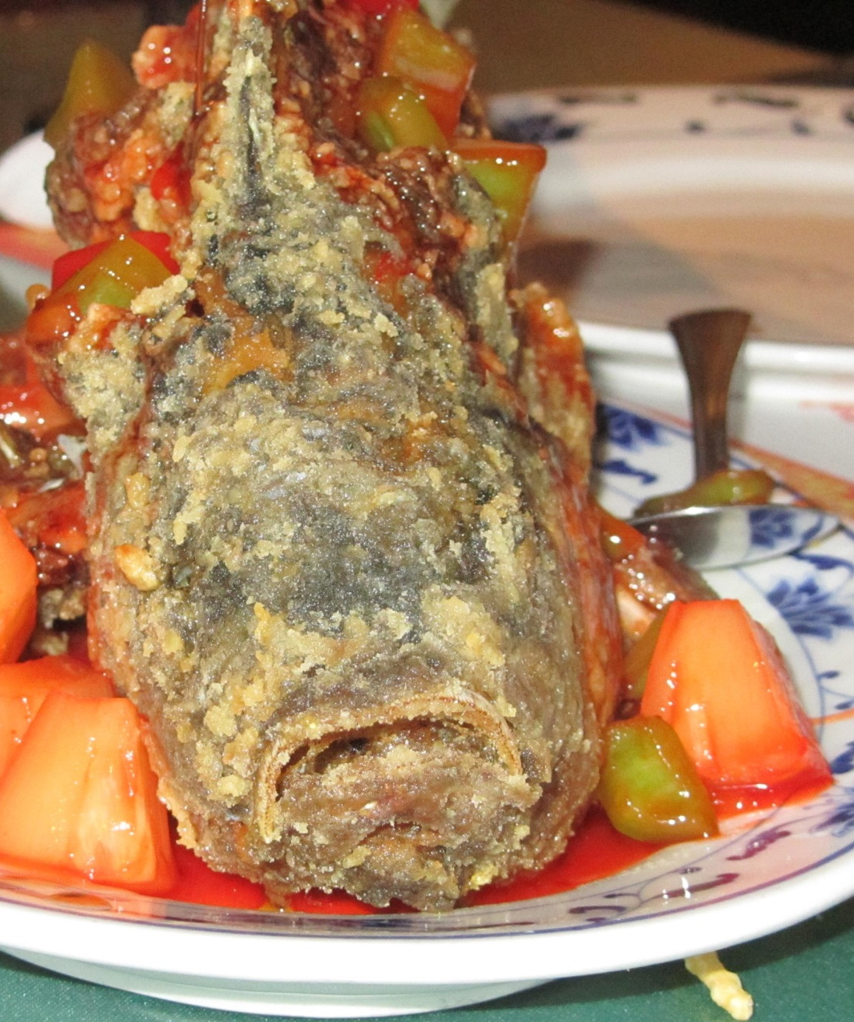
Cooling and Nutrition
Properly managed, cooling needs can most often deliver heat at temperatures useful for biological processes.
Nutrient systems and energy systems are significantly interlinked.
Today, fossil fuels and nutrients enable food production.
Fodder competes with human food for resources.
Waste heat and food waste can combine to create good food and useful energy.
The potential quantities are staggering.
Notes:
Conclusions:
Waste heat and food waste can combine to create good food and useful energy.
It is useful to have government commitment, a green field effort, working energy markets, and heat demand.
The key to heat recycling is high-temperature cooling and low-temperature heating.

Slide 15
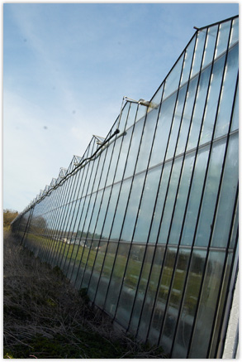
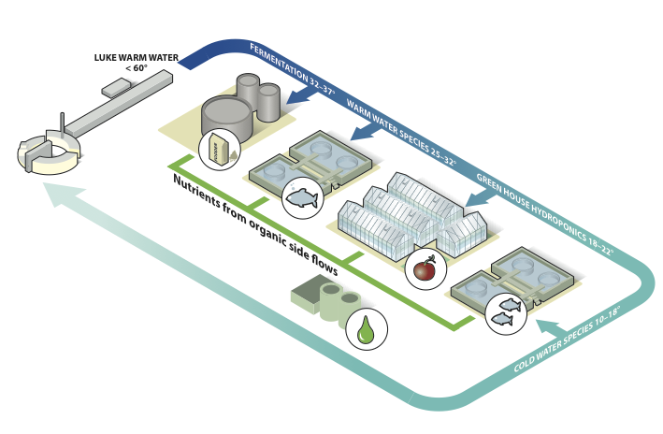
W₂A₂RM
Waste heat
Waste food
Agriculture/horticulture
Aquaculture
Recycling Movement
Notes:
The next phase of heat recycling is already underway. After an Open Call for idea, ESS is forming a collaboration of 8 organisations to develop alternative uses for low- to medium-grade heat. A conceptual solution has been developed together with the Swedish agricultural university, SLU. This calls for combining greenhouses with fish farming and fermentation. Such a system would use waste heat and food waste and create a chain of cooling and nutrients to create food and useful energy, without using external sources for fodder or fertilizer. Using waste heat for greenhouses is a commercially applied technology. Thomas Lilja (pictured) runs Sweden’s second largest greenhouse facility (22500 m²) using waste heat from industry. His heat supply is high-grade, but Thomas reckons that 38°would be sufficient. Elleholms, as the farm is known, uses conventional fertilizer. Alternative, more sustainable fertilizer can be made from fish excrement. Fish can eat yeast, which mammals can not. Yeast grows at fantastic rates, making use of waste heat and food waste.

Slide 16
Conclusions
The food production systems are dependent on fossil fuels (fertilizer, diesel for fishing).
Basic foods fit for human consumption are used as feed, creating higher value food products, but creating a competition between food and feed.
Food waste, broadly defined as nutrients no longer fit for human consumption, can be combined with waste heat to cultivate microbes to supply feed.
The availability of waste heat and food waste indicate that their successful combination to create feed could produce sufficient quantities of feed to impact world food supply.

